Slide 1
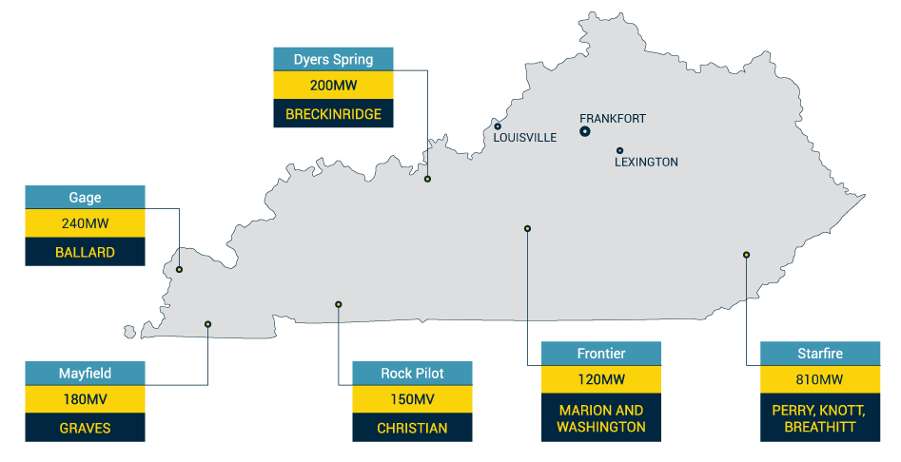
Who is BrightNight?
Our investment in Kentucky
Independent power producer
Made up of experts from across the industry
Built to address energy transition needs
Proprietary software
Why Kentucky?
Great solar resource
A history of energy leadership
Strong energy infrastructure
Exceptional energy workforce

Slide 2
Leading renewable power from Pikeville to Paducah
Gage Solar Project
Starfire Renewable Energy Center
240 MW solar project
~50 landowners
Rural area on undeveloped land
LG&E KU; serving 2,400 Ballard County customers and 5 commercial customers
No local permit, construction certificate
Traditional challenges
810MW solar project
Small group of commercial landowners
Active mine site
Multi-phased approach
Rivian and The Nature Conservancy
Highly unique challenges

Slide 3
BrightNight community engagement
Our Strategic Approach
Listen to local needs, norms, and goals
Project webpage
Community project brochure
Project video features
Paid social media to ensure project information sharing
Quarterly community newsletters
Visualization (project simulations)
Economic impact assessment
Philanthropic support
Local organization support (Chamber, schools, native species)
Apply feedback to project designs and long-term local support investments
Educate and build engaged stakeholders

