Slide 1
Potential Funding Opportunities
Office of Energy Policy

Slide 2
Office of Energy Policy (OEP) Who we are – What we do
Non-regulatory agency
October 2021, Governor Beshear and EEC released Kentucky’s Energy Strategy for a transitioning energy landscape.
KYE3 – Designs for a Resilient Economy – is an energy strategy wrapped in economic development and focused on resilience
Through federal grant partnerships, we fund projects throughout the state that are focused on energy education, affordability, grid resilience, data modeling, power sector modernization – and more.
Support the utilization of all of Kentucky’s energy resources
Resources
Host interactive dashboards and data – makes it easy to find out more information about Kentucky’s energy statistics
Information on reducing your energy bill, grant programs, cleaner transportation options
Kentucky’s Energy Profile

Slide 3
Application Status
Funding Program | OEP Status | Amount | Due Date
BIL Section 40101(d) | Awarded | $11,118,903.00
BIL EE Revolving Loan Fund | Applied | $7,719,310.00
BIL SEP | Awarded | $6,927,290.00
Annual SEP | Awarded | $973,520.00
BIL State EECBG | Applied | $2,237,940.00 | 31-Jul-23
IRA Rebate Admin | Applied | $3,356,172.25 | 30-Jun-23
IRA Rebate | Full Application will be developed with a program design consultant | $130,890,717.75 | Dec-24
IRA Contractor Training Section 50123 | Application in Progress | $2,420,420 | 30-Sep-23
BIL Energy Auditor Training Sec. 40503 | Waiting on DOE Guidance
EPA Solar for All | Application In Progress | $100,000,000 | 12-Oct-23
BIL Building Codes | OEP will not apply

Slide 4
IRA Home Energy Rebates
Program | IRA Funding Level | Timeline
Home Efficiency Rebates (HOMES), Section 50121 | $ 67,319,140.00 | Available through 2031
High-Efficiency Electric Home Rebate Program, Section 50122 | $ 66,927,750.00 | Available through 2031
REBATES ARE NOT AVAILABLE YET; HOWEVER TAX INCENTIVES ARE AVAILABLE

Slide 5
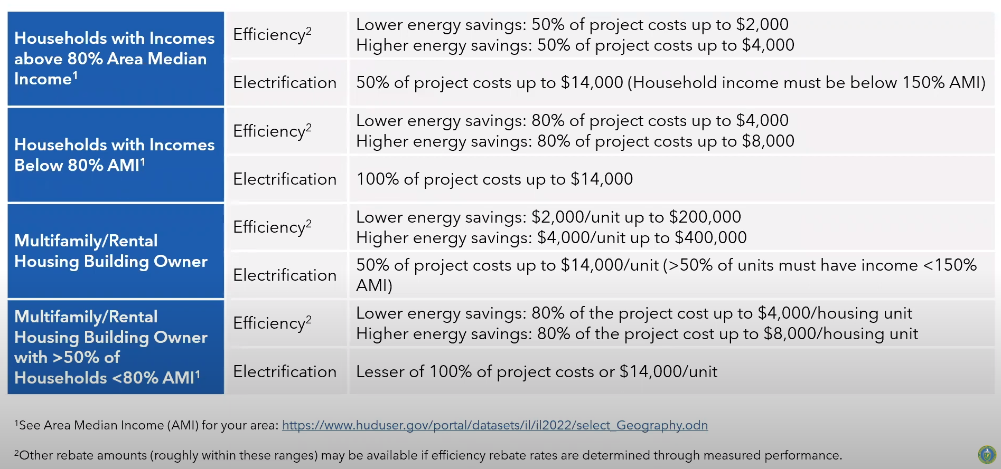
How much $ is potentially available per household?

Slide 6
Inflation Reduction Act: HOMES Rebates
Who?
Single-family homeowners and multifamily building owners
What?
Rebates for energy efficiency
Whole-house approach
Rebate amounts based on energy savings:
$2,000 for 20% energy savings
$4,000 for 35% energy savings
Doubled for LMI households!

Slide 7
High-Efficiency Electric Home Rebate Act (HEEHRA)
Eligible Use | $ Limits
Electric Load Service Center Upgrades | $4,000
Electric Stove, Cooktop, Range, and/or Oven | $840
Electric Wiring | $2,500
Heat Pump Clothes Dryer | $840
Heat Pump Heating/Cooling | $8,000
Heat Pump Water Heaters | $1,750
Insulation and Air Sealing | $1,600

Slide 8
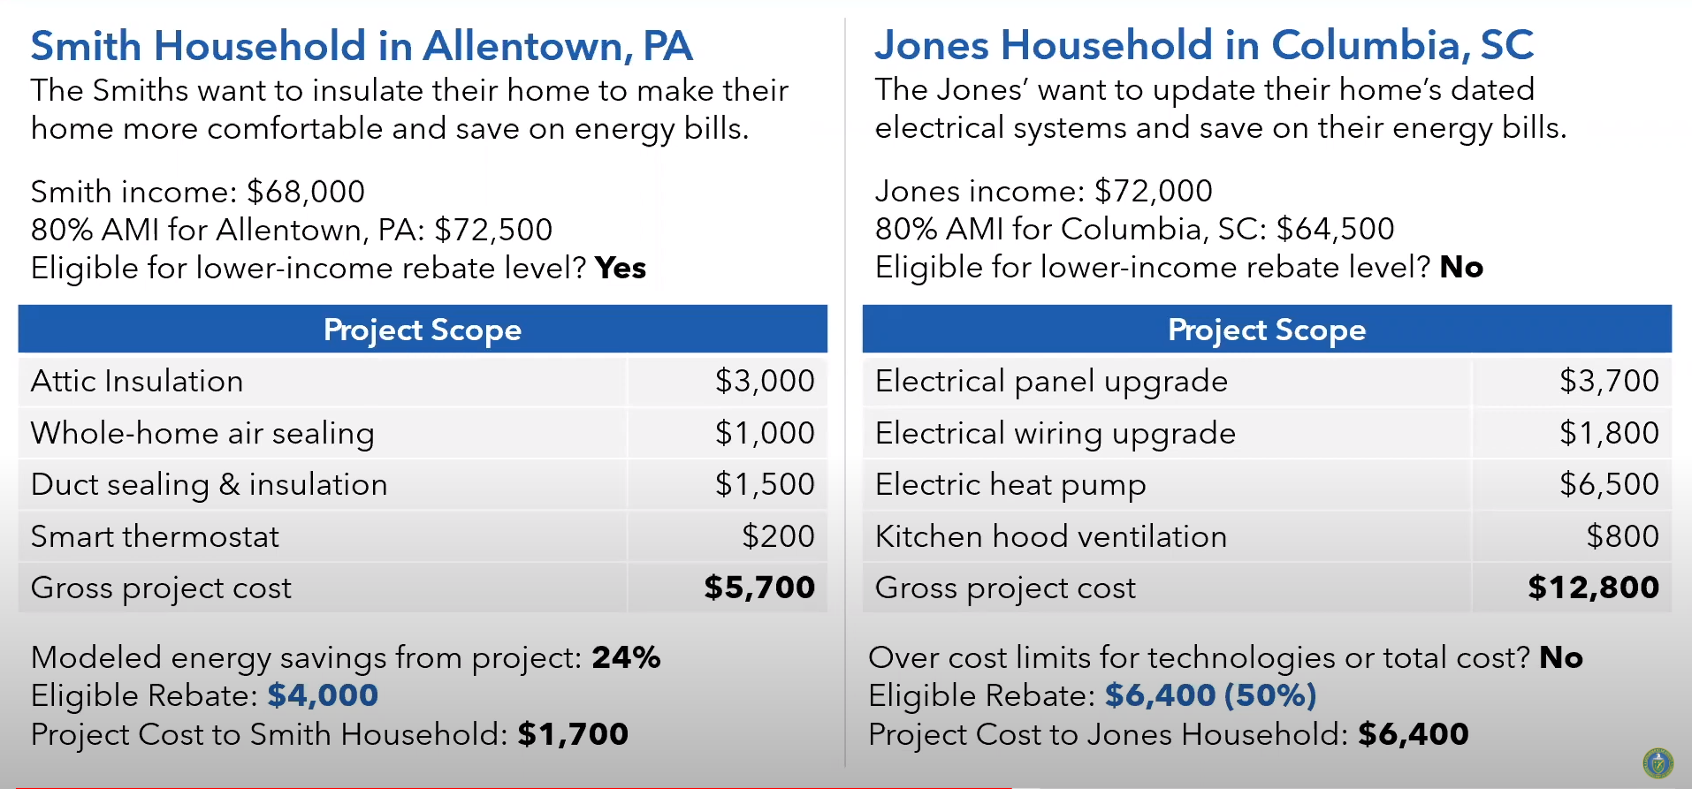
Illustrative Examples

Slide 9
IRA Rebate Next Steps
The Office of State and Community Energy Programs (SCEP) has released the applications for states and territories to apply for full program funds for both the Home Efficiency Rebates and Home Electrification and Appliance Rebates. Only state and territory energy offices are eligible to apply at this time.
OEP has been awarded the Administrative Funding Award
Hire a program staff administrator
Conduct an RFP for a program planning consultant
Use most of 2024 to build the program application
File for the IRA Rebate funding in late 2024
In 2025, procure a third party rebate administrator and begin implementation in late 2025.

Slide 10
For consumers
https://www.whitehouse.gov/cleanenergy/

Slide 11
https://www.energy.gov/scep/home-energy-rebate-program

Slide 12
Connect with Us –
Energy Policy Website –
eec.ky.gov/energy
Email:
energy@ky.gov
Contact information
Kenya Stump
Kenya.Stump@ky.gov
Lona Brewer
Lona.Brewer@ky.gov

