Slide 1

The Future of Sustainability is Digital
Steve Wilhite
President, Schneider Electric Sustainability Business

Slide 2

At Schneider Electric, our purpose is to empower all to make the most of our energy and resources, bridging progress and sustainability for all.
Our mission is to be your digital partner for Sustainability and Efficiency.

Slide 3
Schneider Electric Kentucky footprint at-a-glance
Schneider Electric is a global business, but our Kentucky roots run deep
1214 employees
our 5th largest US state footprint
Advanced Lighthouse
Lexington factory designation by World Economic Forum
Louisville
Global Sustainability Business HQ
300+ employees
$14.2M
Invested in Lexington plant in 2022 alone
3200+
Kentucky business sites using Schneider
Lexington
Smart Factory
~800 employees
$235,000
Invested by Schneider Electric Foundation across 78 Kentucky non-profit organizations

Slide 4






We lead many of the world’s most well-known organizations to decarbonize
Sustainability Business
Client
Examples
2,800
global consultants
2,700
Clients served
40%
Of the F500
155+
countries
Hotels
Finance
Retail
Healthcare
Food & Beverage
Real Estate
Life Sciences
Cloud / IT
Manufacturing
Consumer Goods
Public Sector

Slide 5



Sustainability is becoming the new business imperative for all
Customers
Consumers
Communities

Slide 6
Kentucky Businesses by Size
11.4x
Average emissions in a company’s value chain, versus its operations
Sources: Kentucky Center for Statistics; CDP

Slide 7
194
SMEs surveyed
60%
of surveyed businesses had a climate reduction plan in place
68%
said lack of resources prevented them from taking climate action
48%
said lack of funding prevented them from taking climate action
Source: UN SME Climate Hub
Page 7

Slide 8

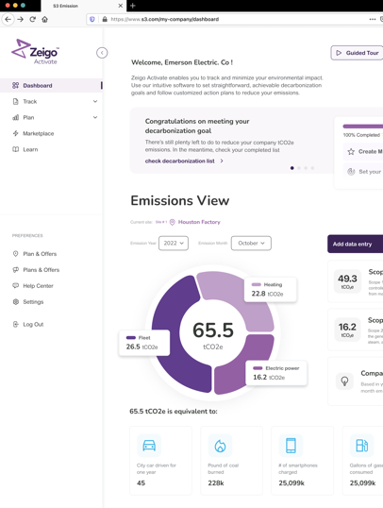
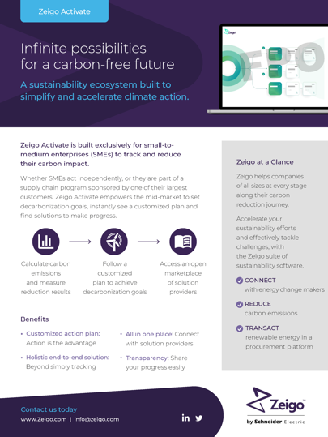

Empowering SMEs to Reduce their Environmental Impact
Whether acting independently or part of a supply chain program sponsored by one of their customers, small and medium-sized enterprises (SMEs) can use Activate to:
Track and measure their emissions
Set decarbonization targets
Follow a customized roadmap to reach their goals
Access an open marketplace of solution providers
activate.zeigo.com
Notes:
Right now, product is designed direct to end user, not for reseller model.
Zeigo Activate is built exclusively for small-to medium enterprises (SMEs) to track and reduce their environmental impact.
Whether businesses prefer to act independently or are part of a supply chain program sponsored by one of their customers, Zeigo Activate empowers the mid-market to set decarbonization goals, instantly see a customized plan, and find solutions to make progress.
Calculate carbon emissions and measure reduction results
Follow a customized plan to achieve decarbonization goals
Access an open marketplace of solution providers
Customized action plan: Action is the advantage
All in one place: Connect with solution providers
Create a complete carbon footprint: Calculate, measure, and analyze.
Transparency: Share your progress easily

Slide 9

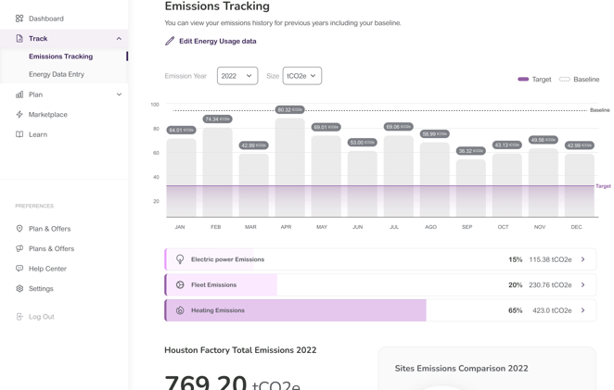
Accurately Calculate and Track Small Business Emissions
Simplified data collection allows SME to build energy consumption profile, see carbon emissions baseline, and track decarbonization progress
activate.zeigo.com
Notes:
Simplicity is key for an SME experience : They don’t have the time for complex software, and may not have prior Sustainability expertise.
Activate provides the user a guided journey that feels comfortable even with no prior Sustainability expertise

Slide 10

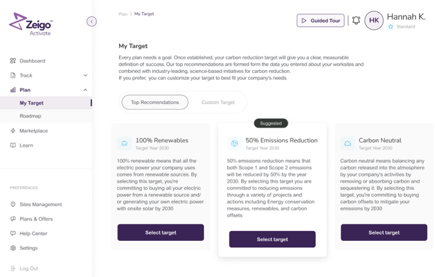

Guided Setup Helps Set Realistic Targets
Decarbonization target selection is customized to meet SME objectives
SMEs can choose from one of our top recommendations or create their own goal
activate.zeigo.com
Notes:
- Users are offered the flexibility to choose from recommended targets, or customize a target to stakeholder needs

Slide 11
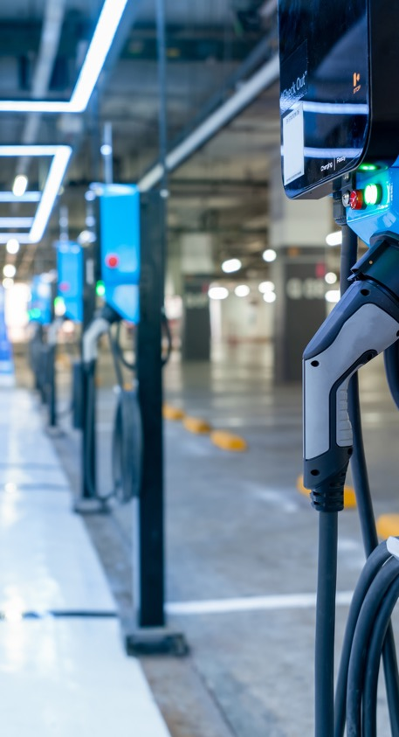
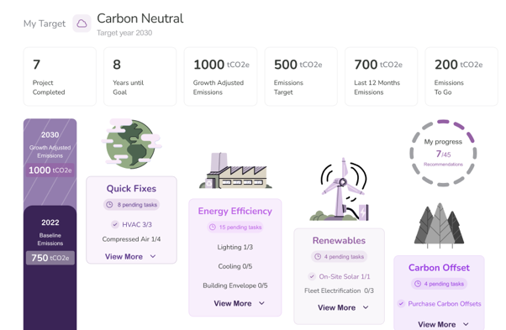
Custom Roadmap Shows What to Do Next
Personalized roadmap of actions and projects designed to reduce emissions
SMEs can choose from a variety of decarbonization actions, such as energy efficiency and renewable energy
activate.zeigo.com
Notes:
Not knowing how to decarbonize is not a barrier anymore ! Our roadmap provides actions (projects) that customers can execute on-site to reduce their emissions
The Roadmap is generated based on customers responses to questions about their site in order to ensure that only relevant energy systems and projects are considered in creating the customer roadmap.
This differentiates the offer from competitors that only offer Carbon Offsets as an Action.
Not knowing how to decarbonize is not a barrier anymore ! Our roadmap provides actions (projects) that customers can execute on-site to reduce their emissions
The Roadmap is generated based on customers responses to questions about their site in order to ensure that only relevant energy systems and projects are considered in creating the customer roadmap.
This differentiates the offer from competitors that only offer Carbon Offsets as an Action.

Slide 12
+
=
DIGITAL
FUTURE!

Slide 13
Notes:
Closing slide

