Slide 1
LG&E and KU Hydrogen Research
Aron Patrick
March 25th, 2022
Manager, Technology Research & Analysis
https://lge-ku.com/research

Slide 2
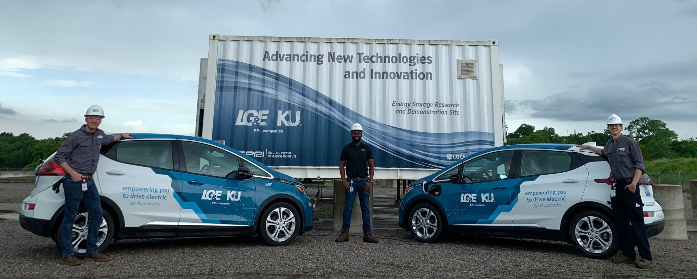
LG&E and KU, Kentucky's largest utility, is committed to research and development.
LG&E and KU, part of the PPL Corporation family of companies, are regulated utilities that serve nearly 1.3 million customers in Kentucky and Virginia.¹
Our mission is to provide safe, affordable, reliable, sustainable energy to our customers.²
We are committed to investing in research and development necessary to support the deployment of affordable and reliable clean energy technologies.³

Slide 3
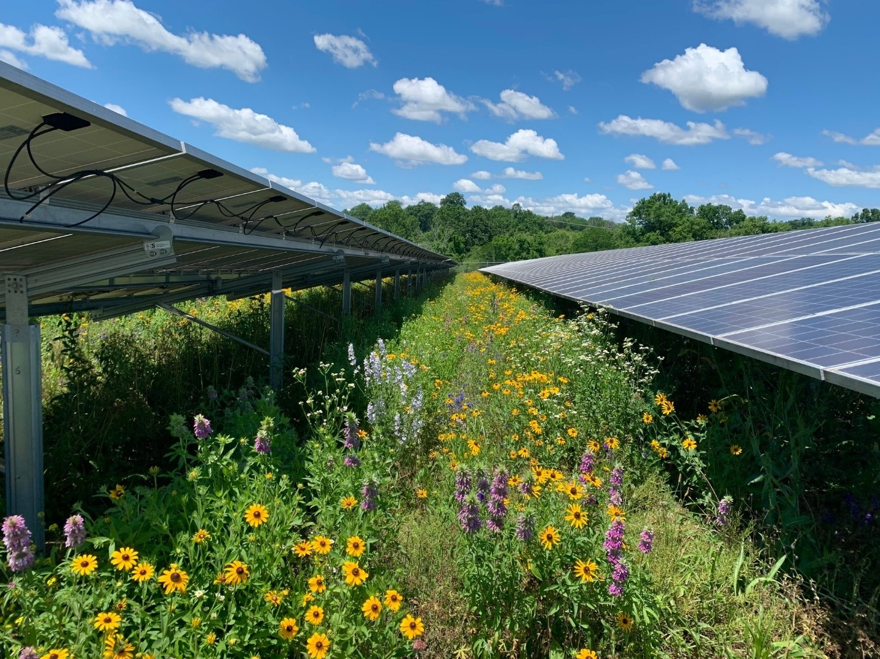
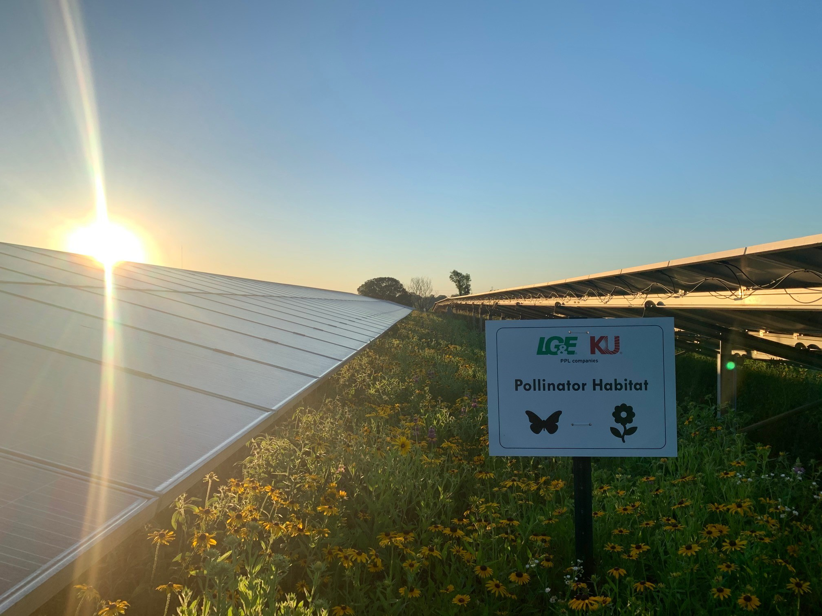
Together with PPL, we have an ambitious goal to achieve net-zero carbon emissions by 2050.
Together with our parent company PPL, we have set an ambitious goal to achieve net-zero carbon emissions by 2050, and a 70% reduction from 2010 levels by 2035. ⁴
Advancing a cleaner energy future is one of the core commitments of our sustainability strategy.⁵
We’re pursuing a broad-based clean energy strategy focused on decarbonizing our operations, investing in clean energy research and development.⁴

Slide 4
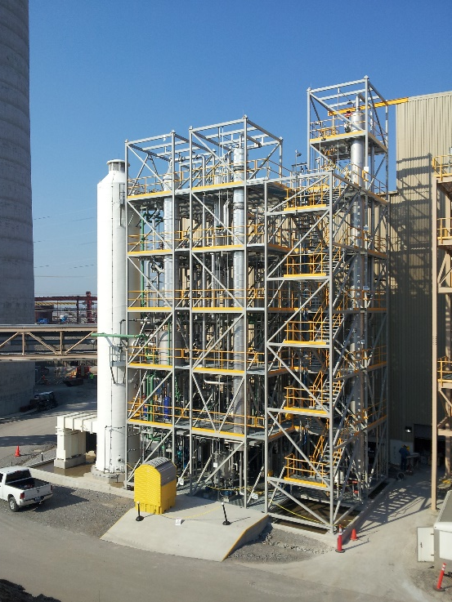
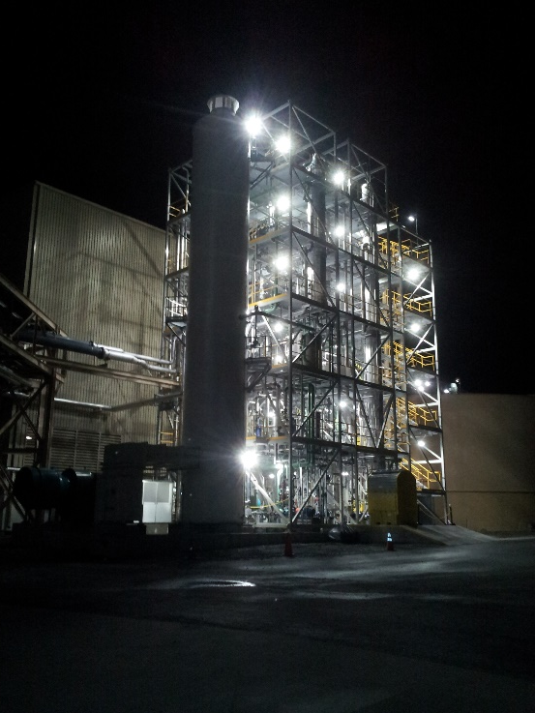
Kentucky is already a leader in carbon capture research.
Partnership began in 2006 with the University of Kentucky Center For Applied Energy Research.⁶
Operational 0.7 MW_{e} carbon capture unit in 2014.⁷
One of a few known operational carbon capture systems in the United States at a power plant.
Pilot scale site for research and development.
Solvent based, post combustion system.
$21.4 million initial investment—primarily from U.S. D.O.E.
Partners: UK, LG&E and KU, Commonwealth of Kentucky, EPRI and several others.
We are currently proposing a large pilot at Cane Run Natural Gas Combined Cycle (NGCC) facility in 2023-2025.
We are proposing a full-scale FEED study at Cane Run.

Slide 5
We believe in collaborative research.
Goal: Advance new technologies through research, development and innovation in partnership with industry.
Low-Carbon Resources Initiative (LCRI)⁸
PPL President and CEO Vince Sorgi serves as Chair of the LCRI Board Working Group.
Staff engagement in numerous technical subcommittees.
University of Kentucky (UK)⁹
We’ve partnered with UK since the 1990’s.
We currently have more than 15 active research projects with UK.
Center for Applied Energy Research (CAER)
Power and Energy Institute of Kentucky (PEIK)

Slide 6
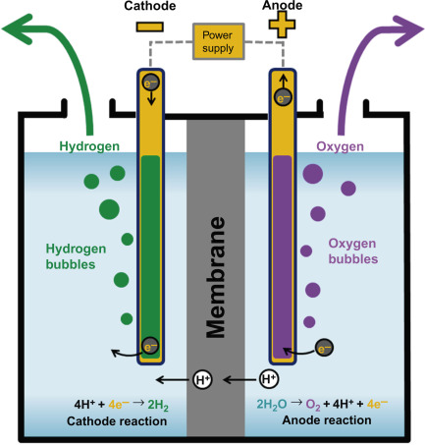
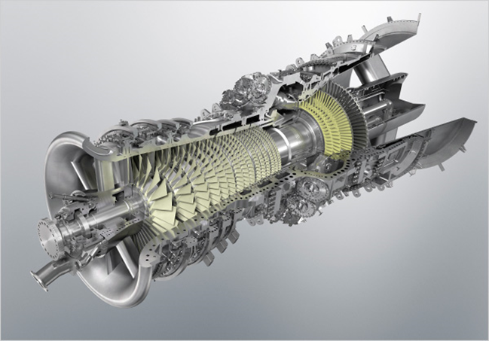
Green hydrogen is clean and dispatchable.
LG&E and KU is interested in being both a consumer and producer of green hydrogen.
Consumption:
Turbines
Fuel cells
Production:
Electrolysis powered by renewable energy
As a byproduct of carbon capture
Benefits
Green hydrogen has zero emissions, is dispatchable, and can be stored.
Can be produced from water using renewable energy.
Suitable for difficult to decarbonize industries:
Shipping and aviation
Cement
Steel
Commodity chemicals

Slide 7
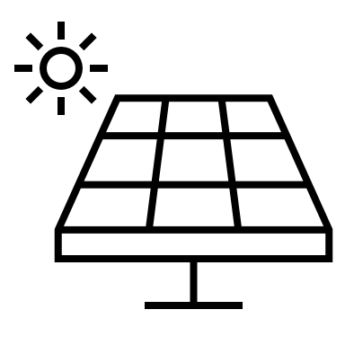
We are already researching hydrogen.
Current Hydrogen Projects:
Hydrogen production with direct air carbon capture.¹⁰
Hydrogen is produced when regenerating the capture solvent.
Hydrogen production during the Negative CO₂ Emissions from NGCC.¹¹
Simulated natural gas flue gas composition in the existing 0.7 MWe carbon capture unit.
Produces an oxygen and hydrogen product stream
Hydrogen Projects Under Consideration:
Green hydrogen production using solar and hydroelectric generation.
Hydrogen battery energy storage system.
Hydrogen is produced with an electrolyzer powered by renewables.
The hydrogen is consumed in a fuel cell to generate electricity.
Hydrogen blending with natural gas for combustion turbines.
Zero-carbon Electricity
Zero-carbon H₂
Electrolyzer
CCT
Zero-carbon Electricity

Slide 8
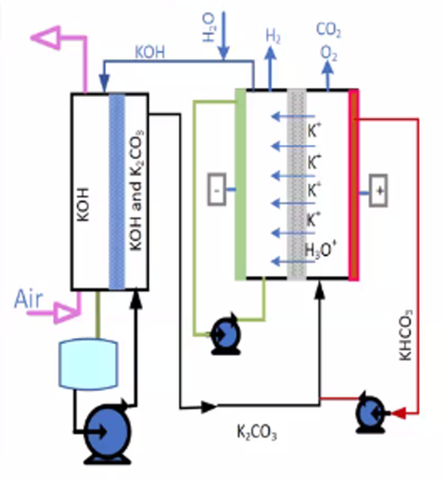
Direct Air Capture with H₂ Production
Total Funding: $1,580,404
DOE Federal Cost Share: $1,263,887
LG&E and KU Funding: $80,000
EPRI LCRI Funding: $79,164
Partners: LG&E and KU, EPRI-LCRI, University of Kentucky, DOE
The bench-scale system captures 90% carbon dioxide from ambient air and produces 99.9% purity hydrogen.
Produces hydrogen through electrolysis
Consumes hydrogen in periods of low renewables
2-year project
Carbon capture solvent is regenerated
Planning to scale up

Slide 9
Read more about our projects and plans.
¹ About Our Company LG&E and KU https://lge-ku.com/about
² About Us https://www.pplweb.com/who-we-are/about-us/
³ PPL’s 2021 Climate Assessment Report https://www.pplweb.com/wp-content/uploads/2021/11/PPL_Corp-2021-Climate-Assessment-FINAL.pdf
⁴ PPL Climate Action https://www.pplweb.com/sustainability/climate-action/
⁵ PPL: Advancing A Cleaner Energy Future https://www.pplweb.com/sustainability/our-strategy/advance-a-cleaner-energy-future/
⁶ LG&E and KU and UK Partnership http://uknow.uky.edu/research/unique-public-private-research-consortium-established-caer-co2-capture-pioneers
⁷ E.W. Brown Pilot Carbon Capture https://lge-ku.com/newsroom/press-releases/2014/07/21/governor-state-officials-and-energy-leaders-cut-ribbon
⁸ PPL joins LCRI https://pplweb.mediaroom.com/2020-08-11-PPL-joins-EPRI-and-GTI-led-initiative-to-accelerate-low-carbon-energy-technologies
⁹ Technology Research and Analysis https://lge-ku.com/research
¹⁰ Direct Air Capture https://uknow.uky.edu/research/caer-project-seeks-capture-carbon-directly-atmosphere
¹¹ Net Negative Emissions https://lge-ku.com/newsroom/press-releases/2021/09/08/lge-and-ku-and-uk-caer-collaborating-create-net-negative-co2

Slide 10
Questions?
Keep up with us online at:
https://lge-ku.com/research

