Slide 1
Learn Before You Burn
Kentucky Division for Air Quality
Notes:
Welcome to the Kentucky Division for Air Quality’s Learn Before You Burn presentation.
Photo: Division for Air Quality Field Operations Branch (DAQ FOB)

Slide 2
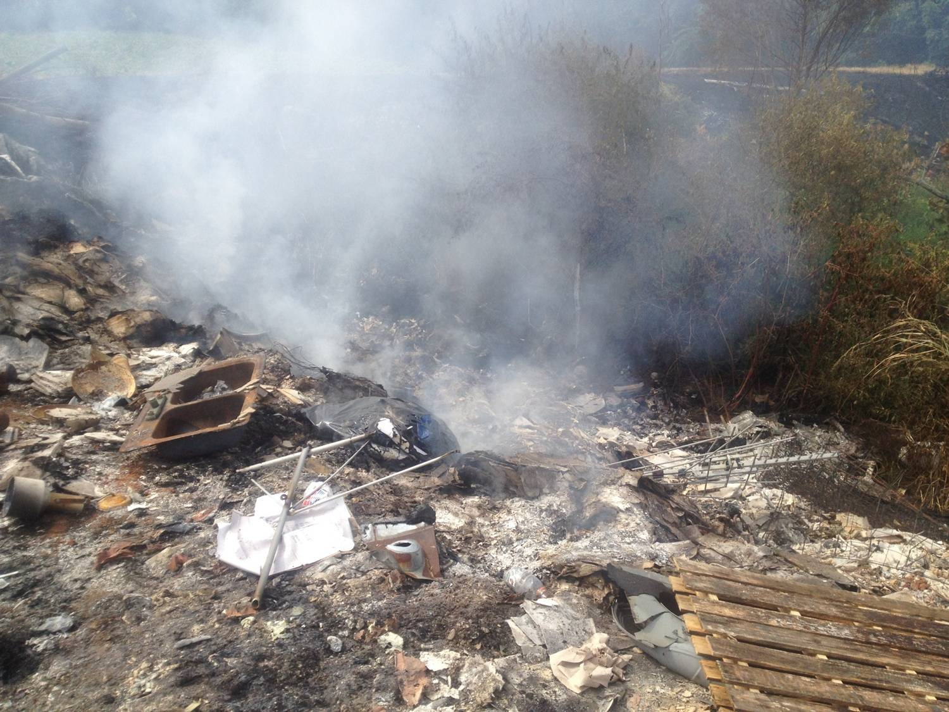
Open Burning in Kentucky
What is it?
Why be concerned?
Legal or Illegal?
Restrictions
How you can help
Notes:
In this presentation, you’ll learn about open burning and its impact on human health; what kinds of open burning are legal or illegal in Kentucky; restrictions on open burning; and how you can spread the word to help keep our air clean and healthy.
(Photo: DAQ FOB)

Slide 3
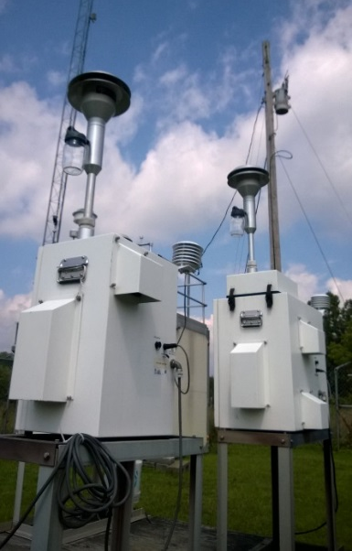
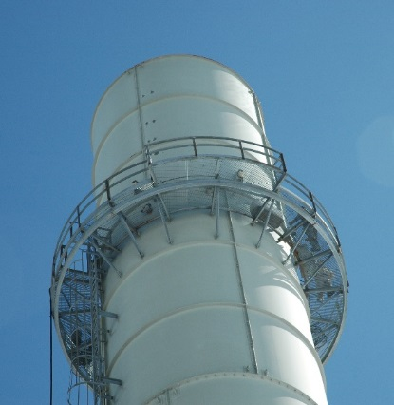
Our Mission
To protect human health and the environment by achieving and maintaining acceptable air quality through:
Air monitoring
Creating partnerships
Public information
Permitting and compliance
Notes:
The Kentucky Division for Air Quality is the state agency charged with protecting human health and the environment by maintaining healthy air for all Kentuckians. We do this through:
A statewide air monitoring network to track pollutants
Creating effective partnerships with air pollution sources and the public.
Providing useful and timely information about air quality to the public.
An air permitting and compliance program with sources operating in the Commonwealth.
(Photos: DAQ and Adobe Stock images)

Slide 4
What is Open Burning?
Outdoor burning of any material without an approved burn chamber, stack, or chimney with control devices approved by the KY Division for Air Quality.
Open burning is regulated under KY Title 401 KAR 63:005.
Notes:
So, when we talk about open burning, we’re really talking about outdoor burning with no chimney, no burn chamber and no air pollution control devices. Open burning may occur on the ground or in a burn barrel. Because it is done outdoors in the open air, open burning is typically a low-temperature, high smoke activity that can seriously impact air quality. That’s why open burning is regulated in the Commonwealth of Kentucky.
(Photo: DAQ FOB)

Slide 5
Jefferson County/Louisville Metro
Additional open burning restrictions year-round
Contact the Louisville Metro Air Pollution Control District for more information.
https://louisvilleky.gov/government/air-pollution-control-district
Notes:
This presentation is about Kentucky’s state open burning regulation. If you live in the Louisville Metro area, you should check with the Louisville Metro Air Pollution Control District for information about additional restrictions to open burning in Jefferson County.
(Photo: Adobe Stock image)

Slide 6
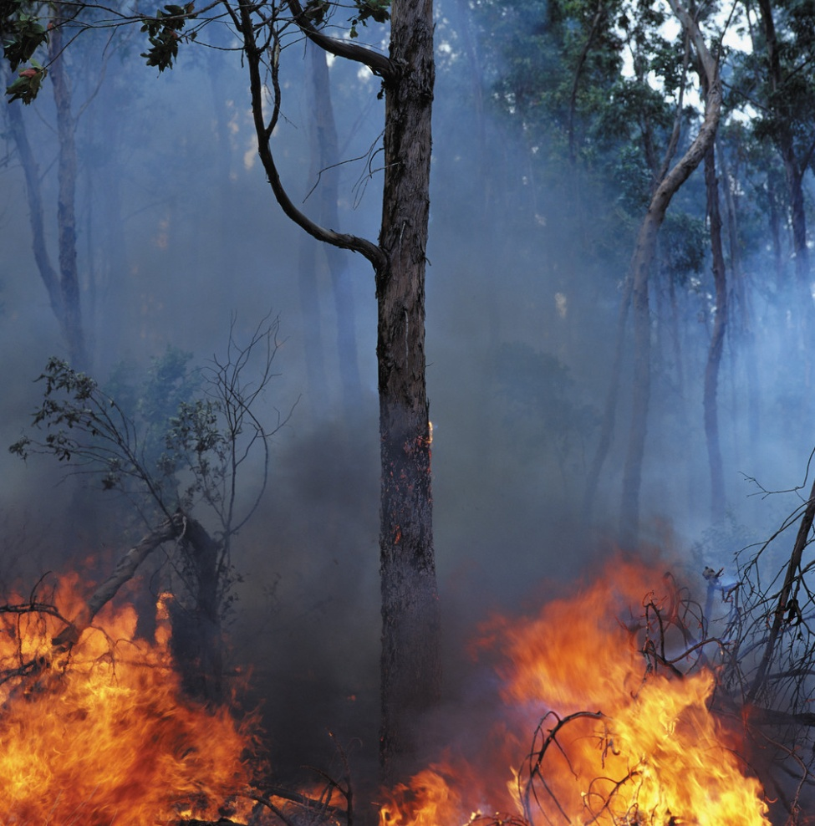
Open Burning Creates Fire and Safety Hazards
The Kentucky Division of Forestry estimates that 35 to 40 percent of wildfires in Kentucky start when open burning gets out of control.
Notes:
Why be concerned about open burning? According to the Division of Forestry, approximately 35 to 40 percent of Kentucky wildfires are caused by open burning.
(Photo: Microsoft Office)

Slide 7
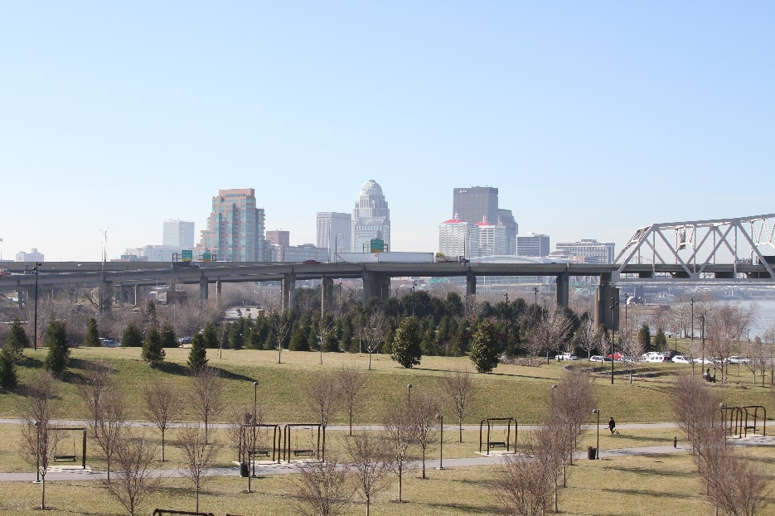
Open Burning Impacts Air Quality
Makes it harder for areas to meet air quality standards
Can’t always tell where or when open burning is occurring, making it challenging to control
Notes:
Open burning floods the air with pollutants – and those pollutants can travel far beyond the location where the burning is happening. It can make it harder for areas to meet air quality standards. And unlike a stationary source with a smokestack, it is nearly impossible to control the smoke from open burning.
(Adobe Stock images)

Slide 8
Open Burning Impacts Soil & Water
Chemicals and heavy metals from open burning settle out of the air and into soil and water.
Notes:
Open burning pollutes more than just the air. Smoke from open burning contains heavy metals and chemicals that settle out of the air and onto surrounding soil and water, where they can accumulate in plants and animals. The ashes from open burning are another pollution source, especially when it rains, as chemicals and heavy metals get washed into groundwater and streams.
(Photo: DAQ FOB)

Slide 9
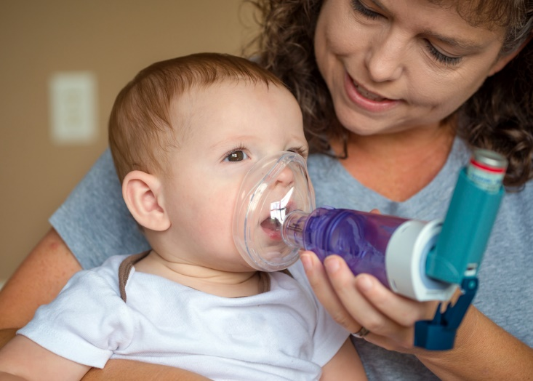
Open Burning Harms Human Health
Smoke from open burning:
Depresses the central nervous system
Is especially harmful to children, the elderly, and adults with respiratory diseases
Notes:
Of course, human health is our biggest concern. Smoke from open burning makes it harder to breathe, can trigger asthma attacks, and worsen existing heart and lung problems. Children, the elderly, and those with pre-existing health problems are especially vulnerable.
(Adobe Stock image)

Slide 10
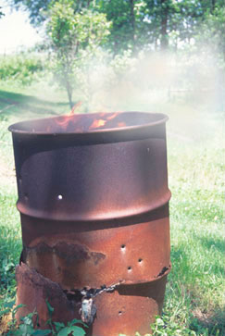
Where there’s smoke …
Dioxins
Furans
Benzene
Arsenic
Carbon monoxide
Lead
Mercury
Hydrogen chloride
Hydrogen cyanide
Notes:
Smoke from open burning contains chemicals, fine particles, and gases that can have immediate and long-term health effects. And it’s not just the person doing the burning who’s at risk, but also their families and neighbors.
(Adobe Stock image)

Slide 11
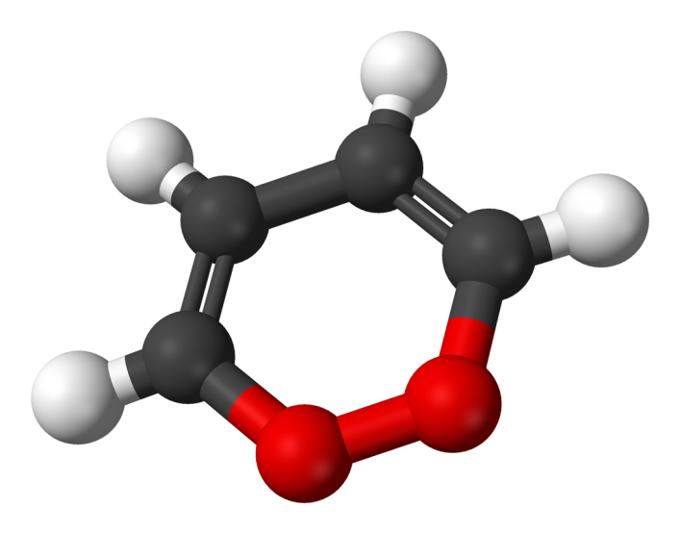
Dioxins
A family of chlorinated organic chemicals
Includes the main chemical ingredient in “Agent Orange”
Found in plastics, bleached paper products
Extremely toxic
Highly persistent in the environment
Accumulate in fatty tissues
Notes:
Dioxins are among the worst of these pollutants. Dioxins are a family of chlorinated organic chemicals that include the main ingredient found in “Agent Orange”. They that form when products containing carbon and chlorine are burned – think paper, food scraps, and plastics. Dioxins are extremely toxic to human health. Dioxins last a long time in the environment, accumulating in fatty tissues as they move through the food chain.
(Adobe Stock image)

Slide 12
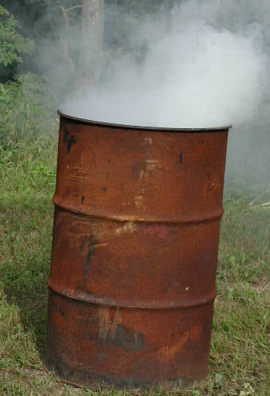
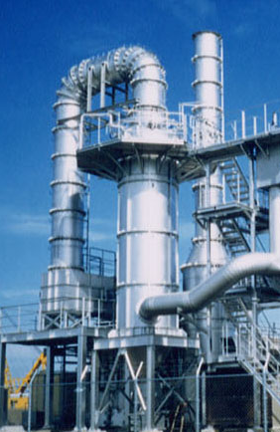
Backyard Burn Barrels
Largest single source of airborne dioxins in U.S. (U.S. EPA)
>
In just one year, a single backyard burn barrel can produce more dioxins than a municipal trash incinerator.
Notes:
Because burn barrels do not have the same strict controls as municipal incinerators, barrel burning releases significant amounts of dioxins. An EPA study found that a single backyard burn barrel serving a family of four, can emit more dioxin pollution in one year than a well-controlled municipal trash incinerator.
(Adobe Stock images)

Slide 13
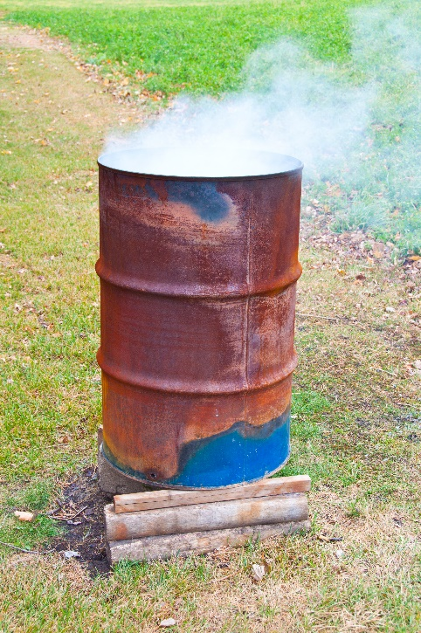
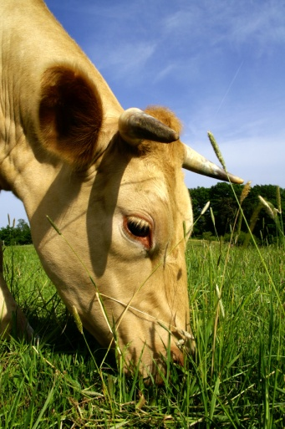
Dioxins move through the food chain
Notes:
Dioxins move through the food chain. Airborne dioxins can settle onto feed crops, which are then eaten by domestic meat and dairy animals. Dioxins also enter waterways through soil erosion and runoff. These dioxins accumulate in the fats of animals, and then in humans when we consume meat, fish, and dairy products.
(Adobe Stock images)

Slide 14
Illegal open burning in Kentucky continues to be a problem
Notes:
Each year, the Division for Air Quality receives hundreds of air quality complaints from citizens. Most of these complaints are about smoke from open burning. This chart shows open burning complaints and violations in Kentucky over the last decade.

Slide 15
How Do We Respond?
Receive complaint
Need an address where the burning happened in order to investigate
Enter information into complaints database
Site visit generally within 3-5 working days
Inspection of burn site
Depending on the outcome of the investigation, a Letter of Warning or Notice of Violation may be issued
It is not necessary for an inspector to witness the actual burn; evidence may be obtained from debris and ash piles, photos, etc.
Notes:
How do we respond to open burning complaints? In order to investigate, a complaint must include a physical address or GPS coordinates where the burning has taken place. An air quality inspector generally visits the site within 3 to 5 working days to inspect the burn site and determine whether the activity was legal or illegal. Depending on the outcome of the investigation, a letter of warning or notice of violation may be issued. It is not necessary for an inspector to witness the actual burn; debris from ash and burn piles can provide evidence for the investigation.

Slide 16
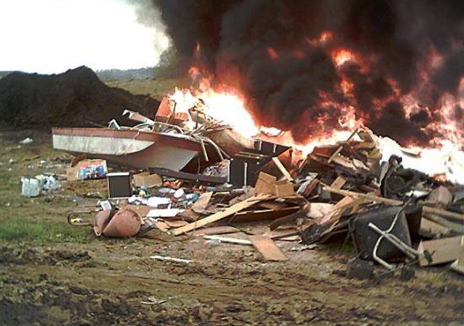
Legal or Illegal?
What, when, where, and how a material is burned determines if the burning is legal or illegal.
Notes:
Is open burning legal or not? It all depends on what, when, where, and how a material is burned. The following slides will help you learn before you burn.
(Photo: DAQ FOB)

Slide 17
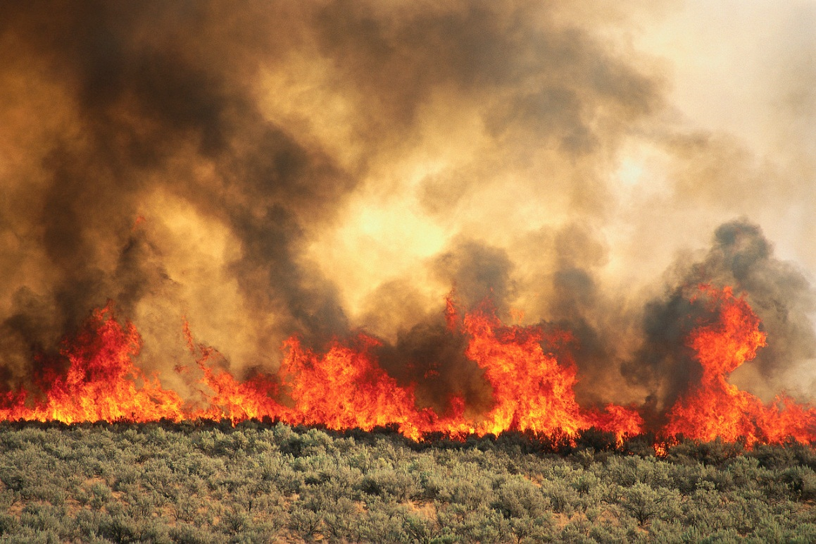
Check Local Ordinances
Local county and municipal ordinances may have more stringent rules than the state regulation described in this presentation.
Notes:
It’s important to remember that local county and municipal ordinances may have more stringent rules than the state regulation described in this presentation.
(Photo: Kentucky Nature Preserves)

Slide 18
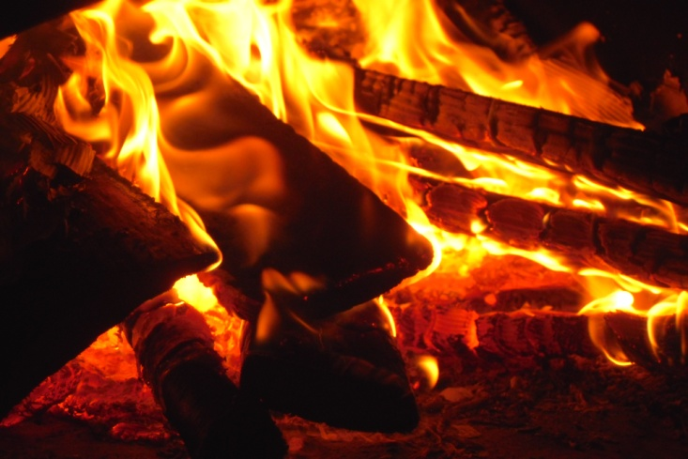
Cooking, Camping, & Comfort Fires
Fires set for recreational or ceremonial purposes (campfires, bonfires)
Fires set for cooking (campfires)
Small fires set for comfort heat at construction sites (only when air temp. is below 50˚)
Notes:
Under Kentucky state regulation, the following kinds of open burning are permitted:
Campfires, bonfires, and fires set for recreational or ceremonial purposes
Fires set for cooking
Small fires set for comfort heat at construction sites when the air temperature is below 50 degrees. Construction site comfort fires must be in a container no larger than 55-gallons in size, and must only contain clean lumber or vegetative debris.
(Photos: Microsoft Office and Stock.xchng)

Slide 19
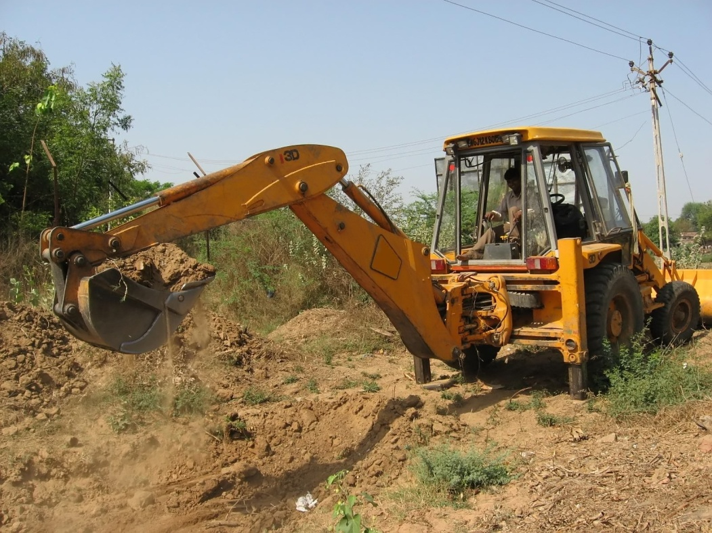
Natural growth from land clearing & storms
Burning of:
Natural growth disturbed as part of land clearing activities (development sites, etc.)
Trees and tree limbs, felled by storms
Ozone season exceptions: Jefferson, Boone, Kenton, Campbell, Boyd, Bullitt, Oldham, and Lawrence (partial)
Notes:
State regulation also permits the burning of natural growth from land clearing, and trees and tree limbs felled by storms. However, a handful of counties are restricted from this type of burning during ozone season, which occurs May 1 – September 30 every year. During these months, open burning of natural growth, tree limbs, and brush is prohibited in Jefferson, Boone, Kenton, Campbell, Boyd, Bullitt, Oldham and Lawrence counties.
(Photo: Stock.xchng)

Slide 20
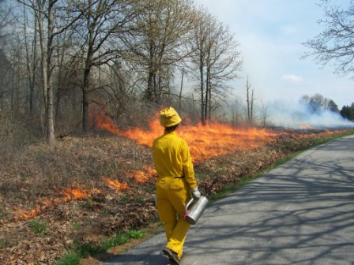
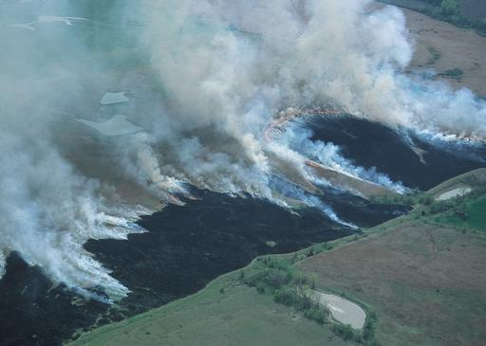
Prescribed Fire
Fires set for recognized agricultural, silvicultural, range, or wildlife management practices.
Notes:
Kentucky regulation also permits prescribed fires set for recognized agricultural, forest, range, or wildlife management practices.
(Top photo used with permission by Zeb Weese, Kentucky Nature Preserves; Bottom photo courtesy of NRCS photo gallery)

Slide 21
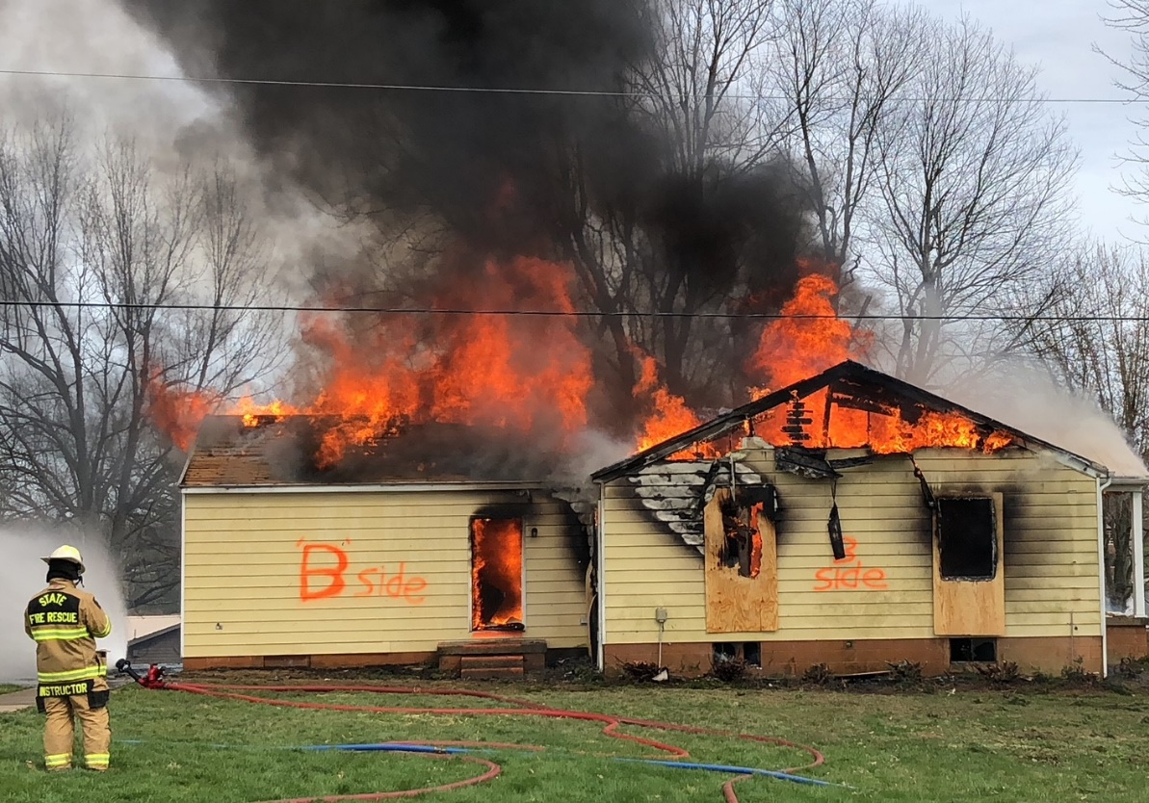
Live Fire Training
Fires set for the purpose of instruction and training of firefighters.
Materials likely to produce toxic emissions must be removed prior to burn.
Contact the State Fire Commission for more information.
Additional restrictions apply.
Notes:
Fire departments may apply for permission from the Division for Air Quality and the Kentucky Fire Commission to conduct live fire trainings. Materials likely to produce toxic emissions, such as shingles and siding, must be removed from a structure prior to the burn, and additional restrictions may apply. Contact the State Fire Commission for more information.
(Photo: DAQ FOB)

Slide 22
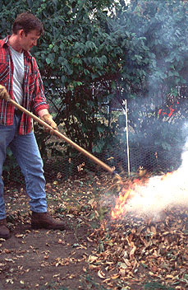
Leaf Burning
Restricted in some areas, permitted in others
Check local ordinances
The following counties are not allowed to burn leaves during ozone season, May - September:
Jefferson, Boone, Kenton, Campbell, Boyd, Bullitt, Oldham, and Lawrence (partial)
Iowa DNR
Notes:
Leaf burning is restricted in some areas and permitted in others, so it’s important to check your local ordinance before burning leaves. Also, leaf burning is never permitted during ozone season, May through September, in Jefferson, Boone, Kenton, Campbell, Boyd, Bullitt, Oldham, and portions of Lawrence county.
(Photo used with permission from Iowa Department of Natural Resources)

Slide 23
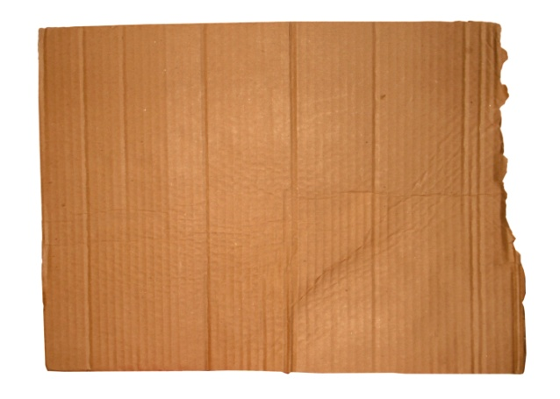
Uncoated Household Paper Products
Check local ordinances
Newspaper
Office paper
Plain cardboard
Notes:
State law permits the burning of uncoated paper products such as office paper, cardboard, and newspaper. Check local ordinances first, as some areas may restrict this kind of open burning.
All photos from stock.xchng (free use)

Slide 24
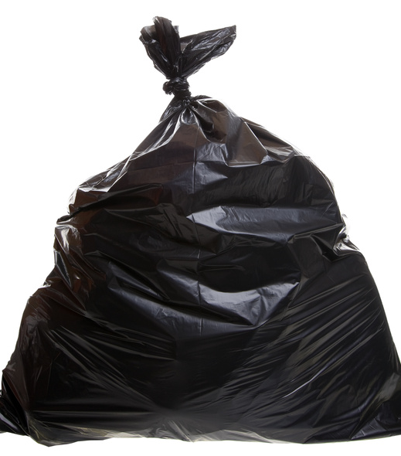
What About Trash?
Nearly everything found in household trash is illegal to burn.
Plastic
Coated paper and cardboard
Food
Foam insulation
Styrofoam
Metal & glass
Aerosol cans
Rubber
Painted products
Diapers, clothing
Notes:
State law prohibits the open burning of materials likely to produce toxic emissions, and that includes nearly everything found in household trash. In Kentucky, it is illegal to burn materials such as plastic, plastic-coated paper or cardboard, food scraps, insulation, Styrofoam, metal and glass, aerosol cans, rubber, painted or stained products, diapers, and clothing.
(Microsoft Office photo)

Slide 25
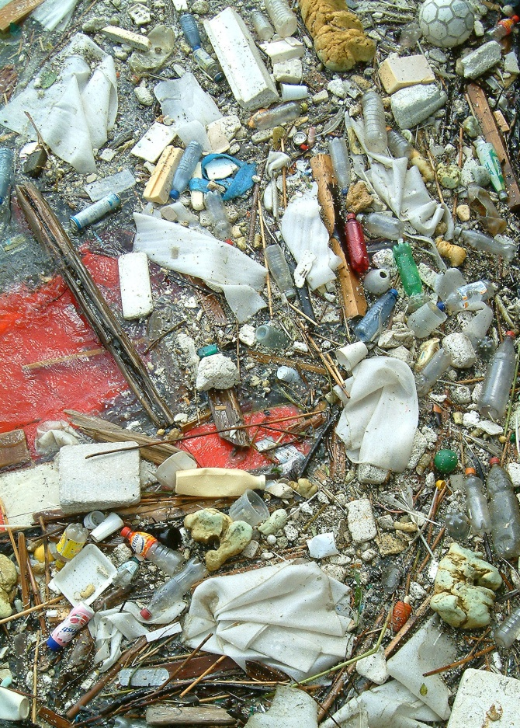
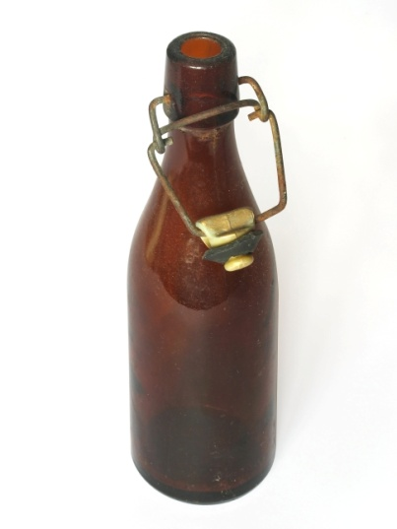
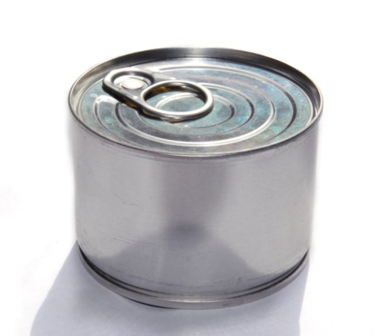
Today’s Trash is Different
Yesterday’s trash
Today’s trash
Notes:
Today’s trash is different than the trash our grandparents used to burn. So much of our trash today contains plastics and other materials that release toxic pollutants when burned.
All photos from stock.xchng (free use)

Slide 26
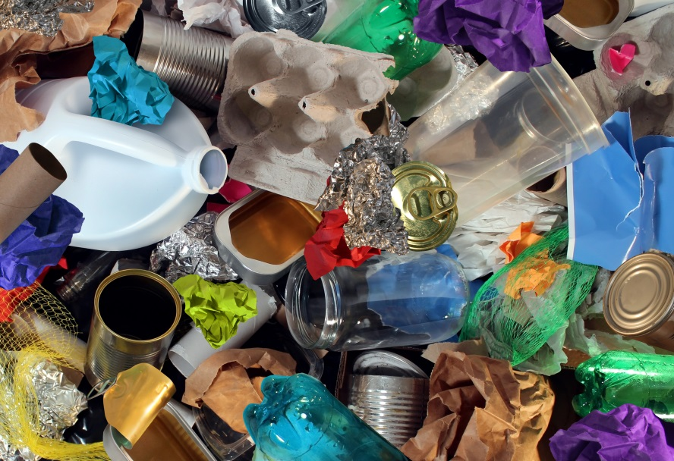
What’s in that trash?
Lead
Dioxin
Mercury
Benzene
Furan
Toluene
Cadmium
Acrolein
Acetaldehyde
Notes:
What’s in that trash? Heavy metals like lead and cadmium are used in dyes on candy and chip bags, and when burned these metals are released as fine particles into the air. Dioxins and furans are released when plastics are burned, and gases such as acrolein and benzene are released when plastics and Styrofoam are burned. These pollutants can make it hard to breathe, irritate lung tissue, and many are linked to cancer.
(Adobe Stock image)

Slide 27
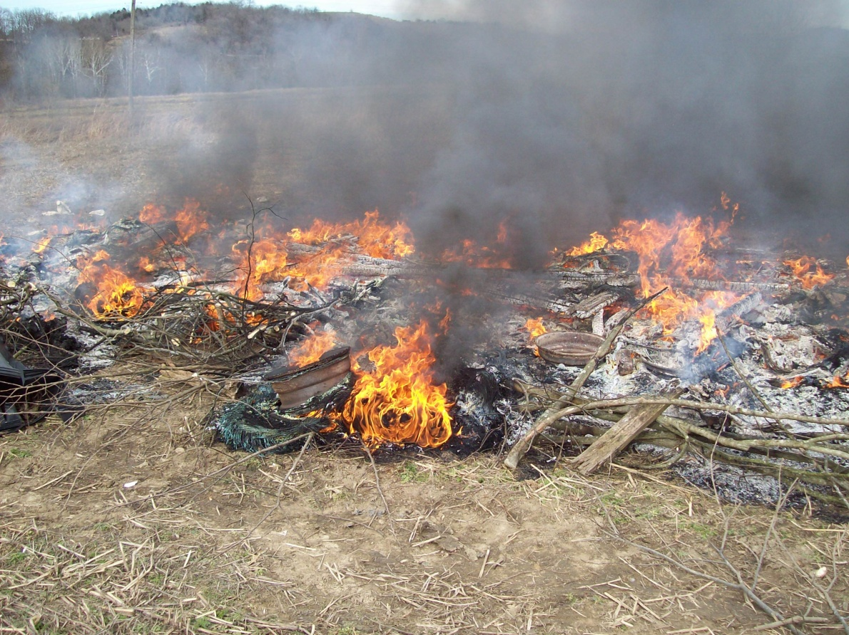
Prohibited Burn Items…
Tires
Plastic
Rubber
Coated wire
Insulated wire
Foam insulation
Used oil
Notes:
State law prohibits the open burning of tires, plastic, rubber, coated or insulated wire, foam insulation, and used oil.
(Photo: DAQ FOB)

Slide 28
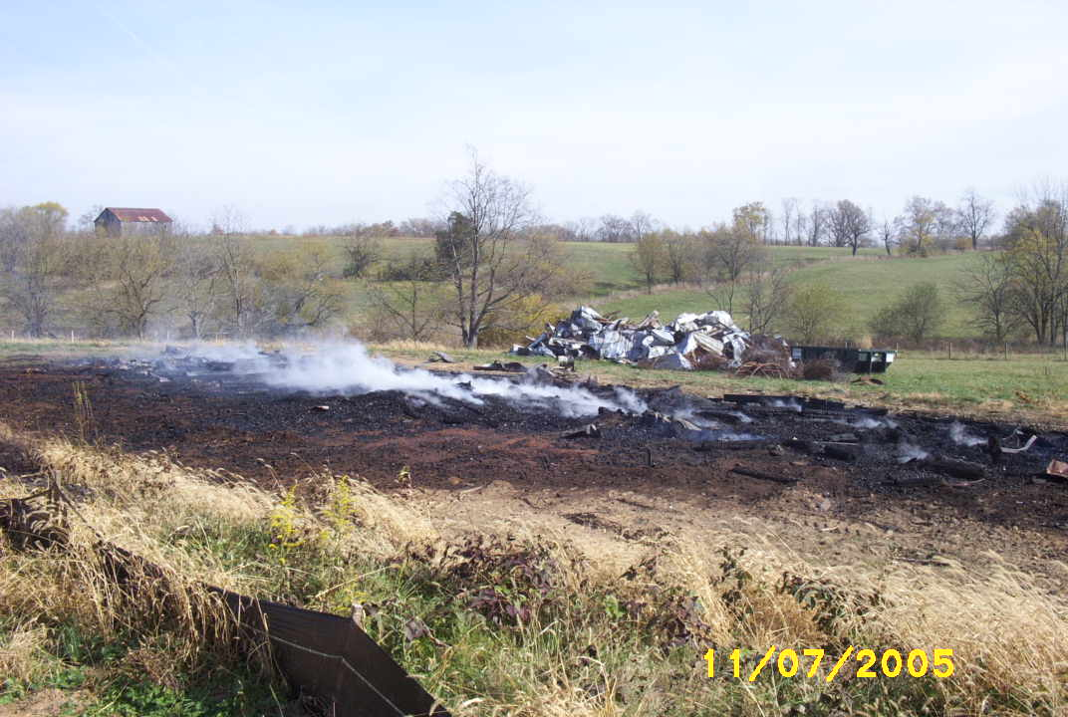
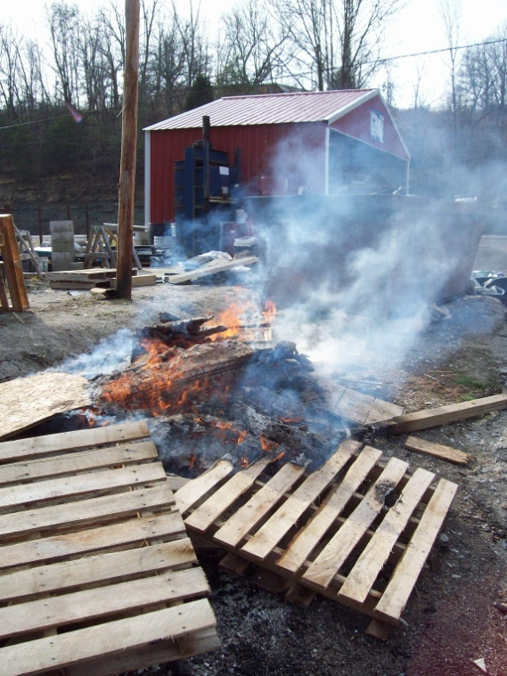
Prohibited: Agricultural Burning
Bedding material
Muck piles
Mulch
Hay
Treated, stained, or painted lumber
Fence posts & wood pallets
Agricultural fields (no plastic)
Notes:
Also prohibited are a wide range of agricultural items, including animal bedding material, muck piles, mulch and hay, treated, stained or painted lumber, fence posts and wood pallets. Burning off old growth from agricultural fields is permitted, provided the agricultural plastic has been removed first.
(Photos: DAQ FOB)

Slide 29
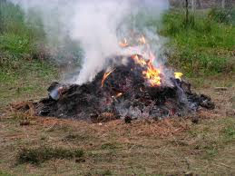
Prohibited: Grass Clippings
Grass clippings produce excessive smoke
Grass clippings are “yard waste”, which is not permitted to be burned according to 401 KAR 63:005
Notes:
Grass clippings and other yard waste produce excessive smoke and are prohibited from open burning in Kentucky.
No photo credit

Slide 30
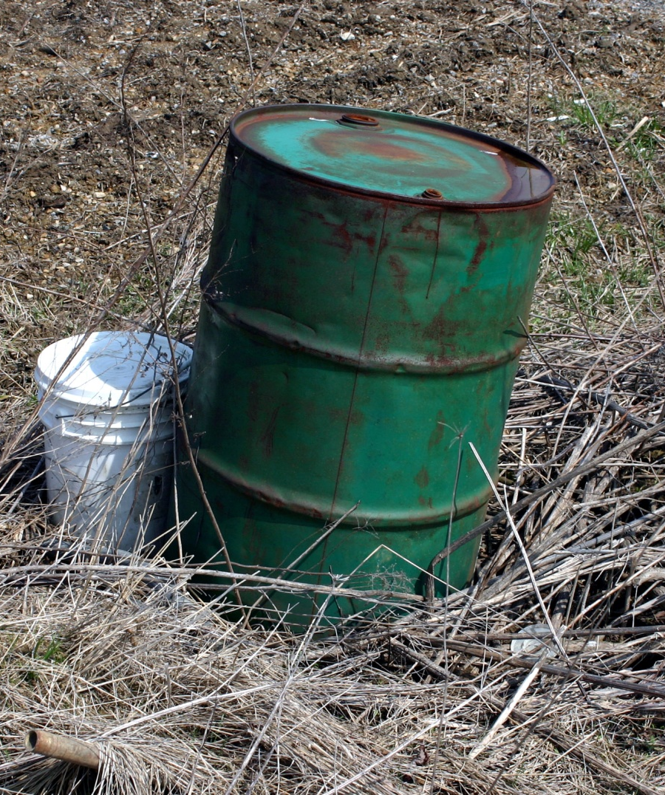
Prohibited: Chemical Containers
Agricultural chemical containers
Household chemical containers
Notes:
It is illegal to burn chemical containers of any size.
(Photo: stock.xchng)

Slide 31
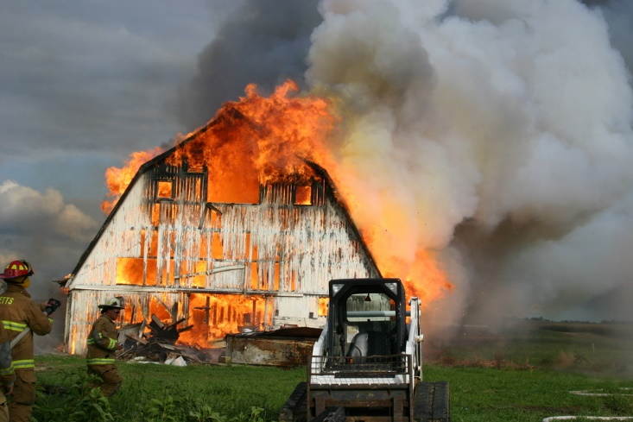
Prohibited: Buildings
Buildings may not be disposed of by burning.
Buildings may be demolished and buried onsite.
Notes:
It is illegal to dispose of a building or trailer home by burning, unless it is part of an approved fire training sanctioned by the State Fire Commission. Kentucky law does permit a landowner to demolish and bury a building onsite. Contact the Division of Waste Management for more information.
(Photo: DAQ FOB)

Slide 32
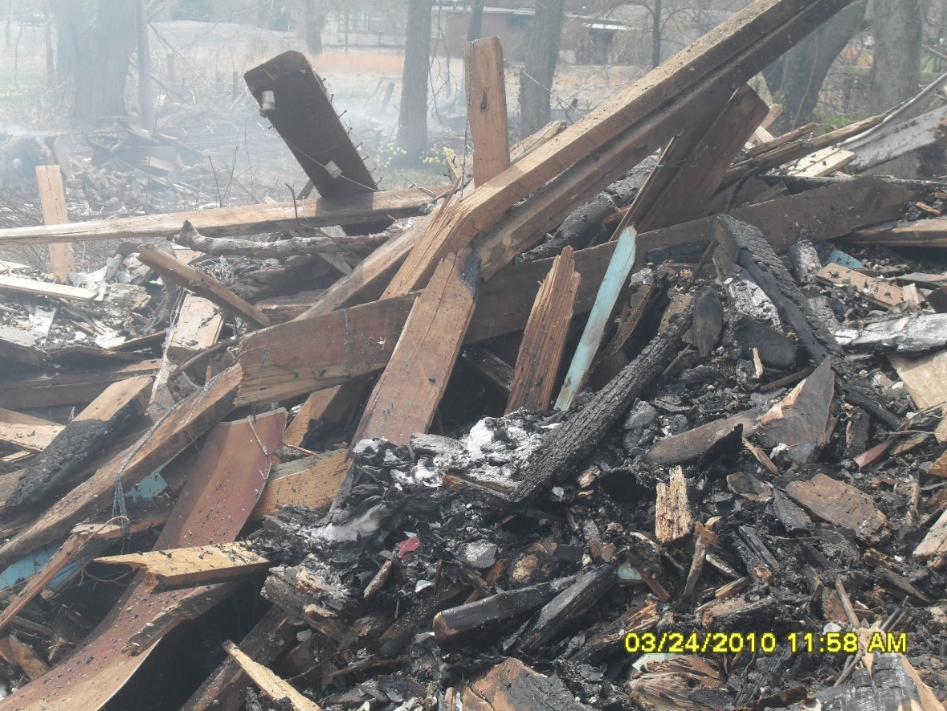
Prohibited: Construction/Demolition Debris
Asbestos materials
Construction debris
Demolition debris
Drywall
Shingles
Notes:
Construction and demolition debris may not be disposed of by open burning. These materials may contain asbestos, treated or painted lumber, drywall, shingles, and insulation – all of which emit hazardous pollutants when burned.
(Photo: DAQ FOB)

Slide 33
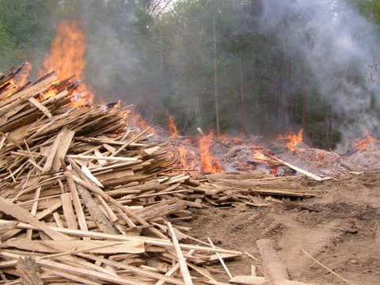
Prohibited: Waste from businesses, schools & churches
Other than land clearing for development, businesses may not dispose of any waste by burning.
Debris from private businesses may not be transported for burning elsewhere.
Notes:
Other than natural growth from land clearing, businesses may not dispose of any waste by burning. Waste or debris from private businesses may not be transported for burning elsewhere. For example, a tree trimming service may not burn tree limbs for disposal if they transport tree trimming debris to another location – even private property -- for burning.
(Photo: DAQ FOB)

Slide 34
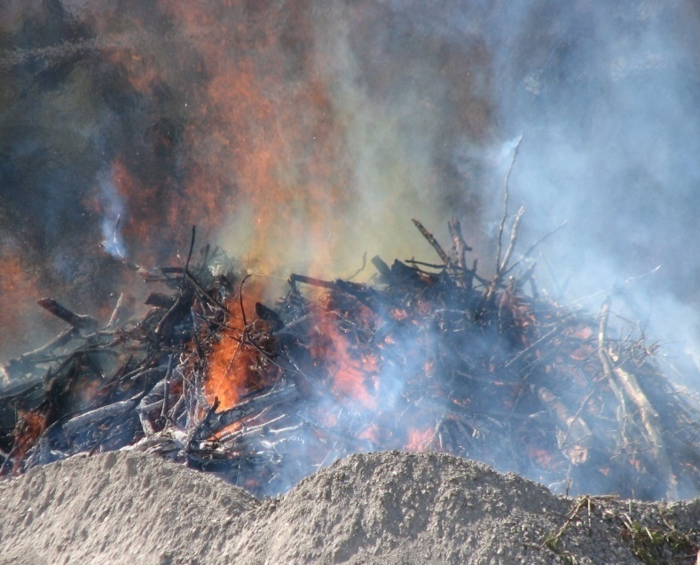
Disposing of Vegetative Storm Debris County or municipal governments only, with approval
May be legally burned (observe fire hazard season restrictions & county burn bans).
Large piles should be divided and burned incrementally over time.
Care should be taken to locate burn piles away from residences and areas that could be impacted by smoke.
Contact the Division for Air Quality before burning large stockpiles of debris.
Notes:
Occasionally, storms and flooding may generate large amounts of debris from downed trees. When this happens, local governments may choose to coordinate community collection and burning of vegetative storm debris, so long as fire hazard season restrictions are observed and there are no county burn bans in effect for that area. Only vegetative debris – that is, tree limbs and branches – may be burned. Large piles should be divided and burned incrementally over time. Also, be sure to locate burn piles away from areas that could be impacted by smoke. Contact the Division for Air Quality before burning large stockpiles of storm debris.
(Photo: DAQ FOB)

Slide 35
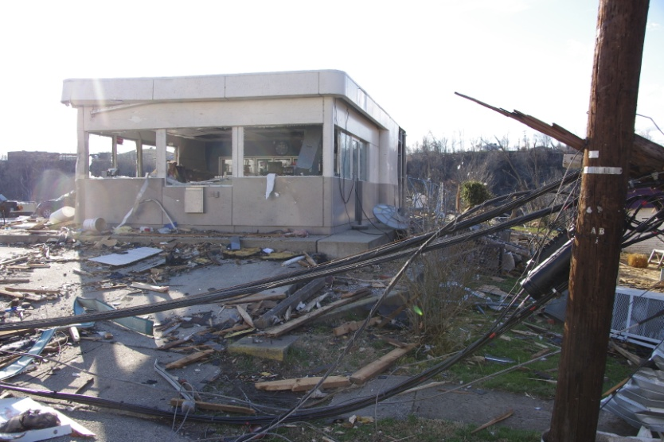
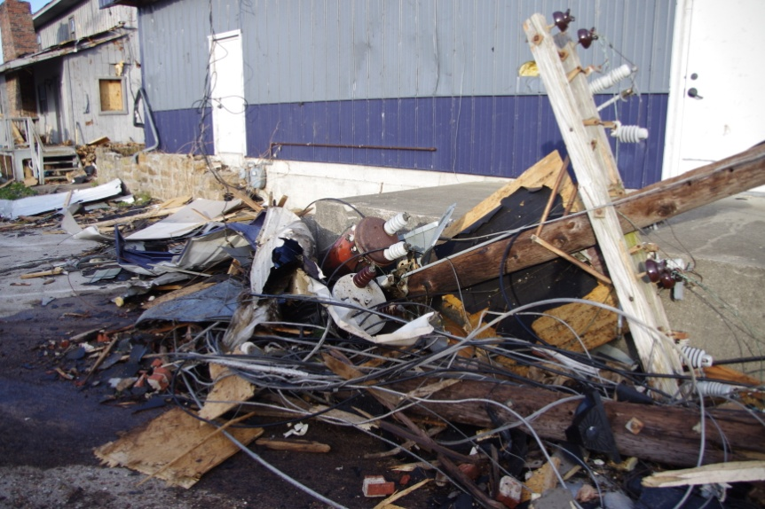
Disposing of Storm Debris
Demolition debris may not be burned. Debris may contain asbestos and other hazardous materials.
Demolition debris piles should be kept wet until final disposal in a landfill.
Notes:
Demolition debris may never be burned – even if it was created by storms or flooding. These images are from the aftermath of tornadoes that ripped through the town of West Liberty in 2012. Numerous buildings were destroyed during the storms, leaving behind tangled piles of mixed demolition debris. To reduce the risk from debris containing asbestos, piles like these should be kept wet until they can be disposed of in an approved landfill.
(Photos: KY DEP)

Slide 36
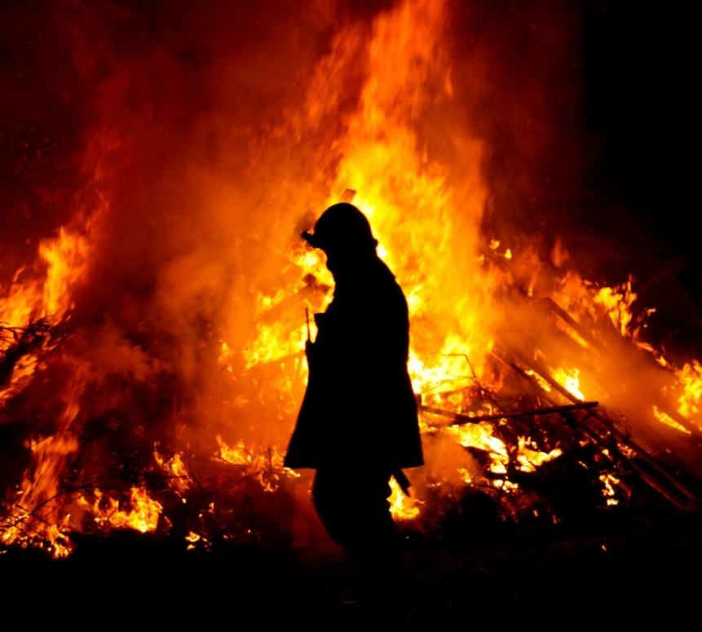
Restrictions During Fire Hazard Season
Oct. 1 – Dec. 15 and
Feb. 15 – April 30
During fire hazard season, burning within 150 feet of any woodland or brushland area is allowed only during evening hours between
6 p.m. & 6 a.m.
Notes:
Open burning is further restricted during Fire Hazard Season. From October 1 through December 15, and from February 15 through April 30, burning within 150 feet of any woodland area is allowed only during the evening hours between 6 PM and 6 AM.
Photo from stock.xchng (free use)

Slide 37
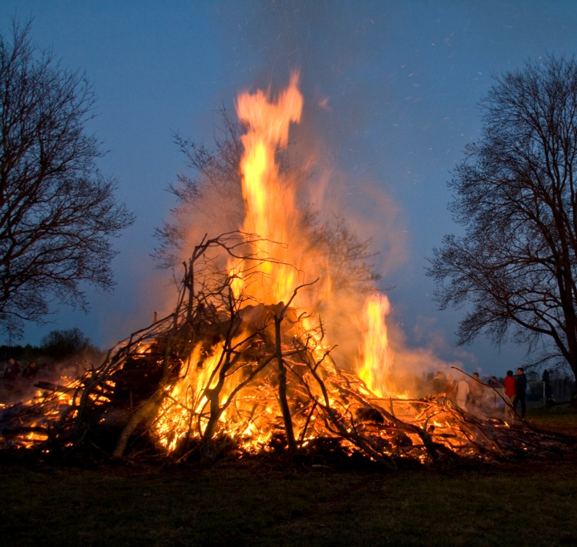
Restrictions during ozone season:
May – September
Only in Boone, Boyd, Bullitt, Campbell, Jefferson, Kenton, Lawrence, & Oldham counties
No open burning for land clearing permitted
Other restrictions apply
Notes:
As mentioned earlier, ozone season means additional open burning restrictions for certain counties. From May 1 through September 30, no open burning for land clearing is permitted in Boone, Boyd, Bullitt, Campbell, Jefferson, Kenton, Oldham, and portions of Lawrence county.
Photos: DAQ FOB (top), stock.xchng (bottom)

Slide 38
Burn Bans
Can be declared by county Judge Executive or Governor
Generally during extreme risk of wildfire hazard
Check Division of Forestry’s County Burn Bans page
Notes:
During times of extreme risk of wildfire, the governor or a county judge executive may declare a county-wide burn ban. The Division of Forestry tracks county burn bans on its county burn bans page. A declared county burn ban temporarily prohibits most or all outdoor burning.

Slide 39
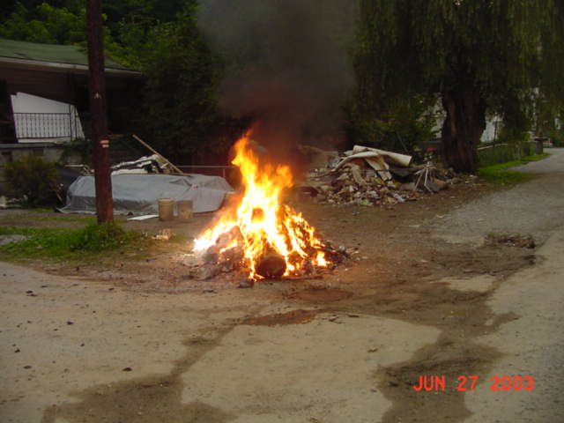
Where Can You Burn Approved Materials?
Do not locate fires near streams, sinkholes, or under/over utility lines.
Use common sense to locate fires away from nearby residences or businesses.
Check to make sure local city/county ordinances allow burning.
Notes:
Be careful when choosing a location for approved open burning. Never burn near streams, sinkholes, or near utility lines. Use common sense to locate fires away from nearby residences or businesses that may be impacted by smoke. And always check local ordinances before burning.
No photo credit

Slide 40
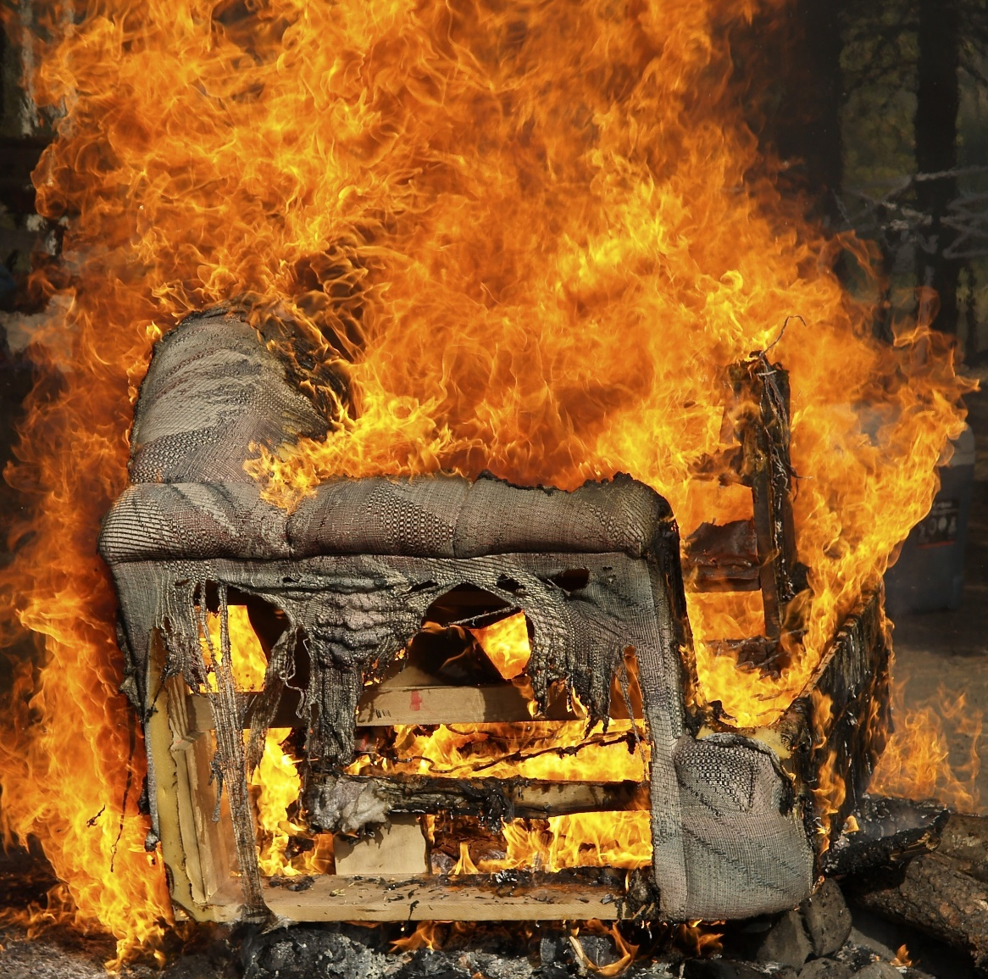
Illegal burning could result in fines up to $25,000 per day per violation.
In addition to Division for Air Quality rules, other state and local regulations may apply.
Notes:
Under Kentucky state regulation, illegal burning could result in fines of up to $25,000 per day per violation.
(Adobe Stock image)

Slide 41
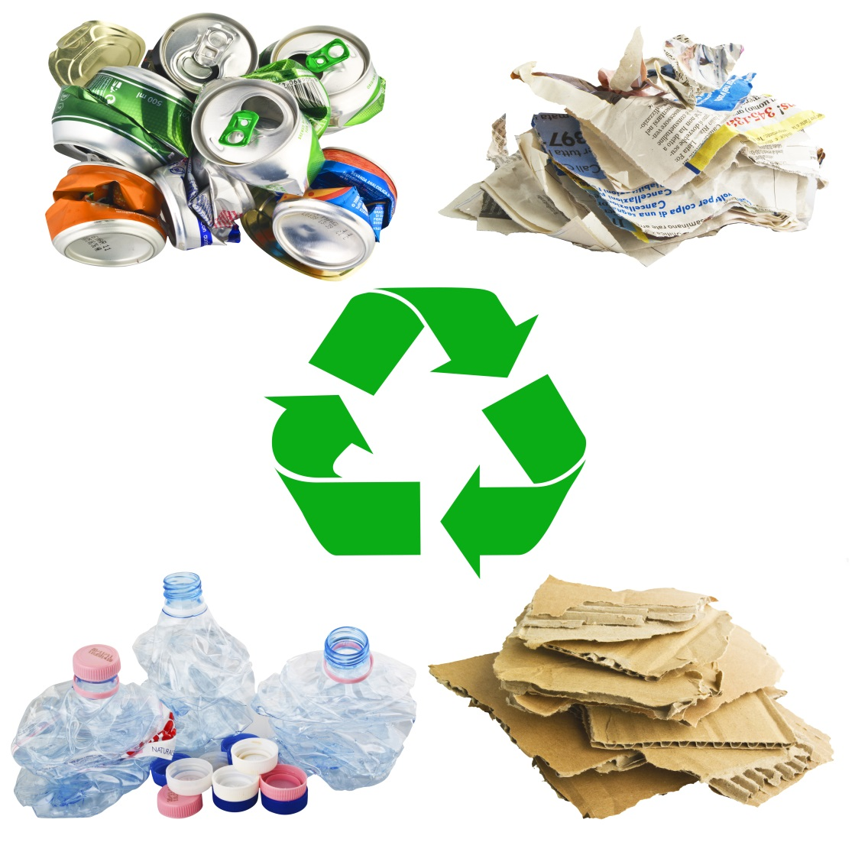
Most Open Burning is Not Necessary
Brush could be composted, piled up for wildlife, or simply left to decay.
Recycling is available in most counties.
Debris that is not recyclable should be landfilled.
Notes:
Most open burning is not necessary. Brush can be chipped and composted, piled up for wildlife, or left to decay on its own. Recycling is available in most counties, and many counties sponsor tire amnesty programs and other annual free days for bulky item disposal. Debris that cannot be recycled should be landfilled.
(Adobe Stock images)

Slide 42
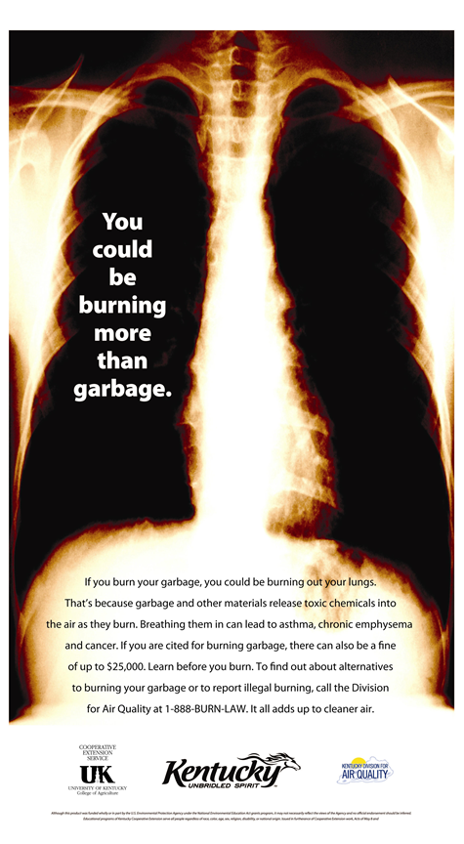
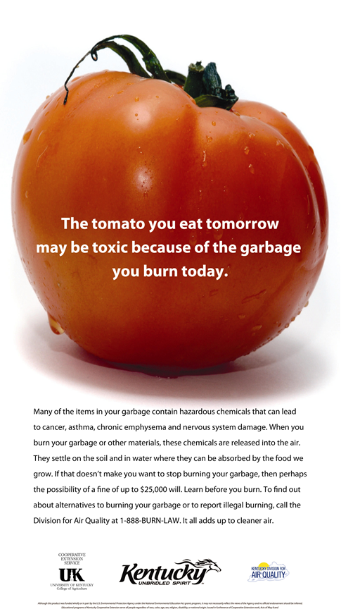
Spread the Word
Contact the Division for Air Quality for posters and brochures. Email your request to burnlaw@ky.gov .
Report illegal burning by calling 502-782-6592.
Notes:
You can help others learn before they burn by sharing Division for Air Quality posters and brochures in your community. Email your request for brochures or posters to burnlaw@ky.gov or call 502-782-6592, and we’ll put them in the mail for you. You can also use this contact information to report illegal burning in your area.

Slide 43
Kentucky Division for Air Quality Regional Offices
Ashland Karen Deskins (606) 929-5285
Bowling Green Troy Tabor (270) 746-7475
Florence Natalie Cox (502) 782-8894
Frankfort Natasha Parker (502) 564-3358
Hazard Steve Hall (606) 435-6022
London Pete Rayburn (606) 330-2080
Owensboro Lori Blair (270) 687-7304
Paducah Beth Lents (270) 898-8468
Notes:
The Division for Air Quality has eight regional offices located in the following cities: Ashland, Bowling Green, Florence, Frankfort, Hazard, London, Owensboro, and Paducah. Each of the regional offices handles air quality complaints for a cluster of Kentucky counties surrounding these cities.

Slide 44
Kentucky Division for Air Quality
300 Sower Blvd. 2nd Floor Frankfort, KY 40601 (502) 564-3999
Need more information?
burnlaw@ky.gov
502-782-6592
eec.ky.gov/air
Notes:
The Kentucky Division for Air Quality’s main offices are located at 300 Sower Boulevard, Frankfort Kentucky, 40601, and our main phone number is 502-564-3999. Need more information about open burning? Email us at burnlaw@ky.gov or call 502-782-6592. Thanks for watching this presentation.

