Slide 1
Tennessee Valley Authority
Integrated Resource Planning
Melanie Farrell, Vice President External Stakeholder & Regulatory Oversight
Notes:
If needed, the blue overlay can slide to the right to accommodate a longer title by clicking anywhere inside the shape and dragging. To avoid distorting the angle, do not stretch the shape by grabbing the handle.
This presentation provides a historical look at the development of TVA and public power in the Valley region.

Slide 2
Our Mission
To serve the people of the Tennessee Valley to make life better.
Notes:
FDR’s intention for TVA lies at the heart of TVA’s enduring mission, which is to make life better for the people of the Tennessee Valley region.
TVA was built for the people, created by federal legislation, and charged with a unique mission - to improve the quality of life in a seven-state region through the integrated management of the region's resources.

Slide 3
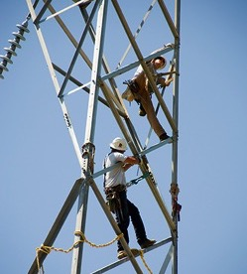
Delivering on Our Mission to You Energy | Environment | Economic Development
Provide affordable, reliable power. |  | Steward the Valley’s natural resources. |  | Partner for economic growth.
Notes:
And we deliver our mission through our work as a provider of affordable, reliable power …
As a faithful steward of the Valley's rich natural resources …
And as a staunch partner for economic growth.
We often refer to these as the three E’s of energy, the environment and economic development.
Energy — Delivering reliable, low cost, clean energy
Environment — Caring for the region's natural resources
Economic Development — Creating sustainable economic growth.

Slide 4
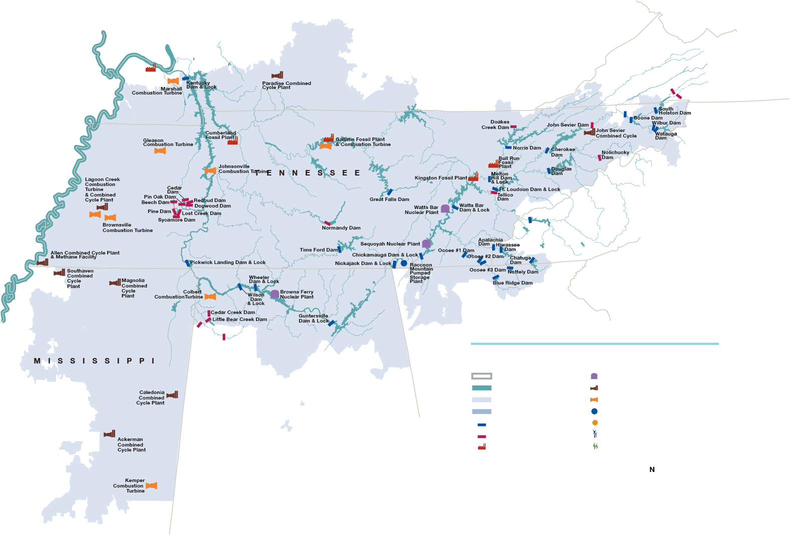
The TVA Power System
4
Notes:
Since power pays the freight for everything we do, let's talk more about the TVA power system.
Our power system includes about 245 nuclear, coal, natural gas and hydro generating units along with 14 solar energy sites and one wind energy site. TVA’s transmission network consists of more than 16,000 miles of high-voltage lines and hundreds of substations, switchyards and related equipment.
• 3 Nuclear Sites (7 Units) • 5 Coal-Fired Sites (25 Units) • 29 Hydroelectric Sites (109 Units) • 1 Pumped-Storage Site (4 Units) • 9 Combustion Turbine Gas Sites (86 Units) • 8 Combined Cycle Gas Sites (14 Units) • 1 Co-Generation Unit • 13 Solar Energy Sites
In 2022, nuclear was TVA's largest source of generation. Natural gas was our second largest source, followed by Coal and hydro.
Adding 10,000 MW of solar energy by 2035 as we are Building the Energy System of the Future.

Slide 5
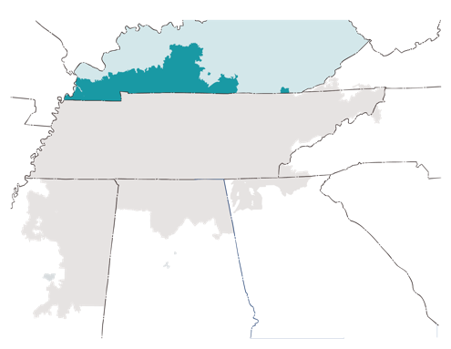
TVA in Kentucky
Provided
3 Billion Kilowatt-Hours of Electricity
to 215,800 households through the LPCs
TVA Covers 7,787
square miles of Kentucky
& 1,043 square miles of
watershed management.
9%
of total
service area
2,000 Miles of Shoreline
60,000 Acres of Public Land
Economic Impact FY19-23
3,000 new jobs created and 15,650 retained
Tax Equivalent Payments
$29.65 Million Paid in Lieu of Taxes

Slide 6
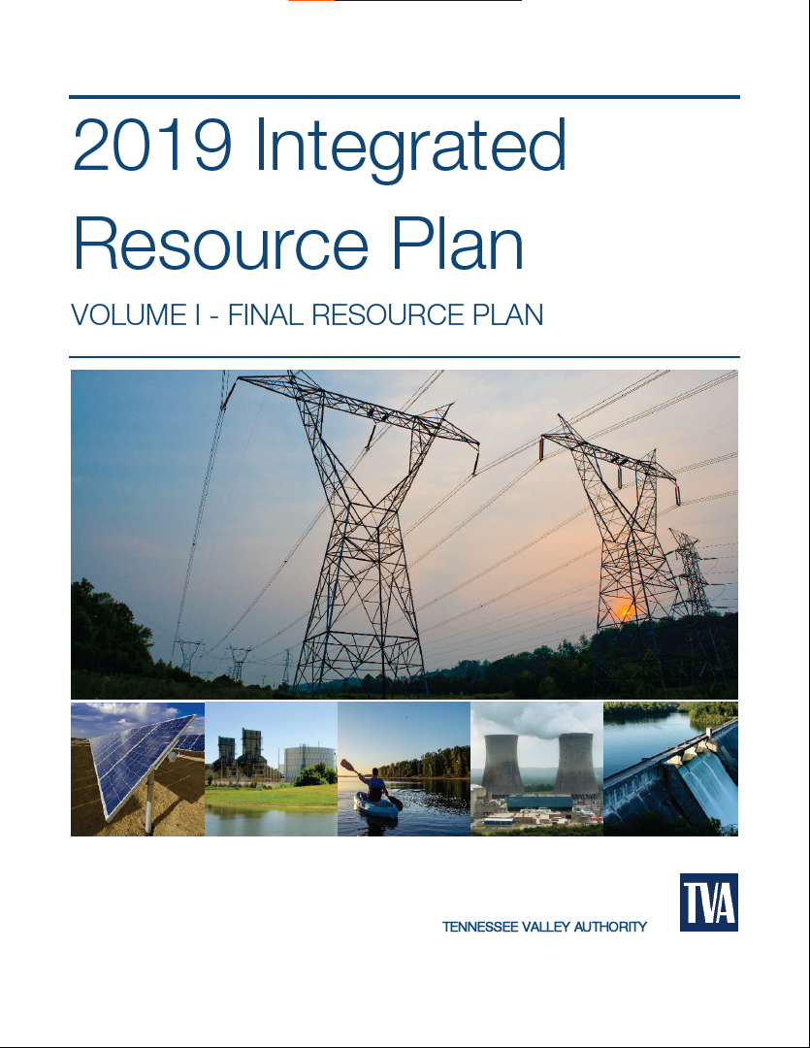
TVA’s Integrated Resource Plan
The IRP is a study of how TVA could meet customer demand for electricity between now and 2050 across a variety of future scenarios.
A programmatic Environmental Impact Statement (EIS) accompanies the IRP to analyze the impacts to the Valley.
An updated IRP is needed in order to:
Proactively establish a strong planning foundation for the 2030s and beyond
Inform TVA’s next long-range financial plan
The IRP provides strategic direction on how TVA will continue to provide low-cost, reliable, and increasingly cleaner electricity to the 10 million residents of the Tennessee Valley.

