Slide 1
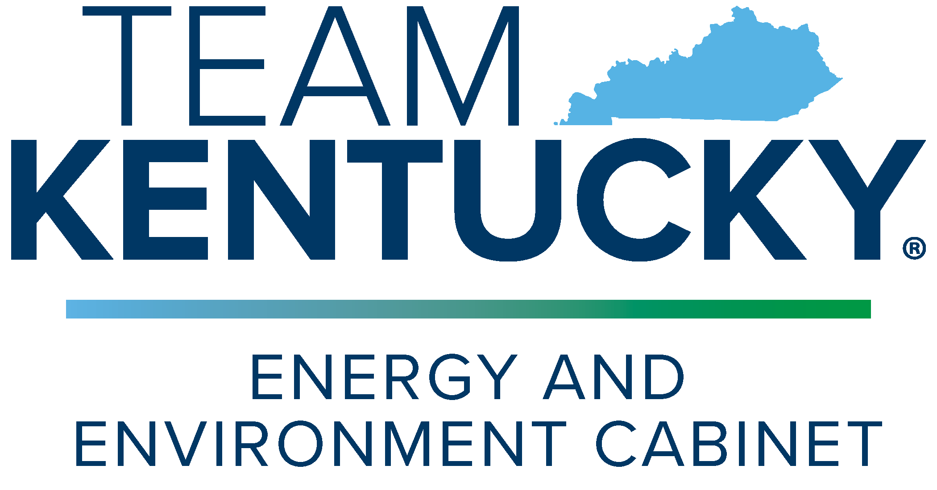
2023 Governor’s Conference on Energy & the Environment John Webb, Assistant Director, Division of Water
October 17, 2023

Slide 2
State Revolving Funds (SRF)
Drinking Water & Clean Water
Low Interest Loans for Infrastructure
$$$
EPA State

Slide 3
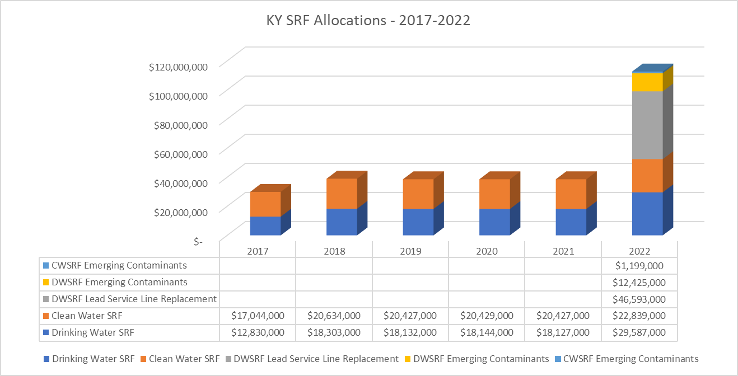
Bipartisan Infrastructure Law

Slide 4
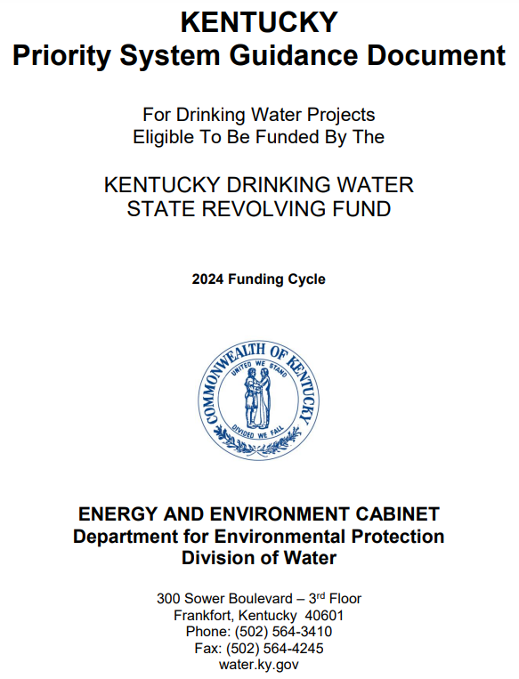
State Infrastructure Loan Programs
Drinking Water SRF Programs
Base Capitalization
Base Supplemental
Lead Service Line Replacement
Emerging Contaminants (PFAS)
Clean Water SRF Programs
Base Capitalization
Base Supplemental
Emerging Contaminants (PFAS)
Notes:
Health advisories provide information on contaminants that can cause human health effects and are known or anticipated to occur in drinking water.
EPA's health advisories are non-enforceable and non-regulatory and provide technical information to states agencies and other public health officials on health effects
Unregulated Contaminant Monitoring Rule 3 (UCMR 3) included PFOA and PFOS from 2013-2015; UCMR 5 to include an additional 29 PFAS chemicals from 2023-2025.

Slide 5
State Infrastructure Grant Programs
Small, Underserved, & Disadvantaged Communities (SUDC) Grant
Designed to help public water systems meet and comply with Safe Drinking Water act requirements
Emerging Contaminants in Small or Disadvantaged
Communities (EC-SDC) Grant
Focus on PFAS in Public Drinking Water
Sewer Overflow & Stormwater Reuse Municipal Grants (OSG)
Planning, design, and construction of CSO, SSO, and Stormwater management projects
Notes:
Health advisories provide information on contaminants that can cause human health effects and are known or anticipated to occur in drinking water.
EPA's health advisories are non-enforceable and non-regulatory and provide technical information to states agencies and other public health officials on health effects
Unregulated Contaminant Monitoring Rule 3 (UCMR 3) included PFOA and PFOS from 2013-2015; UCMR 5 to include an additional 29 PFAS chemicals from 2023-2025.

Slide 6
Infrastructure Funding Considerations
Build America, Buy America Act
Requires all iron, steel, manufactured products, and construction materials are US-produced
Davis-Bacon Act
Requires Prevailing Wage Rate for Federally funded or assisted projects – update effective 11/23/2023
Environmental Justice
Projects should include elements of consideration for fair treatment and meaningful involvement of all people
Climate Change
Projects should include elements considering climate resilient and sustainable solutions
Notes:
Health advisories provide information on contaminants that can cause human health effects and are known or anticipated to occur in drinking water.
EPA's health advisories are non-enforceable and non-regulatory and provide technical information to states agencies and other public health officials on health effects
Unregulated Contaminant Monitoring Rule 3 (UCMR 3) included PFOA and PFOS from 2013-2015; UCMR 5 to include an additional 29 PFAS chemicals from 2023-2025.

