Slide 2
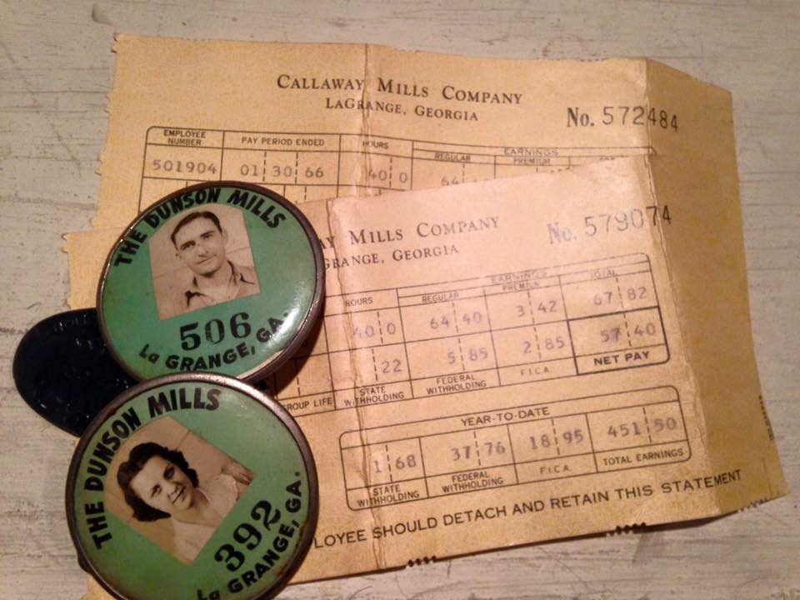

Slide 3
What would our energy systems look like if they embodied the commandment to “love your neighbor as yourself?”

Slide 4
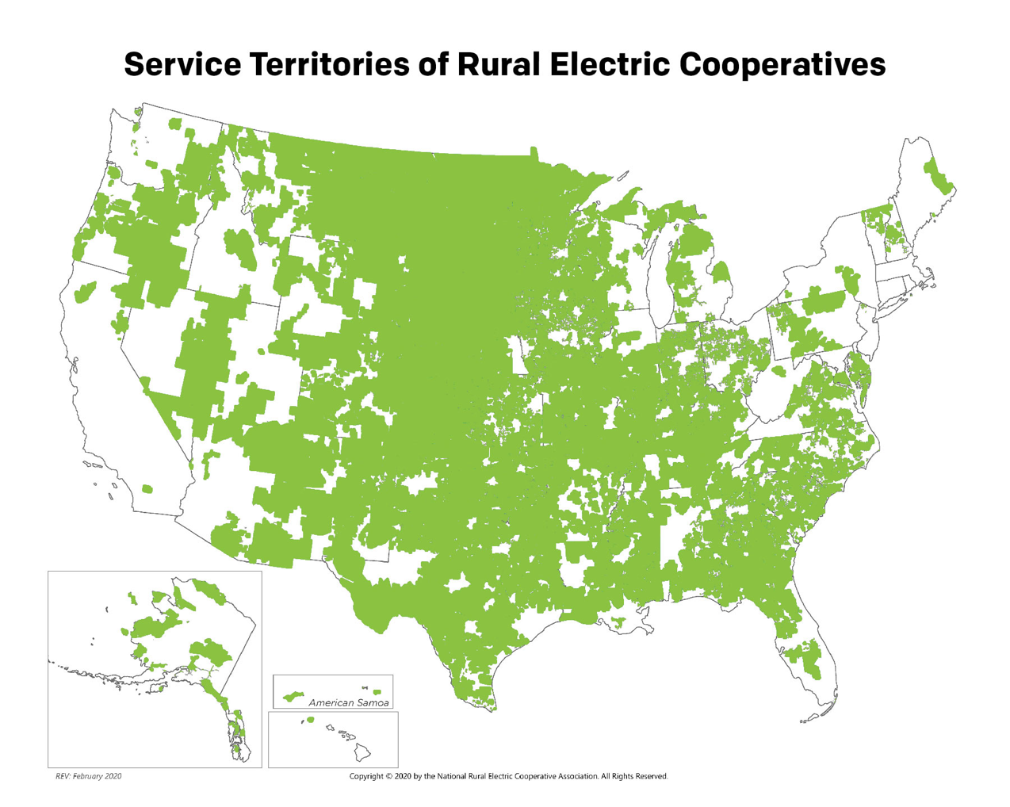

Slide 5
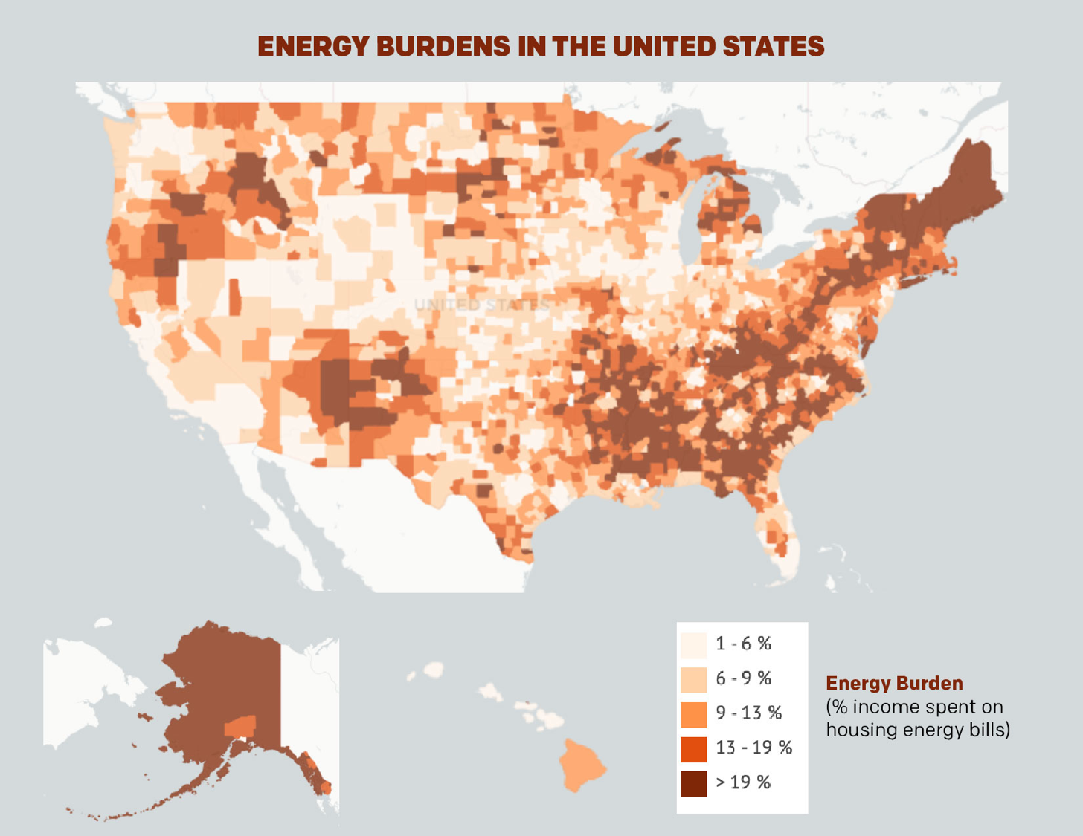

Slide 6
PUT THE PUBLIC BACK IN PUBLIC UTILITIES

Slide 7
ALIGN VALUE WITH VALUES

Slide 8
REPAIR, RESTORE, and DO JUSTICE

Slide 9
COUNT YOUR BLESSINGS and WORK FROM ABUNDANCE

Slide 10
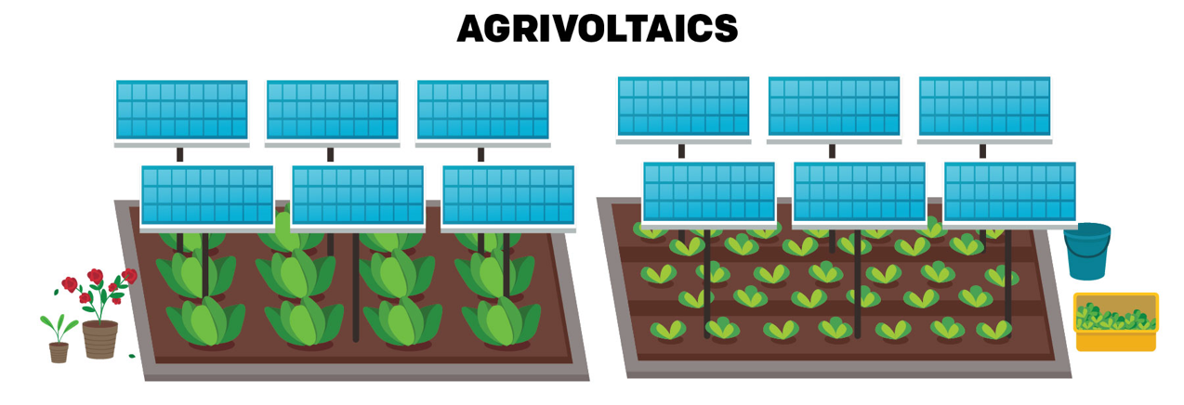

Slide 11
SHARE and SERVE

Slide 12
COURAGEOUS INNOVATION

Slide 13
PARTNERSHIP and CONNECTION

Slide 14
LET’S
GET
TO
WORK

Slide 15
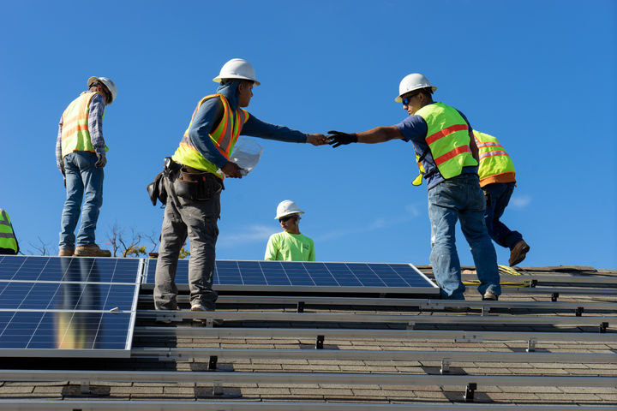
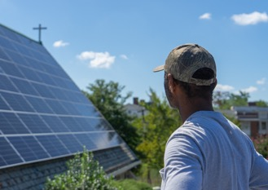
SOLAR
FOR ALL
RESILIENCE
CENTERS
ENERGY EFFICIENCY
CUSTOMER SUPPORT
R&D
From project origination through project finance, construction, and delivery – we develop community solar projects and solar projects that serve local community-based organizations.
We develop community-centric resilience centers that incorporate solar, energy storage, and microgrids to provide back up power and essential services to vulnerable and under-resources communities.
We deliver energy efficiency as a reparative investment in housing equity, layering in public and partner sources of investment to make critical home repairs to improve overall housing, health, and quality of life.
We deliver full lifecycle customer enrollment, and support – all optimized to meet the unique needs of LMI households. We deliver millions of dollars per year in direct utility bill savings.
We use data science combined with people-centric research methods including Human Centered Design to keep people and communities at the center of our programs and to drive systems change.

Slide 16
ruralrenaissance.org

