Slide 1
Advanced Nuclear in Coal Communities of Wyoming
PacifiCorp

Slide 2
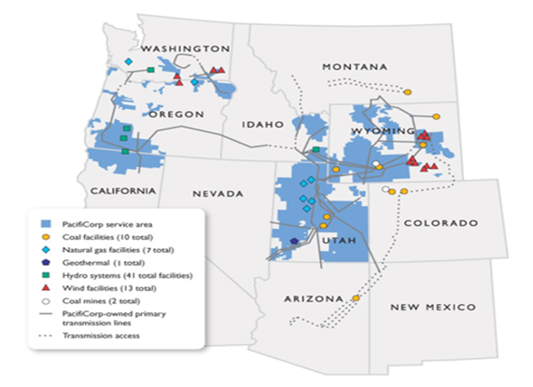
PacifiCorp Overview
Six-state service territory
Rocky Mountain Power
  Serves Utah, Idaho and Wyoming
Pacific Power
  Serves Oregon, Washington and California
4,800 employees
2 million electricity customers
141,400 square miles of service territory
17,000 transmission line miles
11,830 MW owned power capacity
  See map for power plant and transmission locations
  Note: Four coal power plants in Wyoming

Slide 3
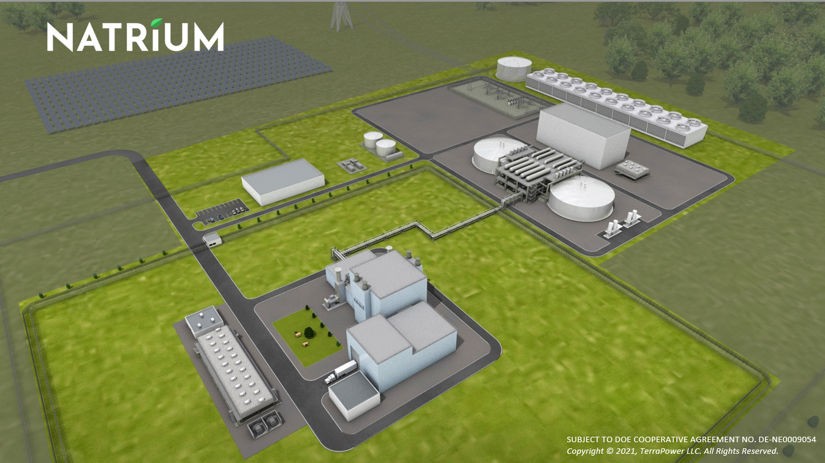
Natrium Nuclear Plant - TerraPower Project

Slide 4
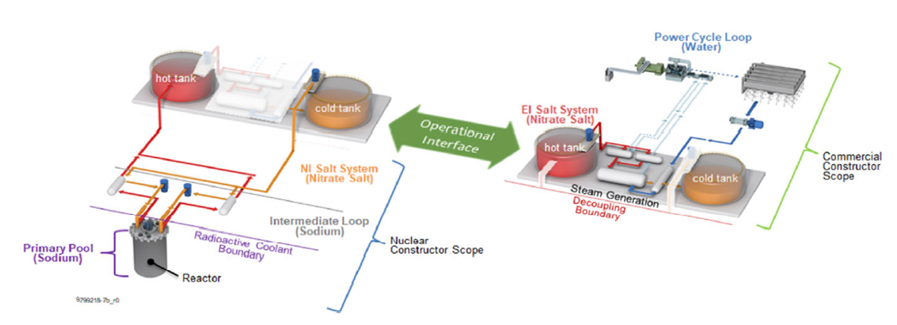
Natrium Project Advantages
Natrium offers many design advantages
  The system features a 345 MWe reactor and can be boosted to 500 MWe for 5.5 hours through its innovative thermal storage system (molten salt tanks), maximizing market opportunities, specifically renewables
  Design will use High-Assay Low-Enriched Uranium (HALEU) fuel providing lower fuel costs with higher energy content maximizing burn-up and reducing wasted fuel
  Sodium fast reactors are inherently safer than light water designs due to higher boiling temperatures and lower operating pressures, which reduce risk and emergency plan requirements including the boundary (limited to site boundary)
  The Nuclear Island (NI) vs. Energy Island (EI) separation (shown below) reduces Nuclear Regulatory Commission oversight, which in-turn significantly reduces capital and on-going O&M costs (NI footprint expected to fit on 1-acre)

Slide 5
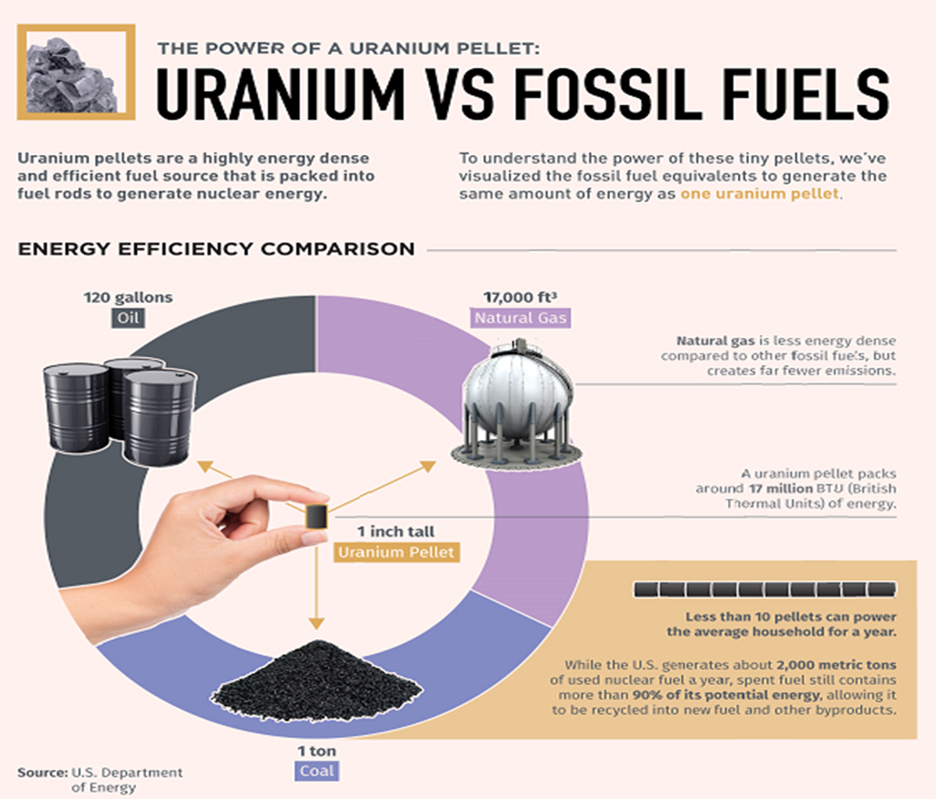
Nuclear Fuel Comparison (HALEU 5x)

Slide 6

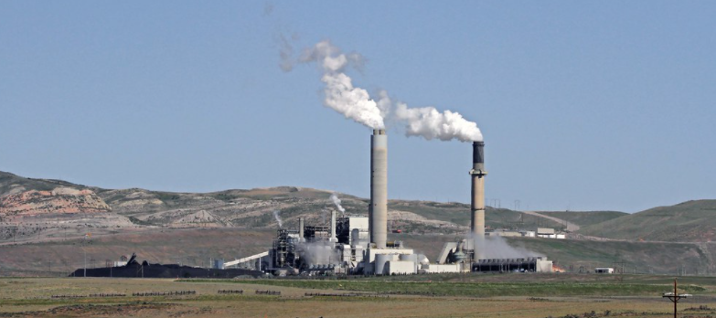
Natrium Project (Coal Plant Advantages)
Re-purposed coal plant opportunities with Natrium
  Uses coal plant workforce to benefit the plant
  and community
  Transmission and distribution lines (including current easements) infrastructure already in place
  Water rights potential to transfer from coal plant. For the Kemmerer, WY project, the water usage for Natrium (6500 acre-foot/year) is forecast to be 2/3 of current coal plant requirements
  Multiple environmental permits provide advantages to meeting Nuclear Regulatory Commission siting requirements (data). This includes items like meteorological data, site access, construction workforce support, socioeconomic inputs, etc.
  Community, state, and federal support

Slide 7
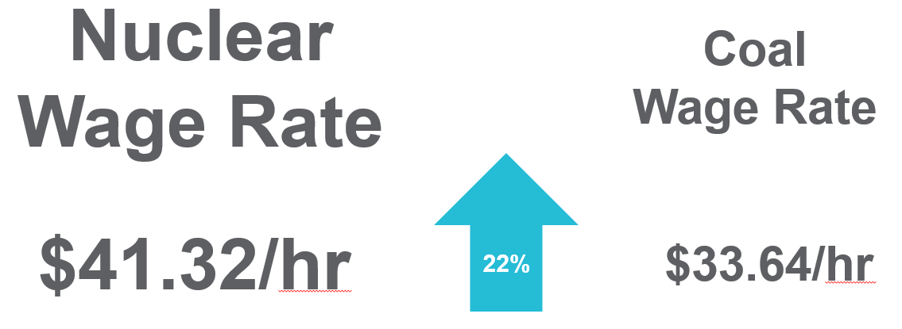
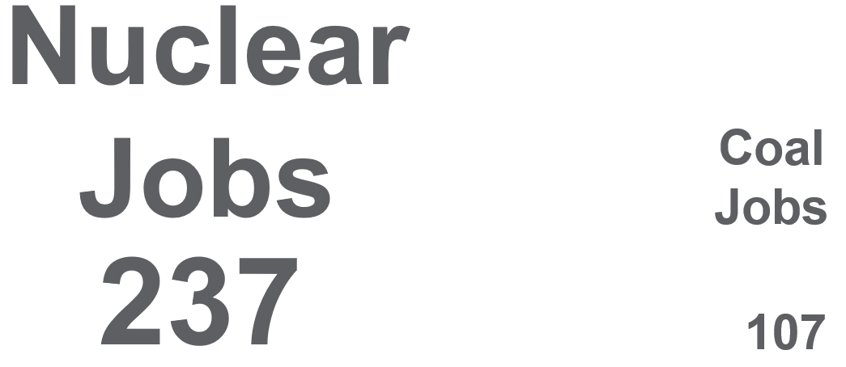
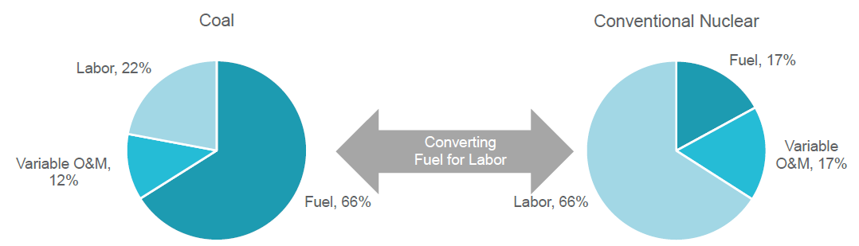
Coal to Nuclear Benefits
Powerful Stats (Scott Madden Consultants)

Slide 8
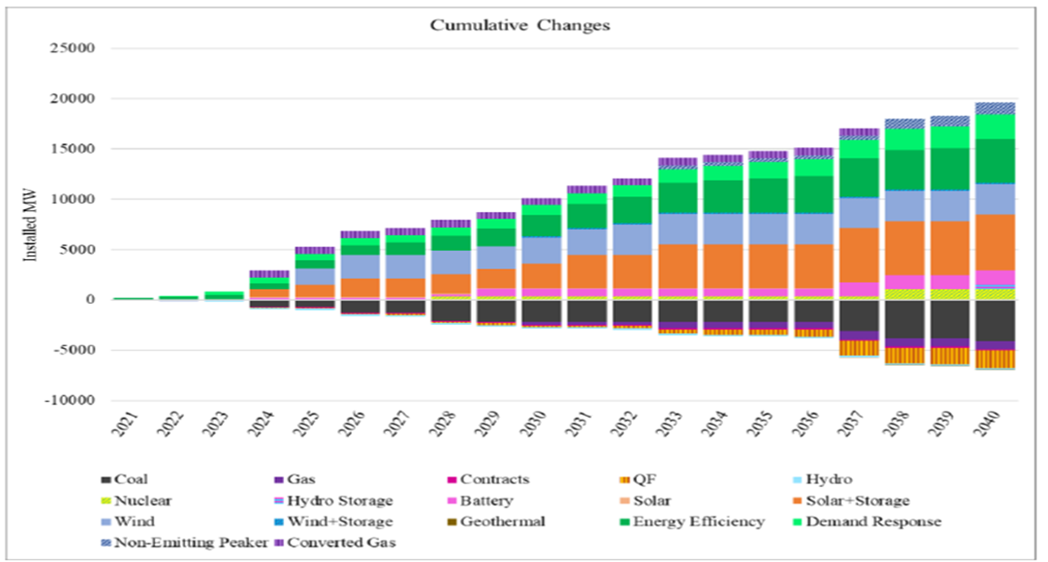
Changing Portfolio
PacifiCorp 2021 Integrated Resources Plan (IRP)

Slide 9
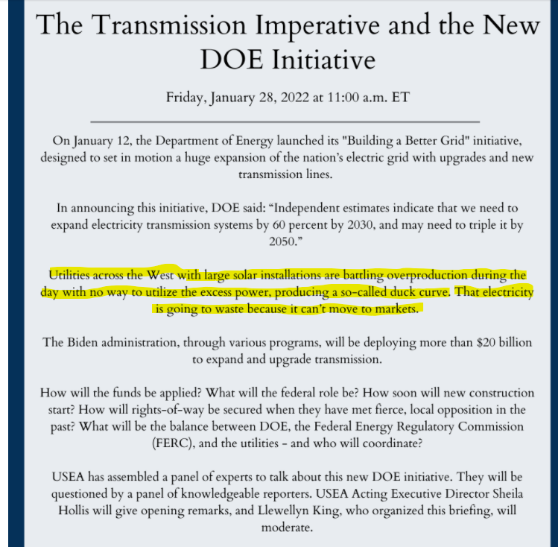
Renewable Overproduction??
United States Energy Association

Slide 10
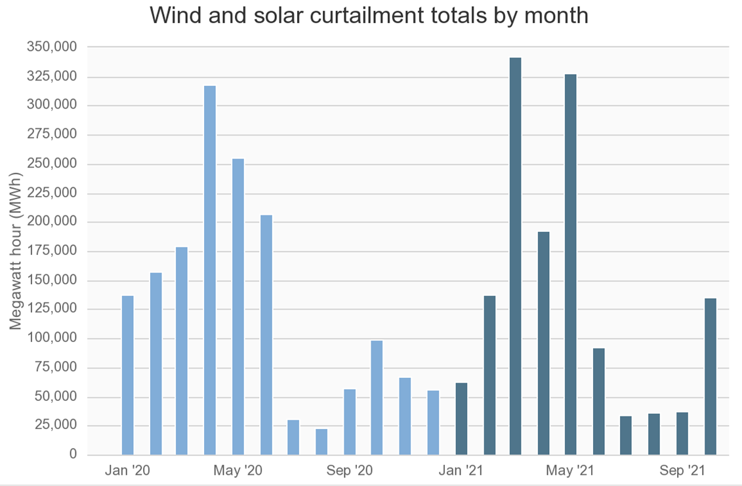
Market Opportunities
CAISO Lost Renewable Opportunities

Slide 11
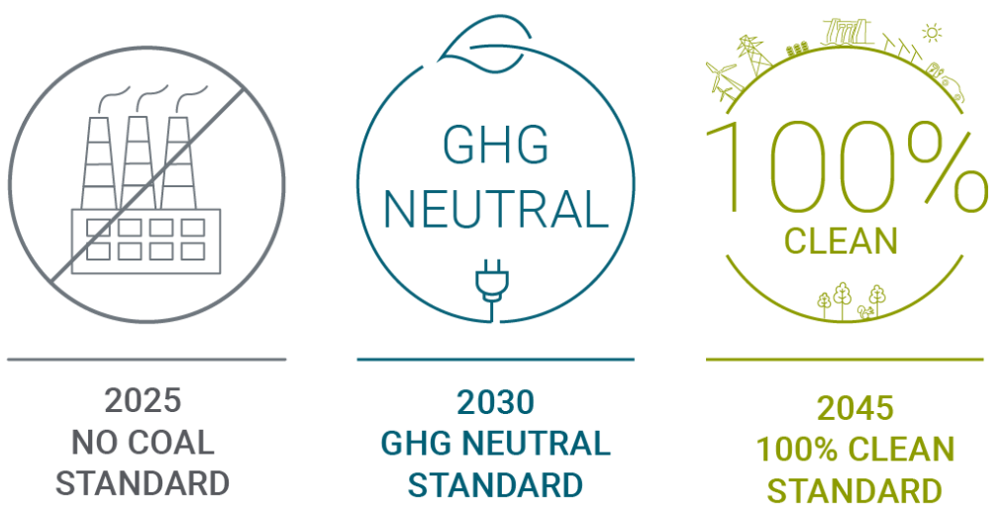
Policy Impacts to PacifiCorp Portfolio…
Clean Energy Transformation Act (CETA):
CETA applies to all electric utilities serving retail customers in Washington and sets specific milestones to reach the required 100% clean electricity supply.
The law requires utilities to phase out coal-fired electricity from their state portfolios by 2025. By 2030, their portfolios must be greenhouse gas emissions neutral, which means they may use limited amounts of electricity generated from natural gas if it is offset by other actions. By 2045, utilities must supply Washington customers with electricity that is 100% renewable or non-emitting, with no provision for offsets

Slide 12

Policy Impacts to PacifiCorp Portfolio…
EPA Proposes “Good Neighbor” Plan to Cut Smog Across Much of the United States:
WASHINGTON (March 11, 2022) – Following clear Clean Air Act requirements and meeting a court deadline, EPA is proposing a federal plan that would cut pollution from power plants and industrial sources that significantly contribute to unhealthy levels of ground-level ozone, or smog, for millions of Americans who live downwind. Relying on a longstanding regulatory framework and commonly used, affordable pollution controls, this action would help states fully resolve their Clean Air Act “good neighbor” obligations for the 2015 Ozone National Ambient Air Quality Standards (NAAQS), enhancing public health and environmental protections regionally and for local communities.

