Slide 1
EPRI Reactor Technology Assessment Guide
For GAIN-State of Kentucky Workshop
Chad Boyer
Advanced Nuclear Technology Program
June 29, 2022

Slide 2
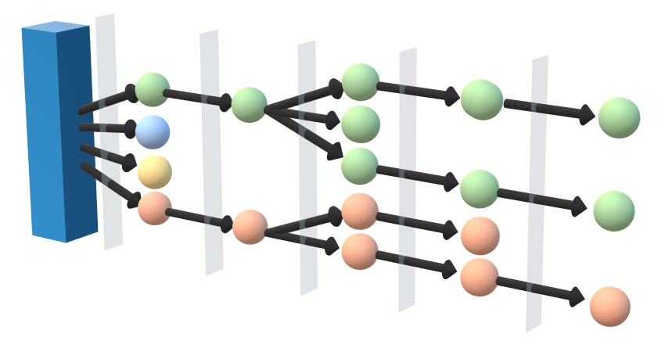
Agenda
Overview
What is the Reactor Technology Assessment Guide?
Key Definitions
Primary Process Steps
Details
Analytical Processes
Risk Management
Mission and Business Objectives
Assessment Criteria

Slide 3
Nonprofit
Chartered to serve the public benefit, with guidance from an independent advisory council.
Thought Leadership
Systematically and imaginatively looking ahead to identify issues, technology gaps, and broader needs that can be addressed by the electricity sector.
KEY ASPECTS
Independent
Objective, scientific research leading to progress in reliability, efficiency, affordability, health, safety, and the environment.
Scientific and Industry Expertise
Provide expertise in technical disciplines that bring answers and solutions to electricity generation, transmission, distribution, and end use.
Collaborative Value
Bring together our members and diverse scientific and technical sectors to shape and drive research and development in the electricity sector.

Slide 4
What is the Reactor Technology Assessment Guide?
Provides an owner-operator, or potential owner-operator, with a straightforward decision-making framework including an uncomplicated and repeatable process that helps the organization:
Define and understand their business objectives
Evaluate general technologies and specific designs against those objectives
Develop a defendable justification for a primary selection and alternatives
Understand the inherent risk of technology and design selection and provide tools to help manage that risk
Intended to cover all sizes and types of reactors, be regulatory neutral, and of value to all EPRI’s global stakeholders

Slide 5
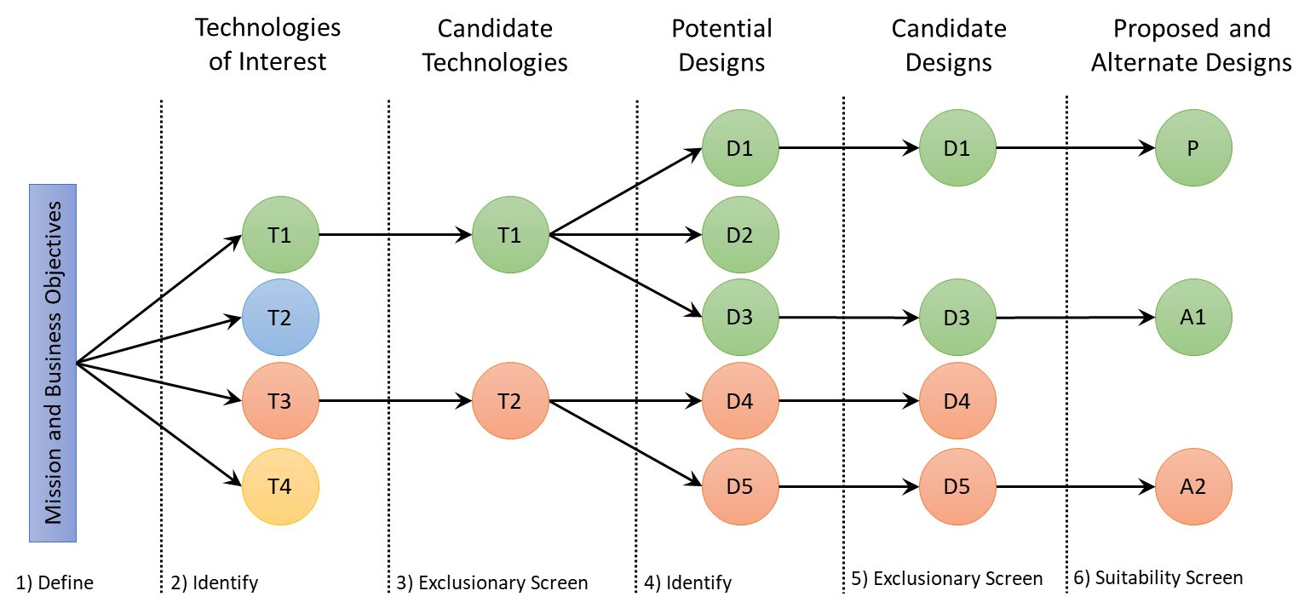
Primary Process Steps

Slide 6
Analytical Processes
Mission and Business Objective—Guidance for the owner-operator on how to develop their mission and business objectives.
Assessment Criteria—represent, facility design, safety, siting, operations, and maintenance requirements.
Criteria/Importance Weighting—Development of weighting factors that reflect the relative importance of individual criteria.
Criterion Scoring—Development of utility functions that quantify the relative suitability of a design with respect to a single criterion.
Evaluation of proposed and alternate designs requires all four processes

Slide 7
Risk Management
Selection Risk – the risk inherent in the process of selecting the ‘best’ technology and design
Rigorous Use of this Process
Well-developed Mission and Business Objectives
Proper Weighting Factors
Pre-Deployment Risk – the risk that a chosen technology or design will be available, licensable, technically capable, and have a supporting supply chain, for deployment on schedule
Avoidance Factors
Suitability Scoring
Deployment Risk – the risk of the actual plant deployment (i.e., construction and operations)
Cost and commercial related factors (financial risk model)

Slide 8
Mission and Business Objectives
Technology and Design Assessment Envelope – Define the overall bounds (i.e., Systems, Structures, and Components, SSCs) for which the assessment process will be performed.
End-Product – Define the desired end-product, or mix of end products, desired for the project.
Required Output – Identify and describe required product output of the plant, based on its mission (ex: MWe, MWt, kg of hydrogen/day)
Target Location of Plant (or Plants) – Identify the target location of the future facility, or facilities.
Service Requirements – items such as the need and priorities for flexible or firm generation, reliability, weather resiliency, and black start capabilities.
Operating Life – the minimum, as well as the desired, operating life of the plant.
Need Dates and Time Frames – the need date (if there is one), or perhaps more general time frames, for not only the in-service date, but also preceding milestones.
Target Budgets – Costs the owner-operator is willing to take on for the project:
Exploration, Engagement with Potential Suppliers, Facility Licensing, Construction, Operations
Owner-Operator’s Long-Term Goals – for example, a single plant, building out a fleet, supporting demonstration, or other goals
Development of the mission and business objectives is a foundational activity

Slide 9
Assessment Criteria Categories
3.1 Basic Operations
Criteria used early in the process to primarily differentiate technology and designs.
3.2 Site Selection and Characterization
How to use site characterization as the criteria when a site has been selected.
3.3 Maturity and Remaining Effort
Criteria to identify the technology readiness level and amount of time and effort required to achieve commercialization.
3.4 Technology Capabilities
The technology specific criteria related to the SSCs of the design.
3.5 Cost and Commercial Related Factors
Financially related criteria.

Slide 10
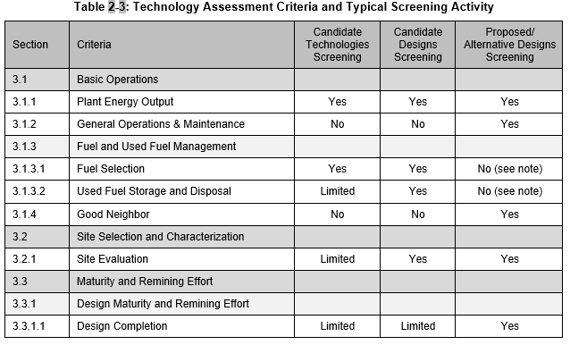
Assessment Criteria – Typical Screening Activity (example)
5 Categories
30 Criteria
Each with several sub-criteria
Each major criteria consists of a set of sub-criteria that is intended to be evaluated in aggregate

Slide 11
Questions?

Slide 12
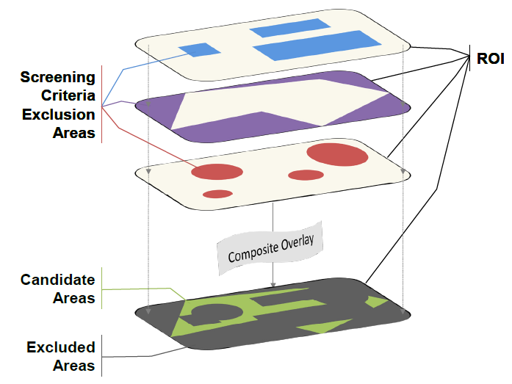
What is the EPRI Siting Guide?
Nuclear siting in 5 basic steps
Identify the region of interest
Screen to candidate areas
Identify potential sites
Screen to candidate sites
Identify proposed and alternative sites
Created as part of the Early Site Permit (ESP) Demonstration Program in early 1990s to provide a generalized, regulatory neutral site selection process for new nuclear plants
Current version* (2015) incorporates experience and lessons learned from first “nuclear renaissance” and emergence of SMRs
Provides a framework that supports development of an individualized site selection process that can withstand regulatory review
Desired outcome is a site selection process that:
satisfies business objectives
meets regulatory requirements
adequately reflects consideration of alternative sites
Region of Interest (ROI) Screening Process
*2015 EPRI Siting Guide – Report no. 3002005435 available at: https://www.epri.com/#/pages/product/000000003002005435/?lang=en-US

Slide 13
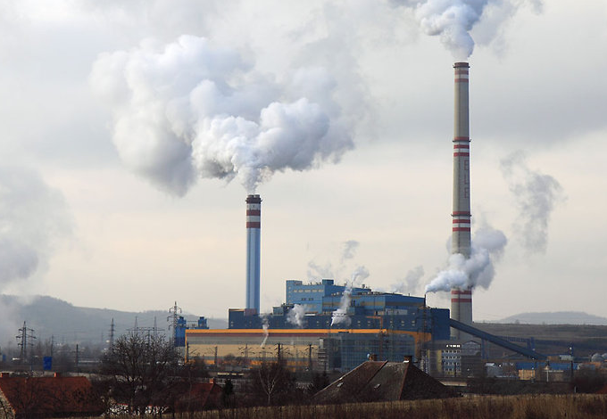
Can the Siting Guide Be Used for Site Reuse?
Current version addresses brownfields and reuse of fossil plant sites for new nuclear – but to a limited degree
Revision expands and clarifies site reuse considerations with respect to:
level of potential site industrialization
degree of site characterization
plant mission and business objectives
Levels of Industrialization
Greenfield | Undeveloped
 | Restored
Brownfield | Decommissioned
 | Industrial
 | Non-Nuclear Generation
 | Contiguous to Nuclear Generation
 | Existing Nuclear Generation
 | Exiting Nuclear Non-Generation
Mission and Business Objectives
Electricity Generation | Firm
 | Flexible
Process Heat | District Heating
 | Industrial Processes
Cogeneration | Electricity + Heat
Product Generation | Hydrogen
 | Desalination
Isotope Production | Commercial Isotopes
Site Characterization
None
Limited
Characterized
Existing

Slide 15
Key Definitions
Technology – Both the general technology (ex: pressurized water reactor, PWR, gas cooled reactor, GCR), or a vendor specific design (Company X’s Model N-100). This is important because the process defined herein uses both instances, to settle on a general technology in the initial stages, and then refine selection to a specific procurable design.
Design – A procurable (or at least advertised) vendor specific reactor developed and marketed by an Original Equipment Manufacturer.
Notes:
Technology
Design
Exclusion factors
Avoidance factors, may have to be relaxed
Suitability Factors
Proposed/ Alternative Designs Screening—ENW is at and can use

Slide 16
Key Definitions
Exclusionary Factors – Criteria that can be evaluated based on requirements, and may be identified as minimums, maximums, needs, or other qualifying language that indicates compliance is mandatory.
Avoidance Factors – Criteria that can be evaluated based on goals, and may be identified as wants, preferences, aims, or other qualifying language that indicates compliance is not mandatory, but so highly desired as to use an exclusionary screening to provide a binary go/no-go decision on a technology or design.
Suitability Factors – Criteria examined based on suitability factors are done to find the best result, not necessarily to exclude any design. Suitability factors are evaluated using criterion weighting and scoring to obtain quantitative results from a qualitative process.
Proposed/ Alternative Designs Screening– Criteria examined to find the best result, not necessarily to exclude any design. Suitability factors are evaluated using criterion weighting and scoring to obtain quantitative results from a qualitative process.
Notes:
Technology
Design
Exclusion factors
Avoidance factors, may have to be relaxed
Suitability Factors
Proposed/ Alternative Designs Screening—ENW is at and can use

Slide 17
Risk Management
Selection Risk – the risk inherent in the process of selecting the ‘best’ technology and design
Rigorous Use of this Process
Well-developed Mission and Business Objectives
Proper Weighting Factors
Pre-Deployment Risk – the risk that a chosen technology or design will be available, licensable, technically capable, and have a supporting supply chain, for deployment on schedule
Avoidance Factors
Suitability Scoring
Deployment Risk – the risk of the actual plant deployment (i.e., construction and operations)
Cost and commercial related factors (financial risk model)

Slide 18
Maturity and Remaining Effort vs. Technology Capabilities
Maturity and Remaining Effort
Maturity describes the current level of completeness, qualification, or suitability for adequately meeting requirements or goals (can sometimes be referred to as Technology Readiness Level, TRL)
Remaining effort describes the time and activities needed to meet a desired maturity level
When evaluating Maturity and Remaining Effort assume that the technology will be adequate for its purpose when it is available
Technology Capabilities
The specific features of a nuclear plant and its design that provide for safety, reliability, flexibility, resiliency, and efficiency, for not only operations, but also construction and ongoing maintenance (i.e., what the plant is capable of)
For lower maturity designs, it is important that the evaluation of technology capabilities assume that the technology will meet the designer’s intention upon complete development

