Slide 1
State Level Trends
June 29, 2022
Christine King, Director GAIN
Kentucky Office of Energy Policy Workshop
Frankfurt, KY
Notes:
Christine sends her regrets, but she is on her way to Kentucky to help the office of energy policy hold a workshop with the utilities and state representatives focused on a feasibility study for advanced nuclear. This workshop is the culmination of 6 months of working directly with the state. Also while in Kentucky, she will be kicking off a Coal to Nuclear case study with the EW Brown station (more details on that later in this talk)

Slide 2
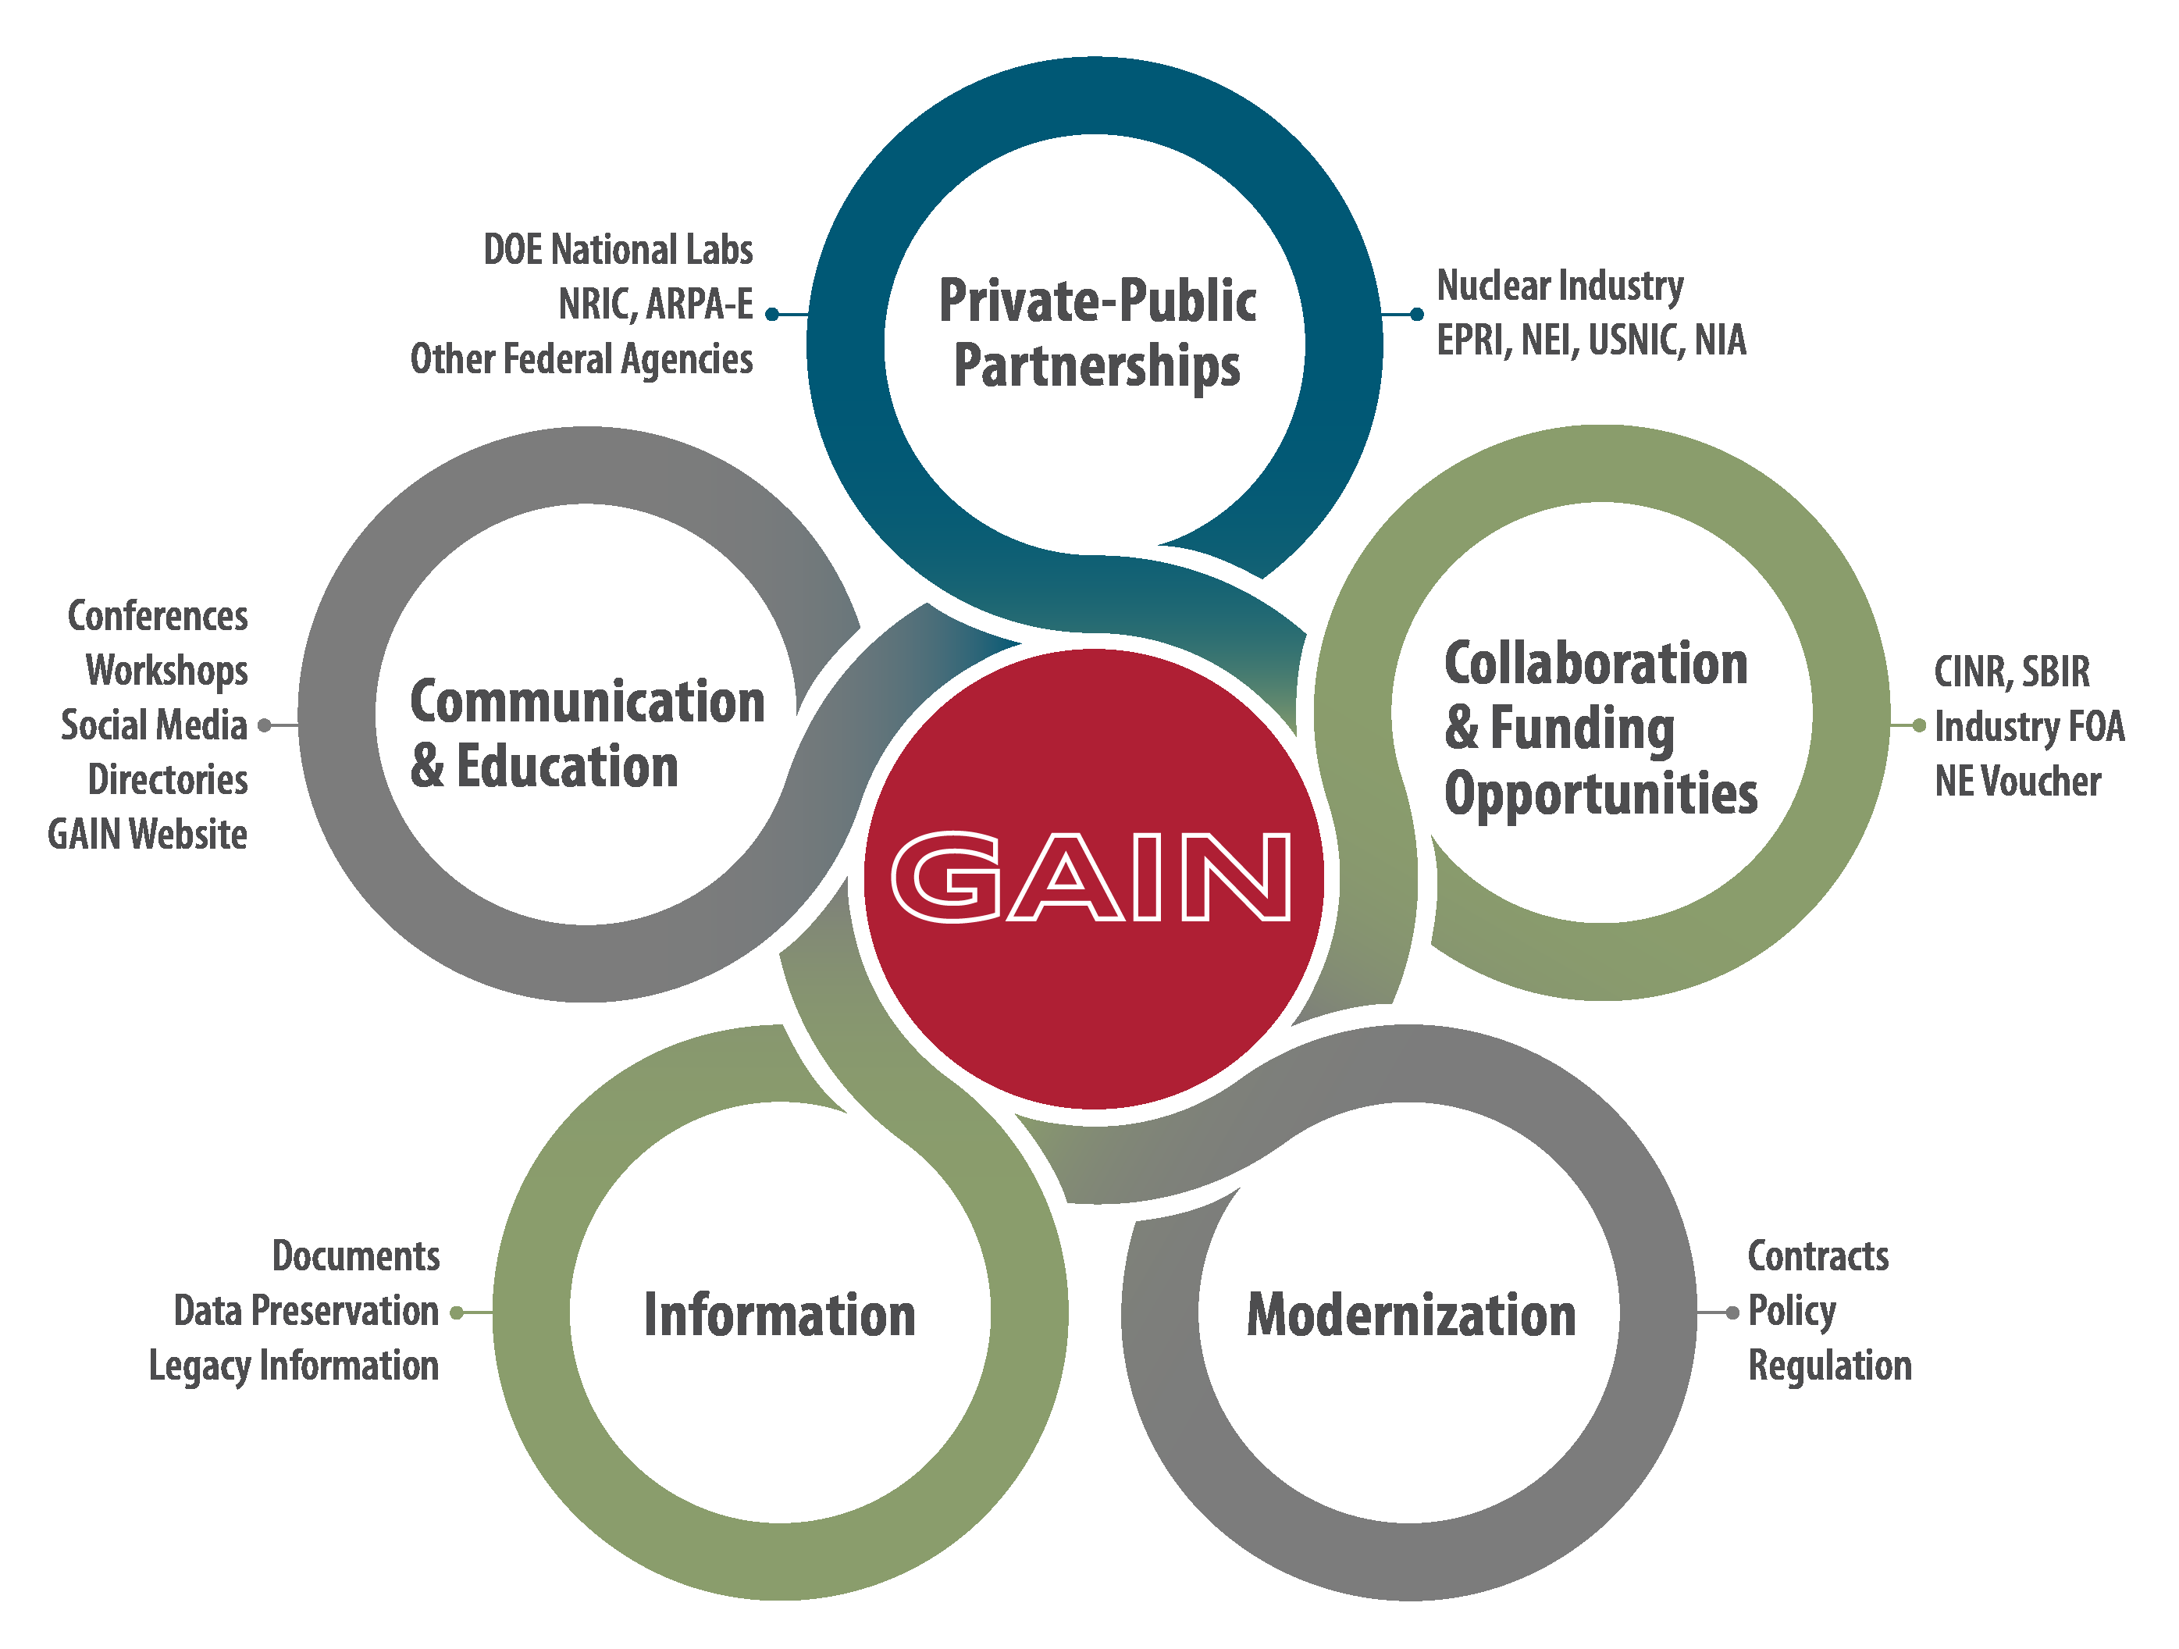
GAIN Mission-Driven Goals GAIN: small enough to be nimble, big enough to be relevant
Provide nuclear industry entities access to financial support opportunities and national laboratory capabilities (facilities, expertise, and tools) to accelerate commercialization of innovations through research, development, demonstration, and deployment.
Work with industry to identify gaps, gather needs, and develop viable paths forward to inform DOE research programs and remove barriers for industry.
Complete the key portions of a modernized risk-informed regulatory framework enabling deployment of advanced nuclear energy technologies.
Facilitate the advanced nuclear industry’s access to information to support their technology commercialization efforts.
Contribute tailored, factual information to key stakeholders to motivate the integration of clean nuclear energy for long-term success.
Notes:
Over the past couple of years, with the implementation of NRIC and ARDP, the world of new nuclear is changing. At our core, GAIN wants to help connect private entities to the resources of the national labs. As we consider commercializing a new fleet, we need to engage with stakeholders that are not in our industry. So…
Bringing Industry Into DOE/NLs
Vouchers
Workshops/Webinars
Legacy Data
Contract Modernization
Connection to other federal agencies
National Lab Gateway
Taking Nuclear to Non-Nuclear Audience
Tools (Energy Calculator)
Stakeholder Outreach
Needs Based Research/Trends
Provide Nuclear Overviews
Overview of Private-Public Partnership
Storyboard for Nuclear in Clean Energy

Slide 3
2022 Activities
State Level Outreach
Policymakers, NGOs, Utilities, Regulators, Industrials, Commissioners
Introduce Advanced Nuclear through direct conversation or testimony
Help connect states to financial or technical resources across DOE complex
Looking at state level regs
vouchers
Advanced Nuclear Industry Milestones
gain.inl.gov
Notes:
This is a high level overview on the items we are focused on this year.
Today I will not go into detail on legacy data or our Milestones page.
Today – we will focus on vouchers, state level legislation related to feasibilty studies. and coal to nuclear.

Slide 4
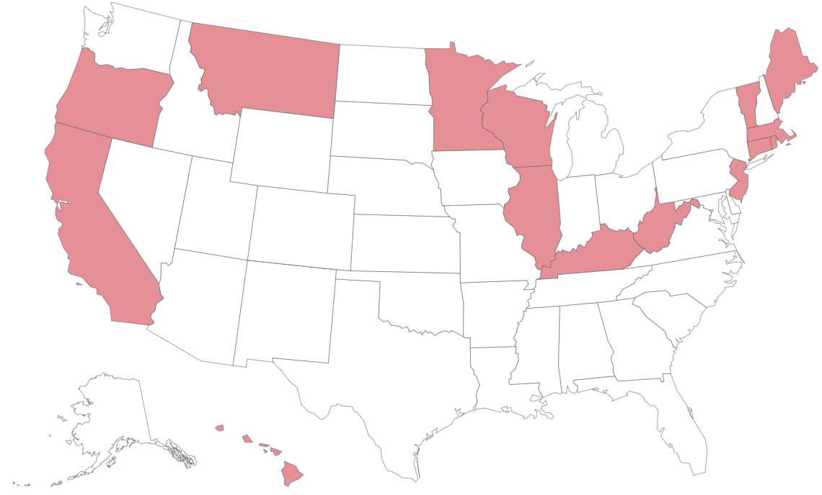
Nuclear Restrictions and Moratoria as of 2016
Notes:
Speaker Notes:
This slide highlights the states with a complete or partial ban of the construction of nuclear facilities in the state as of 2016.
Background Information:
Complete ban on the construction of new nuclear (MN and parts of NY).
Ban until there is an identification of a demonstrable tech or means for high level waste disposal or reprocessing (California, Connecticut, Illinois, Main, Oregon)
Ban until there is an approval by state environmental protection commissioner (New Jersey)
Ban absent legislative approval (Hawaii, Illinois, Massachusetts, Rhode Island, and Vermont)
Ban absent voter approval (Main, Massachusetts, and Oregon)

Slide 5
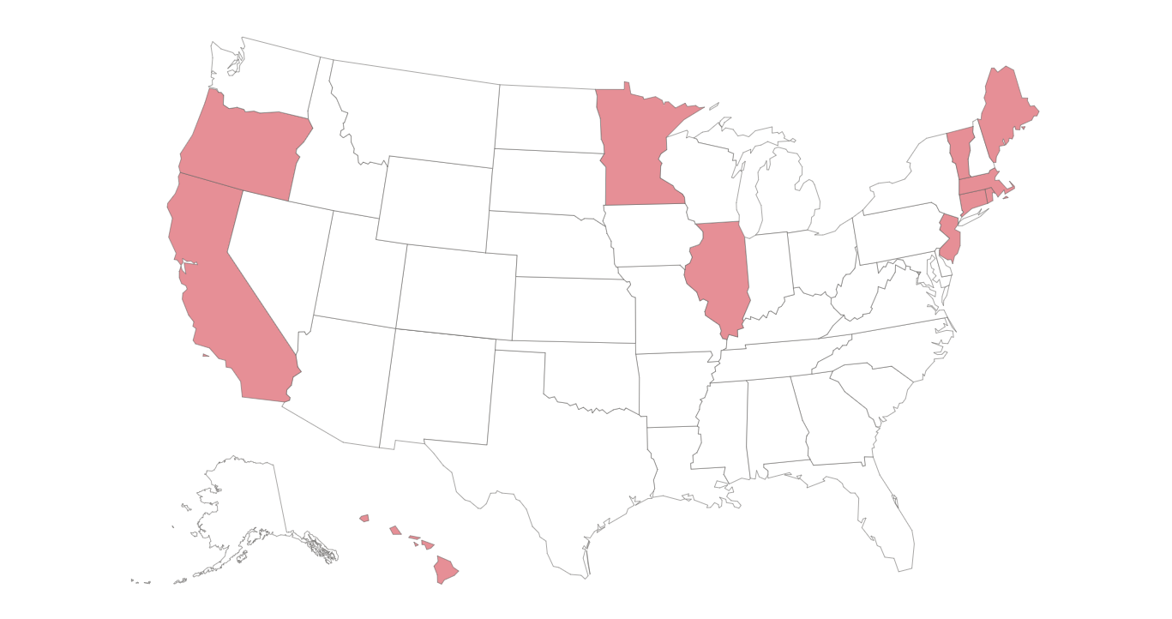
Current Nuclear Restrictions and Moratoria
Notes:
Speaker Notes:
This slide shows states with nuclear restrictions and moratoria currently in place. The first thing you probably noticed is that there are less red states on this map. One of the legislative trends in nuclear at the state level is the removal or partial removal of a nuclear moratorium
Kentucky lifted its nuclear ban in 2017 (with the passage of SB 11) and was followed shortly after by Montana in 2021 and West Virginia in 2022.
Connecticut also passed a limited exception to its nuclear ban this year to allow new nuclear construction at existing CT nuclear facilities HB 5202
Background:
States with recent lifts on nuclear moratorium:
West Virginia (SB 4) - 2022
MT (HB 273) - 2021
KY (SB 11) - 2017
WI (A.B. 384) - 2016

Slide 6
Permitting and Regulatory Pathways to State Level AR / SMR Development
Phase 2 - Create State-Level Licensing Pathway
Phase 1 - Legislative actions towards an organized review of state level regulatory framework
Example 1: Through the passage of SJ3 in 2021 Montana legislators created a task force to evaluate current Montana regulations that would need revision in order to enable the construction and operation of advanced nuclear reactors.
Example 2: The IN General Assembly through the passage of SB 271 has directed the Indiana Utility Regulatory Commission to adopt rules related to granting certificates for the construction, purchase, or lease of small modular reactors.
Notes:
Speaker Notes:
Several states have introduced legislation to conduct a larger review of their state-level regulatory framework surrounding AR and SMR technologies relative to their energy goals.
This can be a helpful first step for states to consider if and how AR and SMR technologies fit in with their energy goals but it can also be a way for the General Assembly to direct state administrative agencies, universities, and other entities to provide recommendations on developing a framework to support its goals.
Discus Example 1
3 states have passed legislation that creates an AR / SMR permitting pathway
Discuss Example 2
Background Information:
Optional additional examples from the other two states that passed legislation that to create an AR / SMR permitting pathway
Alaska excluded microreactors from their more stringent requirements for larger scale nuclear reactors in the state and directs an administrative agency to coordinate comments from various state level administrative agencies in the event NRC license if filed for a micro reactor in the state.
Wyoming passed a more comprehensive licensing framework for AR and SMR technologies in the past legislative cycle that was amended this year.

Slide 7
Legislation Introduced to Support Financial Case for Nuclear Development
Type of Legislation | Examples from 2022
Feasibility Study | KY - SCR 171 - Explores funding sources for a feasibility study on deploying advanced nuclear energy technology
Zero Emissions Credits | PA - SB 979 - Would create a program to compensate eligible electricity generators for the value of providing electricity without emitting greenhouse gases
Support of Nuclear Development Costs | NJ - SB 220 - Would invest money from business assistance programs into fusion industry development companies that meet specified criteria.
Nuclear Rate Setting Provisions | MO - SB 969 - Would allow for the costs of construction and other costs associated with owning, operating, maintaining, or financing a new nuclear electric generating facility to be considered when setting rates.
Notes:
Speaker Notes:
There’s been a wide variety of legislation introduced this year to identify financial pathways for successful nuclear deployments.
The example on top from Kentucky is the only bill that has passed this session (so far) but we wanted to include a couple of other examples to show financial mechanisms other states have considered or are currently considering.
Explain categories and discuss example for each
Sample brief description of each example:
Feasibility Study - some states like Kentucky (Senate Concurrent Resolution 171) are just starting to explore funding sources to conduct a feasibility study. There has been some variation with
Pennsylvania considered developing a Zero Emission Credits (ZEC) program to compensate eligible electricity generators, which could include new nuclear) for the value of providing electricity without emitting greenhouse gases
New Jersey is considering funding mechanisms to support business that manufacture or develop advanced small modular reactors.

Slide 8
Types of Legislation Introduced Related to Nuclear Waste
Studies Related to Waste
Tax Provisions Related to Waste
NE - LR 363 - Interim study to examine the reprocessing and recycling of spent nuclear fuel and to examine the statutes relating to the disposal, transportation, and storage of spent nuclear fuel.
NJ - S 1701 - Classifies spent nuclear fuel from a decommissioned nuclear power plant to be considered real property for tax purposes.
Notes:
Speaker Notes:
Neither of the bills highlighted in this session have passed yet (NJ’s still in session) but were included to show some of the types of waste specific legislation introduced this session.

Slide 9
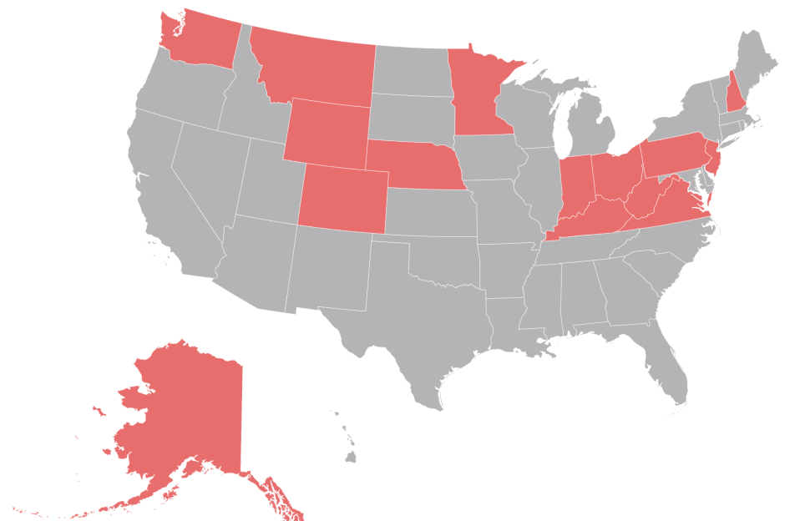
SMR/AR Legislation Introduced in 2022
Notes:
Concluding remarks / Q&A time permitting

Slide 10
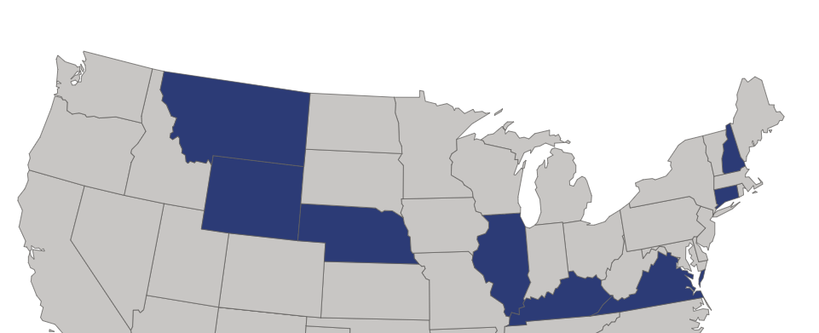
State Level Studies or Task Forces
9 states passed legislation related to studying nuclear technology
VA, MD, MT specific to fossil sites
3 states with pending legislation
NJ – fusion focus
3 states did not pass
NE and Colorado are moving ahead with grassroots efforts
State | Bill | Description
New Hampshire | H 543 | Establishes a commission to study nuclear power and nuclear reactor technology in state
Connecticut | HB 5200 | Task force to study hydrogen power
Virginia | HB 894 | Establishes Southside Virginia Energy Research Development Authority. Siting SMRs at fossil sites
Nebraska | LB 1099 | Working group to look at regional hydrogen hub
Wyoming | SB 1 | Several initiatives here
Illinois | SB 3613 | Task force to collaborate on IL Hydrogen Hub
Kentucky | SCR 171 | Find experts and dollars to conduct adv nuclear feasibility study
Montana | SJ 3 | Energy and Telecommunications Interim Committee Coal Strip Study
Maryland | Climate Solns Now Act | Advanced nuclear study with X-energy
State | Bill | State
Pending |  | Did Not Pass
Michigan | HB 6019 | Nebraska
New Jersey | S 1384 | Oklahoma
Minnesota | SF 4163 HF 4462 | Colorado
Notes:
Just focusing on one of these items: 9 states have passed legislation to either establish a task force to evaluate new nuclear or have requested a feasibility study. GAIN has been talking with each of the states to understand specifically what they are doing and if there is any help needed from NLs or DOE. 3 states work is specific to fossil sites. You can also see here that 6 more states either have legislation pending or legislation that may come back in next session. Either way – the states are digging in and it behooves us to be part of the conversation.
These activities are very labor intensive, but very valuable. We have been pulling in EPRI, NEI and utilities pursuing advanced nuclear.
University of Wyoming recently awarded a grant to assess this transition in the context of environmental justice and community engagement, with hopes of impacting the future of nuclear energy siting in the state and beyond. Which leads us into a quick discussion of what GAIN is doing with Coal To Nuclear Transitions

Slide 12
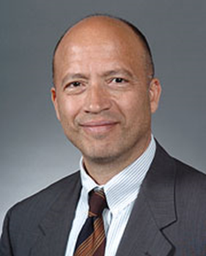
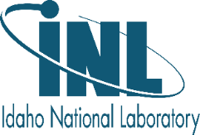
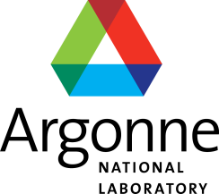
The GAIN Team
Director – Christine King
Deputy Director – Andrew Worrall
Senior Advisor – Hussein Khalil
Program Manager
Lori Braase
Innovation & Technology Manager
Chris Lohse
Administrator
Teresa Krynicki
Voucher Principal Investigators
Communications
Donna Kemp Spangler
National Lab Technical POCs
Operations Manager
Holly Powell
Process Modernization
Rachel Taow
Regulatory Interface
Jim Kinsey
June 10, 2022
Notes:
Chris Lohse
Since the last GAIN-POC quarterly meeting, there have been several personnel changes @ GAIN.
Christine King took over as directory in February 2020 just before COVID restrictions started.
Chris Lohse has taken over for John Jackson in the Innovation and Technology Manager Position May 2021
Donna Kemp Spangler joined in July 2020 as one of the media liaisons
Holly Powell joined GAIN in December of 2020 and is the project coordinator for GAIN vouchers as well as the lead on legacy documents
Rachel Taow recently joined the GAIN team in April of 2021 and is the lead for contract modernization work
Also on the phone we have:
Andy Worrall – Deputy Director
Hussein Khalil – Senior Advisor
Jim Kinsey – Regulatory Interface
Alison Conner – Business Manager
Lori Braase is out on leave today, but normally, she’d be joining us
With that, I’m going to turn this over to Christine to run through a few items.

Slide 13
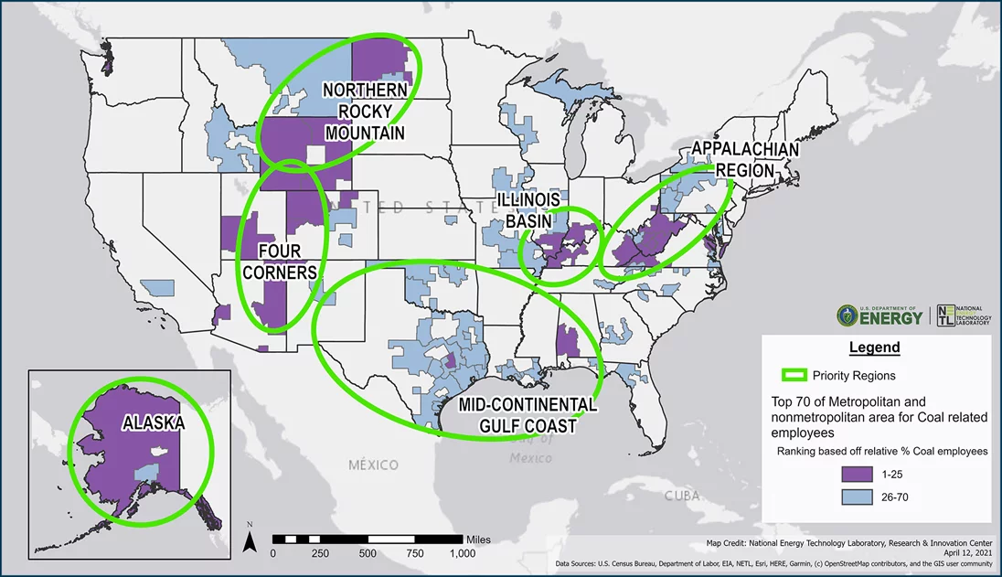
Wyoming Summary: TerraPower, WY Energy Authority, PacifiCorp, Kemmerer
Document the decisions that led to siting the Natrium project at the Kemmerer site.
GAIN will help share the WY experience and perspective to a broader audience by preparing a report/roadmap and likely filming some short videos.
This will help other communities and/or utilities begin their journey to consider advanced nuclear as part of a new energy future
Coal to Nuclear Research Group
Each group is leading important projects associated with potential repurposing coal sites with nuclear technology. Use group discussions to align our individual efforts to make the most of this opportunity for the broader industry. In addition, get constructive feedback on GAIN case study pilot project.
Case Study Pilot (in partnership with DOE-FECM)
GAIN is in the process of scoping several case studies of specific coal sites/plants to understand the parameters that will have the most influence on moving forward with transitioning a coal site to nuclear. Scope several this year – complete 1 or 2 in the calendar year and initiate others in the future.
Coronado Generating Station, St Johns, Arizona
Warrior Run Generating Station, Cumberland, Maryland
EW Brown Generating Station, Harrodsburg, Kentucky
Notes:
Maybe your first question is why is GAIN doing this? Consistent with our mission to accelerate the innovation and commercialization of a new nuclear fleet. Coal to Nuclear projects may provide an early adopter market. However, it has become clear that you have to get beyond the glossy analysis and engage in the details. These projects may not be ‘investable’ from any one perspective; however, the shared goals and objectives of the utility, state, local community, and developer may make these projects compelling.
This project is coordinated with front office staff for NE and OFECM and Interagency Working Group (Secretary Granholm) – coordination with NETWG (nuclear energy tribal working group).
This project has three elements:
1) Use information on the slide

Slide 14
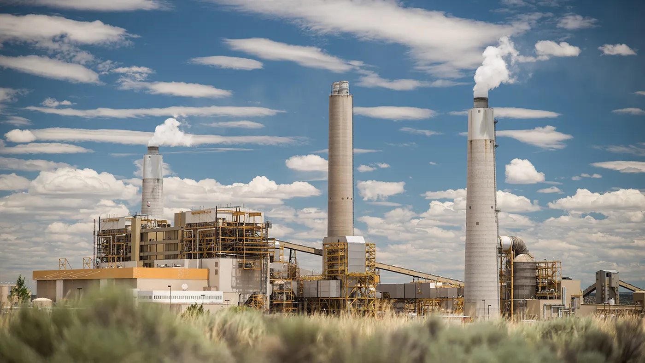
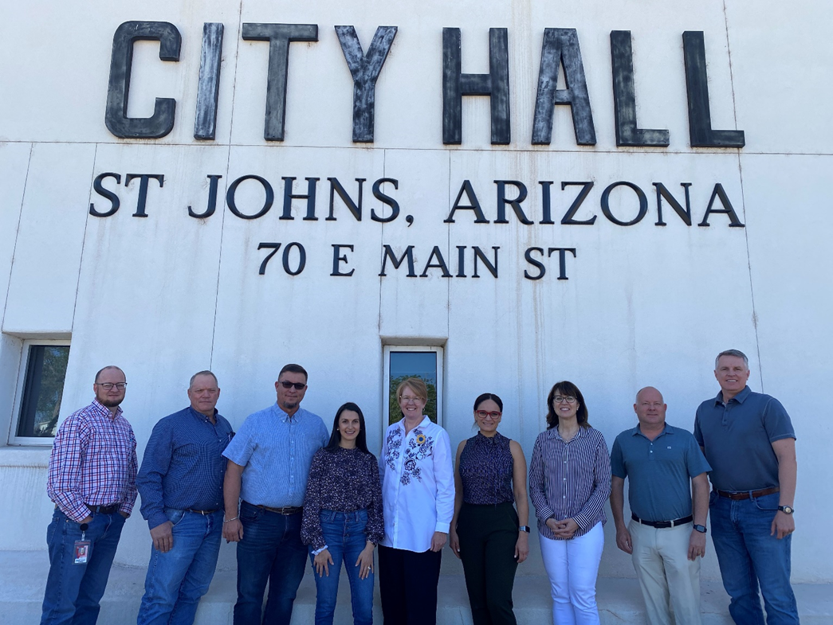
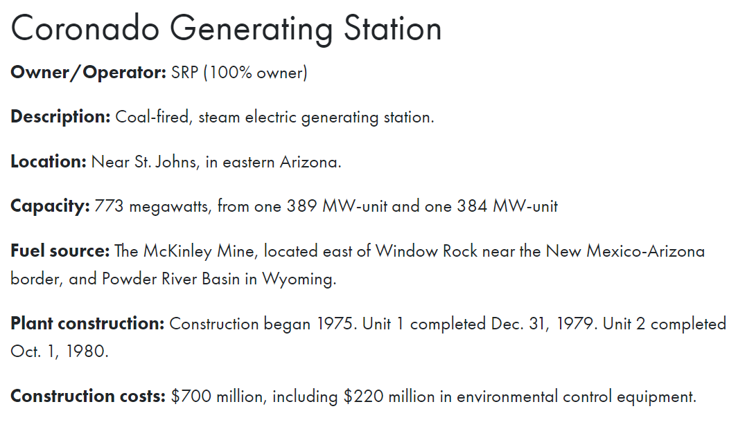
Coronado Generating Station, St Johns, Arizona
Partnered with Salt River Project and St Johns Mayor’s Office
Plant is in same county as Navajo Nation
St Johns
Economic Analysis – specific to nuclear, will include time gap between coal retirement and nuclear operations
Begin education strategy for community and workforce
Serve as a peer connection for other communities with retiring coal stations
Salt River Project
Siting Analysis
Technology Assessment – compares adv nuclear designs against their business objectives. Identify candidate technologies for their further consideration
Serve as a peer connection for other utilities with retiring coal stations
GAIN
Help assess the feasibility of coal to nuclear transitions
Combined with other studies
NOTE: there are 10 coal stations in Northeast AZ – 8 have retirement dates announced.
Notes:
Recent work completed by Systems Analysis and Integration program – based on an initial screening, site is suitable for advanced reactor and large LWR
Using draft Technology Assessment Guide written by EPRI – will give the utility a framework to continue with after our project is complete.
This is the most comprehensive set of evaluations we are planning to do.

Slide 15
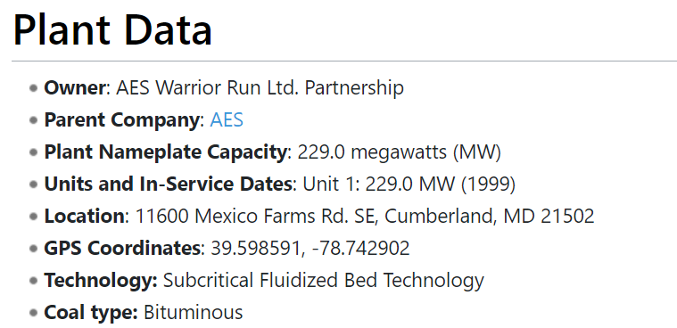
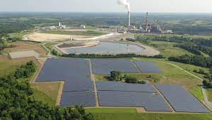
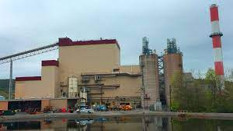
EW Brown Generating Station, Harrodsburg, Kentucky
LG&E – owner, operator and balancing authority
Kickoff Meeting June 29
Coal-fired unit
Net generating capacity: 457 megawatts
Original startup date: 1957 for Unit 1 which is now retired,
Unit 3 started in 1971
Fuel: Coal
Annual fuel consumption: Approximately 0.8 million tons
Emission controls: FGD, Low NOx, ESP
Solar facility
44,000 solar panels
Net generating capacity: 19,000 MW hours
10 megawatts
Natural gas combustion turbines
Seven units
Net generating capacity: 895 megawatts
Warrior Run Generating Station, Cumberland, Maryland
AES retiring fossil by 2025, Plant has PPA through 2030
Refurbishment/Sale
Hydroelectric plant
Three generating units
Net generating capacity: 33 megawatts
Notes:
Last week, the state of MD announced they would partner with x-energy to complete an economic analysis of Warrior Run.
We are going to focus on understanding the value of the assets on the site, the objectives of the local community, and an initial technology screening.
The utility has indicated Warrior Run has 3 choices: retire, sell, or change fuel.
Separately the station is evaluating biomass – nearby retired pulp and paper mill would provide the feedstock.
GAIN will use this opportunity to understand if it is feasible to attract a nuclear buyer to this site. Kind of like a version of getting expert real estate advice when you can sell your house.
We are meeting EW Brown this week to scope their project.
GAIN has the money to scope these two studies but not complete them. Need support from the Office of Fossil Energy and Carbon Management.

Slide 16
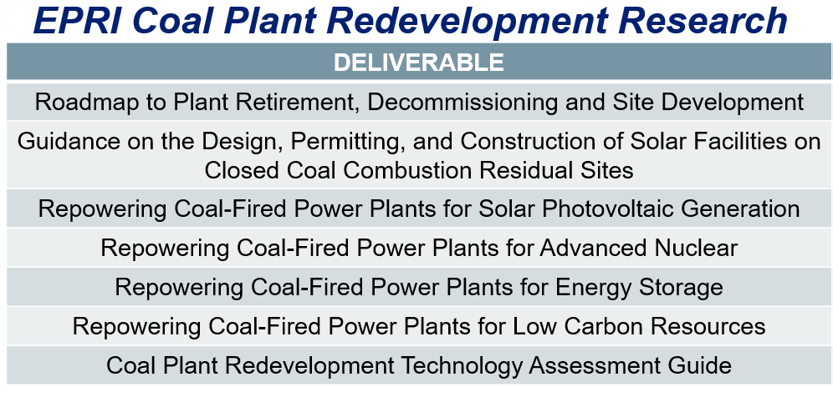
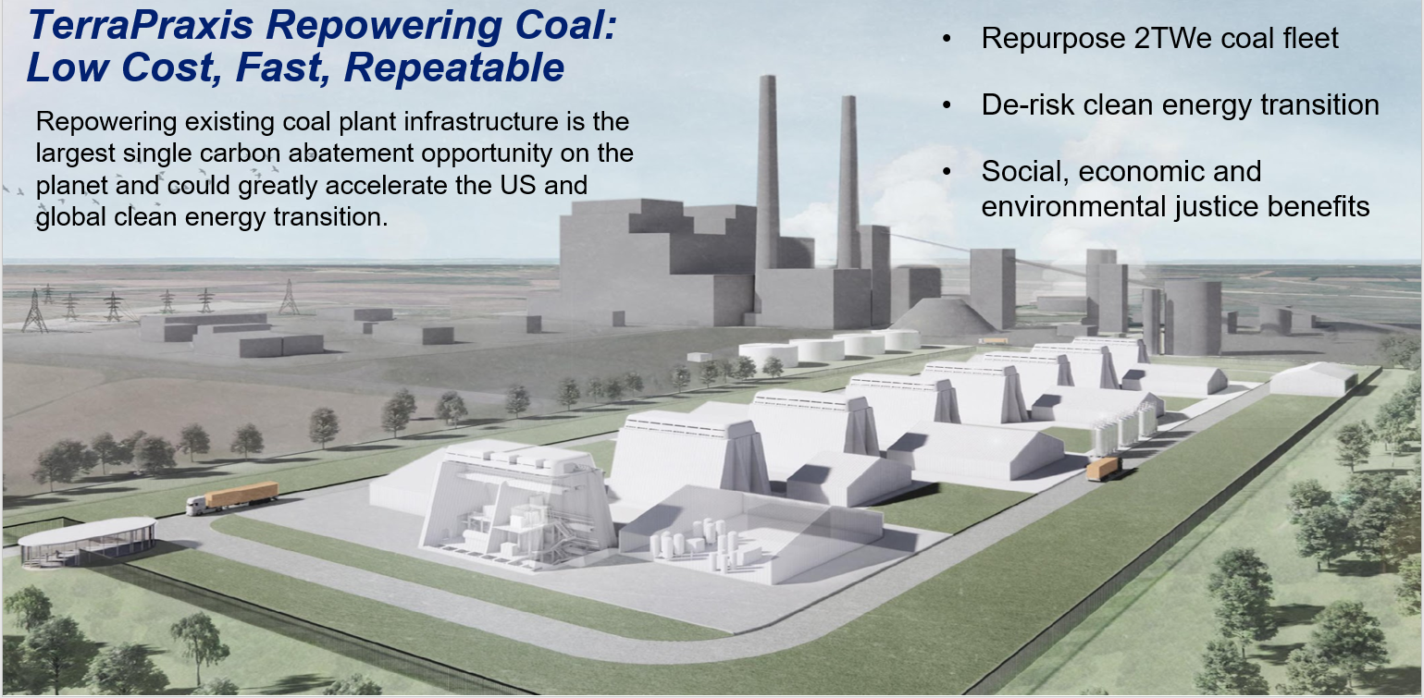
Coal to Nuclear Research Group
Site Reuse Deployment Guidance
Benefits & Challenges of CPP to NPP/ SA&I
Estimate the scale of repurposing feasibility in the US
Characterize infrastructure compatibility CPP to NPP
Develop a cost model for evaluating the conversion decision
Assess regional economic impacts, including jobs, taxes, and re-training requirements
Report coming out in next couple of months
Notes:
Do not plan on going through the details of each of these, but more wanted to point out the importance of gathering the researchers together on the nuclear side on a regular basis to share results, align on tasks, and learn from one another.
EPRI, NEI, SODI, NRIC, Terrapraxis, Systems Analysis & Integration

