Slide 1
TVA & Advanced Nuclear Energy
THE CLINCH RIVER NUCLEAR PROJECT AND
ADVANCED NUCLEAR TECHNOLOGY PROGRAM
Joe Shea
VICE PRESIDENT OF ADVANCED NUCLEAR TECHNOLOGY
Prepared for the Kentucky Office of Energy Policy and GAIN
SHAPING OUR ADVANCED ENERGY FUTURE WORKSHOP
June 28, 2022

Slide 2






TVA Mission
BUILT FOR THE PEOPLE OF THE VALLEY
ENERGY | Electricity at the lowest feasible rate and highest feasible reliability
ENVIRONMENT | Stewardship of the natural resources for best use by the public
ECONOMIC DEVELOPMENT | To attract and retain good jobs and capital investment in the Valley
2020+
TVA’S ENERGY SYSTEM OF THE FUTURE
To reduce carbon emissions and support increasing electricity demands, TVA is pioneering emerging technologies in advanced nuclear, solar, pumped storage, and battery storage to create the Energy System of the Future.
1970s
PUMPED STORAGE& GAS
TVA continues to innovate to meet peak daytime demands through pumped storage at Raccoon Mountain. TVA also begins producing power by simple cycle combustion turbines (gas).
1960s
NUCLEAR
To address challenges with burning coal and increasing energy demand, TVA constructs the nation’s first GE BWR-4 nuclear plant at Browns Ferry.
1950s
FOSSIL
Rise of inexpensive coal power to meet Valley demands. Innovations in fertilizer and land management techniques established model for modern agriculture extension services.
1940s
HYDRO
Largest hydropower construction programs ever undertaken in the US to support power needs during WWII.
INNOVATING FOR THE PEOPLE OF THE VALLEY
1933
TVA ACT SIGNED
Innovating out of economic depression

Slide 3





Generation Capacity vs. Carbon Reduction Goals
LEVERAGING ADVANCED NUCLEAR TO MEET BOTH OBJECTIVES
TVA needs to add generation capacity while reducing carbon by 2050.
TVA’s Energy System of the Future
CARBON-FREE OPTIONS
Advanced Nuclear | Small modular reactors (SMRs) are a safe, reliable, and flexible source of carbon-free power.
Hydro | TVA is working to extend the life of the existing hydro fleet and evaluating new pump storage and pumped back capabilities.
Carbon Capture | Gas can be combined with carbon capture technology for a net-zero effect.
Solar | A renewable form of energy from the conversion of sunlight to electricity.
Battery Storage | Can be combined with solar to support peak demands.
Hydrogen | Technology is in development.
TVA’S ENERGY SYSTEM OF THE FUTURE
2020 | 2025 | 2030 | 2035 | 2040 | 2045 | 2050
Notes:
Clean Energy Economy
Partnered to bring 80,900 jobs and $8.8 billion in capital investments to the Valley.
Purchased $1.2 billion from small and diverse businesses.
Averted $170 million in flood damage in the Tennessee Valley.
Helped 34 small businesses make free energy upgrades to lower their energy bills through the Community-Centered Growth program.
Launched the Green Connect program to create a qualified solar contractor network for residential customers who want to install solar.

Slide 4
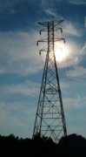
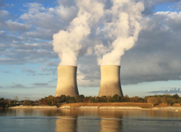
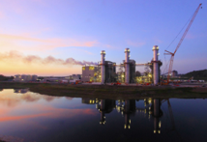
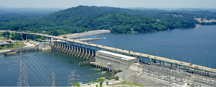
TVA’s Nuclear Power and Construction Experience
OUR EXPERIENCE & EVOLUTION POINT TO ADVANCED NUCLEAR
TVA operates the third largest nuclear reactor fleet in the U.S.
TVA’s Watts Bar Unit 2, the nation’s first new nuclear generation in 20 years, entered commercial operation in 2016
At any given time, TVA has around 900 active projects totaling $12 Billion in approved funding for construction and refurbishment projects for coal and gas plants, hydro-electric dams, and transmission infrastructure across the Tennessee Valley.

Slide 5
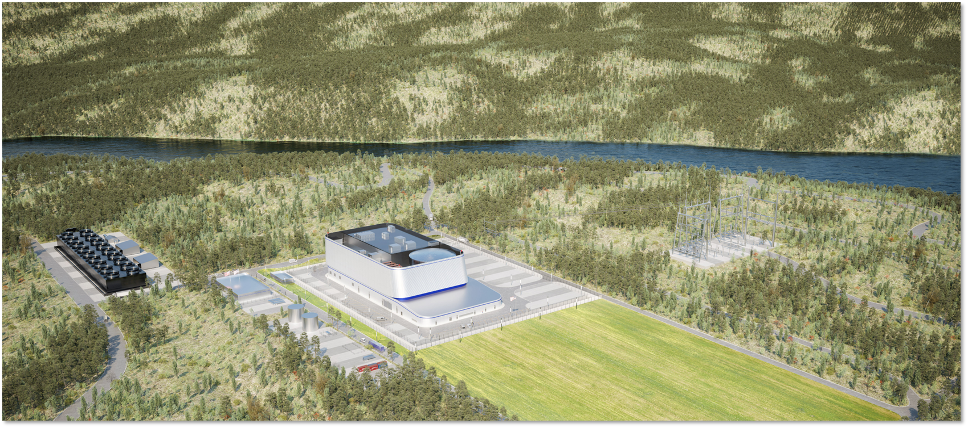
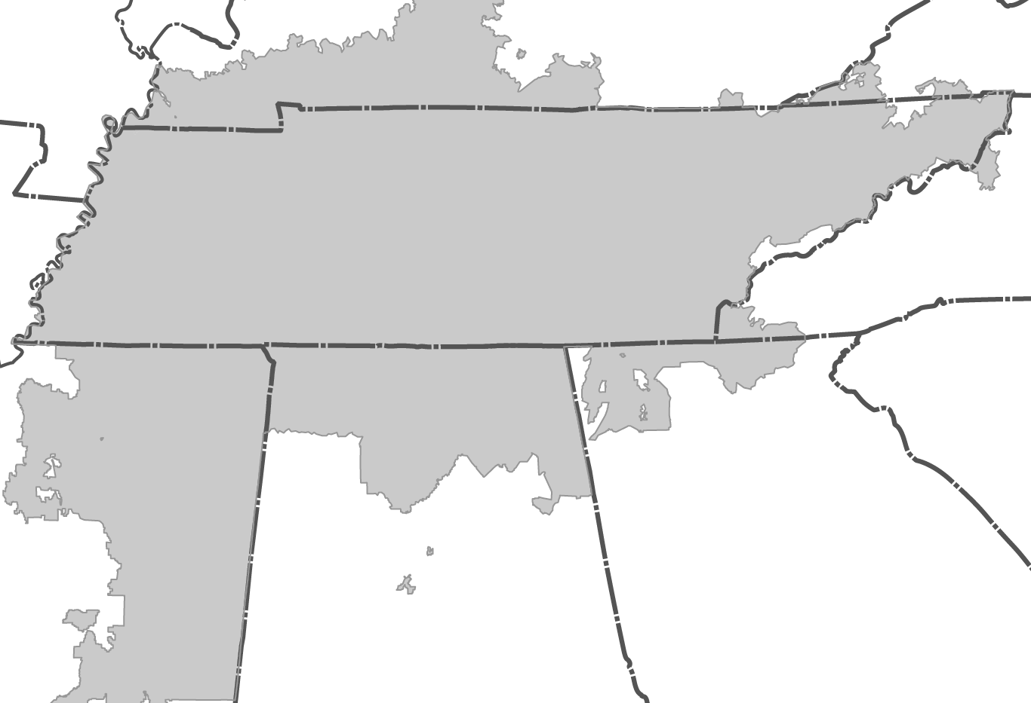

Clinch River Nuclear Project
TVA’S FIRST ADVANCED NUCLEAR SMALL MODULAR REACTOR
Oak Ridge, TN
PROJECT LOCATION
FOR ILLUSTRATIVE PURPOSES ONLY

Slide 6
Clinch River Nuclear Decision Gate Process
PHASED DECISION APPROACH TO REDUCE RISK AND COSTS
Board Authorization required to proceed beyond Decision Gate (DG) for each phase.
Enterprise evaluation criteria to support recommendation to the CEO and Board.
Planning
Begins
(~2 years)
Project
Begins
(~2 years)
Construction
Begins
(~5 years)
DG #1
DG #2
DG #3
Submit Permit
Finalize Design
Construction Planning
Obtain permit
Build
Test
Transfer to Operations
Design
Licensing
Estimating
Phase 1
Phase 2
Phase 3
Potential Off-Ramp or Timing Delay
Potential Off-Ramp or Timing Delay
6

Slide 7




TVA Vision for Advanced Nuclear
STRATEGICALLY MOVING FORWARD FOR THE PEOPLE OF THE VALLEY
Leadership |  | TVA’s leadership in technology innovation provides a pathway to net-zero carbon emissions.
Experience |  | TVA has the nuclear and construction experience and talent to support small modular reactor (SMR) development and deployment.
Approved Site |  | TVA’s Clinch River site is approved by the Nuclear Regulatory Commission for SMRs.
Strategic Approach |  | TVA’s Decision Gates will ensure the timing of deployment is right.
Future-Looking |  | TVA’s Advanced Nuclear Program will inform future SMR decisions and potential deployment locations across the Tennessee Valley.
7

