Slide 1
Kentucky and the Volkswagen Settlement
Hailey Mullins, KY Office of Energy Policy

Slide 2
Before we begin..
This webinar is being recorded and will be shared on the Office of Energy Policy’s (OEP) website.
All information discussed today can be found within the application instruction manuals.
Please remain muted through the presentation and hold questions until the end. We will have a Q&A session.
https://eec.ky.gov/Energy/Programs/Pages/Volkswagen-Settlement.aspx

Slide 3
Summary of Funding Source
The Volkswagen Settlement comprised a series of legal settlements addressing the company's manipulated emissions tests, resulting in vehicle emissions exceeding the limits set by the Clean Air Act.
$2.7 billion of this settlement was allocated to an Environmental Mitigation Trust. These funds were then divided among the states to finance projects targeting the reduction of Nitrogen Oxide (NOx) emissions at the local level.
The Kentucky General Assembly directed the state's $20.3 million share towards the replacement of school and transit buses, and light-duty electric vehicle (EV) infrastructure throughout the Commonwealth.
​​Kentucky has $3,498,638 of unspent funds allocated to Light Duty EV Infrastructure.

Slide 4
Level 2 and Level 3 Charging
The Office of Energy Policy is seeking applications for the installation and operation of level 2 and level 3 electric vehicle charging infrastructure under two separate rebate programs.
What are level 2 and level 3 EV chargers?
Level 2 Chargers: Use 240V power, faster than standard home outlets, typically add 20–30 miles of range per hour.
Level 3 Chargers: (DC Fast Chargers): Use high-voltage DC power, adding 100+ miles of range in 20–30 minutes. Significantly more expensive than level 2.

Slide 5
This is a Reimbursement Program
The costs of implementing the full project are reimbursable and at a 50% cost reimbursement of eligible expenses. Eligible expenses include:
  Design costs
  Labor
  New charging station units and associated equipment
  Conduit, signage at the parking spot, bollards, cable/wiring and electrical service box disconnects
  Concrete or asphalt addition or replacement
  Paint striping and stenciling of the charging station parking spaces
  Annual network and maintenance fees up to 3 years

Slide 6
Eligibility
Level 2 Program:
Eligible applicants are individuals that own or operate locations where Level 2 EV charging can be installed and accessed by the public, employees, or residents of multi family housing.
This includes public places such as government facilities, parks, and transportation hubs; workplaces including offices, industrial sites, and other employer-operated locations; and multi-unit residential properties, such as apartment complexes, condominiums, or other shared housing. Individual private residences are not eligible.
Reimbursements under the Level 2 program are capped at $25,000 per project.
Level 3 Program:
Public, Commercial and General Aviation airports located in Kentucky

Slide 7
Timeline
Applications will open on April 13th, 2026 and remain open until all funding is obligated. Funds will be awarded on a first come-first serve for completed application framework. Funding levels will be updated on the website.
Once an application is reviewed and approved, the applicant will receive a letter outlining the amount approved for reimbursement and detailed instructions on how to complete a reimbursement request.
Entity must begins work immediately to construct stations once their project is approved by the Office of Energy Policy.
Immediately following operational status, entity submits a request for reimbursement. Request for reimbursement must be sent by August 1st, 2027.
OEP reviews/approves reimbursement request and submits reimbursement for payment
Entity maintains operation of stations for a minimum of three years and submits usage data to OEP when requested.

Slide 8
Application
For both programs, an entity may submit only one application per program. If an entity is eligible for both programs, they may submit one application to each program.
Example: A government entity wants to install Level 2 chargers at two separate locations within its jurisdiction. The entity may submit a single application that includes both locations and would be eligible to receive up to $25,000—or 50% of eligible costs—to fund the full project.

Slide 9
Application Package
The OEP will open the virtual application portal on April 13^{th in} Submittable. Applicants will receive communications about their applications, including approval status, via emails from the platform.
A successful application will include the following:
  Entity UEI number and eMARS ID - Register for the Vendor Self Service Portal to get an eMARS ID
  Detailed Budget Estimate – Excel spreadsheet provided, 50% cost match must be demonstrated. Federal funds may be used as cost share.
  Utility Letter – The site must have adequate capacity to accommodate the installation. Your utility can provide a will serve letter confirming this.
  Project Information – Number of ports, the brand/models of equipment, and project timeline. Equipment must be energy star certified and meet Underwriter Laboratory (UL) Certification.
  Financial structure information – Who will own the stations, receive any financial benefit, pay for maintenance/repair for all three years of the required operability.
  Site Information – Location of station(s), site type (public, workplace, multi-family unit, airport), who will have access to the charger?
  ADA compliant considerations – A diagram detailing the layout of the proposed station and how you will make it accessible
  Additional documents – Maintenance contracts, equipment estimates, operation agreements, etc.

Slide 10
Types of EV Charging Stations that must meet ADA Requirements
State or local government offices
Public parks
Municipal building parking lots
Street parking and the public right-of-way
Residential housing facilities provided by a state or local government
Public EV charging stations provided by a private entity
Commercial fleet charging stations available to corporate clients

Slide 11
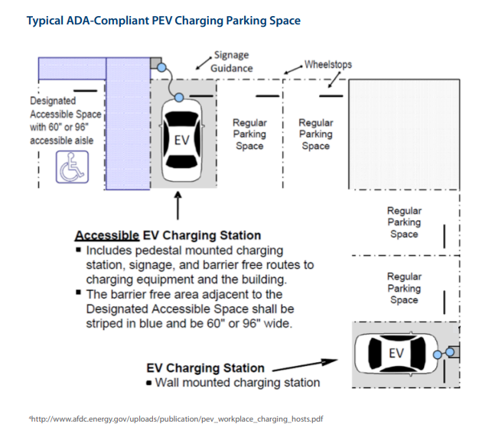
How to comply with ADA Requirements
Review the Design Recommendations for Accessible Electric Vehicle Charging Stations Guide on our webpage
Review the Guidance in Complying with ADA Requirements document on our webpage
Submit a diagram of accessibility configurations along side application. Example:
Key Considerations
Barrier free (ramp or curb cut) route to equipment, striped in blue minimum of 60” wide.
Proximity to entrance or route to the entrance
Accessible communication features and user interface
Accessible payment system

Slide 12
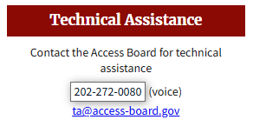
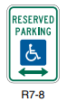
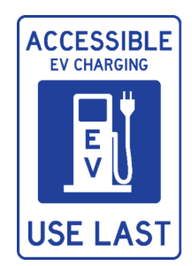
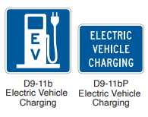
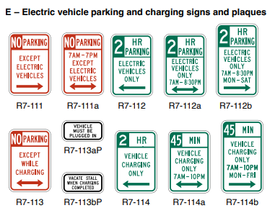
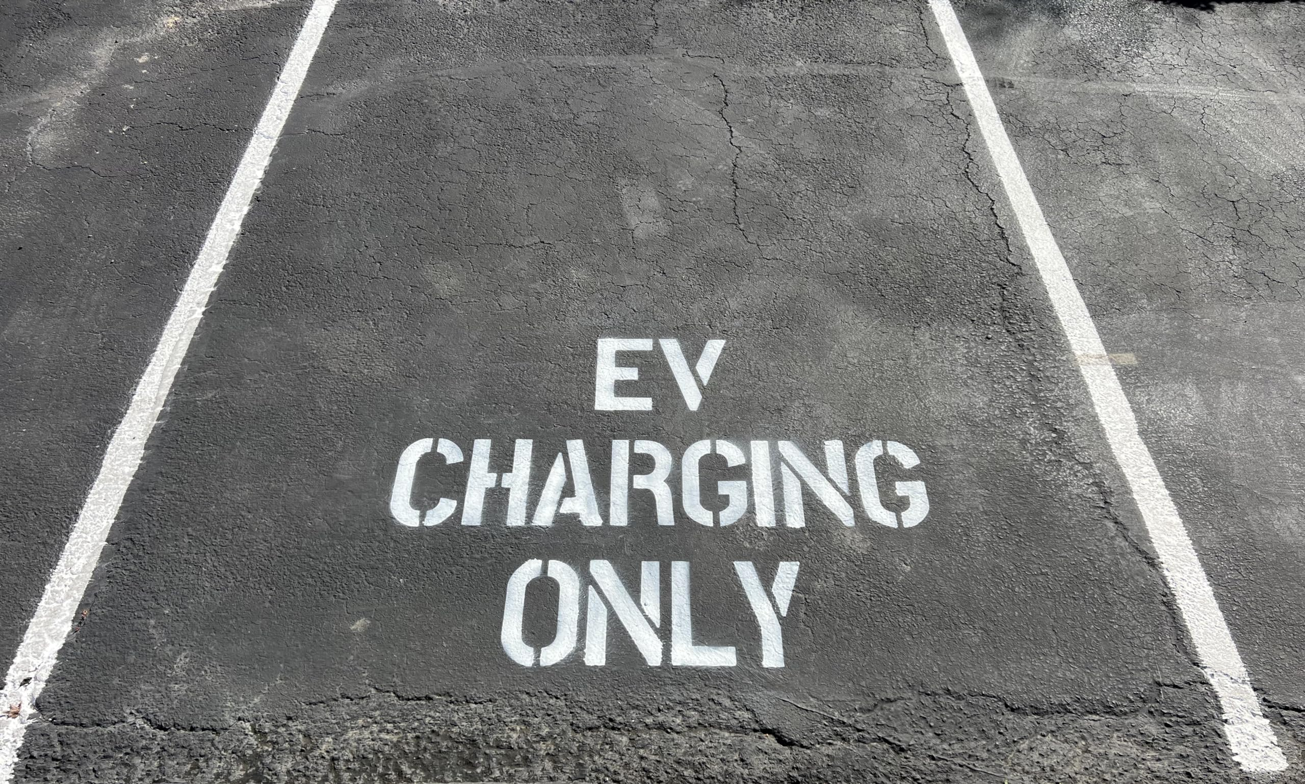
Signage
If the station is open to the public, it must have on-site signage (D9-11) that directs drivers to the EV charging station
Signage that denotes stations that are ADA accessible (R7-8) is optional, but blue stenciling is mandatory to denote wheelchair accessibility.
Install signs appropriate with the regulations you want to enforce:
Where parking spaces are designated for parking of electric vehicles or where parking is subject to a time limit, the R7-111,112,113,114 series signs should be used or utilize EV parking only stenciling

Slide 13
Additional Requirement Considerations
Public facing charging stations must meet up-time requirements of at least 95% up-time
Public facing stations MUST be networked and connected to via an open source, non-proprietary communications protocol that allows for collection of usage data. The software must enable drivers to find stations, view the real-time status of stations, start charging sessions, and pay for charging (if payment is required).
All stations must be capable of providing usage data to the operator and applicants must agree to provide this data to the OEP if requested.
Sites may not be located within a 100-year flood plain.
Sites should be in safe and well-lit areas and at a safe distance from traffic circulation.

Slide 14
Contact Information and Q&A
Hailey Mullins
Federal Program Specialist
Hailey.Mullins@ky.gov

