Slide 1
KENTUCKY AGRITECH & DISTILLERS’ GRAINS FORUM

Slide 2
A FEW EXAMPLES
Farm Management Software, Sensing
IOT
Animal Science
Bioenergy & Biomaterials
Food Safety & Traceability Tech
Crop Science
Logistics & Transport
Farm Robotics, Mechanization & Equipment
Novel
Farming
Systems
Home & Cooking Tech
In-Store Retail & Restaurant Tech
Processing & Storage Tech
Innovative Food & Ingredients
Fintech for Farmers

Slide 3
Everyone eats & drinks
Recognizes value generation in production & supply chain
Challenges as opportunities
Solutions via cross-industry collaboration

Slide 4
STATE GOVERNMENT SUPPORT
Convening players
Cooperating & coordinating internally
Contributing expertise & existing financial support programs

Slide 5
GOVERNOR’S OFFICE OF AGRICULTURAL POLICY
Anne Marie Franklin

Slide 6
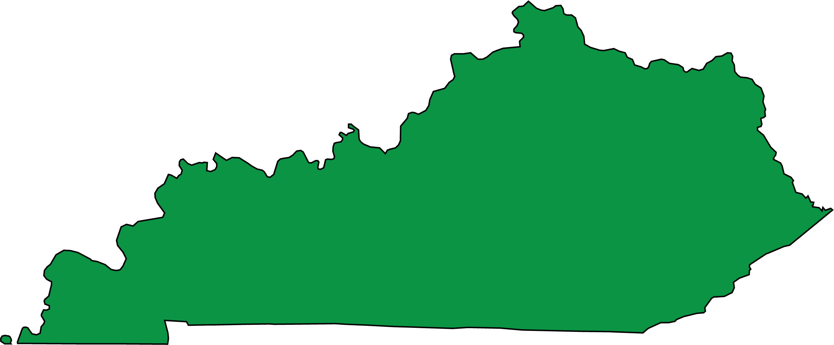
GOVERNOR’S OFFICE OF AGRICULTURAL POLICY
INVESTING IN GROWING OPPORTUNITIES
THROUGHOUT KENTUCKY
FUNDS INVESTED
INTO KADF PROJECTS
& PROGRAMS
$632,609,208
404 Ann Street Frankfort, KY 40601 | agpolicy.ky.gov | 502-782-1757
Info as of 7/15/2020

Slide 7
AVAILABLE KAFC LOAN PROGRAMS
MORE THAN
1,030
LOANS APPROVED
Agricultural Processing (APLP)
Agricultural Infrastructure (AILP)
Diversification through Entrepreneurship in Agribusiness (DEAL)
FUNDS APPROVED
KAFC Rate is 2%, Lender Servicing Fee is 0.75%;
Maximum term not to exceed 15 years or remaining economic life;
Loans secured by real estate may be amortized over 25 years.
Ali Hulett, Loan Manager – 502-782-1760
$17,043,773

Slide 8
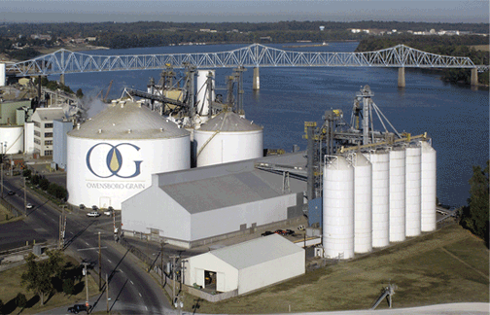
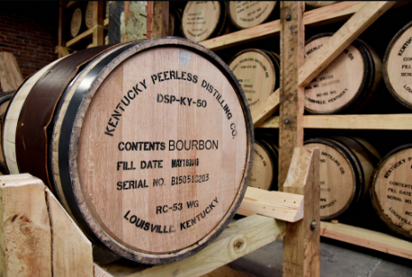
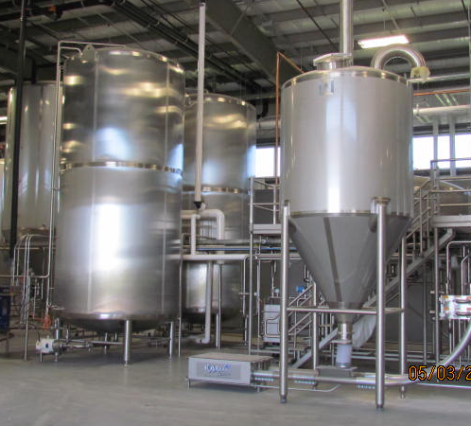
AG PROCESSING LOAN PROGRAM
Maximum participation may vary, but will be limited to 50% of project cost
Eligible expenses: purchase of equipment; acquisition, construction or renovation of operating facilities; permanent working capital
Construct glycerin refinery, Daviess County
Renovation of facility & equipment,
Jefferson County
Construct storage & aging facilities, Barren County
Construct brewing facility & purchase equipment, Scott County

Slide 9
CABINET FOR ECONOMIC DEVELOPMENT
Kristina Slattery & Annie Franklin

Slide 10
CASE STUDY
CLERMONT DISTILLING CO.
New distillery project in Bullitt County
by Lee Wilburn of CrossPath Group
22 jobs
$13.4M Investment
Notes:
TALKING POINTS FOR 4 P.M. PRESS CONFERENCE
This next project we have to announce is great news for Kentucky’s signature bourbon industry.
Startup Clermont Distilling Co. plants to construct a new distillery in Bullitt County. Phase I of the project will comprise a $13.4 million investment creating 22 full-time, high-paying jobs for Kentucky residents.
These jobs are expected to carry an average hourly wage of $56, including benefits. The company intends to hire for both management and operations positions.
Clermont Distillery will locate right off Interstate 65 at the Clermont/Bardstown exit, spanning 55 acres of land total on both sides of KY 245 leading to Bardstown.
Company leaders currently expect to begin construction on the distillery in Spring 2021.
FOR PRESS RELEASE
Clermont Distilling Co. plans to construct a new distillery in Bullitt County. Phase I of the project will comprise a $13.4 million investment creating 22 full-time jobs for Kentucky residents. These high-paying jobs will cover all levels of employment, including both management and operations positions.
Clermont Distillery will locate right off I-65 at the Clermont/Bardstown exit, spanning 55 acres of land total on both sides of KY 245 leading to Bardstown.
Company leaders currently expect to begin construction on the distillery in Spring 2021.

Slide 11
2020 ANNOUNCEMENTS
YEAR THRU DEC. 15
$
213
expansion and
new-locations projects announced
7,800 new full-time
jobs planned
$2.35B in planned ongoing investment

Slide 12
EXISTING INDUSTRY EXPANSIONS LEAD THE WAY
2020 THRU DEC. 15
Existing Industry Expansions
Existing Industry Expansions
Existing Industry Expansions
New Locations
New Locations
New Locations
TOTAL – 213
TOTAL – 7,800
TOTAL – $2.35B

Slide 13
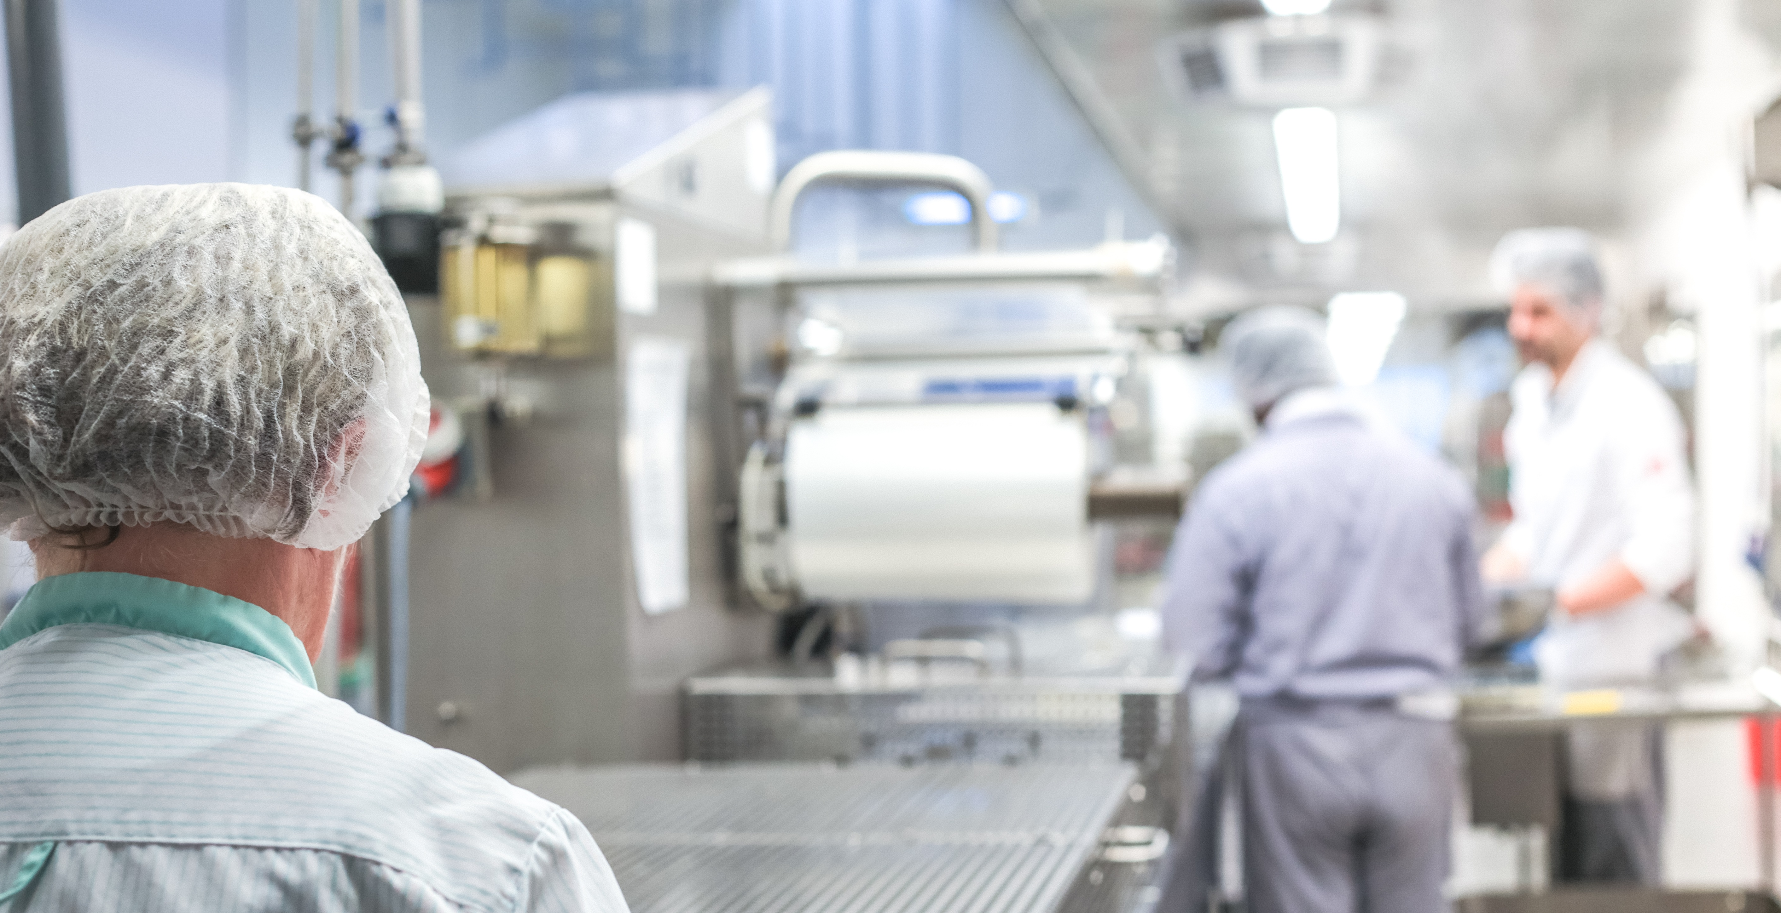
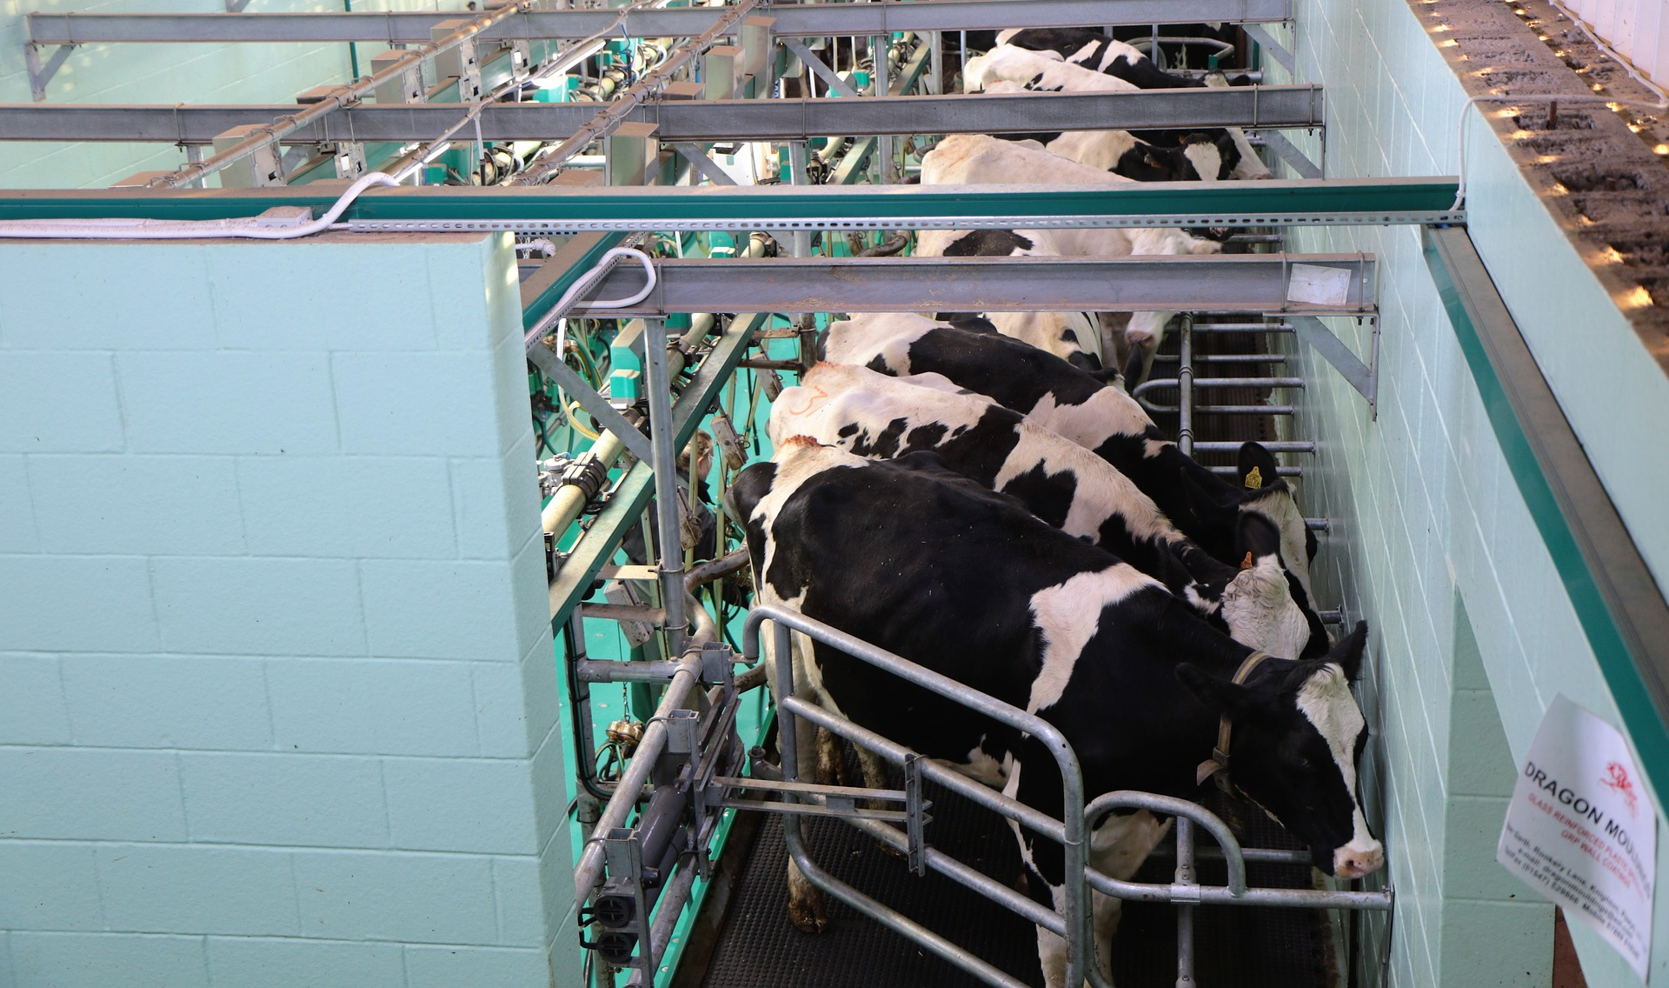
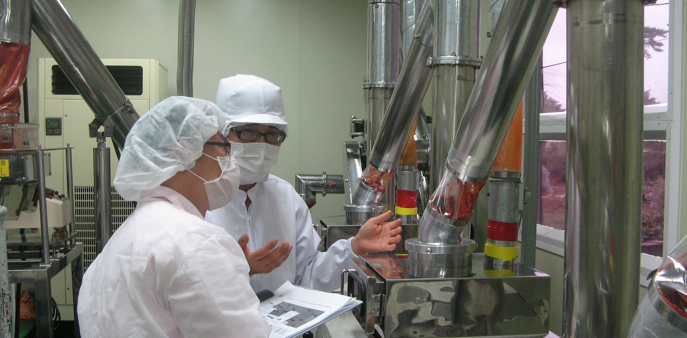
KENTUCKY OVERVIEW
FOOD & BEVERAGE
A vital part of Kentucky’s economy
300-plus Food & Beverage facilities
52,000-plus employees in Kentucky’s Food & Beverage industry
$4.04 billion in investments and nearly 6,400 new jobs announced over the last 5 years
$7 billion-plus contributed to Kentucky’s economy from Food & Beverage related industries
95% of the world’s bourbon is produced in Kentucky
Kentucky has the greatest concentration – 2x more than average – of beverage manufacturing in the U.S.
Notes:
How does Kentucky measure up?

Slide 14
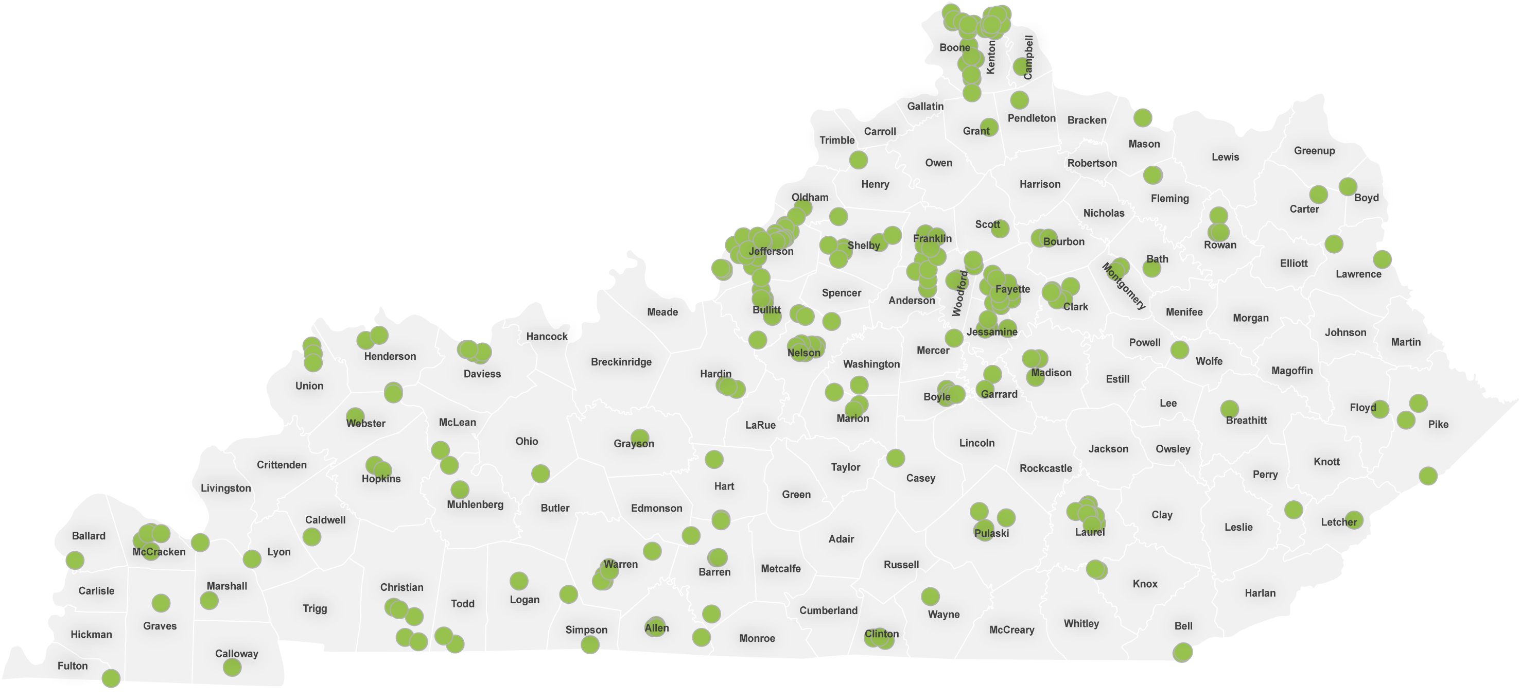
FOOD & BEVERAGE FACILITIES IN KENTUCKY
Food and Beverage Facility (366 locations)
Date: May 29, 2020
Notes:
WILL EVENTUALLY BE UPDATED BY JENNY.
The proof is in the pudding! Over 300 companies have already found success in Kentucky…

Slide 15
HOW WE CAN HELP
PROGRAMS | SERVICES
Incentive programs | Site evaluation services
Build-Ready | Detailed community data
Zoom Prospector | Connect you to resources and expertise
Work Ready | Incentive and training inducements
Product Development Initiative | Workforce services
Opportunity Zones

Slide 16
INCENTIVES AT A GLANCE
Notes:
We recently launched an interactive dashboard highlighting KY’s New & Expanding Industry announcements since 2014. You can filter by Local Workforce Area, County, Industry, and Parent Country of Origin.
It can be found through the link below at the bottom of the page.
https://ced.ky.gov/KYFacts/Kentucky_Facilities.aspx –

Slide 17
KENTUCKY BUSINESS INVESTMENT PROGRAM (KBI)
ELIGIBILITY
Manufacturing, agribusiness, regional/national headquarters or non-retail service and technology businesses
RECOVERY METHOD
Corporate income/LLET credits and employee wage assessments for up to 10 or 15 years, depending on location
REQUIREMENTS
Create at least 10 new, full-time jobs for Kentucky residents
Minimum investment of $100,000 in eligible costs
Minimum hourly wage and total hourly compensation requirements
Negotiated job and wage targets

Slide 18
KENTUCKY ENTERPRISE INITIATIVE ACT (KEIA)
ELIGIBILITY
Manufacturing, service and technology businesses, or those operating or developing a tourism attraction
RECOVERY METHOD
Refund of sales and use tax paid for building fixtures, construction materials, electronic processing equipment and/or R&D equipment
REQUIREMENTS
Minimum investment of $500,000 in eligible costs
Statutory limit of $20 million for building fixtures and construction materials, and $5 million for electronic processing and R&D equipment per fiscal year

Slide 19
KENTUCKY HELPS TRAIN YOUR WORKFORCE
Recruitment & Job Placement
Customized Training
Training Incentives
Skill Development
Notes:
Kentucky is here to help companies with their workforce needs today and tomorrow.
Let’s shift gears a bit, and talk about two companies that have found success in Kentucky.

Slide 20
WORKFORCE PROGRAMS BLUEGRASS STATE SKILLS CORPORATION (BSSC)
Grant-in-Aid (GIA) – Provides up to 50% cash reimbursement of eligible costs to eligible companies/consortia for approved training activities
Skills Training Investment Credit (STIC) - Provides up to 50% tax credit of eligible costs to eligible companies/consortia for approved training activities
Eligible trainees must be FTE, Kentucky residents and meet wage requirements
Budget includes $6.8 million funding for this program - $4.3 million for GIA, $2.5 million for STIC

Slide 21
KY INNOVATION
Ellie Puckett

Slide 22
PROGRAMS & INCENTIVES
KY Innovation Hubs
Kentucky Commercialization Ventures
Governor’s School for Entrepreneurs
KY Pitch
Kentucky Enterprise Fund
Commonwealth Seed Capital
KIIP - SBIR Matching
Kentucky Small Business Tax Credit
Kentucky Angel Investment Tax Credit
Kentucky Investment Fund Act (KIFA)
Kentucky Small Business Credit Initiative
Selling Farmer Tax Credit
Notes:
a. 136 expansion and new-location projects announced
b. 4,700-plus new full-time jobs
c. $1.36 billion in planned and ongoing investment

Slide 23
SUPPORTING KY’S STARTUP & INNOVATION ECOSYSTEM
These offices provide support to startups and entrepreneurs through coaching and connecting companies to:
Entrepreneurial community
Investors
Mentors
Business leaders
Universities
Local governments
Service providers

Slide 24
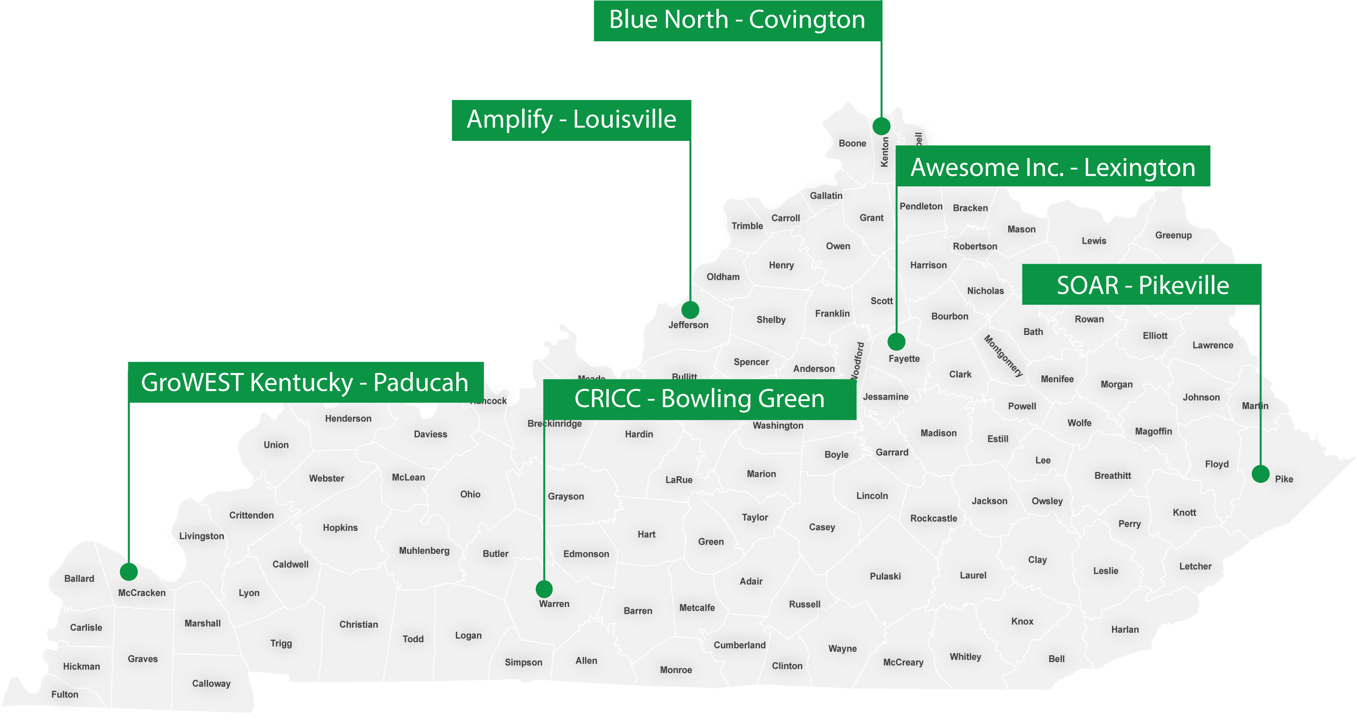
STATEWIDE
PRESENCE
KY Innovation Hub Headquarters

Slide 25
KENTUCKY COMMERCIALIZATION VENTURES (KCV)
A public-private partnership to create market-ready products, services and businesses from research and intellectual property developed at Kentucky’s public colleges and universities by:
Working with inventors at public colleges & universities statewide
Identifying and advancing innovations
Helping to license and protect intellectual property (IP)
Moving IP toward market-ready products and services
Creating high-growth potential startups

Slide 26
KCV PARTNER NETWORK
Kentucky Science
and Technology Corp.
KY Innovation
Morehead State University
Kentucky State University
University of Louisville
Kentucky Commercial Ventures
University of Kentucky
Kentucky Community & Technical College System
Northern Kentucky University
Northern Kentucky University
Murray State University
Eastern Kentucky University
Western Kentucky University

Slide 27
KENTUCKY SMALL BUSINESS TAX CREDIT
Non-refundable tax credit for businesses creating full-time jobs and investing $5,000 or more in qualifying equipment or technology
Tax credits range from $3,500 to $25,000 per calendar year per applicant business
Job creation is the driver!

Slide 28
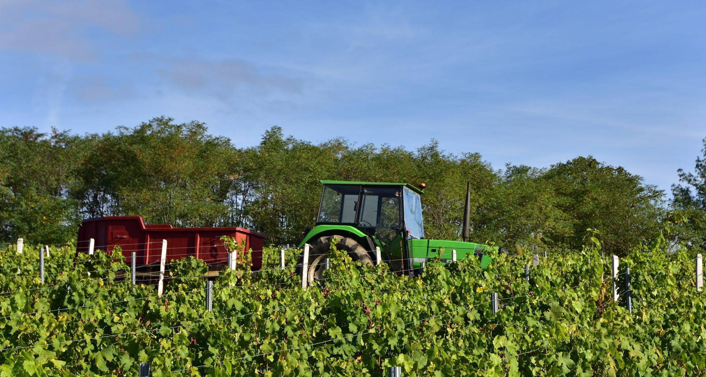
KENTUCKY SELLING
FARMER TAX CREDIT
Encourages continued use of agricultural land for farming by granting tax credits to selling farmers who agree to sell agricultural land and assets to beginning farmers
Farmers wanting to sell agricultural land and assets may be eligible for a Kentucky income tax credit up to 5% of the purchase price of qualifying agricultural assets, subject to a $25,000 calendar year cap and a $100,000 lifetime cap

Slide 29
THANK YOU

