Slide 1
Alliance Water Resources, Inc. Operations Update
Martin County Water Districts
September 16, 2024

Slide 2
Project Updates
Upcoming Projects
Operations Update
Discussion/Questions

Slide 3
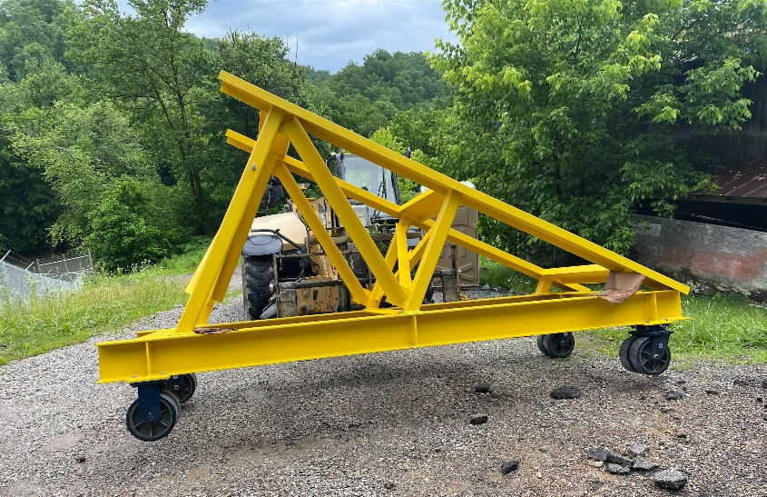
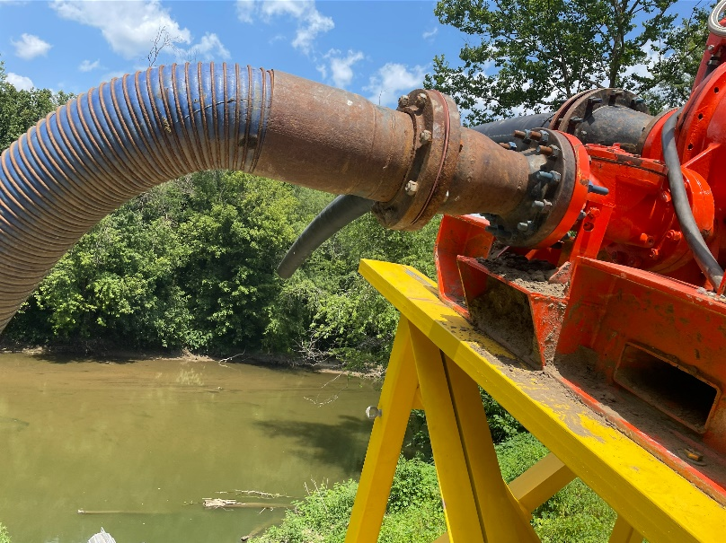
Raw Water Project Update
Raw water trailer delivered
Pump & motor have been mounted to trailer
VFD has been tested and ready to operate
Connecting the pump to the floating screen is only remaining task
Parts for the connection have been ordered

Slide 4
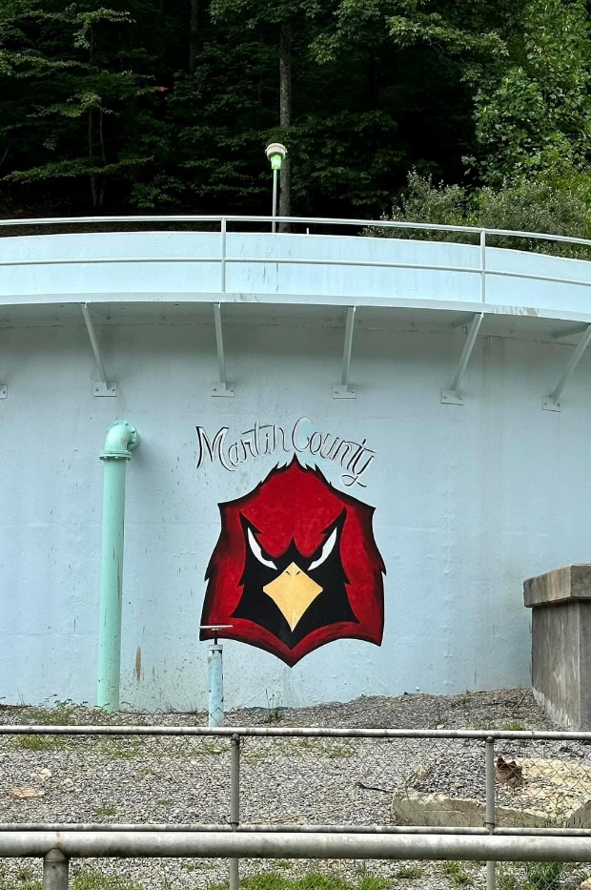
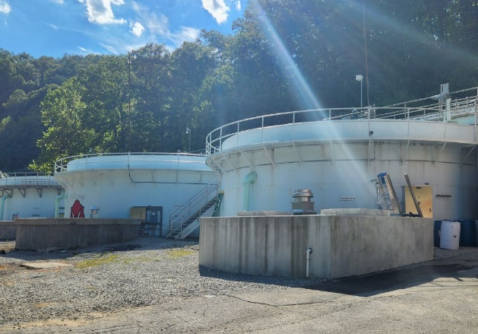
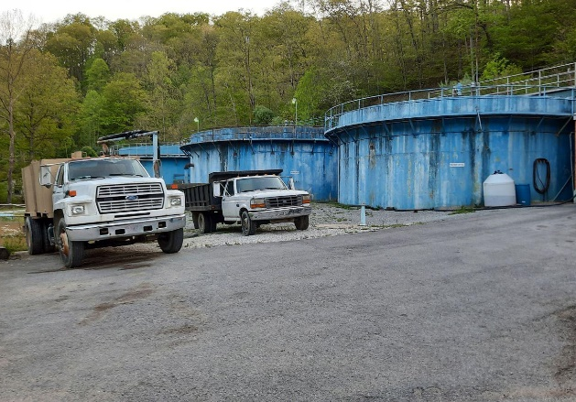
Clarifier # 3 Rehab
New tube settlers installed
Inside basin was repaired and painted
New chain installed on rotating arm
Bearings and sprocket installed
Filters 5 & 6 disinfected
Put in service 9/10/2024

Slide 5
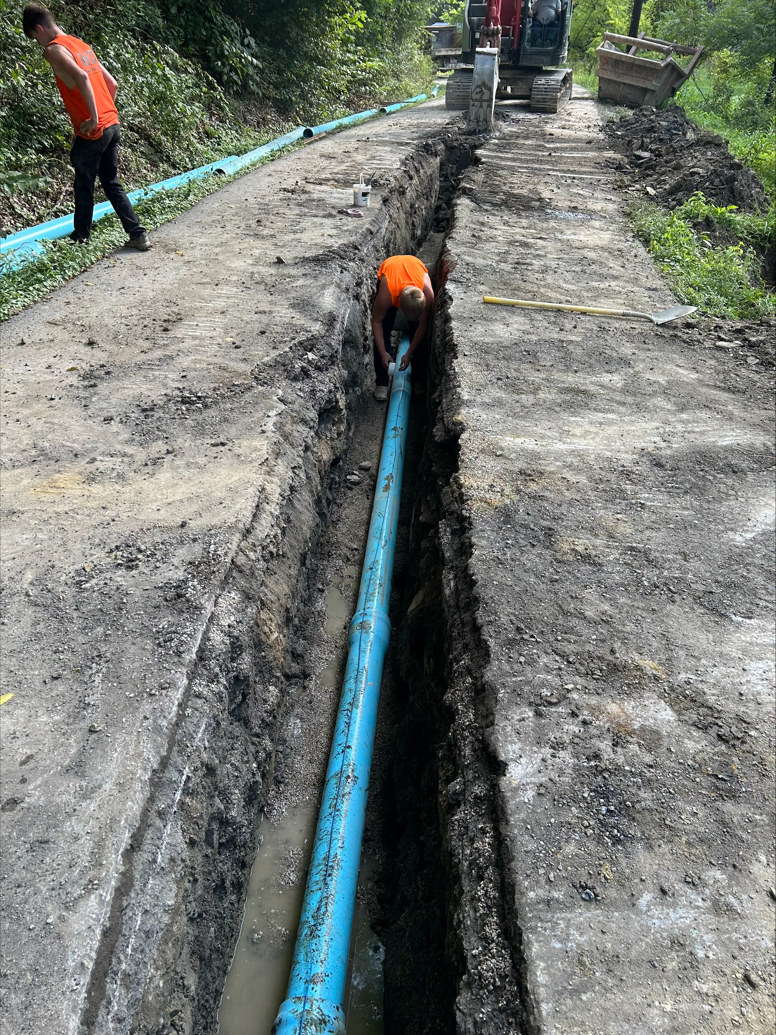
Additional Capital Projects
Collins Creek Project – main line replacement complete. Service lines and meters in progress.
Telemetry – 292 pump station is currently being operated locally and no controls at WTP – this will allow the plant operators to see tank levels and control operation at plant

Slide 6
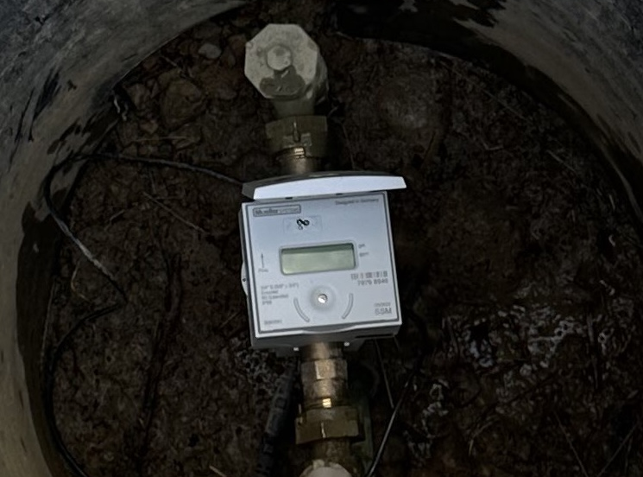
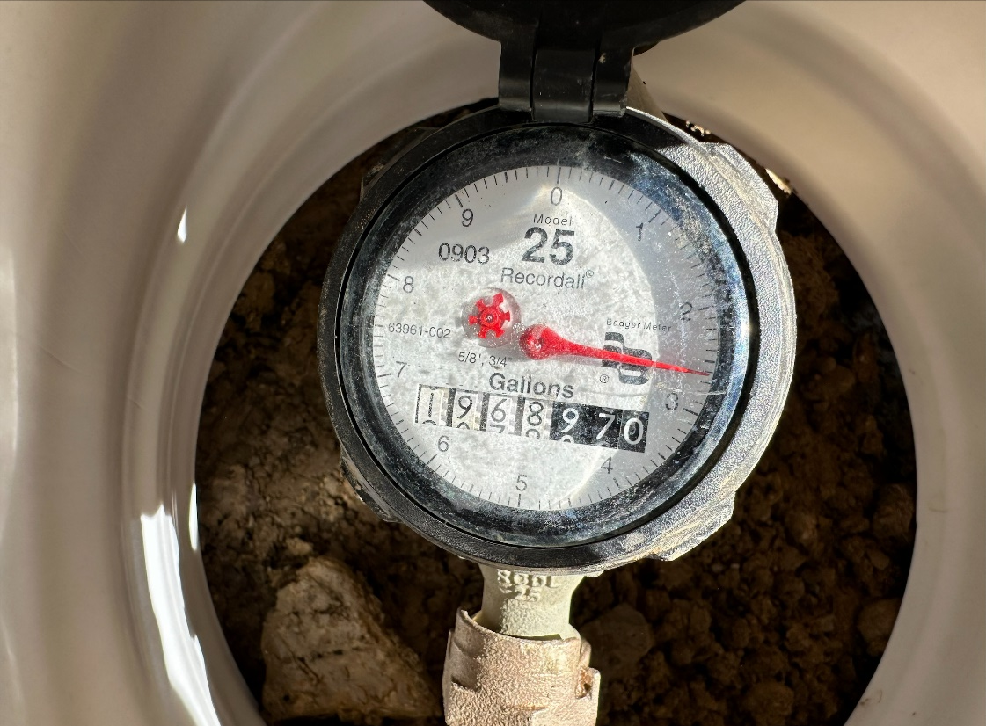
Upcoming Funded Projects
Water Meter Replacement – 2 million was funded to replace all the water meters in the system – pressure zone meters will be included
Turkey Tank Rehabilitation – $681,000 was funded to rehab the Turkey tank – will include painting and adding fence for security
Otto Brown Pump Station and Line Replacement –2 million funded project - will replace approx 20,000 feet within the service area as well as replace existing pump station – station currently is below ground and only designed with one pump
Water Line Relocations– These projects are being funded by the state highway department to relocate water mains for road improvements– several of these are in suspected high water loss areas

Slide 7
Projects that District have Applied for Funding
Downtown Inez Water Line Replacement – This will address the oldest lines in the distribution system – phase 1 of this project will include replacing the AC water mains and service line for 200 customers
Coldwater Water Replacement – This will replace approximately 40,000 feet of water main – Will also include new service line for 240 customers
Old Route 3 Water Replacement – This will replace approximately 24,500 feet of water main – Will also include replacing service line for 200 customers
Spicy Mountain Water Extension– This project would add up to 8 new customers that currently have no access to water. It would also include a small tank and a regional connection to Paintsville
Raw Water System Improvements – This will address rehabbing clarifier # 2 and work at the reservoir including valves

Slide 8
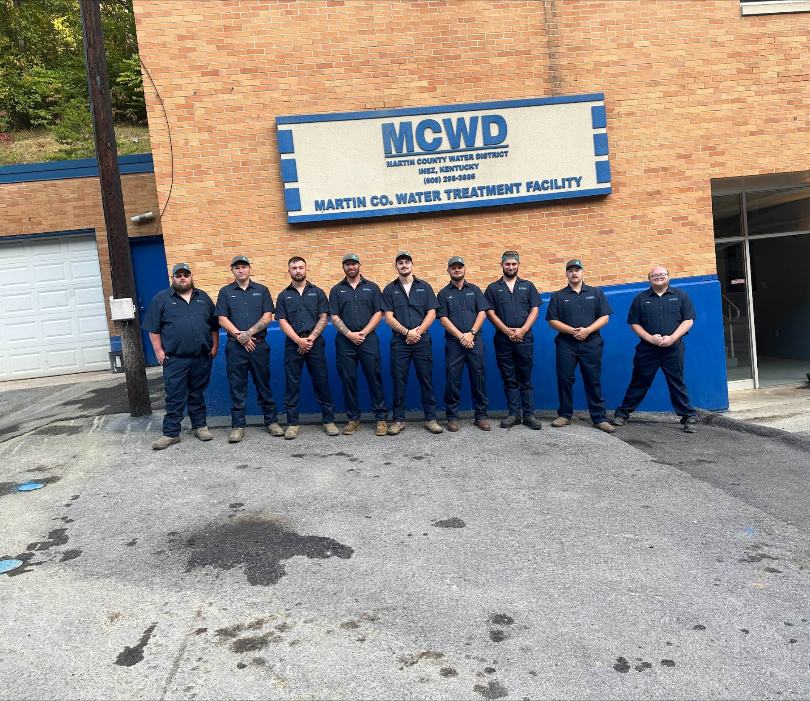
Operations Update
Water Plant has produced 328,697,000 YTD 2024.
Clarifier # 1 put back in service
District has been able to maintain tanks at full capacity
Reservoir is above 3rd screen
Sludge Valve for clarifier # 2 replaced
District is fully staffed

Slide 9
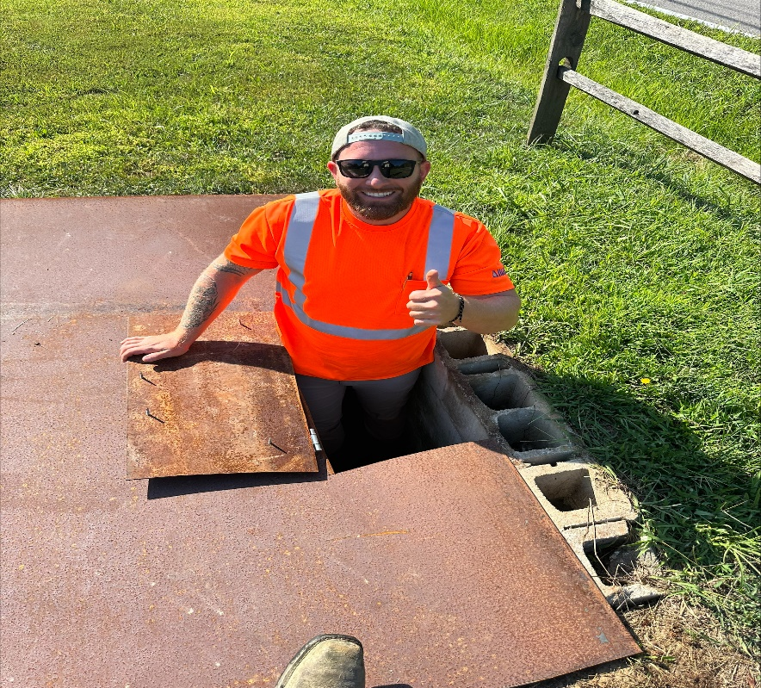
Operations Update
Installed new pumps in multiple pump stations: Otto Brown, Devella, Big Elk – to address redundancy issues
Organized Distribution Conex and established working inventory program
Pump station and Tank sites roads and housekeeping addressed
Sanitary Survey conducted early 2024 – all nonsignificant deficiencies have been addressed
Lead service line inventory currently 90% complete – Currently field verifying unknown service lines – District will meet the filing deadline
Class IV Water Treatment Operator | 3
Class III Water Treatment Operator | 1
Class II Water Treatment Operator | 1
Class I Water Treatment Operator | 1
Class III Water Distrubution Operator | 5
Class I Water Distrubution Operator | 1

Slide 10
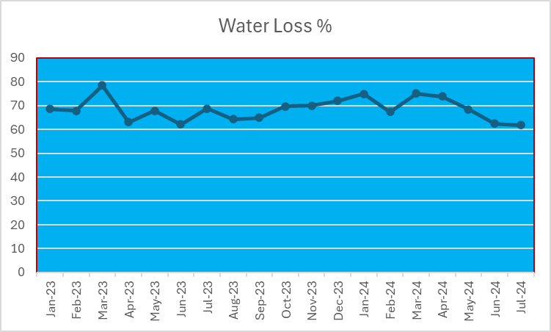
Water Loss Program
Month | Water Loss % | Total Produced | Leaks Repaired
Jan-23 | 68.54 | 49,870 | 10
Feb-23 | 67.75 | 40,811 | 31
Mar-23 | 78.49 | 50,762 | 25
Apr-23 | 62.98 | 46,018 | 18
May-23 | 67.87 | 47,131 | 12
Jun-23 | 62.13 | 41,875 | 24
Jul-23 | 68.76 | 48,378 | 16
Aug-23 | 64.18 | 45,499 | 26
Sep-23 | 64.93 | 42,694 | 23
Oct-23 | 69.68 | 43,594 | 19
Nov-23 | 69.98 | 42,751 | 24
Dec-23 | 71.88 | 46,035 | 20
Jan-24 | 74.86 | 46,917 | 20
Feb-24 | 67.37 | 45,892 | 14
Mar-24 | 75.09 | 47,418 | 13
Apr-24 | 73.83 | 47,202 | 16
May-24 | 68.47 | 47,963 | 18
Jun-24 | 62.43 | 44,693 | 34
Jul-24 | 61.83 | 48,612 | 36
Dedicated water loss crew working daily to identify leaks
Purchased new equipment for leak detection May of 2024
Installed check valves at booster stations to prevent water from flowing back thru plant
Flow meters and pits are being used to pinpoint high water loss pressure zones

Slide 11
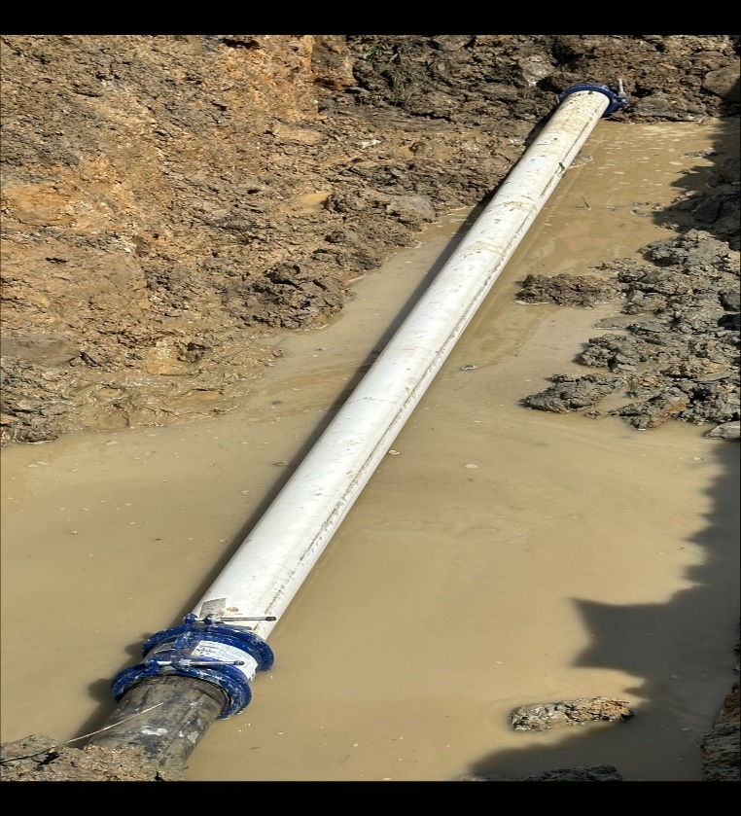
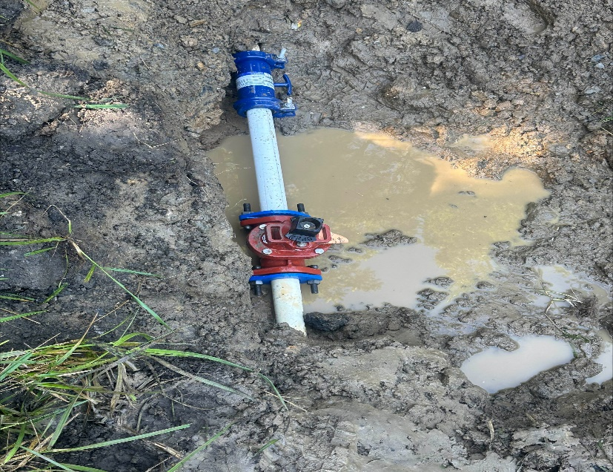
Water Loss Update
Have repaired 190 leaks thru end of August 2024
PRV’s are being adjusted as leaks are being repaired
Dedicated crew making repairs daily
Installed 12 valves throughout troubled pressure zones to help isolate and improve leak detection program

Slide 12
Water Loss Update

Slide 13
Questions?

