Slide 1
Kentucky Public Drinking Water System Capacity Development Annual Report Federal Fiscal Year 2023

Slide 2
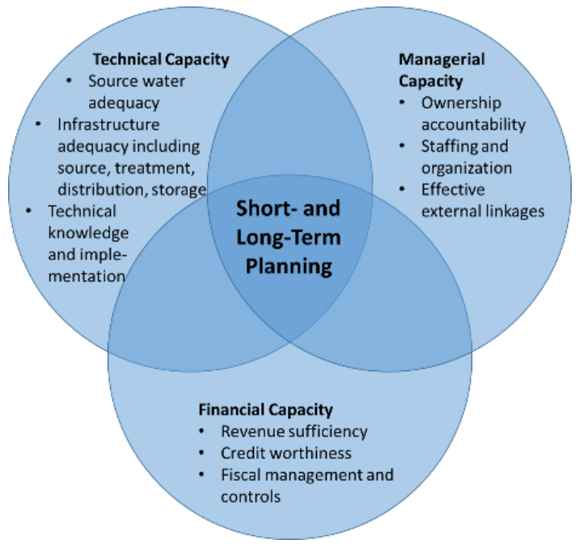
Capacity Development
Technical, managerial, and financial (TMF) capability to consistently provide safe drinking
Everyone is involved
Notes:
Capacity Development is a process to help public drinking water systems acquire and maintain the technical, managerial, and financial capacity, or capability, to consistently produce safe drinking water.
It takes the combined effort of water system(s), the public, local government, state agencies, organizations, and stakeholder groups to make this happen.
What is TMF capacity?
Technical capacity is having adequate source water, infrastructure, knowledge, and ability
Managerial capacity is having adequate institutional and administrative capabilities
Financial capacity is having adequate revenue, credit, and fiscal management

Slide 3
Program History
Created under Safe Drinking Water Act Amendments of 1996
Section 1420(a) – New Systems
Section 1420 (c) – State Capacity Development Strategy
Section 1452(a)(3) – Assessment of Capacity
America’s Water Infrastructure Act of 2018
Kentucky's current Drinking Water Capacity Development Strategy was approved by EPA in March 2023.
Reporting: Triennial Report to the Governor and Annual Report
Notes:
Program was created with 1996 amendments to the SDWA along with creation of the Drinking Water State Revolving Fund program
3 major components of the program:
1420(a) – Under penalty of DWSRF withholding, state must have a program established to ensure all new community water systems and non-transient, non-community water systems starting operation after October 1, 1999, demonstrate TMF capacity with the SDWA
1420(c) – Under penalty of DWSRF withholding, the State must develop and implement a strategy to assist public water systems in acquiring and maintain technical, managerial, and financial capacity
1452(a)(3) – States may not provide DWSRF loan assistance to systems which lack TMF capacity or if the system is in significant non-compliance
However: State may provide assistance if the it will ensure compliance and the system has agreed to make the necessary changes in operation to ensure it has the capacity to comply over the long term
4. Kentucky’s capacity development strategy outlines the methods EEC uses to identify and prioritize systems most in need of improving capacity; identifies factors the encourages and impairs capacity development; describes how EEC will use its primacy authority to assist water systems in training building partnership and TMF capacity; Identify those having an interest and getting them involved in the development and implementation of the CD strategy
The strategy and reports are hyperlinked to DOW’s Capacity Development webpage
Failure of Kentucky to comply with these EPA can withhold 20% of the CAP Grant

Slide 4
Violation Trends
Notes:
SDWA violations remain low
Majority of violations are monitoring & reporting in nature
Increase in health-based violations due to disinfection by-products

Slide 5
TMF Capacity Assessment
Community Systems
Non-Community Systems
Notes:
TMF capacity assessment is conducted during the sanitary survey every three years at community water systems and every five years at non-community water systems
In 2023, DOW began transferring historic sanitary survey data stored in PDFs to Survey 123 as well as collecting new data using the Survey 123 app. Survey 123 allows the DOW to more efficiently collect, extract, and analyze sanitary survey.
Data shows that most community systems do not have adequate managerial & financial capacity
Nearly all non-community systems have inadequate capacity
Currently the criteria used to assess TMF capacity is the same among community and non-community water systems. EEC may need to investigate with stakeholders if non-communities should be evaluated differently

Slide 6
Unfavorable Capacity Responses
Non-Community Systems
Community Systems
Notes:
Using Survey 123 we can now assess responses from systems question-by-question to determine which are answered unfavorably and are causing them to lack capacity
Most of the unfavorable responses from community and non-community systems dealt with management and finances
Under Kentucky’s current strategy, if a system answers one technical, managerial, or financial capacity assessment question unfavorably, then the system is deemed to lack capacity
For us, we can now easily analyze data at a detailed level. Prior to transferring data from old PDFs to Survey 123, data analysis was time consuming and labor-intensive. This improves our ability to understand where training and technical assistance is needed at systems

Slide 7
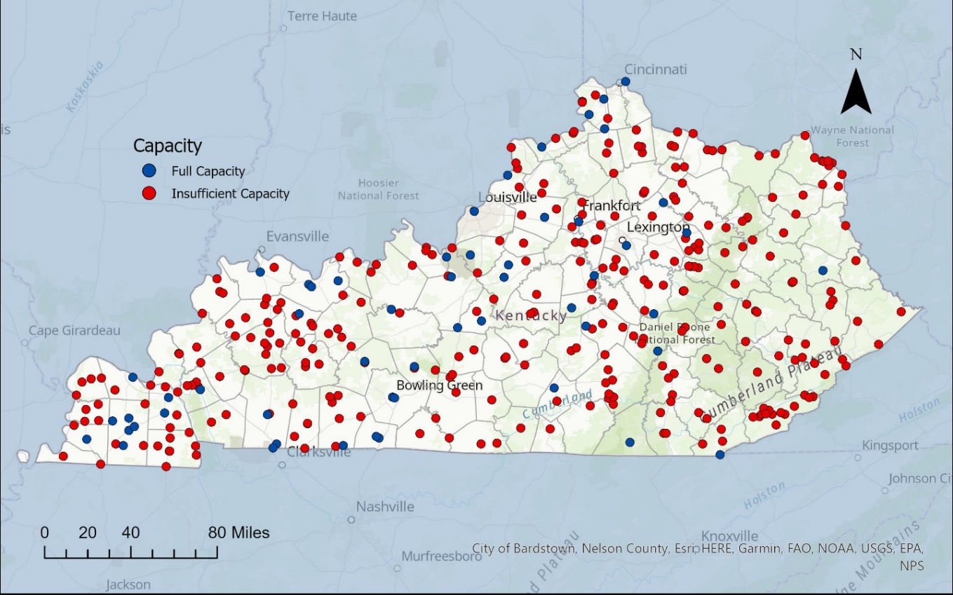
Community Public Drinking Water System TMF Capacity
Notes:
Map showing community water systems with sufficient (full) capacity in blue and community systems with insufficient capacity in red. Community public drinking water systems with insufficient capacity is pervasive across the state.

Slide 8
Community Public Drinking Water System TMF Capacity by Population
Notes:
Breaking capacity data down by system population, all large systems have sufficient capacity, about 1/3 of all medium systems have sufficient capacity, and less than 10% of small systems have sufficient capacity
Medium and small systems primarily lack capacity in areas of management and finances

Slide 9
Looking Ahead
We have work to do
Continue to promote implementation of asset management planning
Provide KIA assistance with implementing Senate Bill 263
Enhance drinking water data management including an electronic data collection & submittal system for compliance
Revise applicable state regulations to improve TMF capacity of public drinking water systems
Continue collaborative relationships with stakeholders to improve public drinking water system TMF capacity
Notes:
Chapter 8 updates due in 2025.
Plug Sometime in February or early March reconvene the Infrastructure Committee and go into detail on some of the data and re-evaluate what we are asking as part of the Survey.

