Slide 1



20
23
Check Your Pipes
Kentucky
Cortni Edwards, Environmental Scientist Advisor

Slide 2


Lead & Copper Rule Revision
CYP KY Initiative
Brand BUILDING
Resource DEVELOPMENT
Rollout
Special thanks to Dale Booth, Joanna Ashford, Elizabeth Dowling, Kirsten Delamarter, Alicia Jacobs, and the amazing group of interns we had assisting this project!

Slide 3


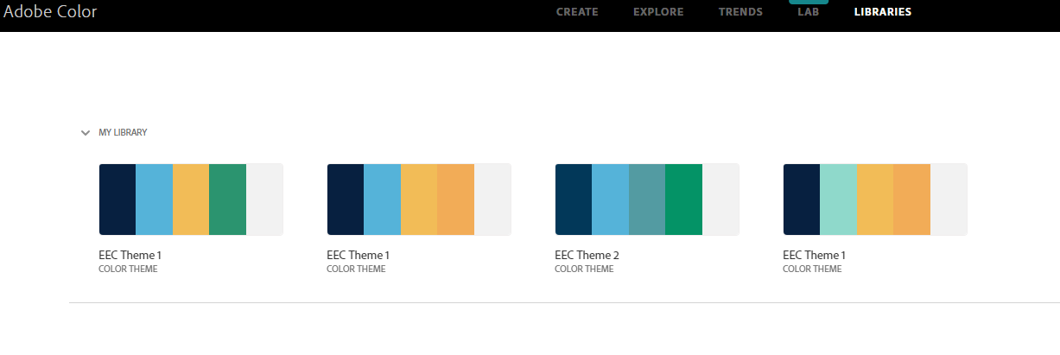




Brand BUILDING

Slide 4
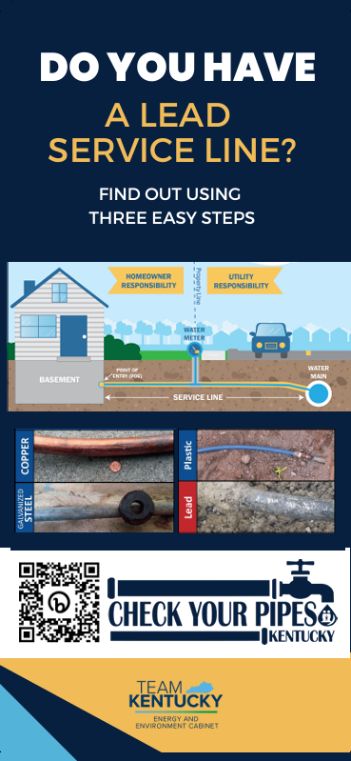
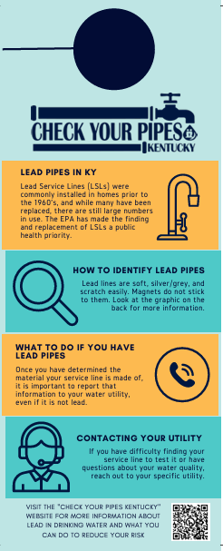

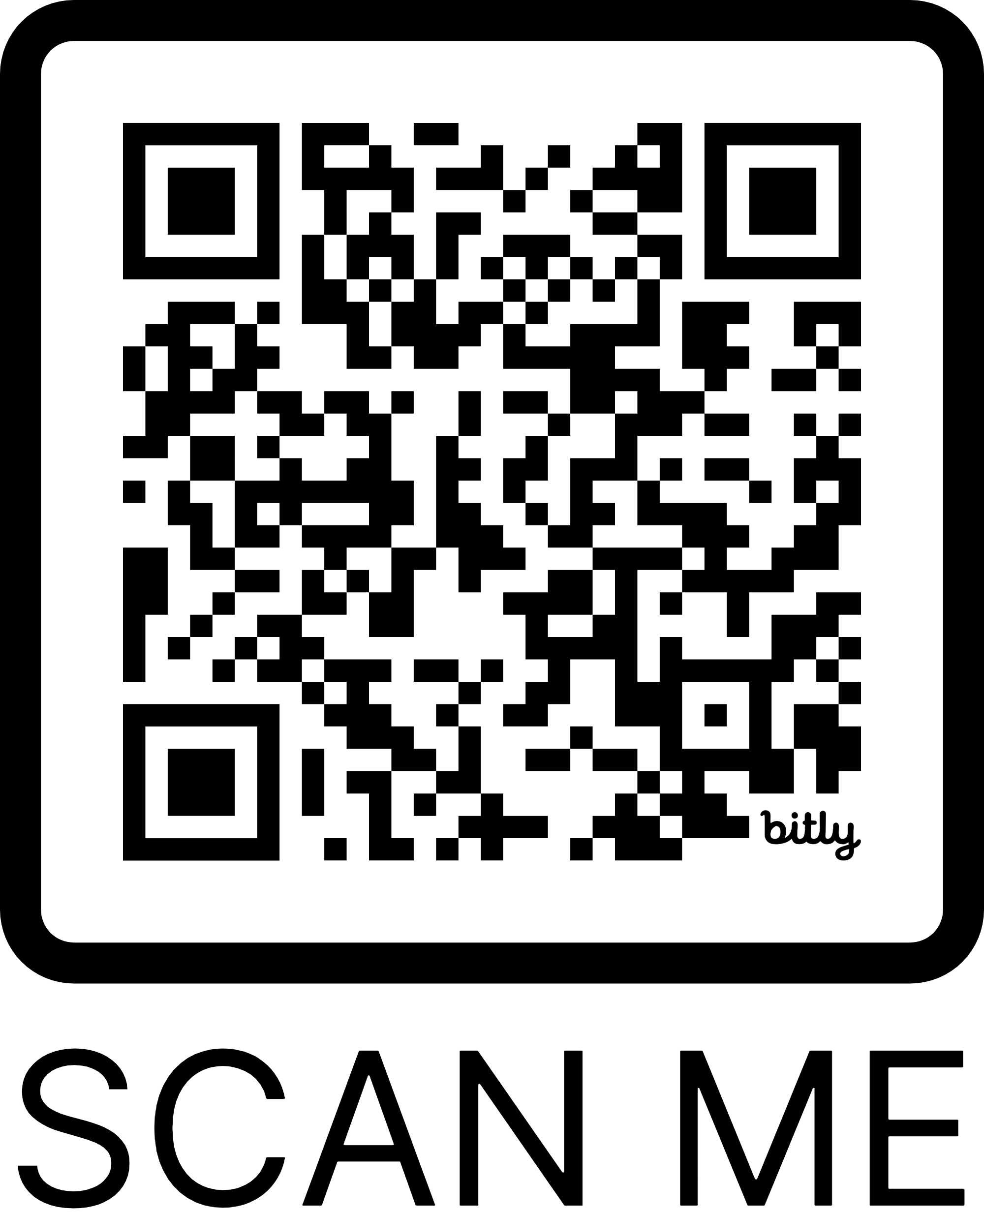
Resource
DEVELOPMENT
bit.ly/cyptoolkit

Slide 5
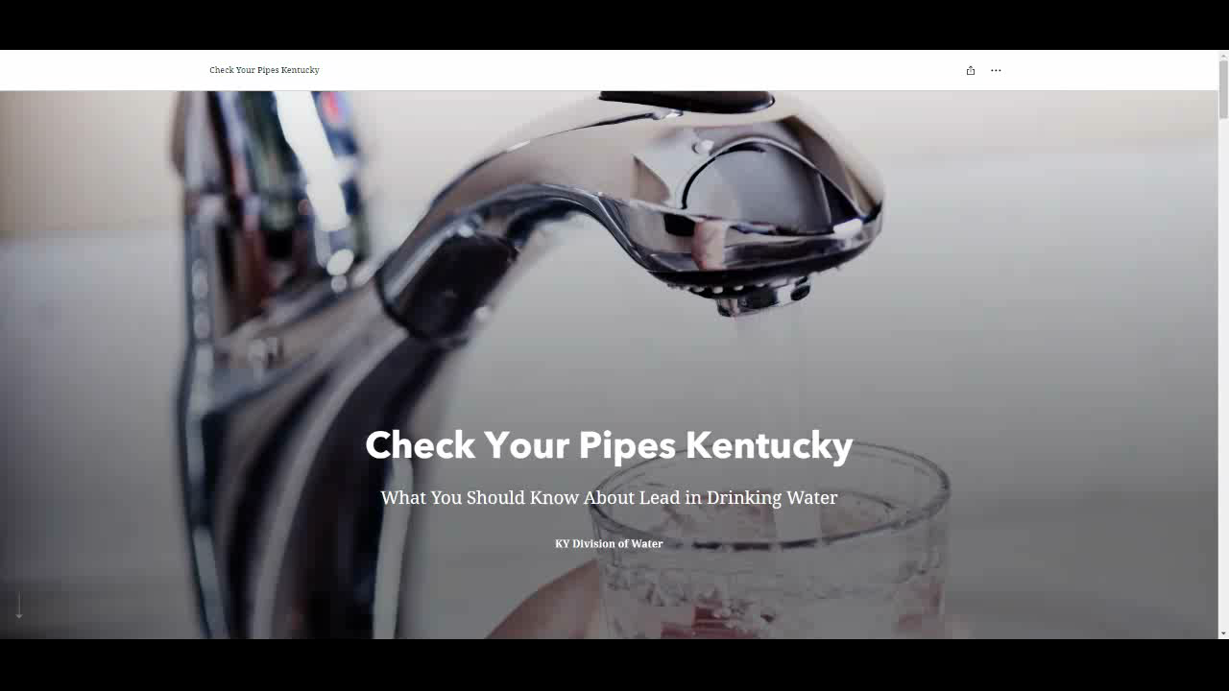
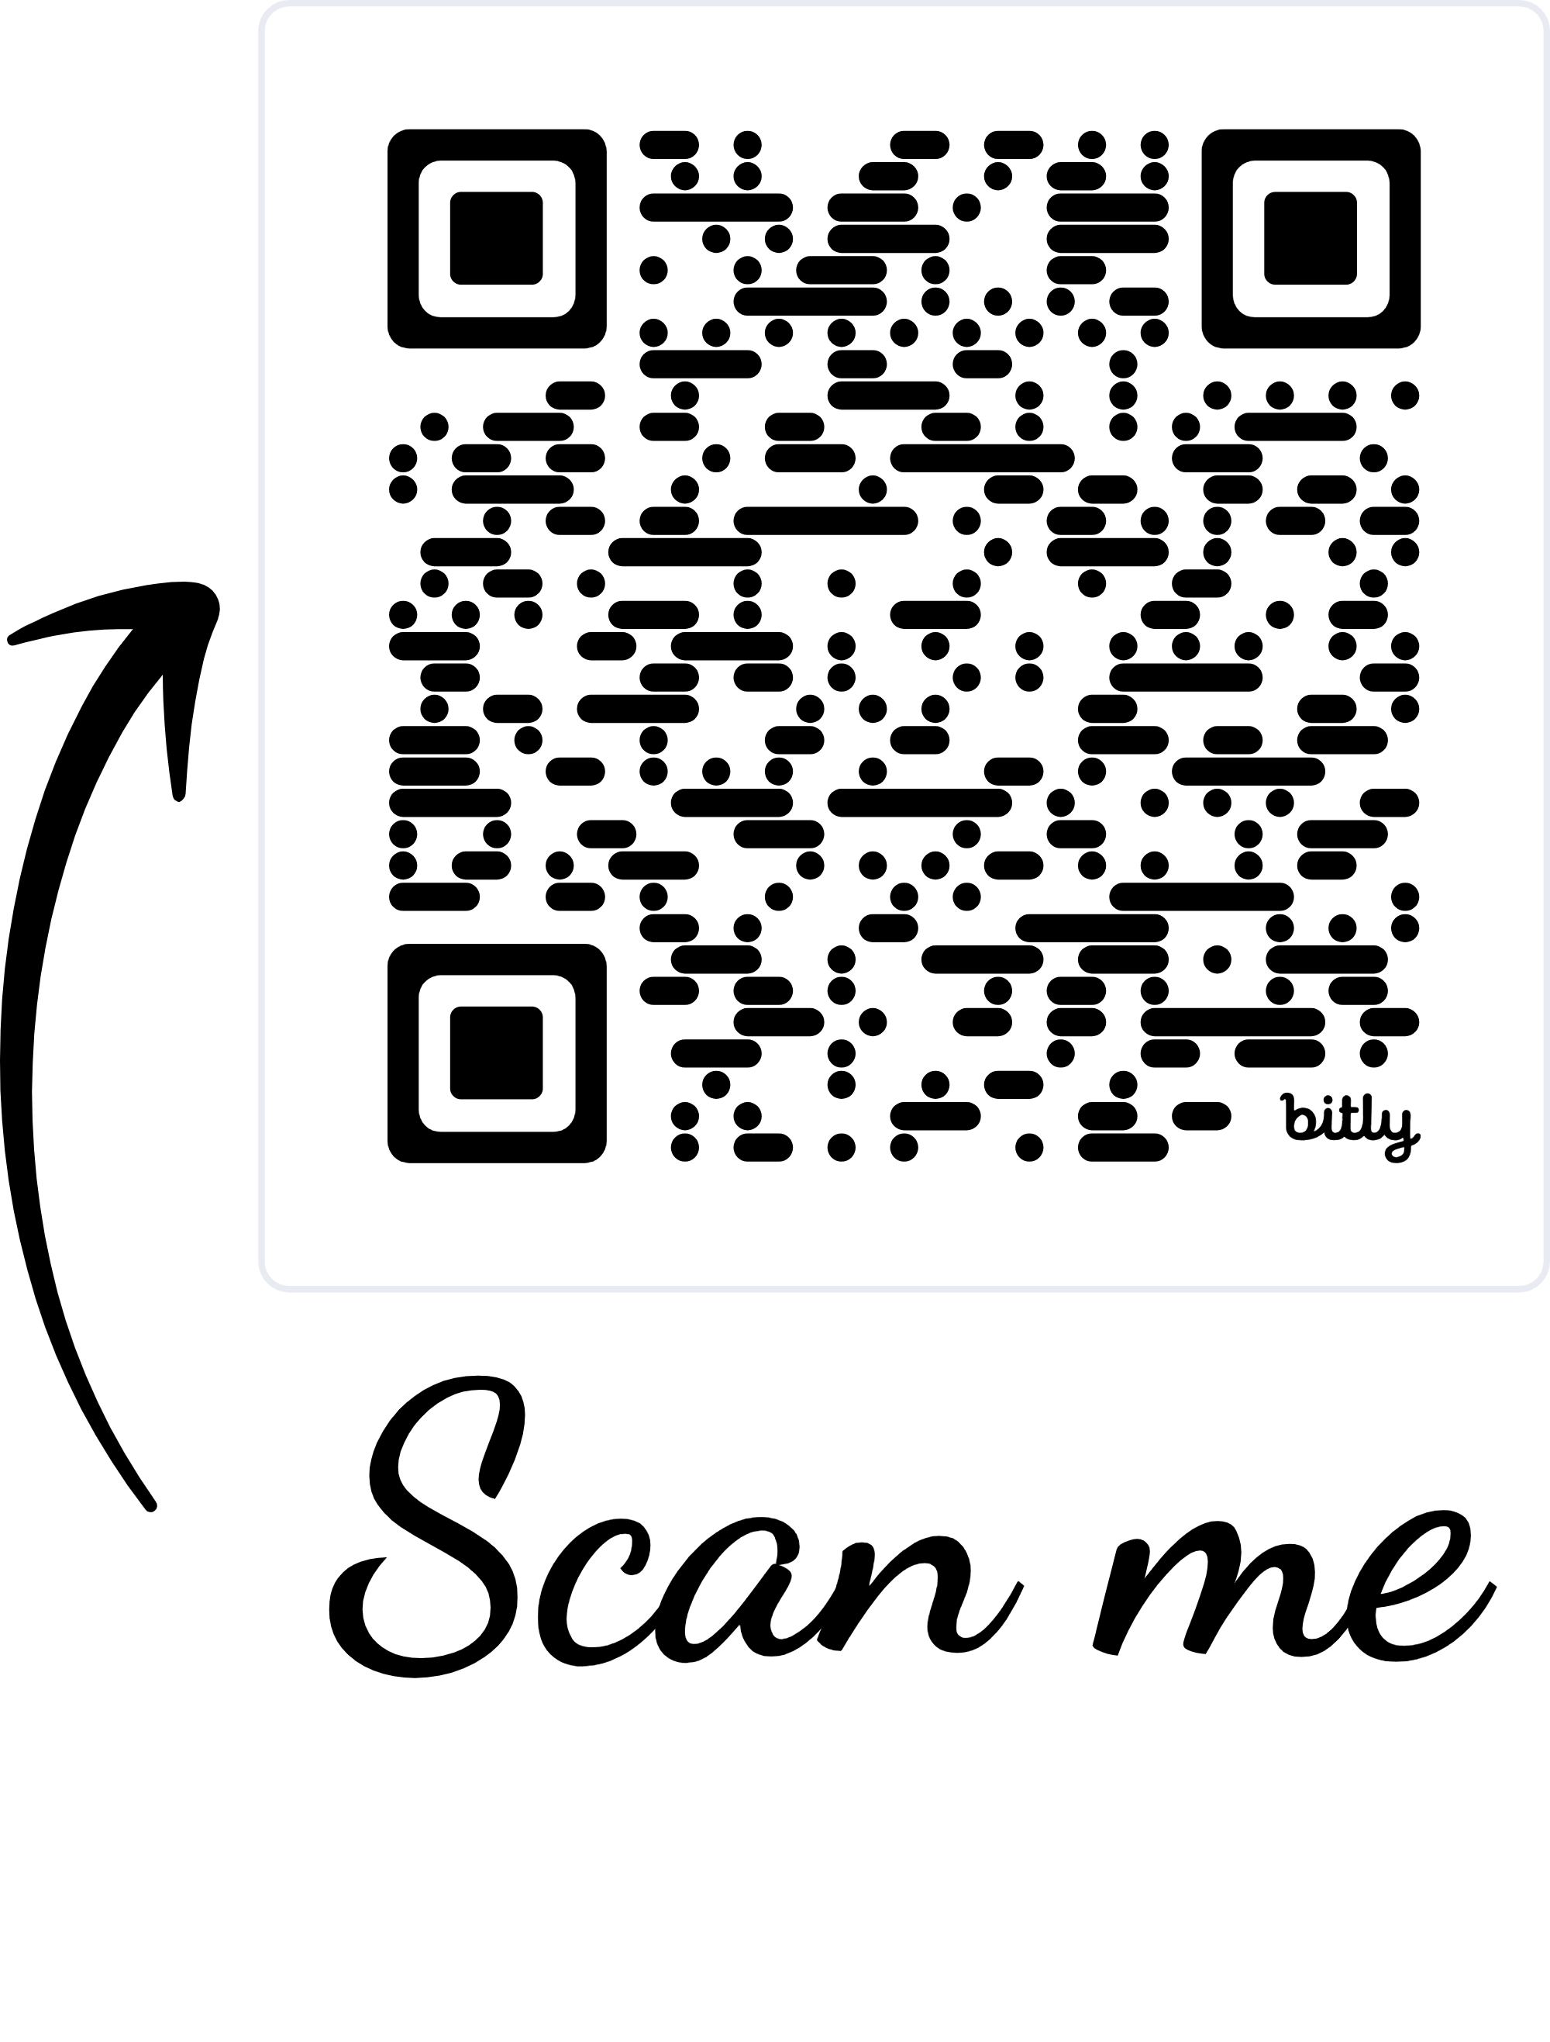
Rollout
bit.ly/checkyourpipesky

Slide 6

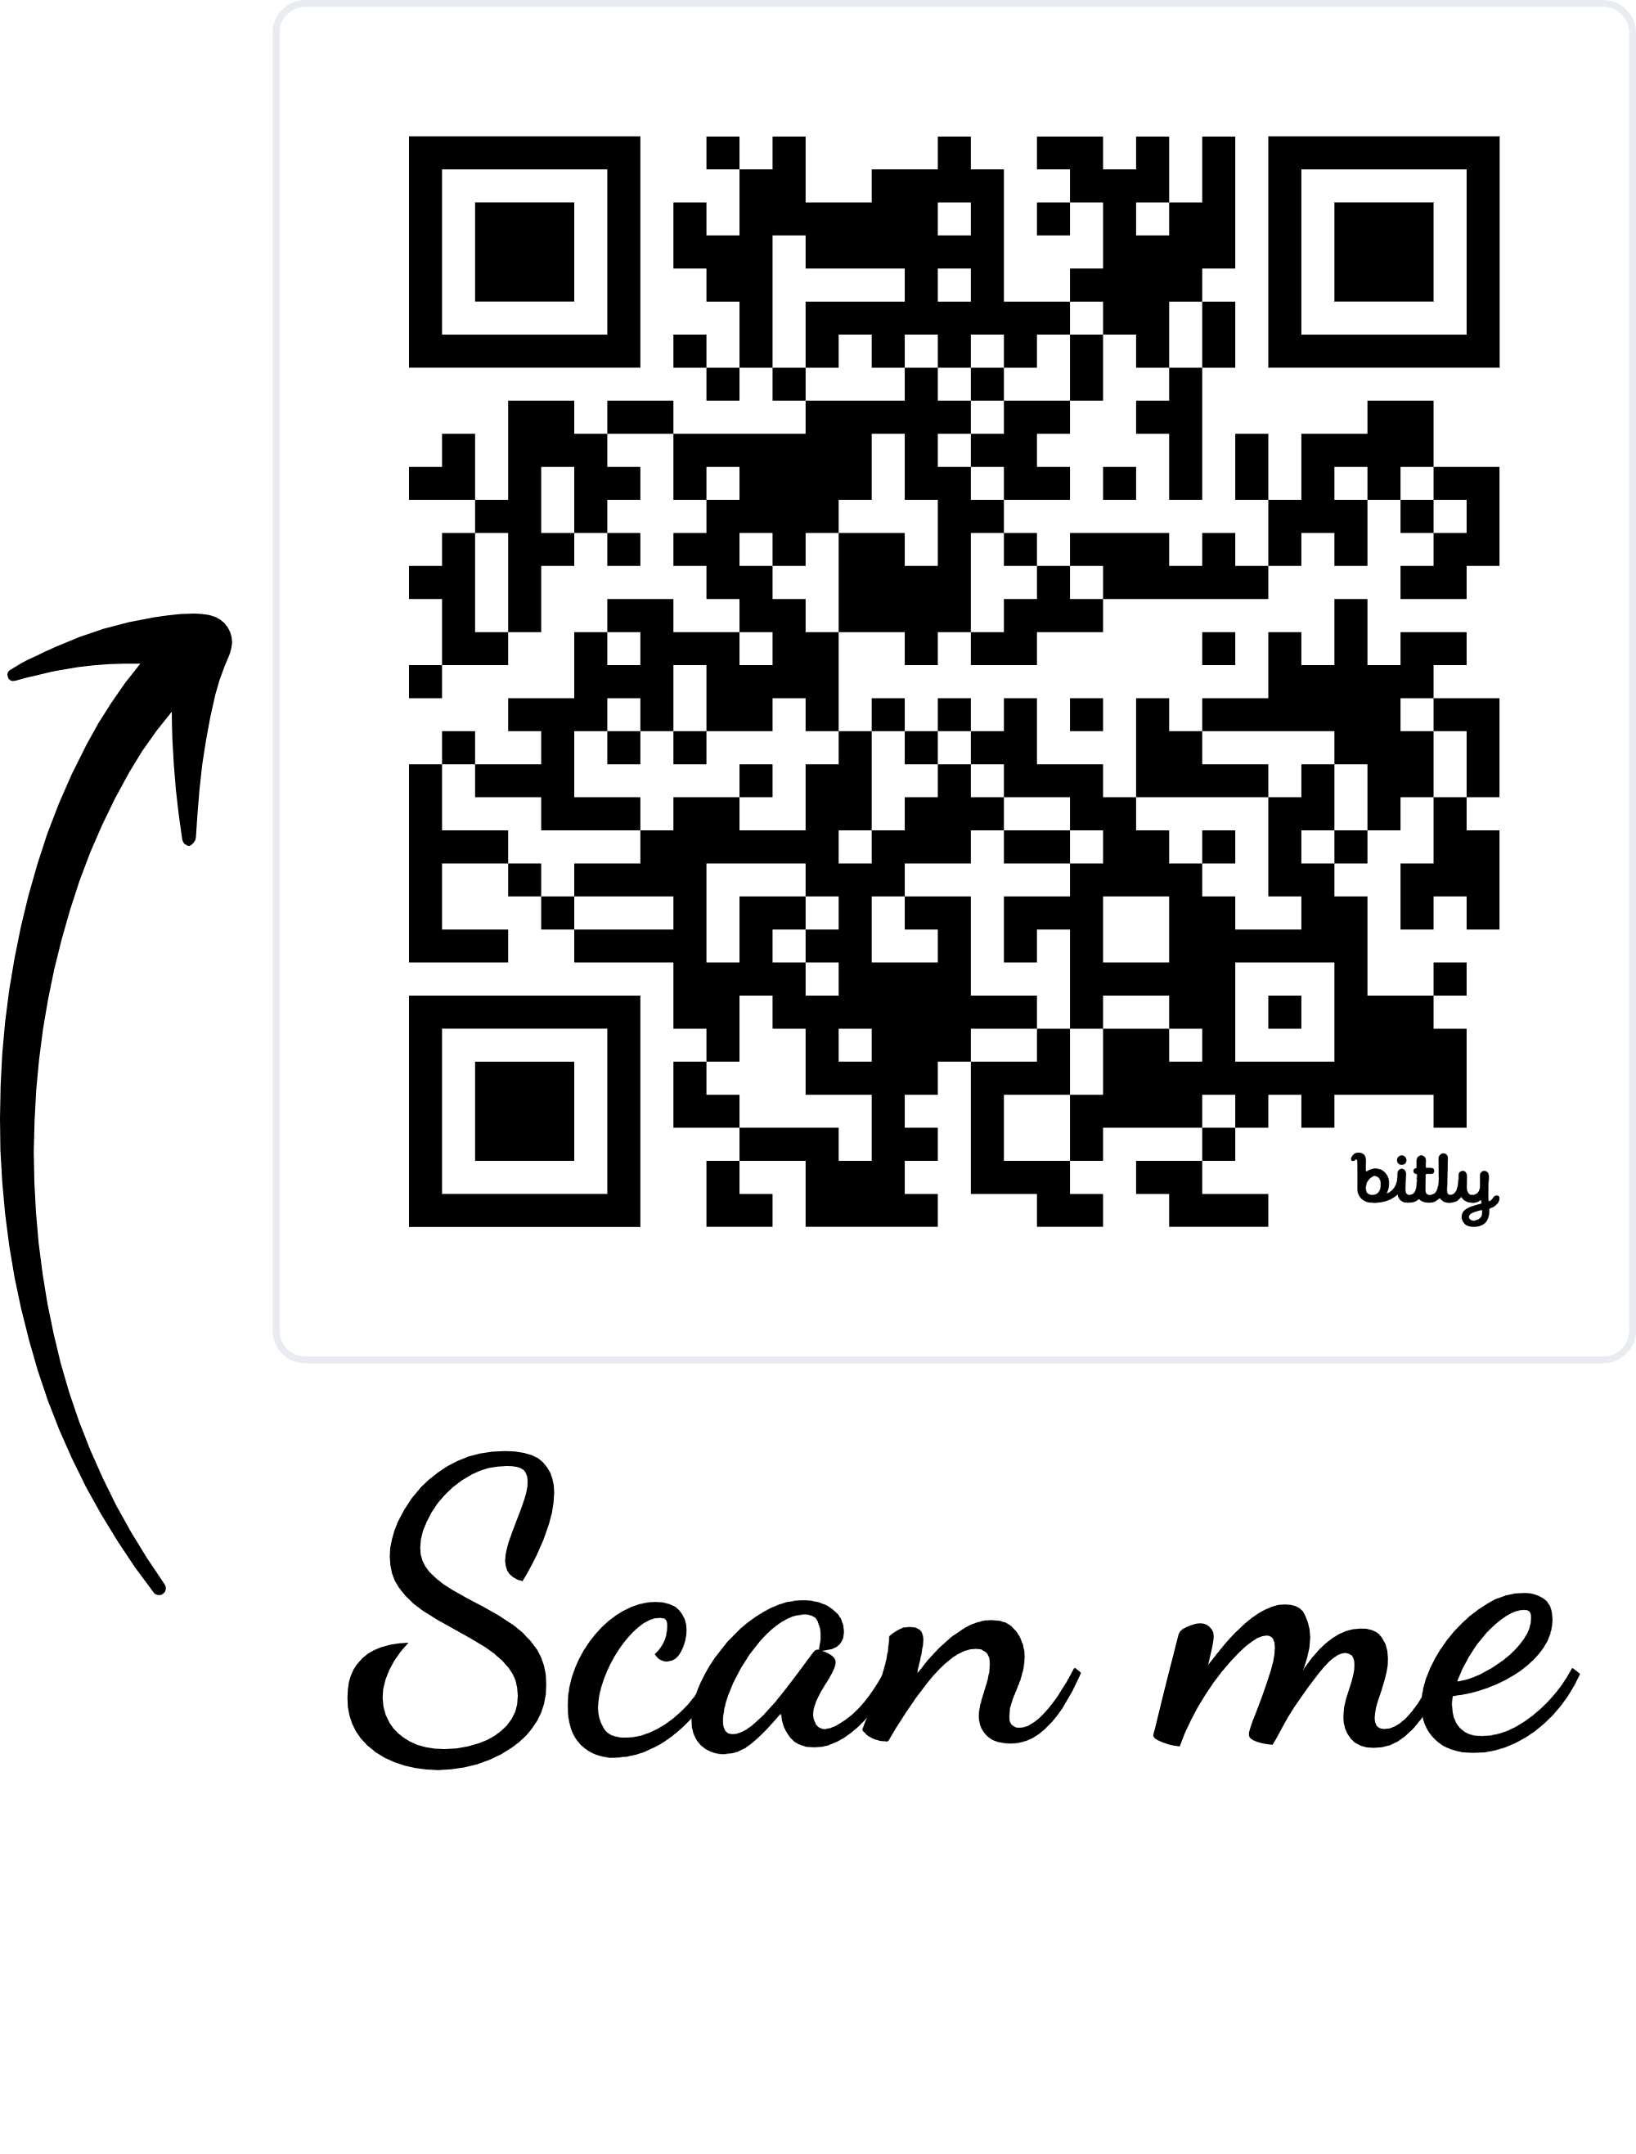
Rollout
https://youtu.be/exu3iCpHfdQ

Slide 7





Further
Projects
LCRI
Continued Outreach
Adjusting resources as needed
Working with systems statewide
Preparing for compliance dates
Providing training and guidance

Slide 8
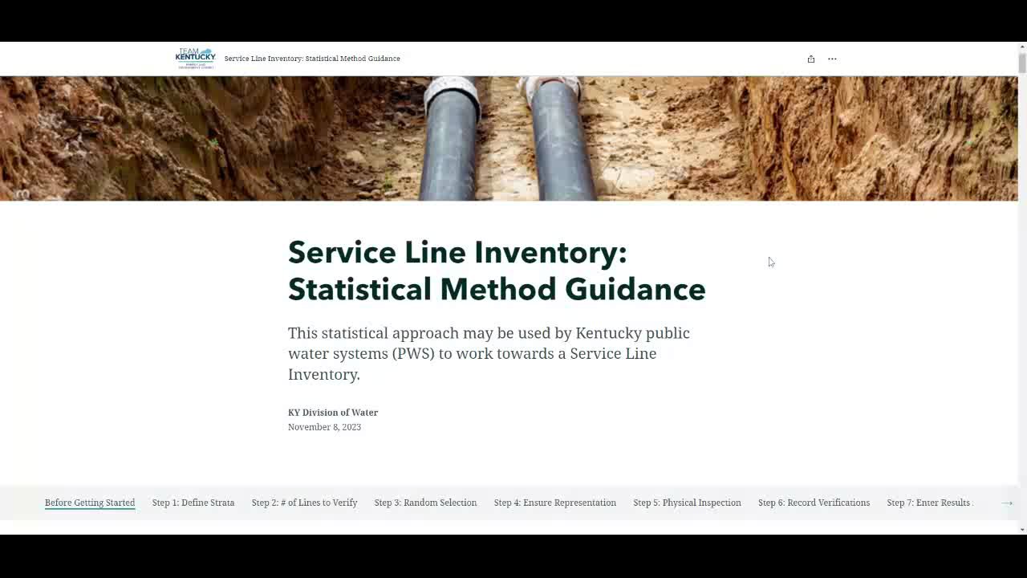
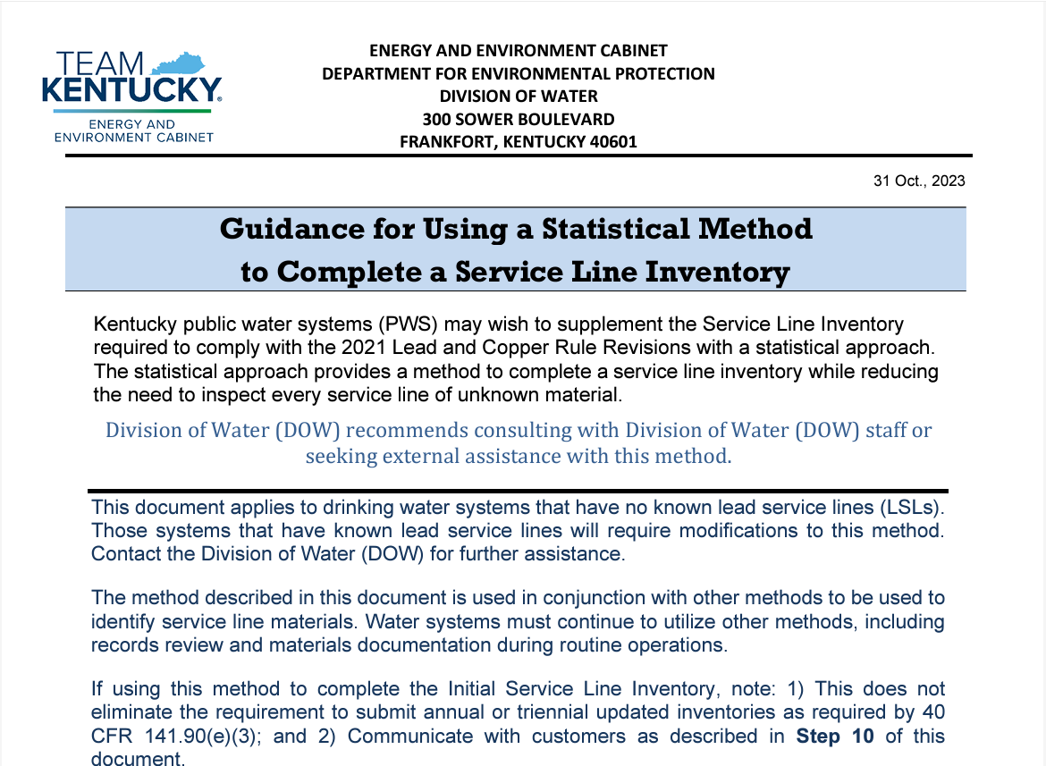
Statistical
Guidance
Huge shoutout to Adrienne Beggs and Elizabeth Dowling on their hard work with this endeavor!

Slide 9
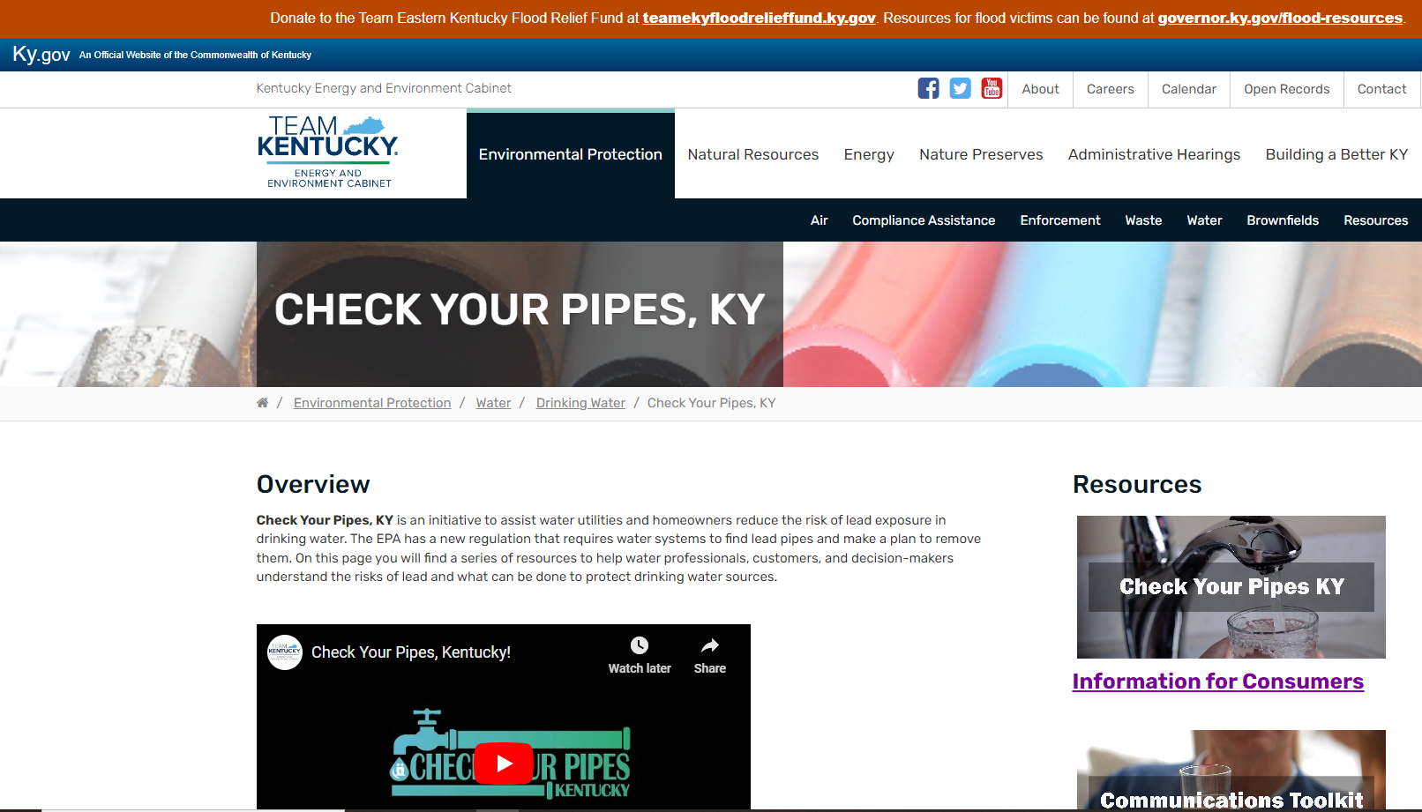
Public comments for the Lead and Copper Rule Improvements are due to EPA by February 5, 2024
Docket ID No. EPA-HQ-OW-2022-0801
Reach out to Cortni Edwards
cortni.edwards@ky.gov
Elizabeth Dowling
elizabeth.dowling@ky.gov

