Slide 1

WATER
CONSERVATION
2024

Slide 2
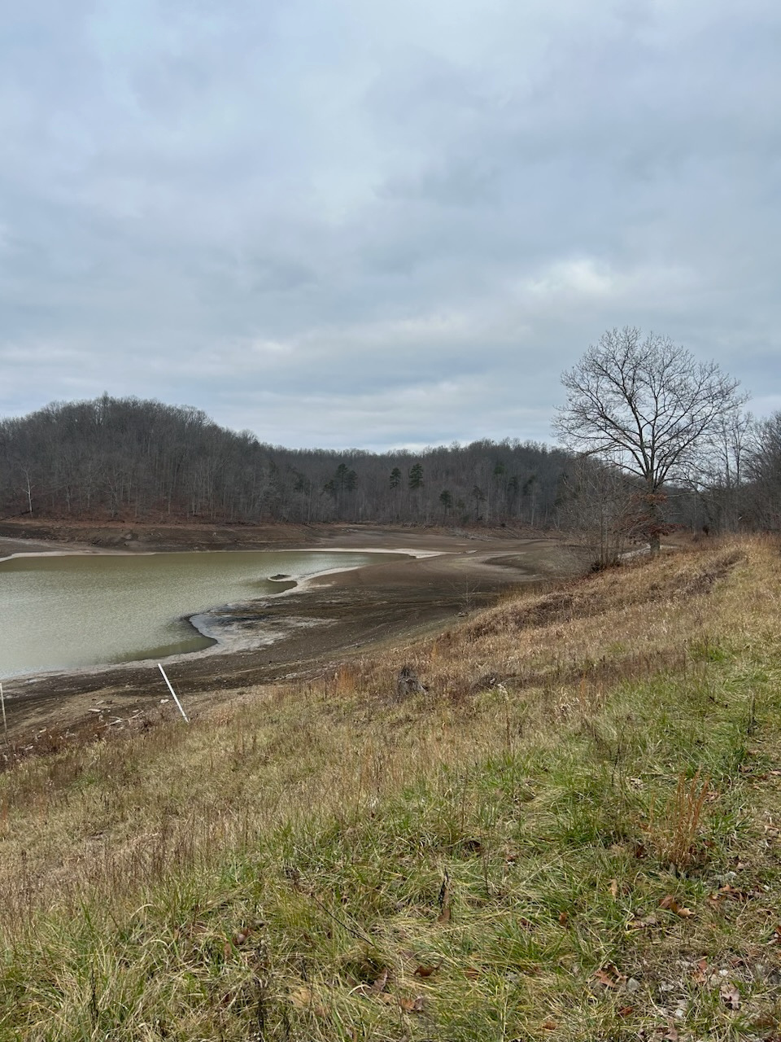
WHY DOES IT
MATTER?

Slide 3
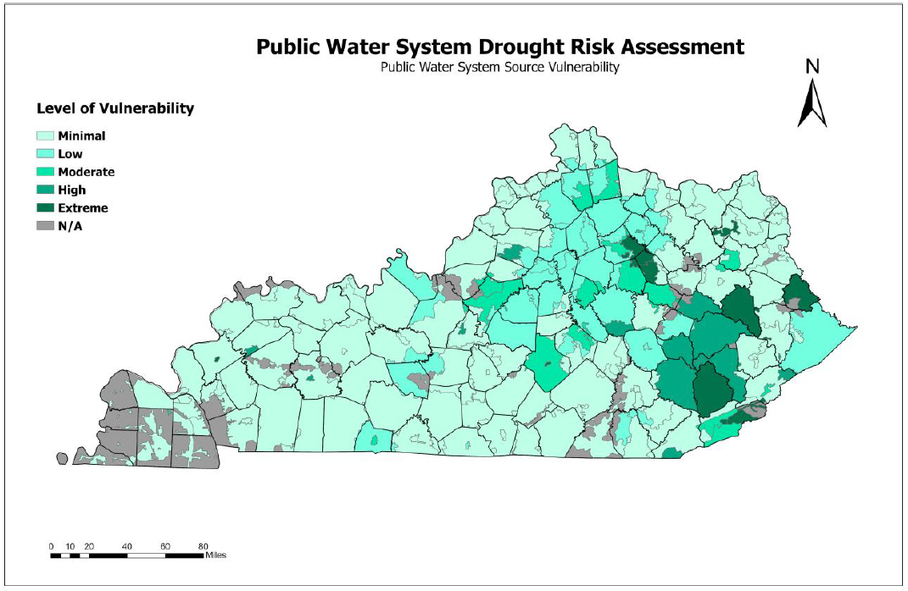
2023 Kentucky Drought Risk Assessment

Slide 4
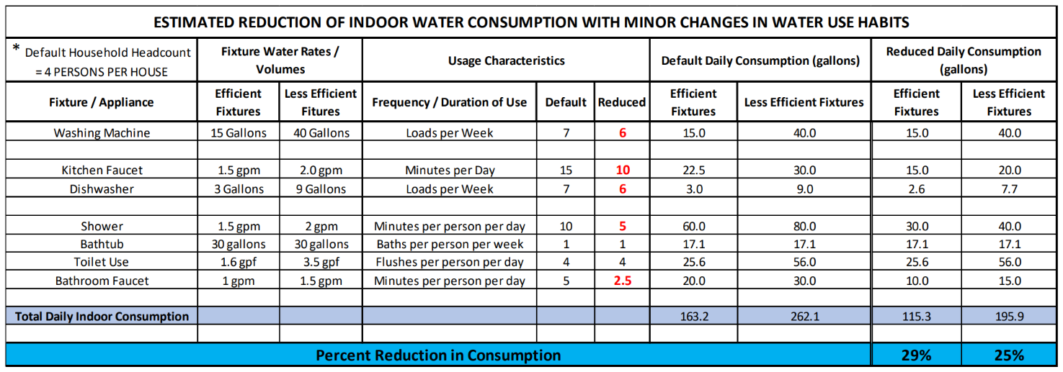
WATER USE
HABITS

Slide 5






WATER USE
Run one less load of laundry per week
HABITS
Limit kitchen faucet to only when necessary
Run one less load in the dishwasher per week
Cut shower times to 5 minutes or less
Limit bathroom faucet to only when necessary

Slide 6
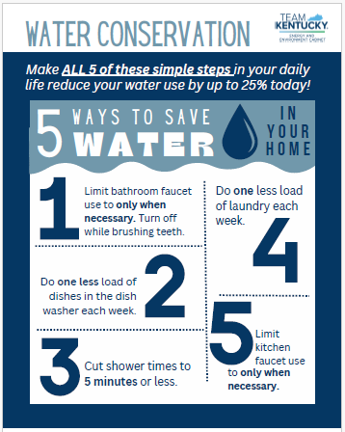
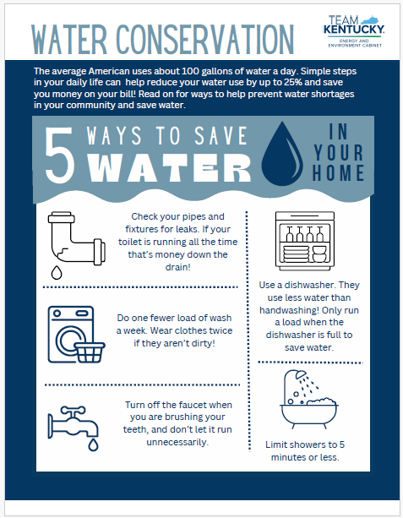
AVAILABLE
RESOURCES

Slide 7



Water Shortage Response Plan Update
NEXT
STEPS
Water Conservation Tool kit
Technical Assistance

Slide 8
THANK YOU
Joanna Ashford
joanna.ashford@ky.gov

