Slide 1


Division of Water
Reduction of Lead in Drinking Water in Schools and Childcare Facilities Program
March 11, 2024
To Protect and Enhance Kentucky’s Environment

Slide 2

What we’ll cover
Overview of the Program
Status Update
How the program benefits Public Water Systems

Slide 3
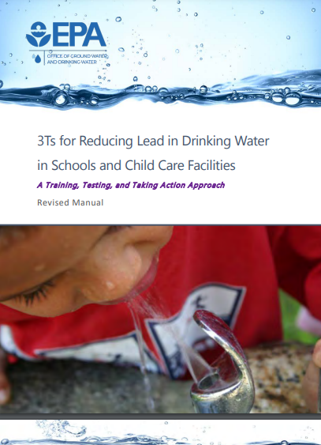
Water Infrastructure Improvements for the Nation (WIIN) grant program
WIIN Act passed in 2016
Authorized EPA to award grants to states to assist with voluntary lead sampling in schools and childcare facilities
Utilizes 3Ts for Reducing Lead in Drinking Water in Schools and Childcare Facilities
Developed program by EPA to assist schools and childcare facilities with a focus on:
Training – education on sources of lead and health effects of lead
Testing – Identify potential problems with lead through sampling
Taking Action – implementing a plan to reduce lead
Communications – establish partnerships and keeping public informed

Slide 4
Kentucky’s Voluntary Lead Sampling Program
Funds from the WIIN grant can be used for sampling, educational purposes and remediation guidance
Schools built after 2014 are not eligible for free sampling under this program
DOW has partnered with Kentucky Rural Water Association to perform sampling.
Prioritizes:
Disadvantaged, low income communities
Schools or childcare facilities with free or reduced lunch programs for 50% of children
Elementary schools and childcare facilities with students aged six years or younger
Facilities built prior to 1986
SDWA amendments in 1986 prohibited the use of pipe, solder, or flux in public water systems that is not “lead free”
Utilizes 3Ts for Reducing Lead in Drinking Water in Schools and Childcare Facilities
KRWA/DOW schedules a date to perform sample collection.
The Public Water System is notified prior to the sampling event
Water must remain stagnant at all outlets for 8 to 18 hours prior to sampling.
Sampling either very early morning or weekend
Two 250 mL samples are collected from each drinking water outlet.
First draw
30 second flush sample

Slide 5
Step by Step Sampling Process
Facility Signs up(on our website)
Pre-meeting to go over sampling process/goals
Inventory Facility
Sample Facility
Analyze Samples and generate report
Send report to facility and upload report to DOW website
Remediation Discussions/Resample as needed

Slide 6
Kentucky’s Voluntary Lead Program Status
 | Number of Facilities
Signed Up | 69
PWS opted to sample | 13
Inventoried | 56
Sampled and Analyzed | 28
Resampled(as needed) | 12
Sampled 241 drinking water outlets sampled and analyzed
Prioritize Drinking Water Fountains/Bottle Fillers and Kitchen Sinks first
Followed by Class Room Sinks/Nurse Sinks
Only sampled Bathroom sinks if used for consumption
Brushing Teeth

Slide 7
Kentucky’s Voluntary Lead Program Status
*Flush samples aren’t analyzed if First draw < 1 ppb

Slide 8
How Voluntary Lead Testing Program can benefit Public Water Systems?
Proposed Lead and Copper Improvements
§ 141.92 Monitoring for lead in schools and child care facilities.
(1) All community water systems must conduct public education and lead monitoring at the schools and child care facilities they serve unless those schools or child care facilities were constructed or had full plumbing replacement on or after January 1, 2014 or the date the State adopted standards that meet the definition of lead free in accordance with section 1417 of the Safe Drinking Water Act, as amended by the Reduction of Lead in Drinking Water Act, whichever is earlier.
Within the first five years following compliance date, PWS must collect samples from at least 20 percent of schools and 20 percent of childcares per year until all schools and childcares have been sampled.
Five samples per school and two samples per child care facility at outlets typically used for consumption shall be collected.
Sampling follows 3Ts protocol

Slide 9
How Voluntary Lead Testing Program can benefit Public Water Systems?
If schools and child care facilities served by a community water system are sampled for lead in drinking water under a State or local law or program, the State may exempt one or more community water system(s) from the requirements of this section by issuing a written waiver:
(v) If the sampling is conducted under a grant awarded under section 1464(d) of the SDWA, consistent with the requirements of the grant and at least the minimum number of samples required in paragraph (f) of this section are collected.
Our program matches sampling protocol of compliance school/childcare sampling
Provide remediation guidance
DOW has applied for federal funding that can directly assist with remediation costs

Slide 10
Lead Sampling in Schools and Childcare Program
Recap:
No safe level of lead
Program focuses on education, remediation guidance, implementation based on sampling
Educational materials and remediation guidance prepared prior to sampling
Messaging and remediation techniques dependent upon sample results
Identify potential problem drinking water outlets in schools and daycare facilities
Provide educational opportunities for children, parents, schools, daycares, and the community as whole
Preparation for Lead and Copper Rules Revision/Improvements (LCRR/LCRI)
Water systems potentially begin conducting testing in schools/childcare facilities in 2024, pre-emptive action is good.

Slide 11
Questions?
Gabriel P. Tanner
Environmental Scientist Advisor
Drinking Water Technical Assistance
Division of Water
300 Sower Blvd Frankfort, KY
(502) 782-7088
Gabriel.tanner@ky.gov

