Slide 1
Drinking Water
New Rule Implementation Updates
Drinking Water Branch
Kentucky Division of Water
To Protect and Enhance Kentucky’s Environment

Slide 2
New Drinking Water Rule Updates
Finalized:
Lead and Copper Rule Revisions (LCRR) – December 2021
PFAS Rule – April 2024
CCR Rule – May 2024
Pending:
Lead and Copper Rule Improvements (LCRI)
expected October 2024
Water System Restructuring Rule
proposed May 2024
Microbial and Disinfectant Byproduct Rule
expect a proposed rule in 2025

Slide 3
Lead and Copper: BIL Set-Asides: MOA with KRWA and RCAP
KRWA
180 water systems
Meeting individually with each system
72 systems are >50% complete
11 are finished
120 systems using same GIS format
RCAP
47 water systems
Working on-site with data entry, records review
15 systems are >75% done
6 are finished
Biggest challenges:
Some have very few records
Late start for many
Customer communication/outreach

Slide 4
Statistical Method to Complete SL Inventory
Allows non-lead systems to save time physically verifying every SL
Must: 1) complete EPA-required records review first, and 2) submit several documents to DOW for review
24 water systems expressed interest; 10 are moving forward

Slide 5
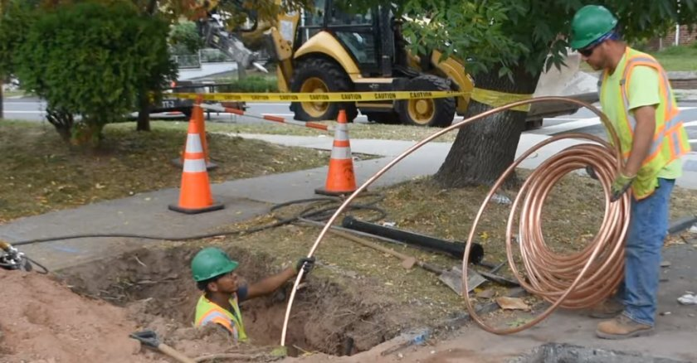
DWSRF – BIL Lead Allocation
Service Line Inventory Projects:
17 active projects, totaling $5.7 million
Service Line Replacement Projects:
1 project approved by KIA Board
Several others working through the logistics

Slide 6
Lead in Schools Voluntary School and Child Care Lead Testing and Reduction Grant Program (WIIN 2107)
Schools/Childcare facilities can sign up now to volunteer for lead testing
DOW currently working to expand communication about the program
Facility sampling under current program can be used by water systems for proposed LCRI compliance
In progress: EPA WIIN grant funding for lead remediation at schools/childcares
Current Program Snapshot
Facilities sampled to date | 56
Total Outlets Sampled | 464
Highest Lead level at any outlet | 59.1 ppb
Contact Gabe Tanner:
Gabriel.tanner@ky.gov, (502) 782-7088
Notes:
12 more facilities have signed up since the last quarter, and will be sampled in coming months

Slide 7
PFAS: Important Dates
April 26, 2027
Initial monitoring results due
First compliance hurdle
April 26, 2029
Compliance with Maximum Contaminant Levels begins
Third compliance hurdle
2027-2029
Regular monitoring period
Second compliance hurdle
Notes:
Initial monitoring: determines routine sampling schedule that will start in 2027. Most facilities must collect 4 samples for initial monitoring (one in each quarter of the year). Small groundwater systems must collect 2 samples for initial monitoring (5-7 months apart, to reflect different times of year).
Compliance monitoring: this is when MCLs go into effect. Facilities will sample quarterly, annually, or triennially, depending on initial monitoring results.

Slide 8
Understanding All the Monitoring
2019 & 2023-2024
2023-2025
Division of Water Sampling
UCMR5 Monitoring
April 26, 2027
4/2027 onward
April 26, 2029
Ongoing
Compliance Monitoring
MCL Compliance Determination
Initial Monitoring
Ongoing monitoring continues
Notes:
Facilities with MCL exceedances in initial or compliance monitoring (now until April 2029) will need to install treatment or obtain new source water by April 26, 2029.

Slide 9
Initial Monitoring Progress
PWS Progress on the April 26, 2027, Deadline | # | %
Completed the initial monitoring requirements | 46 | 22%
Expected to finish w/UCMR5 monitoring (2023-2025) | 77 | 38%
DOW is conducting the initial monitoring (2023-2025) | 63 | 31%
Private businesses, federal facilities | 12 | 6%
Issues on UCMR5 sample collection timeframes | 7 | 3%
Total community & NTNC PWSs under the rule | 205 | 100%
Notes:
A total of 186 facilities (91%) will be completed by the end of 2025 (between DOW and UCMR sampling).

Slide 10
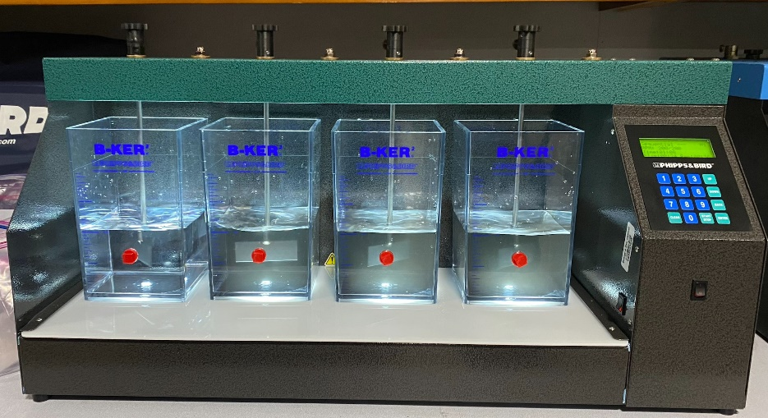
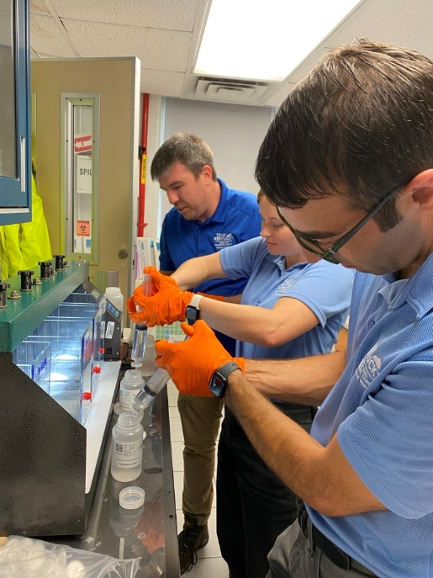
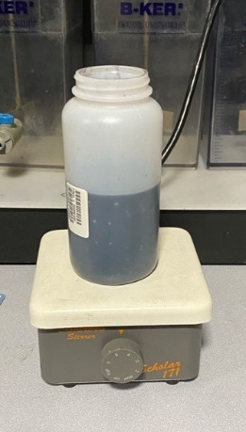
Technical Assistance Powdered Activated Carbon (PAC) Project
Option for some systems
Benefits of PAC:
Usually does not require upfront infrastructure costs.
Fed into the existing treatment process.
May be more affordable to operate and maintain
Collaborative pilot with EPA-ORD
7 systems participating
EPA: jar testing and sampling support
Procedures will be developed based on KY studies and disseminated nationwide.

