Slide 1
WATERSHED MANAGEMENT BRANCH
September 2024 Update

Slide 2
THE KENTUCKY DROUGHT MITIGATION TEAM MEETS TODAY TO DISCUSS A LEVEL 1 STATE DROUGHT DECLARATION.
01.
MAJOR RAIN DEFICIT
Rain fall across the state has been minimal during the last summer
02.
EXTREME AGRICULTURAL DROUGHT
In western and central portions of the state
03.
HYDROLOGIC IMPACTS
Eastern protions of the state are starting to experience low flows

Slide 3
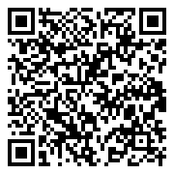
WATER CONSERVATION WEEK
SEPTEMBER 22-28

Slide 4
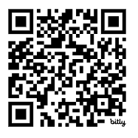
SOURCE WATER PROTECTION WEEK
SEPTEMBER 29-OCTOBER 5

Slide 5
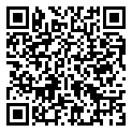
KENTUCKY WATER RESOURCES REPORT

