Slide 1
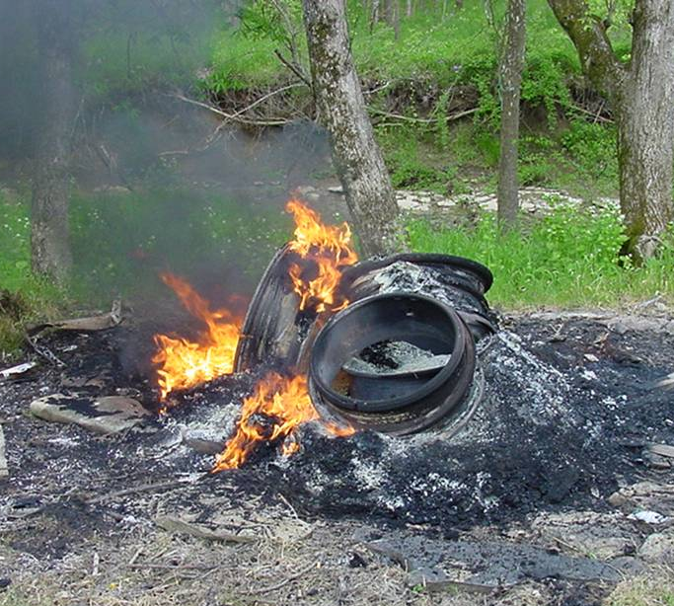

Learn Before You Burn
Kentucky Division for Air Quality
Notes:
Welcome to the Kentucky Division for Air Quality’s Learn Before You Burn presentation.
Photo: Division for Air Quality Field Operations Branch (DAQ FOB)

Slide 2
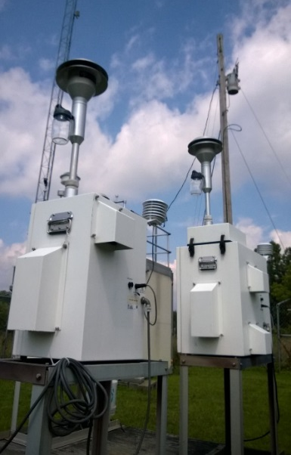


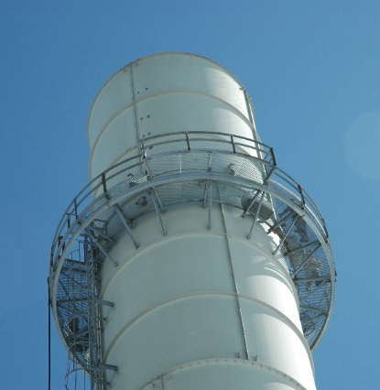
Our Mission
To protect human health and the environment by achieving and maintaining acceptable air quality through:
Air monitoring
Creating partnerships
Public information
Permitting and compliance
Notes:
The Kentucky Division for Air Quality is the state agency charged with protecting human health and the environment by maintaining healthy air for all Kentuckians. We do this through:
A statewide air monitoring network to track pollutants
Creating effective partnerships with air pollution sources and the public.
Providing useful and timely information about air quality to the public.
An air permitting and compliance program with sources operating in the Commonwealth.
(Photos: DAQ and Adobe Stock images)

Slide 3
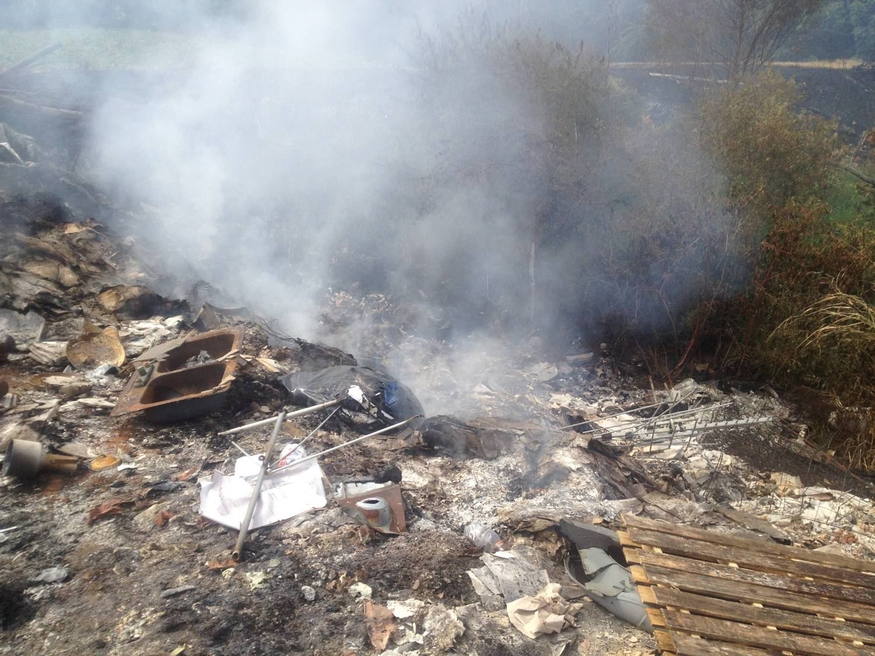
Open Burning in Kentucky
What is it?
Why be concerned?
Legal or Illegal?
Restrictions
How you can help
Notes:
In this presentation, you’ll learn about open burning and its impact on human health; what kinds of open burning are legal or illegal in Kentucky; restrictions on open burning; and how you can spread the word to help keep our air clean and healthy.
(Photo: DAQ FOB)

Slide 4
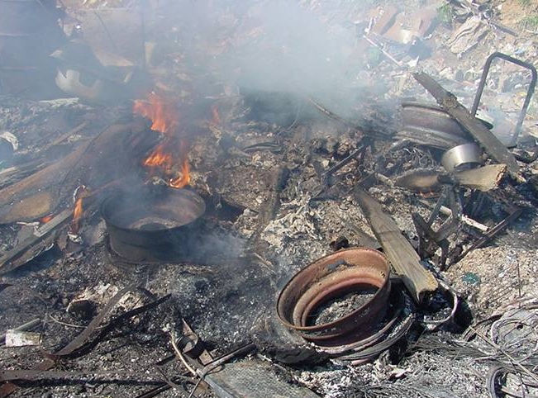
Open burning is defined as:
The outdoor burning of any material without an approved burn chamber, stack, or chimney with control devices approved by the KY Division for Air Quality.
Open burning is regulated under KY Title 401 KAR 63:005.
Notes:
So, when we talk about open burning, we’re really talking about outdoor burning with no chimney, no burn chamber and no air pollution control devices. Open burning may occur on the ground or in a burn barrel. Because it is done outdoors in the open air, open burning is typically a low-temperature, high smoke activity that can seriously impact air quality. That’s why open burning is regulated in the Commonwealth of Kentucky.
(Photo: DAQ FOB)

Slide 5

Jefferson County/Louisville Metro
Additional open burning restrictions year-round
Contact the Louisville Metro Air Pollution Control District for more information.
https://louisvilleky.gov/government/air-pollution-control-district
Notes:
This presentation is about Kentucky’s state open burning regulation. If you live in the Louisville Metro area, you should check with the Louisville Metro Air Pollution Control District for information about additional restrictions to open burning in Jefferson County.
(Photo: Adobe Stock image)

Slide 6
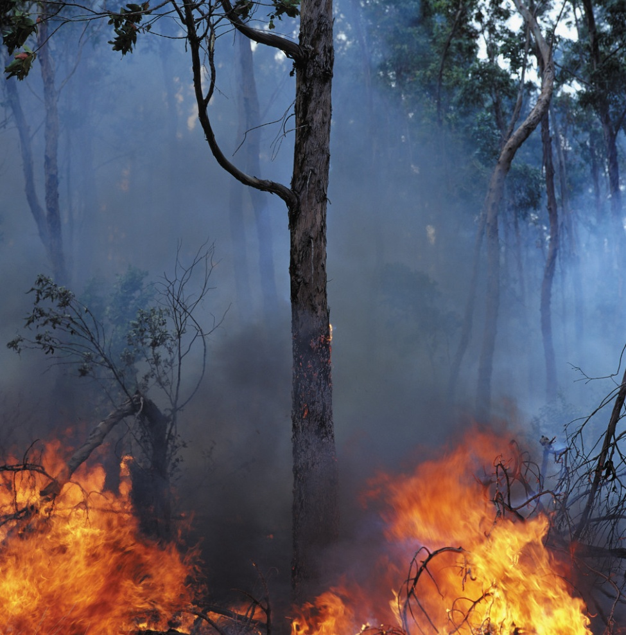
Open Burning Creates Fire and Safety Hazards
The Kentucky Division of Forestry estimates that 35 to 40 percent of wildfires in Kentucky start when open burning gets out of control.
Notes:
Why be concerned about open burning? According to the Division of Forestry, approximately 35 to 40 percent of Kentucky wildfires are caused by open burning.
(Photo: Microsoft Office)

Slide 7
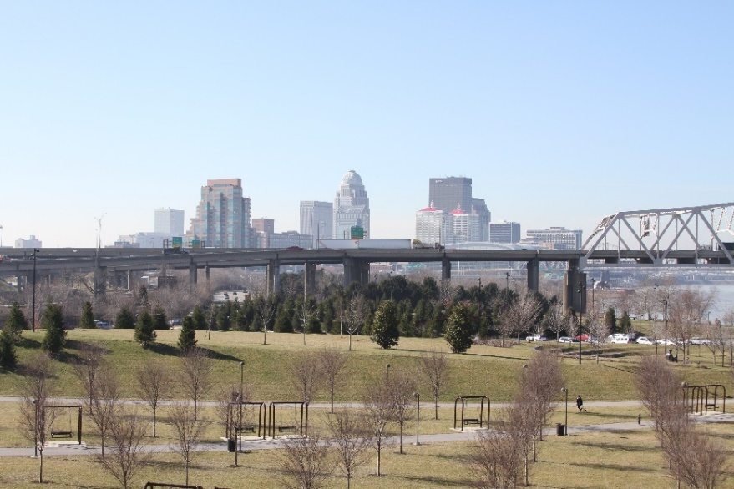

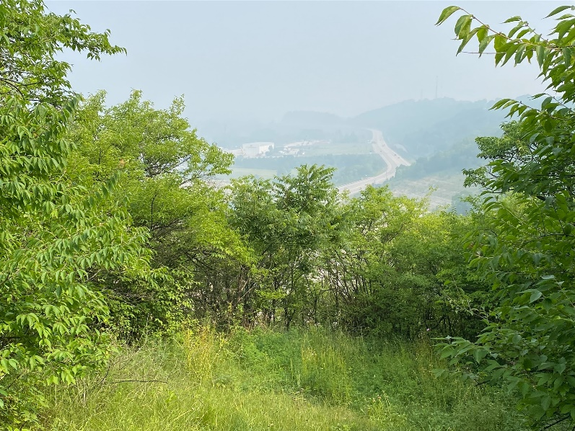
Open Burning Impacts Air Quality
Makes it harder for areas to meet air quality standards
Notes:
Open burning floods the air with pollutants – and those pollutants can travel far beyond the location where the burning is happening. It adds to the burden of pollution from other sources, such as wildfires and transportation. It can make it harder for areas to meet air quality standards. And unlike a stationary source with a smokestack, it is nearly impossible to control the smoke from open burning.
(Adobe Stock images)

Slide 8
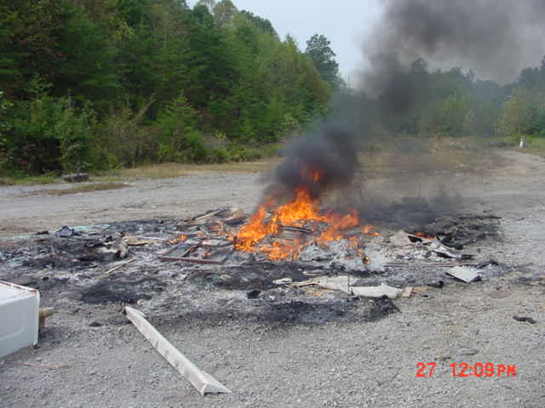
Open Burning Impacts Soil & Water
  Chemicals and heavy metals from open burning settle out of the air and into soil and water.
Notes:
Open burning pollutes more than just the air. Smoke from open burning contains heavy metals and chemicals that settle out of the air and onto surrounding soil and water, where they can accumulate in plants and animals. The ashes from open burning are another pollution source, especially when it rains, as chemicals and heavy metals get washed into groundwater and streams.
(Photo: DAQ FOB)

Slide 9
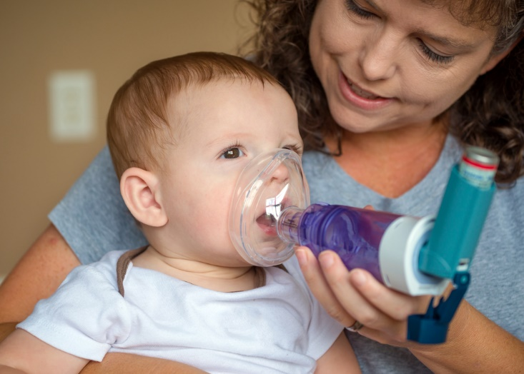
Open Burning Harms Human Health
  Smoke from open burning:
  Depresses the central nervous system
  Is especially harmful to children, the elderly, and adults with respiratory diseases
Notes:
Of course, human health is our biggest concern. Smoke from open burning makes it harder to breathe, can trigger asthma attacks, and worsen existing heart and lung problems. Children, the elderly, and those with pre-existing health problems are especially vulnerable.
(Adobe Stock image)

Slide 10
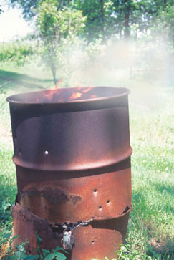
Where there’s smoke …
Dioxins
PFAS
Benzene
Arsenic
Carbon monoxide
Lead
Mercury
Hydrogen chloride
Hydrogen cyanide
Notes:
Smoke from open burning contains chemical compounds, fine particles, and gases that can have immediate and long-term health effects. And it’s not just the person doing the burning who’s at risk, but also their families and neighbors.
(Adobe Stock image)

Slide 11



Dioxins & PFAS
Extremely toxic & persistent
Accumulate in the body
Released into the air during open burning
Notes:
Dioxins and PFAS are among the worst of these pollutants. Dioxins are a family of chlorinated organic chemicals that include the main ingredient found in “Agent Orange”. Dioxins form when products containing carbon and chlorine are burned – think paper, food scraps, and plastics. PFAS are the so-called “forever chemicals” we’ve heard a lot about lately, and many commonly used household products contain them. Burning these items releases these chemicals into the air, soil, and eventually water. Dioxins and PFAS are toxic to human health.
(Adobe Stock image)

Slide 12
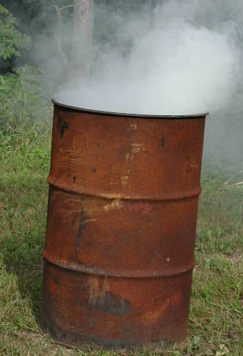
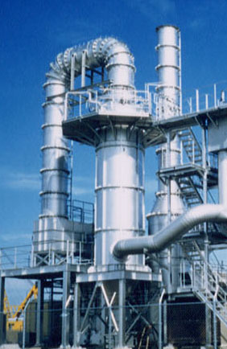
Backyard Burn Barrels
Largest single source of airborne dioxins in U.S. (U.S. EPA)
>
In just one year, a single backyard burn barrel can produce more dioxins than a municipal trash incinerator.
Notes:
Because burn barrels do not have the same strict controls as municipal incinerators, barrel burning releases significant amounts of dioxins. An EPA study found that a single backyard burn barrel serving a family of four, can emit more dioxin pollution in one year than a well-controlled municipal trash incinerator.
(Adobe Stock images)

Slide 13
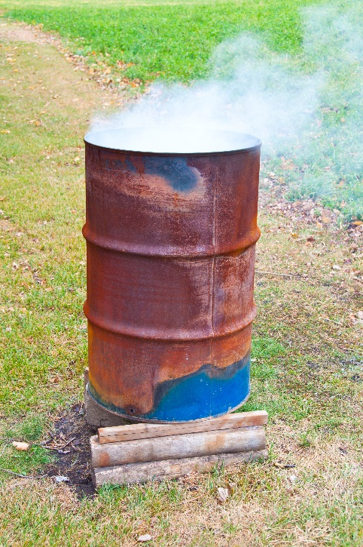

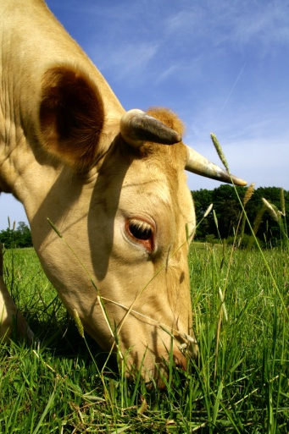
Dioxins & PFAS move through the food chain
Notes:
Dioxins and PFAS move through the food chain. The airborne chemicals can settle onto feed crops, which are then eaten by domestic meat and dairy animals. They also enter waterways through soil erosion and runoff. Dioxins accumulate in the fats of animals, and then in humans when we consume meat, fish, and dairy products. PFAS accumulate in our liver and lungs.
(Adobe Stock images)

Slide 14
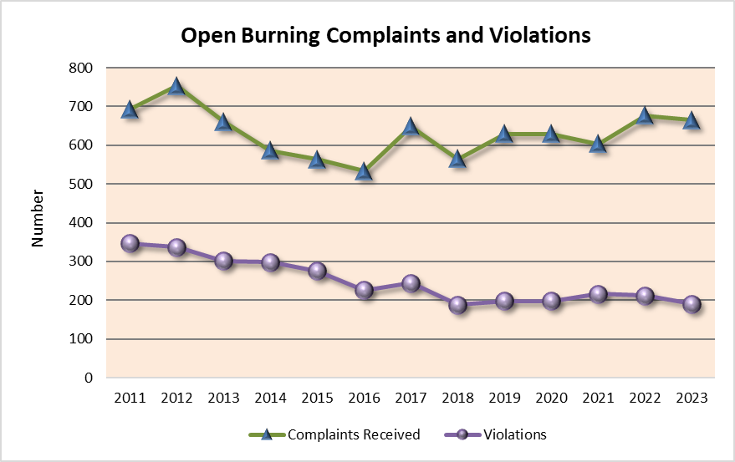
Illegal open burning in Kentucky continues to be a problem
Notes:
Each year, the Division for Air Quality receives hundreds of air quality complaints from citizens. Most of these complaints are about smoke from open burning. This chart shows open burning complaints and violations in Kentucky over the last decade.

Slide 15
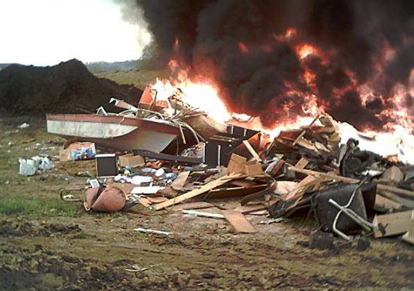
Legal or Illegal?
What, when, where, and how a material is burned determines if the burning is legal or illegal.
Notes:
Is open burning legal or not? It all depends on what, when, where, and how a material is burned. The following slides will help you learn before you burn.
(Photo: DAQ FOB)

Slide 16
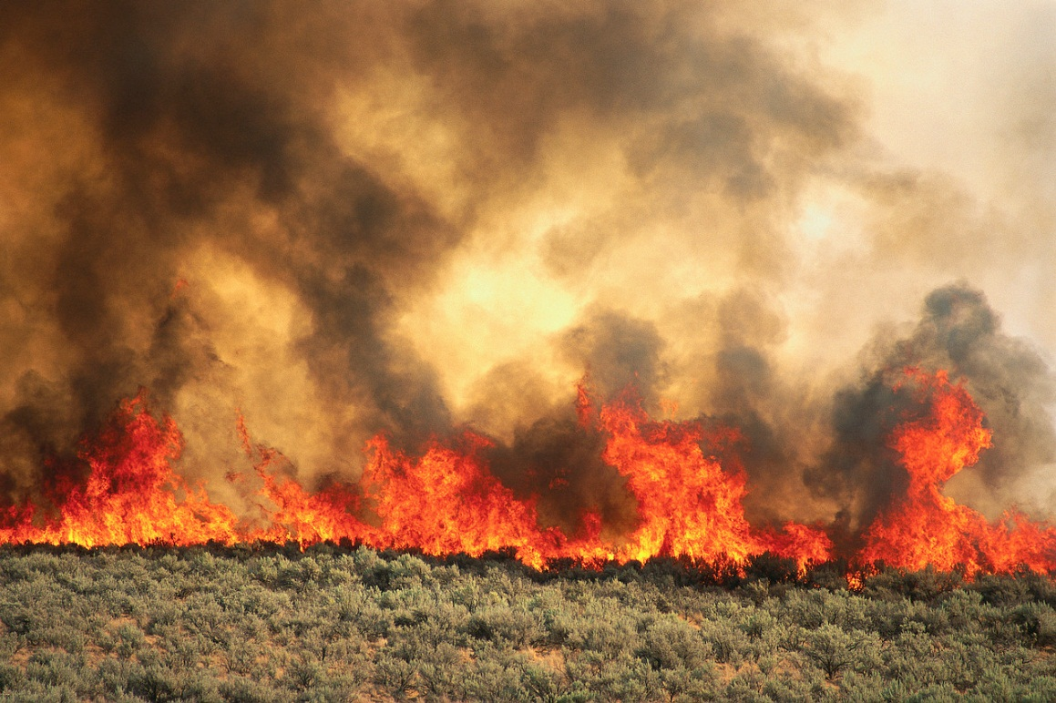
Check Local Ordinances
Local county and municipal ordinances may have more stringent rules than the state regulation described in this presentation.
Notes:
It’s important to remember that local county and municipal ordinances may have more stringent rules than the state regulation described in this presentation.
(Photo: Kentucky Nature Preserves)

Slide 17


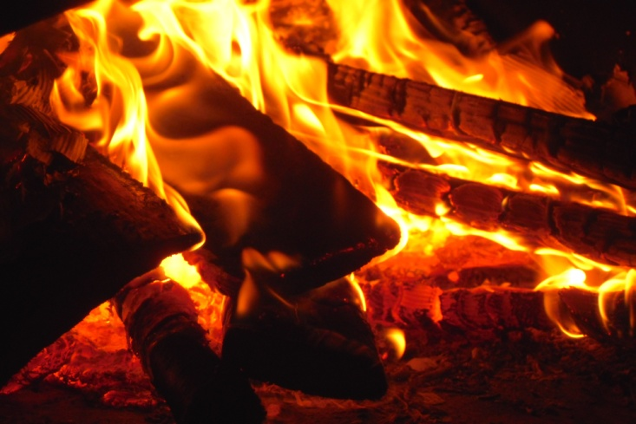
Cooking, Camping, & Comfort Fires
Fires set for recreational or ceremonial purposes (campfires, bonfires)
Fires set for cooking (campfires)
Small fires set for comfort heat at construction sites (only when air temp. is below 50˚)
Notes:
Under Kentucky state regulation, the following kinds of open burning are permitted:
Campfires, bonfires, and fires set for recreational or ceremonial purposes
Fires set for cooking
Small fires set for comfort heat at construction sites when the air temperature is below 50 degrees. Construction site comfort fires must be in a container no larger than 55-gallons in size, and must only contain clean lumber or vegetative debris.
(Photos: Microsoft Office and Stock.xchng)

Slide 18
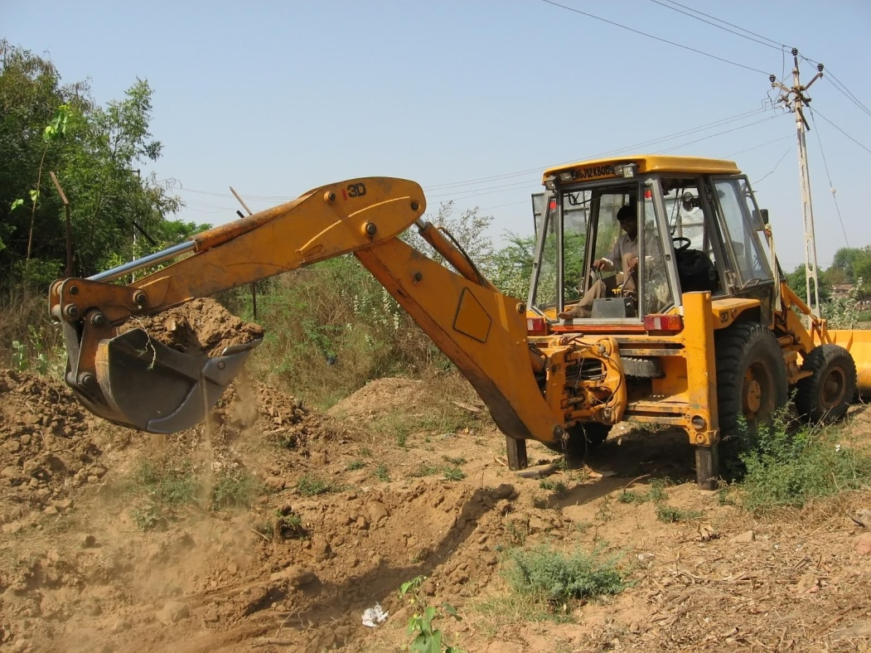
Natural growth from land clearing & storms
Burning of:
Natural growth disturbed as part of land clearing activities (development sites, etc.)
Trees and tree limbs, felled by storms
  Ozone season exceptions: Jefferson, Boone, Kenton, Campbell, Boyd, Bullitt, Oldham, and Lawrence (partial)
Notes:
State regulation also permits the burning of natural growth from land clearing, and trees and tree limbs felled by storms. However, a handful of counties are restricted from this type of burning during ozone season, which occurs May 1 – September 30 every year. During these months, open burning of natural growth, tree limbs, and brush is prohibited in Jefferson, Boone, Kenton, Campbell, Boyd, Bullitt, Oldham and Lawrence counties.
(Photo: Stock.xchng)

Slide 19
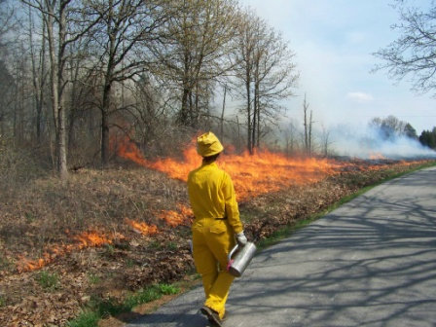
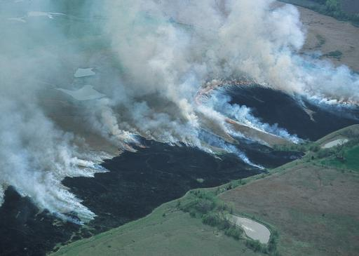
Prescribed Fire
Fires set for recognized agricultural, silvicultural, range, or wildlife management practices.
Notes:
Kentucky regulation also permits prescribed fires set for recognized agricultural, forest, range, or wildlife management practices.
(Top photo used with permission by Zeb Weese, Kentucky Nature Preserves; Bottom photo courtesy of NRCS photo gallery)

Slide 20
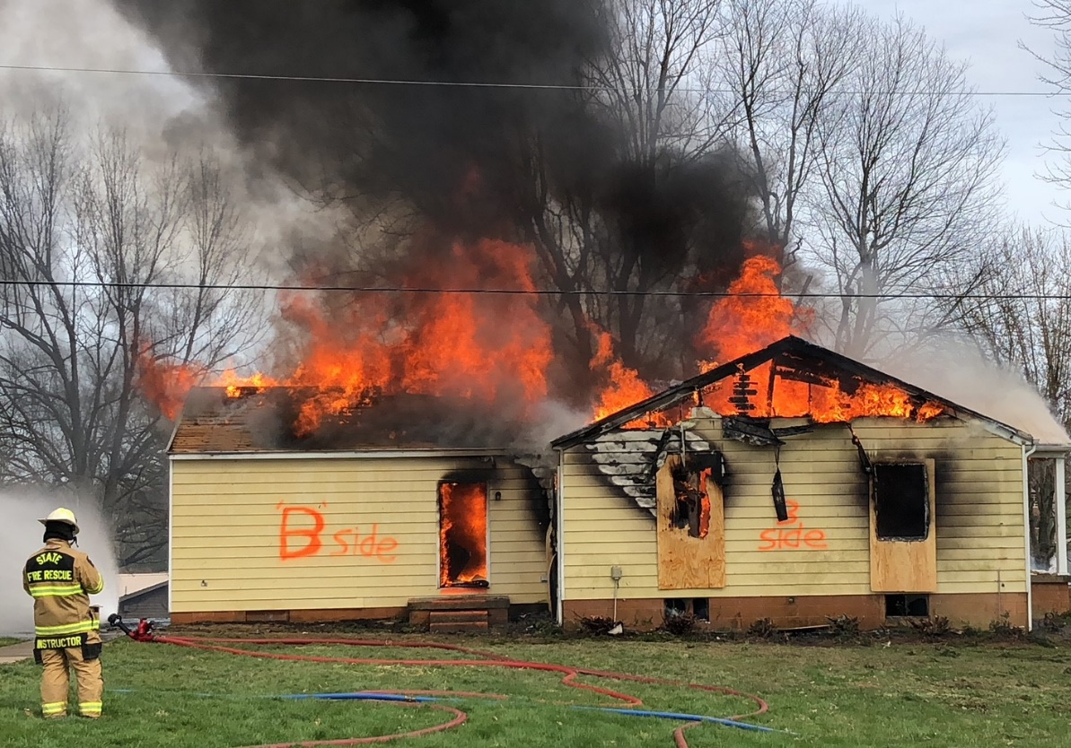
Live Fire Training
Fires set for the purpose of instruction and training of firefighters.
Requires approval from Division for Air Quality and Fire Commission
Materials likely to produce toxic emissions must be removed prior to burn.
Contact the State Fire Commission for more information.
Notes:
Fire departments may apply for permission from the Division for Air Quality and the Kentucky Fire Commission to conduct live fire trainings. Materials likely to produce toxic emissions, such as shingles and siding, must be removed from a structure prior to the burn, and additional restrictions may apply. Contact the State Fire Commission for more information.
(Photo: DAQ FOB)

Slide 21

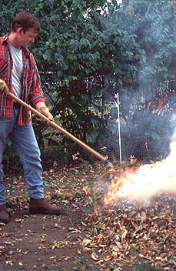
Leaf Burning
Restricted in some areas, permitted in others
Check local ordinances
The following counties are not allowed to burn leaves during ozone season, May - September:
  Jefferson, Boone, Kenton, Campbell, Boyd, Bullitt, Oldham, and Lawrence (partial)
Iowa DNR
Notes:
Leaf burning is restricted in some areas and permitted in others, so it’s important to check your local ordinance before burning leaves. Also, leaf burning is never permitted during ozone season, May through September, in Jefferson, Boone, Kenton, Campbell, Boyd, Bullitt, Oldham, and portions of Lawrence county.
(Photo used with permission from Iowa Department of Natural Resources)

Slide 22


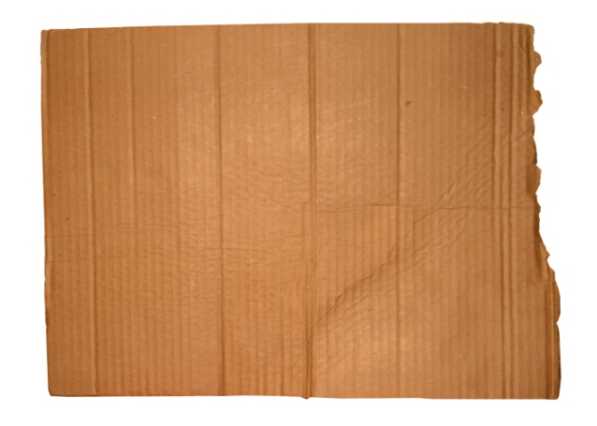
Uncoated Household
Paper Products
Check local ordinances
Newspaper
Office paper
Plain cardboard
Notes:
State law permits the burning of "household rubbish", as long as it does NOT include garbage (which is basically food scraps), cans, glass, plastic, or other potentially hazardous materials. Uncoated paper products such as office paper, cardboard, and newspaper do not fall into these categories, so would be allowed. Check local ordinances first, as some areas may restrict this kind of open burning.
All photos from stock.xchng (free use)

Slide 23
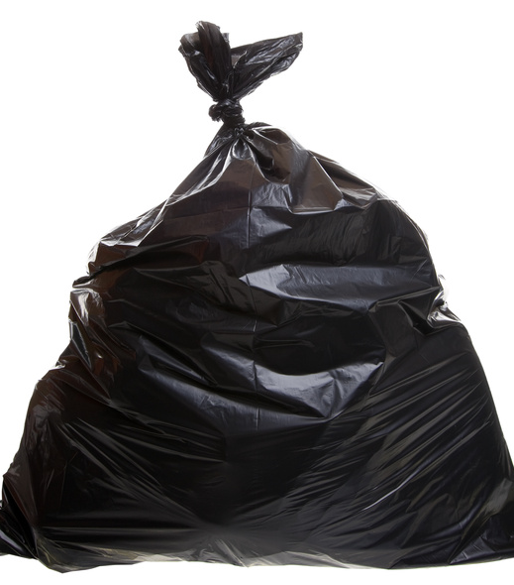
What About Trash?
Nearly everything found in household trash is illegal to burn.
  Plastic
  Coated paper and cardboard
  Food
  Foam insulation
  Styrofoam
  Metal & glass
  Aerosol cans
  Rubber
  Painted products
  Diapers, clothing
Notes:
State law prohibits the open burning of materials likely to produce toxic emissions, and that includes nearly everything found in household trash. In Kentucky, it is illegal to burn materials such as plastic, plastic-coated paper or cardboard, garbage containing food scraps, insulation, Styrofoam, metal and glass, aerosol cans, rubber, painted or stained products, diapers, and clothing.
(Microsoft Office photo)

Slide 24
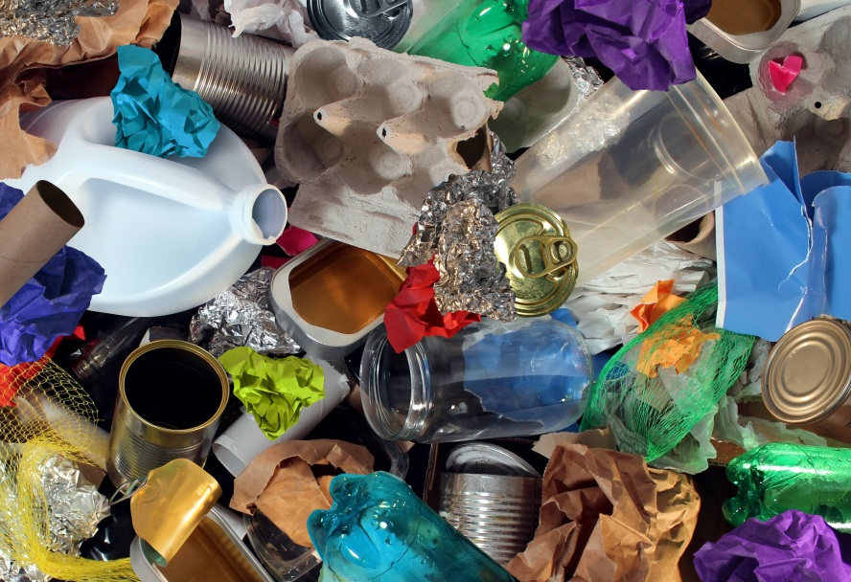
What’s in that trash?
Lead
Dioxin
Mercury
Benzene
Furan
PFAS
Cadmium
Acrolein
Acetaldehyde
Notes:
What’s in that trash? Heavy metals like lead and cadmium are used in dyes on candy and chip bags, and when burned these metals are released as fine particles into the air. Dioxins and furans are released when plastics are burned, and gases such as acrolein and benzene are released when plastics and Styrofoam are burned. These pollutants can make it hard to breathe, irritate lung tissue, and many are linked to cancer.
(Adobe Stock image)

Slide 25
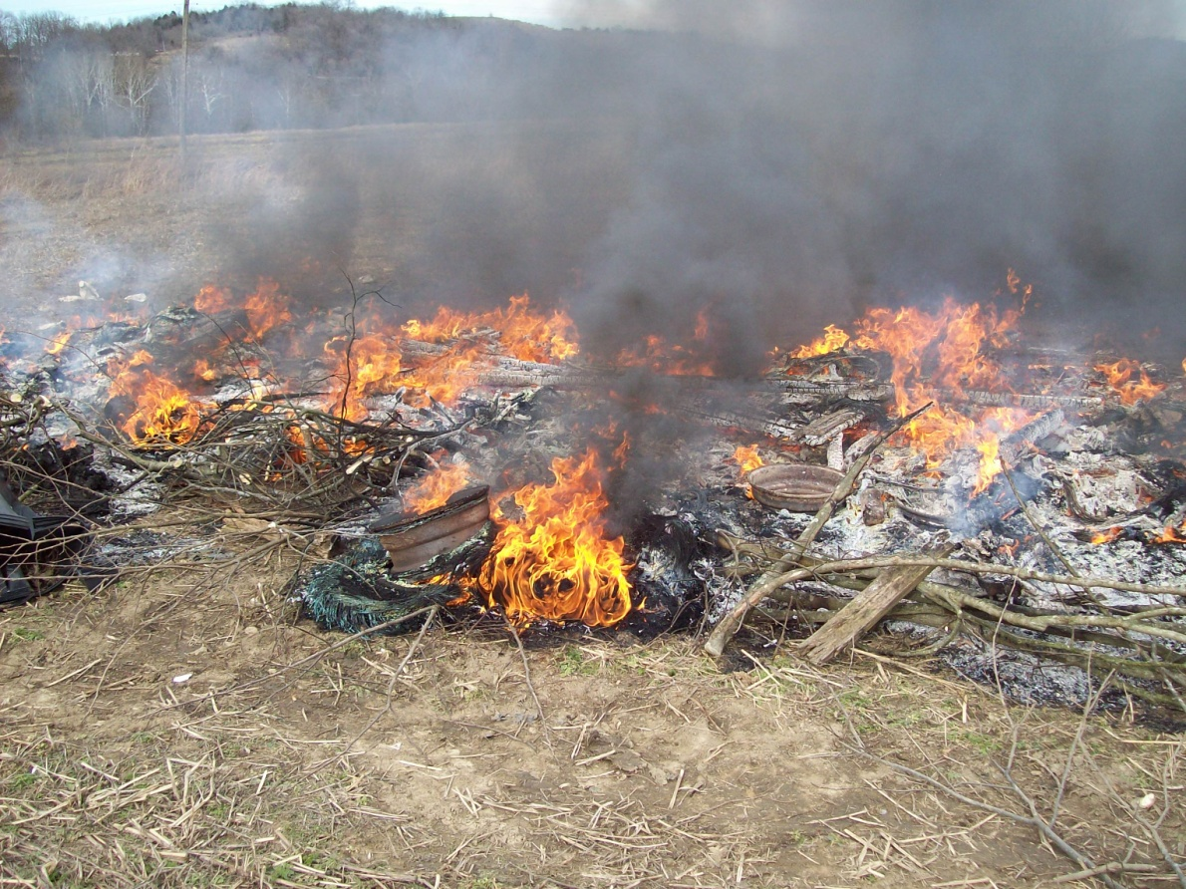
Prohibited Burn Items…
Tires
Plastic
Rubber
Coated wire
Insulated wire
Foam insulation
Used oil
Notes:
State law prohibits the open burning of tires, plastic, rubber, coated or insulated wire, foam insulation, and used oil.
(Photo: DAQ FOB)

Slide 26
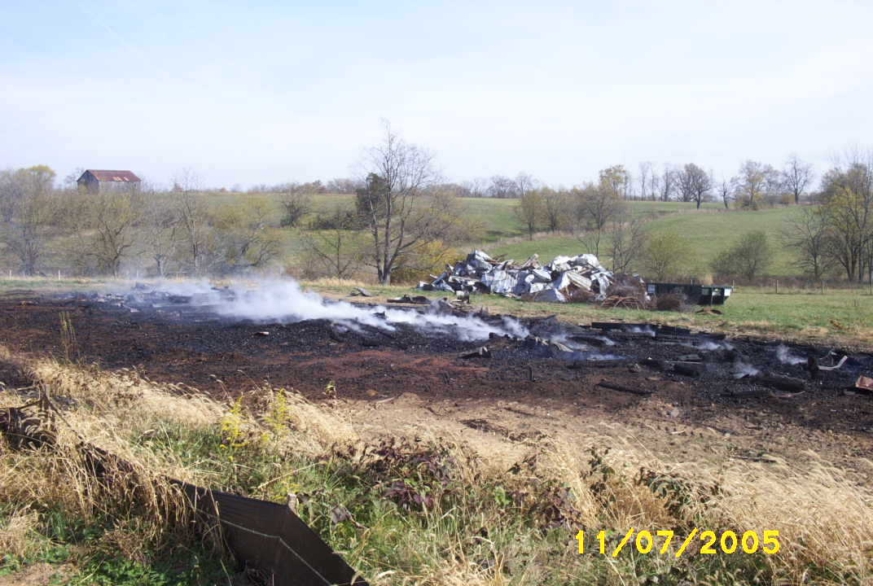
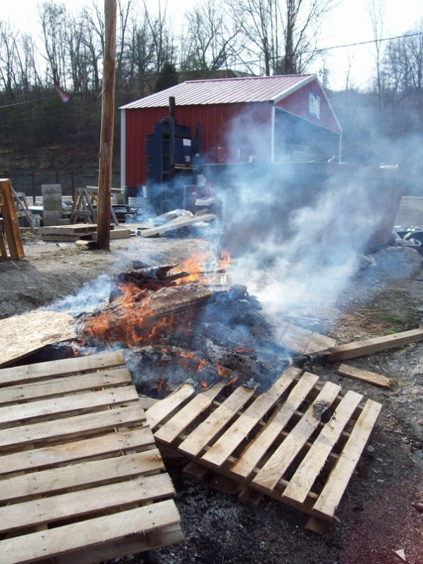
Prohibited: Agricultural Burning
Bedding material
Muck piles
Mulch
Hay
Treated, stained, or painted lumber
Fence posts & wood pallets
Agricultural fields (no plastic)
Notes:
Also prohibited are a wide range of agricultural items, including animal bedding material, muck piles, mulch and hay, treated, stained or painted lumber, fence posts and wood pallets. Burning off old growth from agricultural fields is permitted, provided the agricultural plastic has been removed first.
(Photos: DAQ FOB)

Slide 27
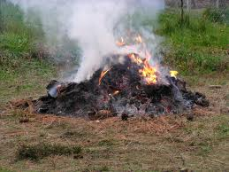
Prohibited: Grass Clippings
Grass clippings produce excessive smoke
Grass clippings are “yard waste”, which is not permitted to be burned according to 401 KAR 63:005
Notes:
Grass clippings and other yard waste produce excessive smoke and are prohibited from open burning in Kentucky.
No photo credit

Slide 28
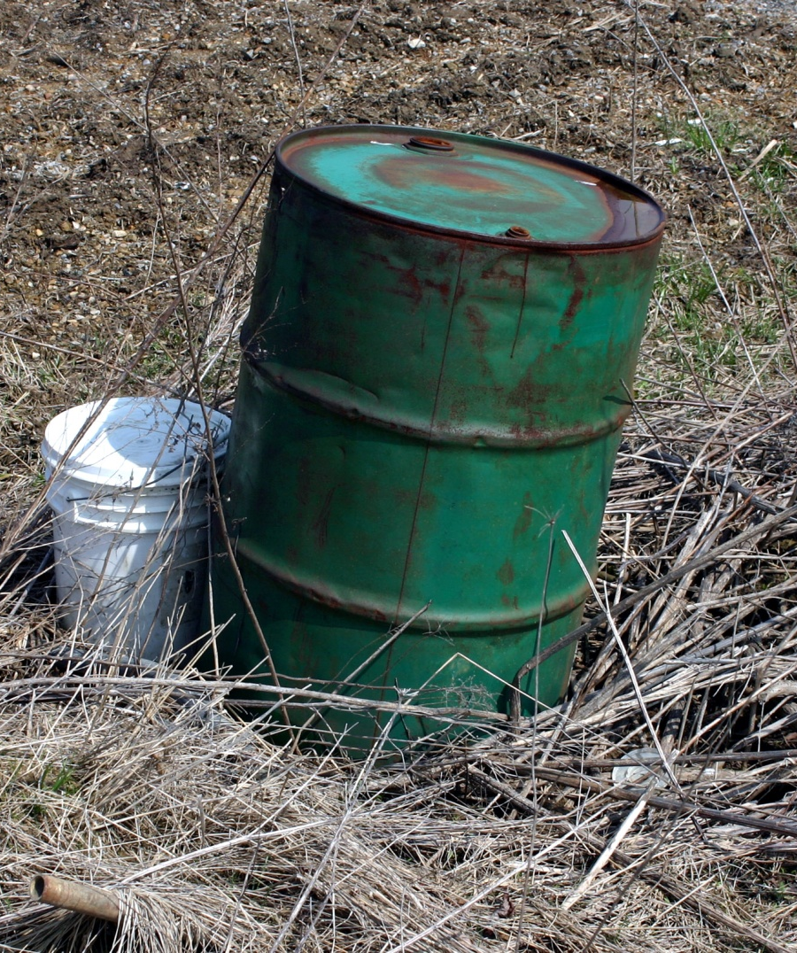
Prohibited: Chemical Containers
Agricultural chemical containers
Household chemical containers
Notes:
It is illegal to burn chemical containers of any size.
(Photo: stock.xchng)

Slide 29
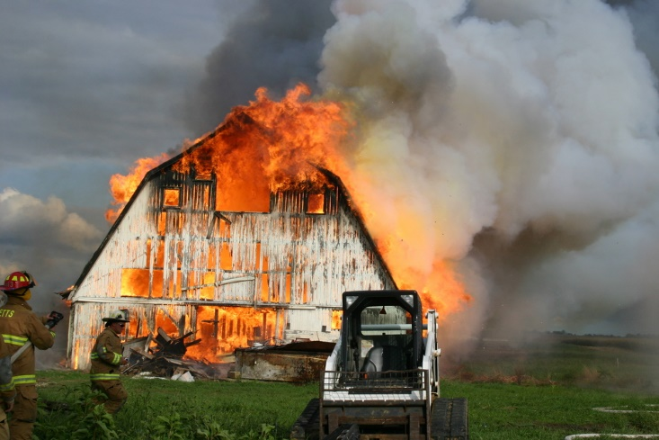
Prohibited: Buildings
Buildings may not be disposed of by burning.
Buildings may be demolished and buried onsite.
Notes:
It is illegal to dispose of a building or trailer home by burning, unless it is part of an approved fire training sanctioned by the State Fire Commission. Kentucky law does permit a landowner to demolish and bury a building onsite. Contact the Division of Waste Management for more information.
(Photo: DAQ FOB)

Slide 30
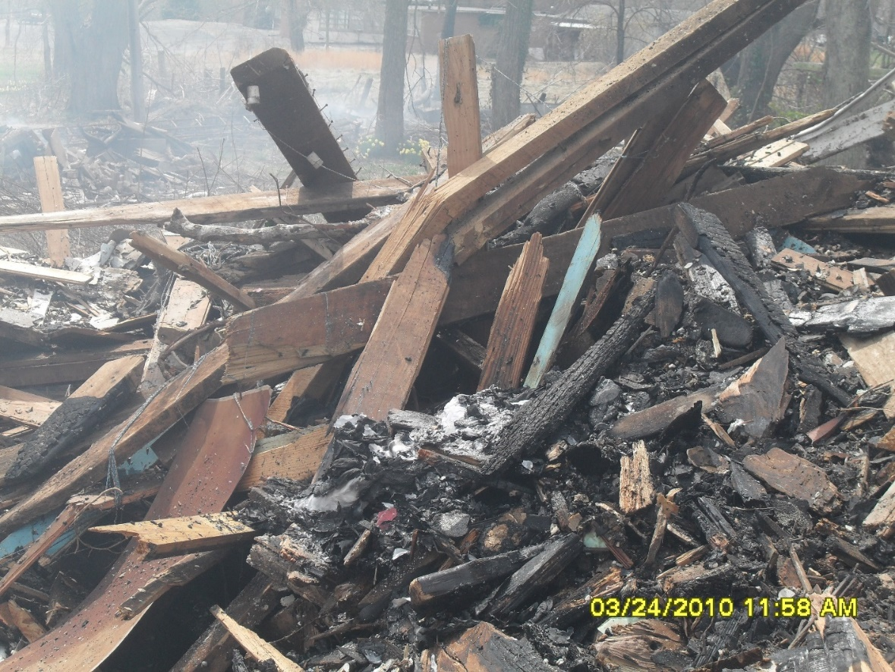
Prohibited: Construction/Demolition Debris
Asbestos materials
Construction debris
Demolition debris
Drywall
Shingles
Notes:
Construction and demolition debris may not be disposed of by open burning. These materials may contain asbestos, treated or painted lumber, drywall, shingles, and insulation – all of which emit hazardous pollutants when burned.
(Photo: DAQ FOB)

Slide 31
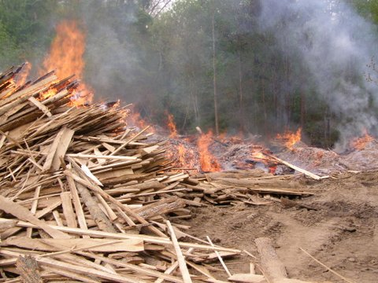
Prohibited: Waste from businesses, schools & churches
Other than land clearing for development, businesses may not dispose of any waste by burning.
Debris from private businesses may not be transported for burning elsewhere.
Notes:
Other than natural growth from land clearing, businesses may not dispose of any waste by burning. Waste or debris from private businesses may not be transported for burning elsewhere. For example, a tree trimming service may not burn tree limbs for disposal if they transport tree trimming debris to another location – even private property -- for burning.
(Photo: DAQ FOB)

Slide 32
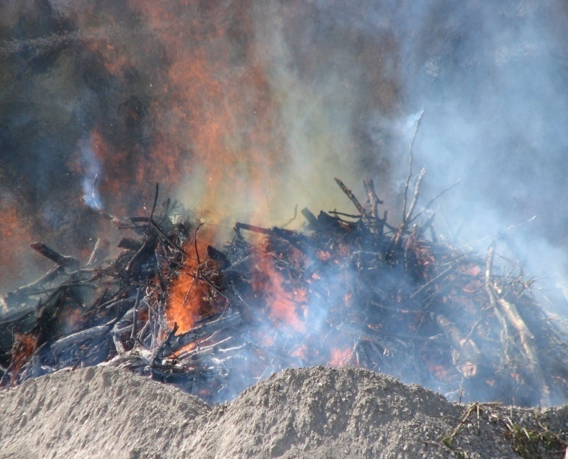
Disposing of Vegetative Storm Debris
County or municipal governments only, with approval
May be legally burned (observe fire hazard season restrictions & county burn bans).
Large piles should be divided and burned incrementally over time.
Care should be taken to locate burn piles away from residences and areas that could be impacted by smoke.
Contact the Division for Air Quality before burning large stockpiles of debris.
Notes:
Occasionally, storms and flooding may generate large amounts of debris from downed trees. When this happens, local governments may choose to coordinate community collection and burning of vegetative storm debris, so long as fire hazard season restrictions are observed and there are no county burn bans in effect for that area. Only vegetative debris – that is, tree limbs and branches – may be burned. Large piles should be divided and burned incrementally over time. Also, be sure to locate burn piles away from areas that could be impacted by smoke. Contact the Division for Air Quality before burning large stockpiles of storm debris.
(Photo: DAQ FOB)

Slide 33
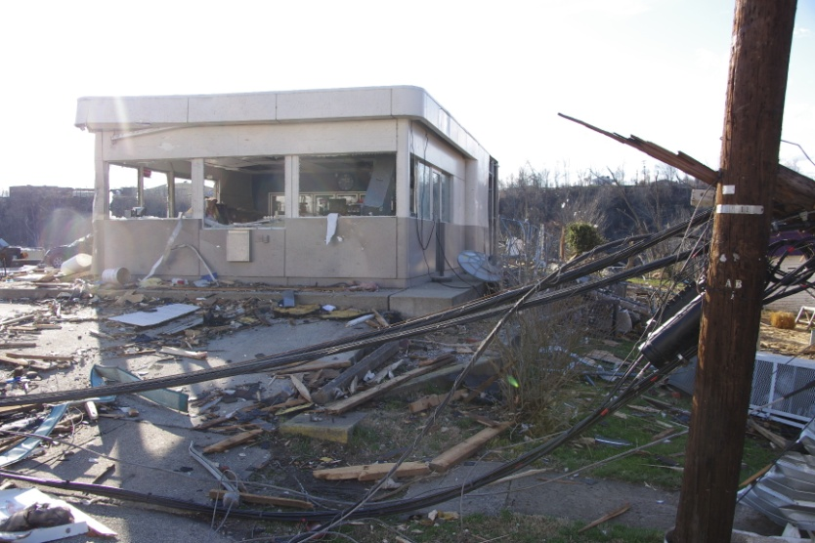
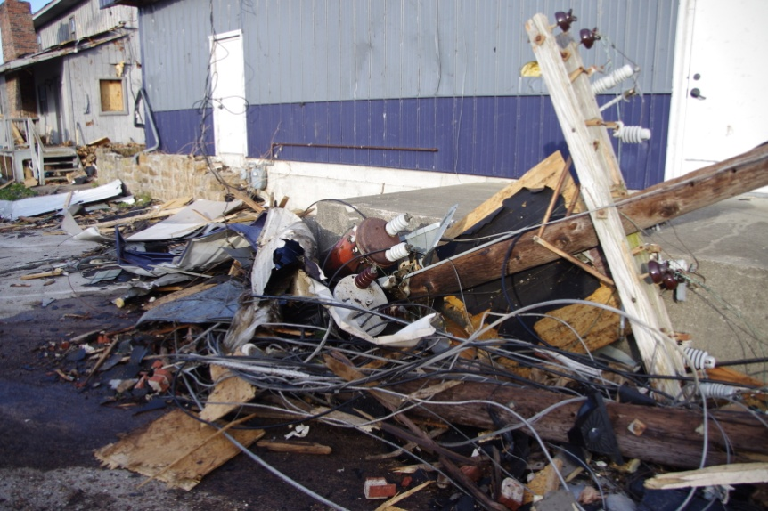
Disposing of Storm Debris
Demolition debris may not be burned. Debris may contain asbestos and other hazardous materials.
Demolition debris piles should be kept wet until final disposal in a landfill.
Notes:
Demolition debris may never be burned – even if it was created by storms or flooding. To reduce the risk from debris containing asbestos, piles like these should be kept wet until they can be disposed of in an approved landfill.
(Photos: KY DEP)

Slide 34
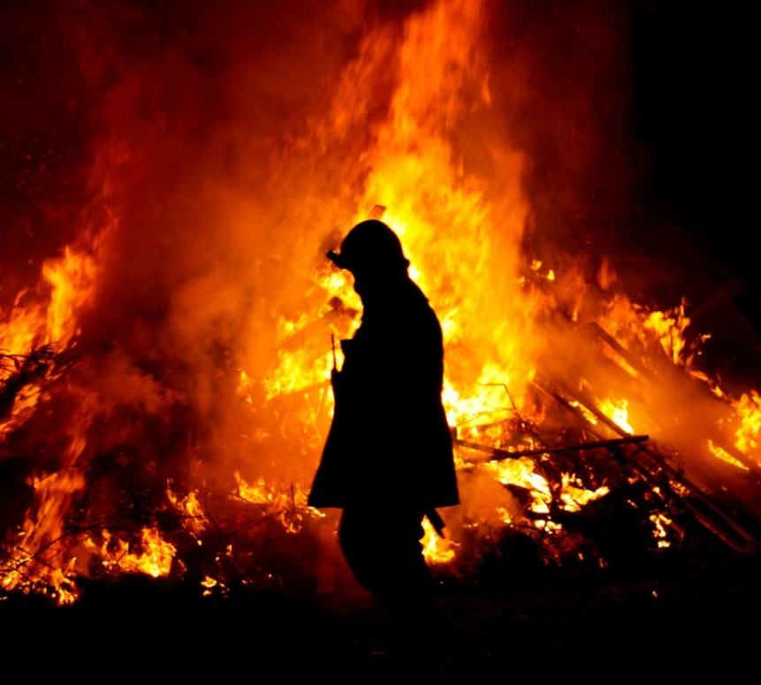
Restrictions During Fire Hazard Season
Oct. 1 – Dec. 15 and
Feb. 15 – April 30
During fire hazard season, burning within 150 feet of any woodland or brushland area is allowed only during evening hours between
6 p.m. & 6 a.m.
Notes:
Open burning is further restricted during Fire Hazard Season. From October 1 through December 15, and from February 15 through April 30, burning within 150 feet of any woodland area is allowed only during the evening hours between 6 PM and 6 AM.
Photo from stock.xchng (free use)

Slide 35
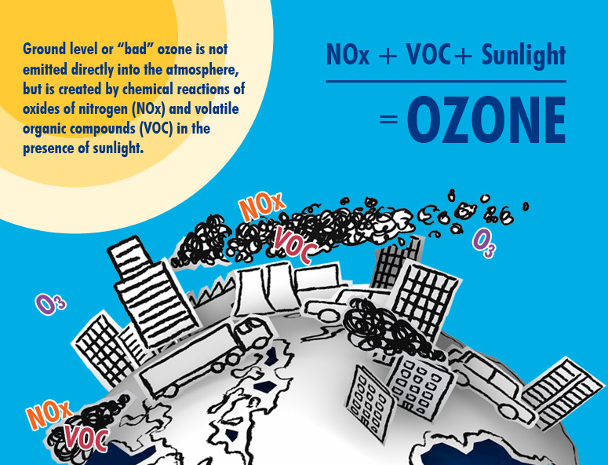
Ozone Season: May – Sept.
Notes:
May through September is Ozone Season. Warmer weather and sunlight causes pollutants from open burning and other sources to chemically react, forming ground-level ozone pollution.

Slide 36
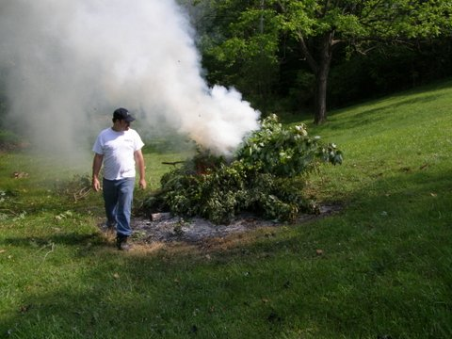
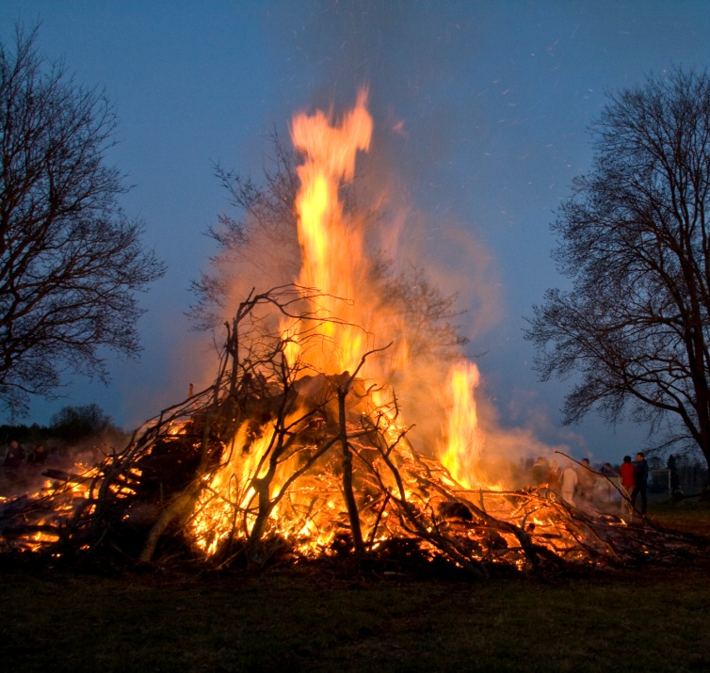
Restrictions during ozone season:
May – September
Only in Boone, Boyd, Bullitt, Campbell, Jefferson, Kenton, Lawrence, & Oldham counties
No open burning for land clearing permitted
Other restrictions apply
Notes:
Ozone season means additional open burning restrictions for certain counties. From May 1 through September 30, no open burning for land clearing is permitted in Boone, Boyd, Bullitt, Campbell, Jefferson, Kenton, Oldham, and portions of Lawrence county.
Why the restrictions for these counties? These counties are – or were at sometime in the past – designated non-attainment for ozone or particulate matter because their pollution levels exceeded those permitted by the Clean Air Act. Once you get that designation, the Clean Air Act requires counties to take extra measures to ensure they don’t exceed those pollution levels ever again – and that includes restricting open burning during ozone season.
Photos: DAQ FOB (top), stock.xchng (bottom)

Slide 37
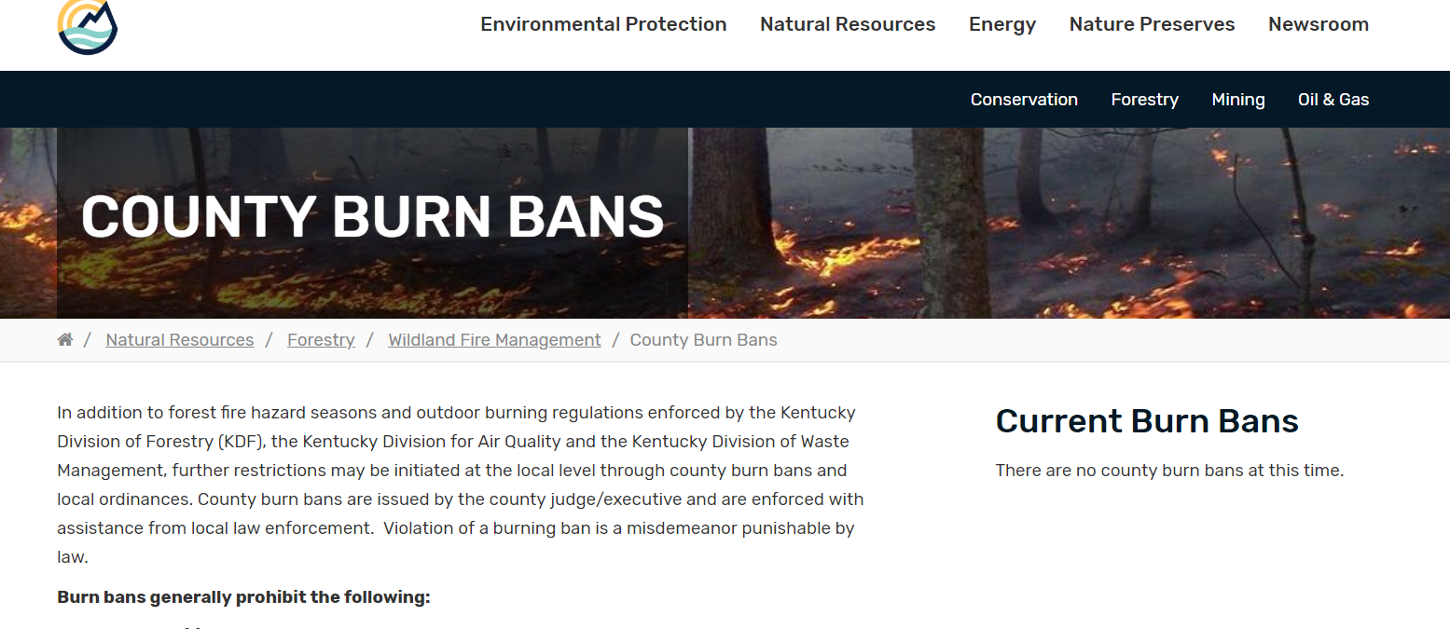
Burn Bans
Can be declared by county Judge Executive or Governor
Generally during extreme risk of wildfire hazard
Check Division of Forestry’s County Burn Bans page
Notes:
During times of extreme risk of wildfire, the governor or a county judge executive may declare a county-wide burn ban. The Division of Forestry tracks known county burn bans on a special web page. A declared county burn ban temporarily prohibits most or all outdoor burning.

Slide 38
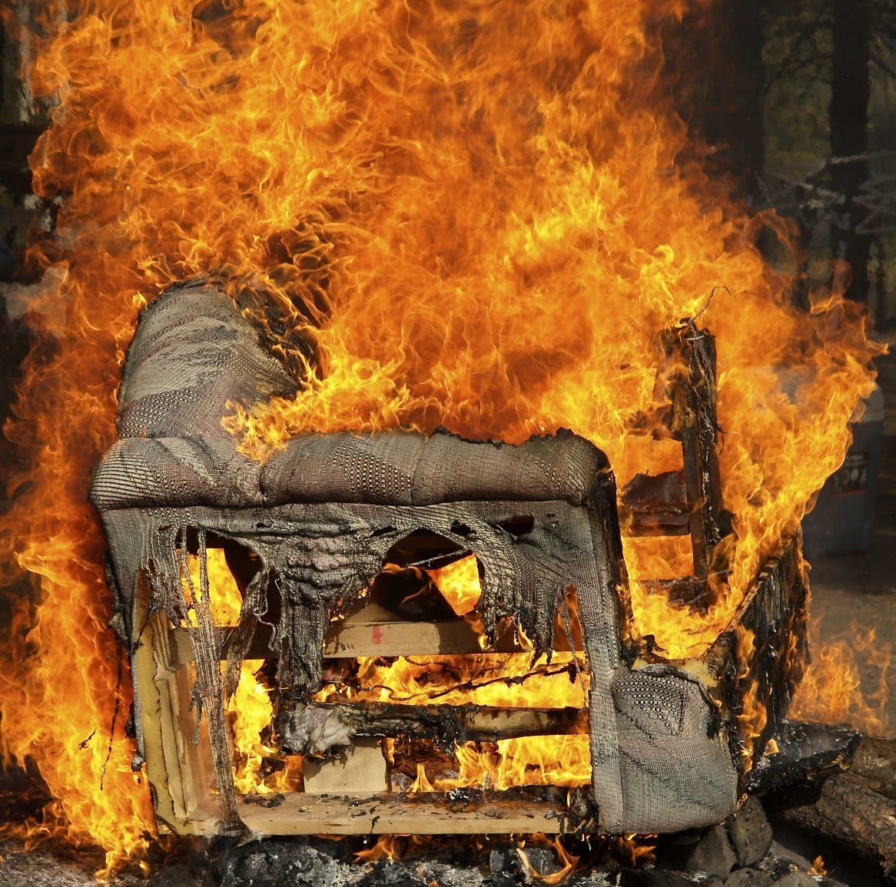
Illegal burning could result in fines up to $25,000 per day per violation.
In addition to Division for Air Quality rules, other state and local regulations may apply.
Notes:
Under Kentucky state regulation, illegal burning could result in fines of up to $25,000 per day per violation.
(Adobe Stock image)

Slide 39
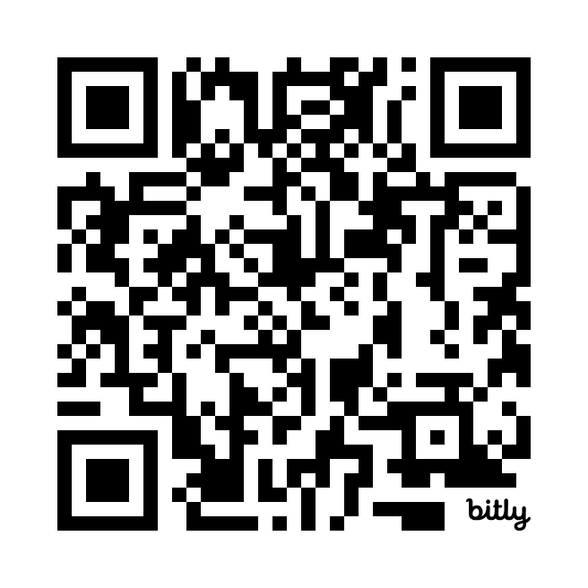
How to Register a Complaint
Multiple ways to reach us:
Email burnlaw@ky.gov
Visit eec.ky.gov/burn
Call your regional air quality field office
Use the QR code to submit a complaint online
  You will need to hit the plus sign to get the form to open up
  Complaint can be submitted anonymously
Notes:
There are several ways to make an air pollution or open burning complaint. You can email burnlaw@ky.gov with details, including an address where the issue is occurring. You can visit our open burning web page at eec.ky.gov/burn. This page contains information, links and phone numbers for registering your complaint. You can always reach out to your regional air quality field office – these offices are listed on the back our open burning brochure. Our preferred way of receiving complaints is through a new, online complaints form. Let’s try it out – point your phone at the QR code and see where it takes you.
Once you get to the site, you will need to hit the plus sign to get the form to load. Here, you will enter as much information as possible to help our field inspectors investigate your complaint. Complaints can be made anonymously, but at the very least, we need a street address in order to respond.

Slide 40
How Do We Respond?
Receive complaint
  Need an address where the burning happened to investigate
Enter information into complaints database
Site visit generally within 3-5 working days
Inspection of burn site
Depending on the outcome of the investigation, a Letter of Warning or Notice of Violation may be issued
It is not necessary for an inspector to witness the actual burn; evidence may be obtained from debris and ash piles, photos, etc.
Notes:
How do we respond to open burning complaints? For us to investigate, a complaint must include a physical address or GPS coordinates where the burning has taken place. An air quality inspector generally visits the site within 3 to 5 working days to inspect the burn site and determine whether the activity was legal or illegal. Depending on the outcome of the investigation, a letter of warning or notice of violation may be issued. These typically contain requirements for the burning to stop and the burn site to be cleaned up. Serious and/or repeat offenders may be referred to the Division of Enforcement for further action. It is not necessary for an inspector to witness the actual burn; debris from ash and burn piles can provide evidence for the investigation.

Slide 41
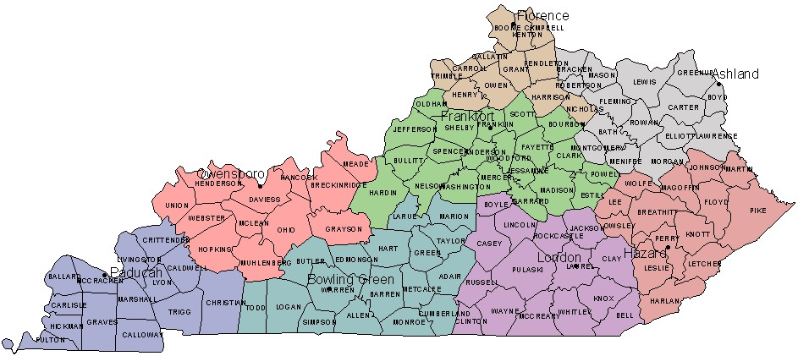
Kentucky Division for Air Quality Regional Offices
Notes:
The Division for Air Quality has regional offices in Ashland, Bowling Green, Florence, Frankfort, Hazard, London, Owensboro, and Paducah. Each of the regional offices handles air quality complaints for a cluster of Kentucky counties surrounding these cities. Louisville Metro has its own air pollution control district.

Slide 42
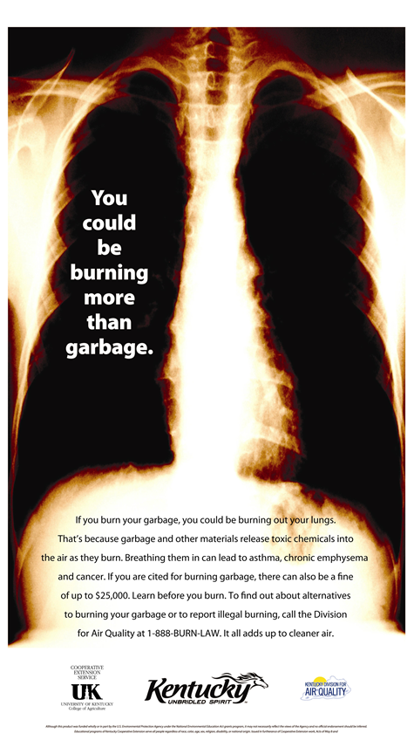
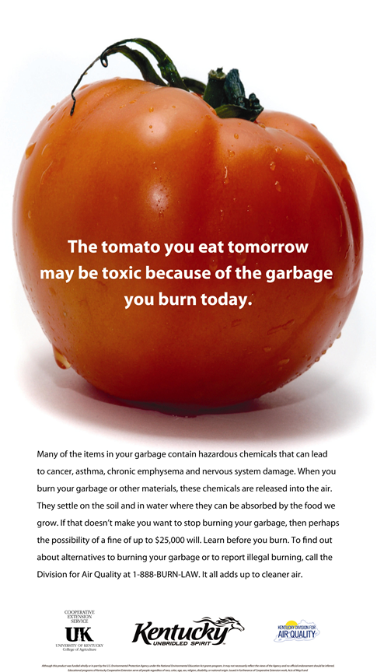
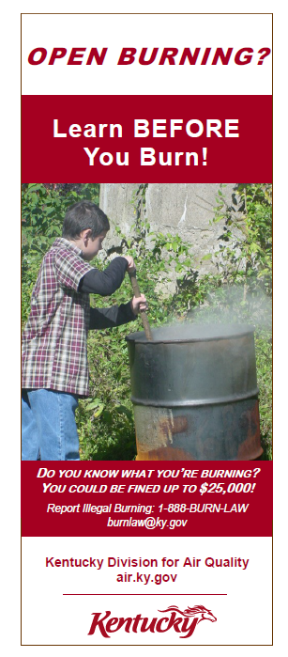

Spread the Word
Contact the Division for Air Quality for posters and brochures. Email your request to burnlaw@ky.gov.
Notes:
You can help others learn before they burn by sharing Division for Air Quality posters and brochures in your community. Email your request for brochures or posters to burnlaw@ky.gov and we’ll put them in the mail for you. You can also use this email to ask questions or report a complaint.

Slide 43

Kentucky Division for Air Quality
300 Sower Blvd. 2nd Floor
Frankfort, KY 40601
(502) 564-3999
Need more information?
burnlaw@ky.gov
502-782-6592
eec.ky.gov/BURN
Notes:
The Kentucky Division for Air Quality’s main offices are located at 300 Sower Boulevard, Frankfort Kentucky, 40601, and our main phone number is 502-564-3999. Need more information about open burning? Email us at burnlaw@ky.gov or call 502-782-6592. Thanks for watching this presentation.

