Slide 1
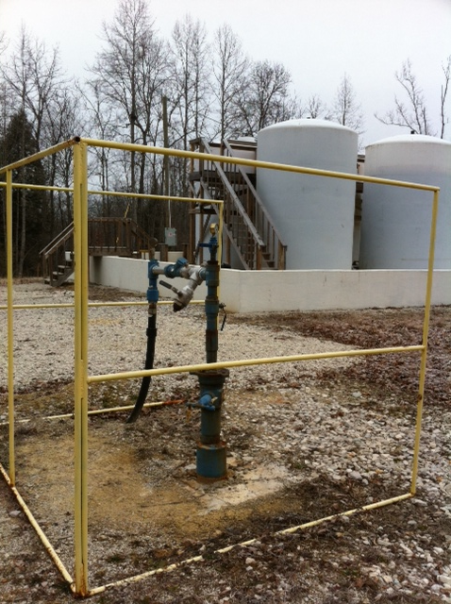
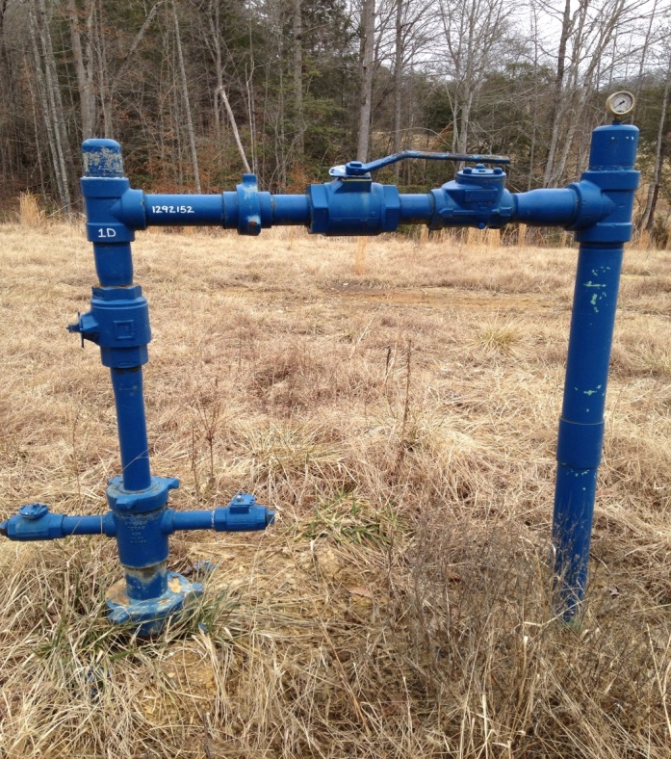
Kentucky Department for Natural Resources
Division of Oil & Gas
Primary Administration of the Underground Injection Control
Class II Program

Slide 2
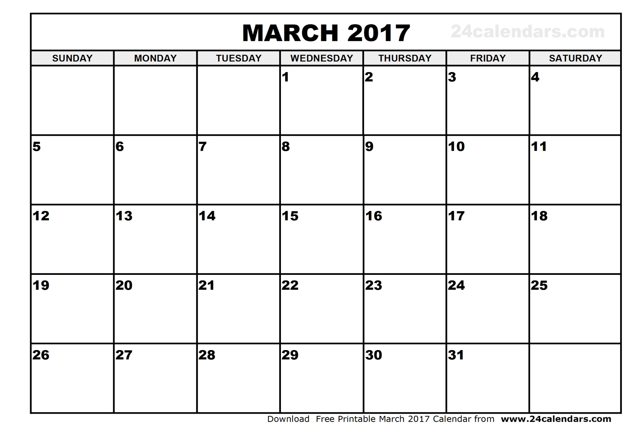
Barren River State Park Outreach Mtg.
4:00 pm CST
Audubon State Park Outreach Mtg.
2:00 pm CST
Jenny Wiley State Park Outreach Mtg.
4:00 pm EST
Class II Primacy Effective Date

Slide 3
UIC Program Overview
Safe Drinking Water Act-Passed in 1974 to protect nation’s public drinking water supply, authorized EPA to establish standards to protect underground sources of drinking water (USDW’s).
900,000 Kentuckians primary drinking water is generated from
domestic water wells.
EPA-Region 4 has administered the UIC-Class II program in Kentucky since 1983 (direct implementation).
Section 1425-Provides for state oil/gas regulatory programs to apply for and administer the UIC-Class II program.
Chapter 805 KAR 1:110 Underground Injection Control
(April, 2008)

Slide 4
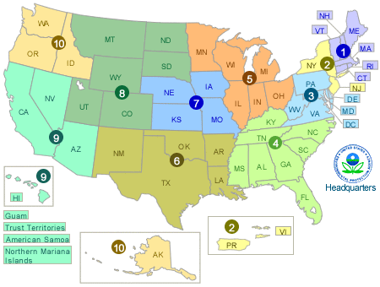
KY Class II Primacy Application History
Submitted Primacy package to USEPA-Region 4 September, 2014
Revisions due to Comments-March 12, 2015
Federal Register –Notice of Public Comment Nov. 10, 2015
Request for public hearing required by Dec. 9, 2015
EPA Office of General Counsel & Enforcement Comments-May 18, 2016
Submitted revised Program Description and Response to Comments-July 13, 2016
EPA approved UIC-Class II application-October 21, 2016
EPA published KY UIC-Class II approval in Federal Register-October 28, 2016
Initial effective date-January 27, 2017
Revised date of Primacy-March 21, 2017
To comply with Title 40 Code of Federal Regulation 144.4
EPA required Class II permits applications be submitted for comments to:
Kentucky Heritage Council (National Historic Preservation Act)
Fish & Wildlife Ecological Services Field Station (Endangered Species Act)
May also include:
Wild and Scenic Rivers Act
Coastal Zone Management Act
Fish and Wildlife Coordination Act

Slide 5
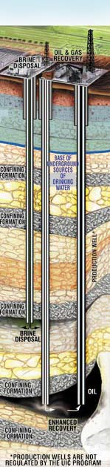
CLASS II WELL S
Wells which inject produced fluids associated with crude oil production. Most of the injected fluid is salt water (brine), which is brought to the surface in the process of producing (extracting) oil. Produced fluid is injected through injection wells back into reservoir to enhance (improve) oil production. Fluid is also injected into permeable reservoirs for permanent disposal
Enhanced Oil Recovery
(KY-2,905 Wells)
Brine Fluid Disposal
(KY-108 Wells)

Slide 6
Class II-Enhanced Oil Recovery System

Slide 7
Class II Well Inventory in Kentucky
Well Category | No. of Wells
Active Injection | 900
Under Construction (New Permits) | 72
Production Well-Class II Approval (Not converted to Class II) | 292
Shut-In (<2 years) | 166
Temporarily Abandoned (>2 Years) | 292
Permitted (Not Drilled) | 100
Never Constructed or Converted | 40
Converted (Injection to Production) | 227
Application Under Review | 19
Unknown After File Review | 43
Abandoned | 1,489
Plugged | 2,914
Plugged (W/O Approval) | 30
TOTAL | 6,557

Slide 8
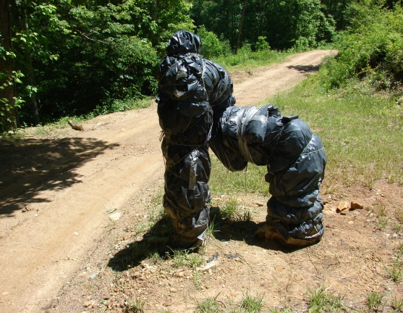
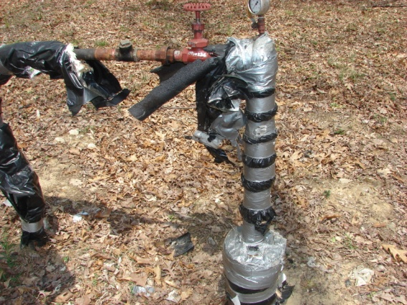
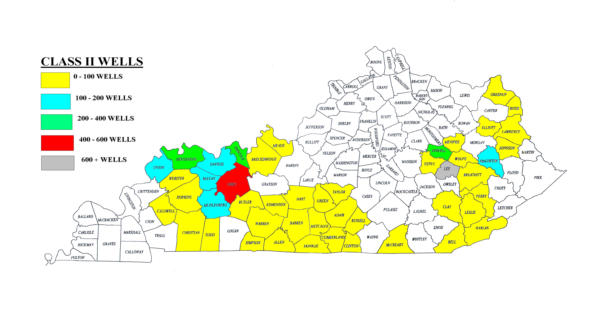

Slide 9
Chapter 805 KAR 1:110 Underground Injection Control
Transition requirements-90 days after primacy date (3-21-17) 805 KAR 1:110 (9) requires operators to submit to DOG (1-5-2017 letter submitted by EPA to Class II operators):
  A plugging and abandonment plan as required by 805 KAR 1:110(10)
  A demonstration of adequate financial responsibility to plug and abandon a well as required by 805 KAR 1:110(8-9)
  A copy of all documents showing approval by the EPA of the well's mechanical integrity and a copy of all forms, test data, and logs required by and submitted to the EPA
  Class II permit applications (7) under review by EPA will be transferred to DOG
  Any permit subject to EPA enforcement action will be maintained by EPA until resolution
All wells permitted at the date of primacy by EPA will be permitted by rule by DOG
Area permits permitted by EPA at date of primacy will be maintained by DOG
Maintain current IMIT schedule

Slide 10
Class II Financial Responsibility
  805 KAR 1:110 (8)(b): The owner or operator of a Class II well authorized by a permit to inject pursuant to this administrative regulation shall, upon application, demonstrate financial responsibility and submit the plugging abandonment plan in accordance with 805 KAR 1:060 or 805 KAR 1:070.
  805 KAR 1:110 (9)(1)(c): The financial responsibility demonstration required in Section 8 of this administrative regulation and the submission of the plugging and abandonment plan in Section 10 of this administrative regulation shall be completed within ninety (90) days following the effective date of primacy.
  805 KAR 1:110 (9)(1)(d): If the existing bond posted with EPA meets the requirements of Section 8 of this administrative regulation and is transferable to the division, the transfer of the bond shall be accepted by the division.
  Programmatic changes??

Slide 11
FINANCIAL RESPONSIBILITY
EPA PLUGGING AND ABANDONMENT
COST SCHEDULE
Cement Top Behind Casing*
Well Depth* CST Below Surface
<500’ $2300.00 $3000.00
501’ – 1000’ $3000.00 $3900.00
1001’ – 1500’ $3700.00 $5000.00
1501’ – 2000’ $4800.00 $6500.00
>2000’ $5800.00 $7400.00
* Primary protective string of casing

Slide 12
Permitting and Permit Conditions
Completion of ED-14 (Class II Permit App) included with a fee of $400
Type (EOR/D), Well location/surface owner information, Injection Zone (Name/Interval), USDW Depth
AOR map on 1”=2,000’ scale of a ¼ mile radius circle around proposed injection well
  Locate and provide data (WLCR) on all producing, abandoned, plugged and dry wells within AOR
  Known Faults, surface and subsurface mines, water wells
Wellbore Schematic of proposed well
Construction requirements: Must prevent fluid movement that may endanger a USDW
  Fresh water string must extend at least 50 ft below USDW
  Applicant shall maintain all casing/cement to prevent fluid movement into USDW
  Injection through tubing and packer set within 50 ft of injection zone
Stimulation (Fracturing or acidizing)
Plugging and abandonment plan
Financial Responsibility
Injection can only commence after submitting Form ED-25 (Casing/Cementing Plan)
Demonstration of Mechanical Integrity
  IMIT-Pressure test witnessed by DOG inspector (15 days prior written notification to DOG), requires completion of ED-22 within 15 days after successful IMIT test (requires DOG inspector signature)
  EMIT-Determined by evaluation of cementing records or CBL
Laboratory analysis of injectate fluid
  Injection can only be make-up water or produced fluids brought to surface in connection with the permitted Class II well
  Documentation of monthly injected volumes and pressure rates to be completed on ED-18 (Annual Injection Well Monitoring Report) and submitted on January 30th for the preceding year

Slide 13
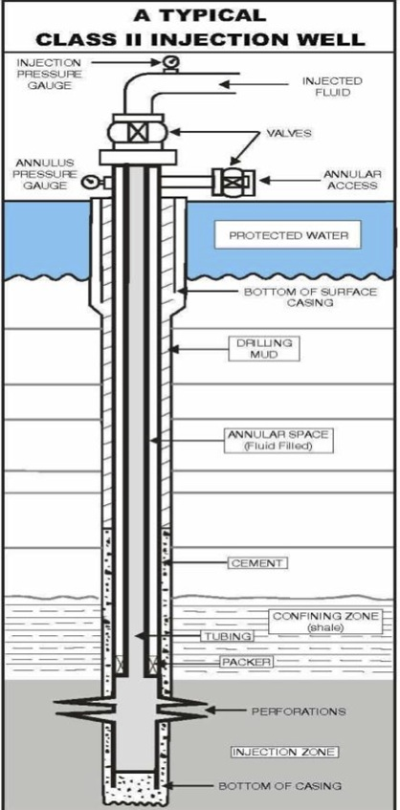
Mechanical integrity tests -Test the ability of the wellbore, consisting of casing, tubing and packer to contain injection pressure and injected fluids. Internal Integrity-The tubing and packer are the primary containment system that is monitored and inspected by DOG inspectors.
MIT Procedure
Pressure applied through annular access valve: (N₂ or H₂0).
300 psi applied for 30 minutes
Pressure loss cannot exceed 3% (9 psi)
External Integrity-The casing and cement are the backup containment system. Mechanical integrity tests are meant to insure that the primary containment system does not leak and ensures the back-up system will hold if the primary system (tubing and packer) fail
Cementing Records
CBL/Temp/Tracer Logs
U. S. D. W.
Tubing Annulus (H₂O or N₂)

Slide 14
Aquifer Exemptions in KY
Aquifers (underground sources of drinking water) in the Commonwealth of Kentucky have been exempted in accordance with the provisions of §§ 144.7(b) and 146.4 of this chapter for Class II injection activities:
It does not currently serve as a source of drinking water; and
It cannot now and will not in the future serve as a source of drinking water because:
a. It is a mineral, hydrocarbon, or geothermal energy producing, or may be demonstrated to contain minerals or hydrocarbons that, considering their quantity and location, are expected to be commercially producible.
b. It is situated at a depth or location which makes recovery of water for
drinking water purposes economically or technologically impractical.
c. It is so contaminated that it would be economically or technologically impractical to render that water fit for human consumption.
d. The total dissolved solids content of the groundwater is more than 3,000 mg/l, and less than 10,000 mg/l and it is not reasonably expected to supply a public water system.
(1) Hancock Co. (Fordsville Quad 9-O-34 2654’ FNL x 2337’ FEL)-A portion of the Tar Springs sandstone formation that has a quarter mile radius areal extent (125.6 acres) that is located at latitude 37.7261⁰ and longitude 86.6914⁰. The formation has a true vertical depth from surface of 280 feet.
(2) Hancock Co. (Fordsville Quad 7-O-34 1452’ FNL x 1315’ FEL)- A portion of the Tar Springs sandstone formation that has a quarter mile radius areal extent (125.6 acres) that is located at latitude 37.7294⁰ and longitude 86.7212⁰. The formation has a true vertical depth from surface of 249 feet.
(3) Hancock Co. (Fordsville Quad 14-O-34 1983’ FSL x 303’ FEL)- A portion of the Tar Springs sandstone formation that has a quarter mile radius areal extent (125.6 acres) that is located at latitude 37.7055⁰ and longitude 86.7177⁰. The formation has a true vertical depth from surface of 210 feet.
(4) McLean Co. (Calhoun Quad 11-M-27 2483’ FSL x 1479’ FEL)-A portion of the Pennsylvanian Age sandstone formation that has a quarter mile radius areal extent (125.6 acres) that is located at latitude 37.5402⁰ and longitude 87.2551⁰. The formation has a true vertical depth from surface of 1,050 feet.
(5) Henderson Co. (Poole Quad 9-O-22 1193’ FNL x 2261’ FWL)-A portion of the Tar Springs sandstone formation that has a quarter mile radius areal extent (125.6 acres) that is located at latitude 37.7301⁰ and longitude 87.6922⁰. The formation has a true vertical depth from surface of 240 feet.
(6) Daviess Co. (Glenville Quad 3-M-29 2105’ FNL x 357’ FWL)-A portion of the Caseyville sandstone formation that has a quarter mile radius areal extent (125.6 acres) that is located at latitude 37.5776⁰ and longitude 87.1321⁰. The formation had a true vertical depth from surface of 350 feet.
(7) Daviess Co. (Glenville Quad 4-M-29 2032’ FNL x 1324’ FEL- A portion of the Caseyville sandstone formation that has a quarter mile radius areal extent (125.6 acres) that is located at latitude 37.5778⁰ and longitude 87.1379⁰. The formation has a true vertical depth from surface of 1,080 feet.
(8) McLean Co. (Utica Quad 8-M-29 551’ FNL x 1605’ FEL -A portion of the Caseyville sandstone formation that has a quarter mile radius areal extent (125.6 acres) that is located at latitude 37.5652⁰ and longitude 87.1222⁰. The formation has a true vertical depth from surface of 1,060 feet.

Slide 15
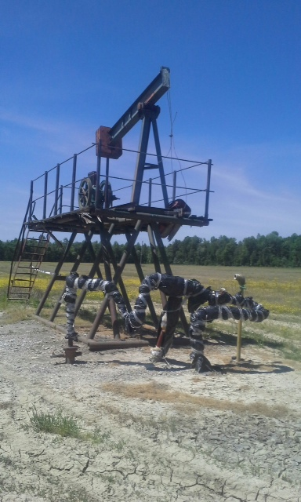
Class II-EOR well
Converted from producing oil well
Henderson Co., KY

Slide 16
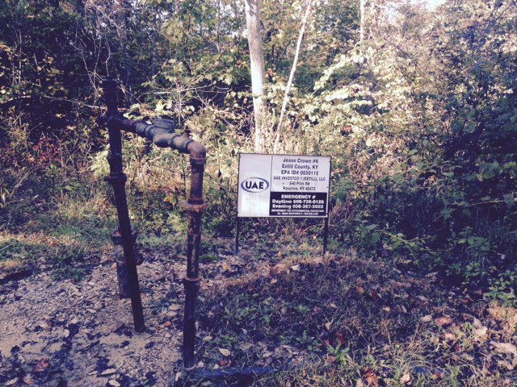
United American Energy Class II-EOR Well-Estill Co., KY

Slide 17
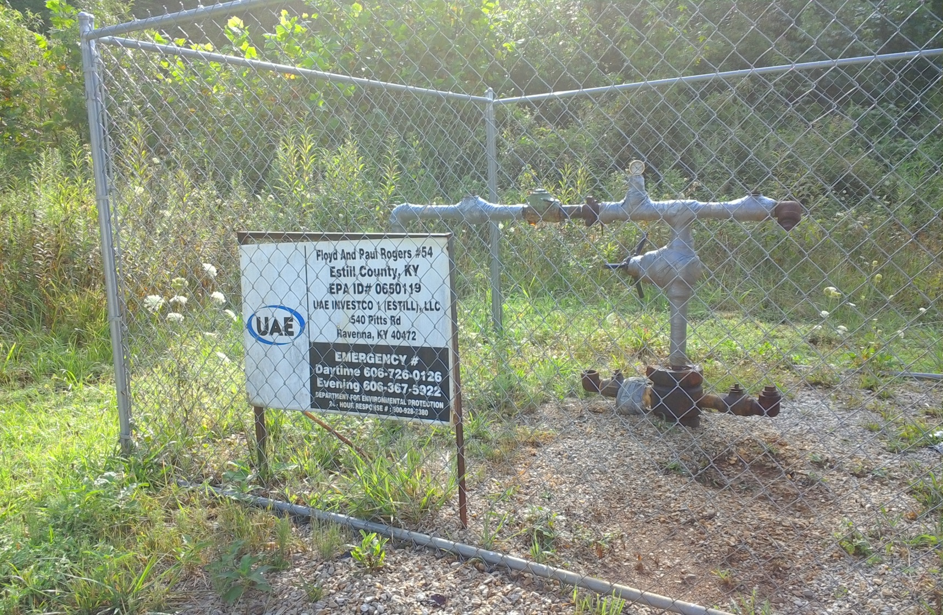
United American Energy
Class II Disposal Well
Estill Co., KY

Slide 18
CLASS II VIOLATIONS:
Injection without a Class II permit/failure to obtain a Class II permit
Failure to protect the Underground Source of Drinking Water (USDW)
Failure to run a Mechanical Integrity Test
Mechanical Integrity Failure
Injection at a higher rate than assigned to permitted well
Injection of a non-authorized fluid
Failure to confine injected fluid to the permitted zone
Failure to Maintain Class II Financial Responsibility
Failure to file well records

Slide 19
ACTIVE INJECTION WELL OPERATORS
UIC Operator | No. of Injection Wells | Active Injection Wells | Current Bond(s)
Countrymark Energy Res. | 212 | 158 | BS-$100,000 (1,107 wells)
Bretagne, G P | 99 | 42 | BS-$100,000 (818 wells)
American Natural Gas | 69 | 61 | BS-$100,000 341 wells)
Cumberland Valley | 55 | 43 | BL-$40,000, BC-$10,000 (301 wells)
Jetta Operating | 29 | 29 | BL-$50,000 (433 wells)
Roseclare Oil | 27 | 27 | BC-$10,000 ($9,000 Forf) (55 wells) [Pioneer Drlg transfer]
Tackett and Sons Drlg. | 22 | 21 | BL-$50,000 (139 wells)
ABANDONED INJECTION WELL OPERATORS
UIC Operator | Abandoned Injection Wells | Bond Forf. Status
Perdue-Davidson Oil Co. | 471 | BC-$5,000 (Forf. 1-31-02)
Western Crude | 102 | No bond
JAF Oil Co. | 88 | Pending Forfeiture
Lyle Energy | 44 | BL-$50,000 (Forf. 5-10-13)
Levine Development | 39 | BS-Partial Forfeiture

Slide 20
Kentucky Class II Injection Well Inventory (October 2016)
EPA_ID | PERMIT_ | WELL_TYPE | WELL NAME & NUMBER | COMPANY_NAME | STATE PERMIT | STATUS | CARTER | CONVERT CARTER |  | GPS | LAST_MIT | LAST_ROUTINE
KYS0010008 | KYI0430 | R | JESSIE SULLIVAN 7 | COOMER DRILLING COMPANY, INC. | 49616 | AC | 20-F-51 2212 S 1732 W | 36.939409 | -85.260741 | 36.939391 -85.260673 | 07/08/2015 | 01/20/2015
KYS0010010 | KYI0407 | R | SNEED 1 | TURNER, ARLIS | 23133 | SI | 13-G-50 1186 N 300 W | 37.046743 | -85.382306 | 37.046744 -85.382305 | 06/29/2005 | 01/20/2015
KYS0010018 | KYI0704 | R | OWEN KEMP 3 | OHIO KENTUCKY OIL CORPORATION | 87605 | AC | 5-G-50 170 N 1455 W | 37.082866 | -85.411680 | 37.082767 -85.411491 | 03/11/2010 | 01/19/2015
KYS0010033 | KYI0714 | R | TURNER 2 | KENTUCKY EAGLE ENERGY COMPANY | 71310 | TA | 12-F-51 1750 S 1200 W | 36.954807 | -85.279227 | 36.954943 -85.279195 | 02/05/2013 | 01/20/2015
KYS0010034 | KYI0712 | R | CLYDE NEAT 1 | WADE ENERGY, INC. | 60339/89090 | SI | 13-G-50 2980 S 590 E | 37.041518 | -85.368688 | 37.041518 -85.368671 | 07/30/2015 | 01/20/2015
KYS0010035 | KYI0719 | R | ROBERT MOSS 2-B | OHIO KENTUCKY OIL CORPORATION | 81896 | AC | 21-H-49 800 S 1430 W | 37.085531 | -85.428431 | 37.085583 -85.428064 | 03/11/2010 | 01/19/2015
KYS0010038 | KYI0721 | R | BILLY WHITNEY 8 | TRAVIS COOMER WELL SERVICES | 41812 | AC | 21-G-50 1450 N 500 E | 37.012684 | -85.335045 | 37.012732 -85.335084 | 07/30/2015 | 01/20/2015
KYS0010039 | KYI0809 | R | DANNY OLIVER 3 | COOMER, TRAVIS | 39111 | SI | 17-H-49 1800 N 2000 W | 37.111723 | -85.476476 | 37.111730 -85.476480 | 07/17/2013 | 01/19/2015
KYS0010041 | KYI0828 | R | JIMMY RELIFORD 4 | TRAVIS COOMER WELL SERVICES | 98575 | AC | 1-G-49 1439 N 1273 W | 37.079381 | -85.428971 | 37.079380 -85.428970 | 08/02/2012 | 01/19/2015
KYS0010042 | KYI0898 | R | JEFF & JOHNNY JANES 1 | HILLSIDE OIL INC | 94988 | AC | 21-H-49 1267 N 661 W | 37.096520 | -85.431067 | 37.096150 -85.431470 | 08/10/2016 | 01/19/2015
KYS0010043 | KYI0908 | R | BRUCE CUNDIFF 7R | B & J OIL COMPANY, INC. | 104296 | AC | 5-G-50 1797 N 549 W | 37.078398 | -85.414785 | 37.078470 -85.414730 | 06/23/2010 | 01/19/2015

Slide 21
Pending Class II Applications
Well Operator | Well Name & No. | County | Injection Zone (Depths) | Financial Responsibility | Class II Type
Bretagne, LLC | Annie Fisher D-1 | Lee | Knox (3528’-3604’) | $5,800 | II-D
Miller Brothers | Jason Camfield #1 | Adair | Knox (1735’) | $4,800 | II-D
Union Petro, Inc | Ruark-Carmon #1 | Union | Cypress (2250’-2254’) | $5,800 | II-R
Legacy Oil | W. Craig #1 | Ohio | Tar Springs (415’-424’) | $2,300 | II-R
Ocean Petroleum | E. Riddle #1 | Cumberland | Stones River (855’-858’) | $3,800 | II-D
Case Drlg. | Roby W-6 | Daviess | Tar Springs (484’-495’) | $2,300 | II-R
Brookston Res. | S. Pritchitt #2 | Henderson | Aux Vases (2521’-2526’) | $5,800 | II-R

Slide 22
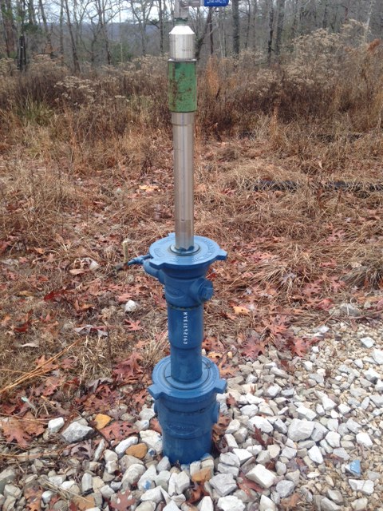
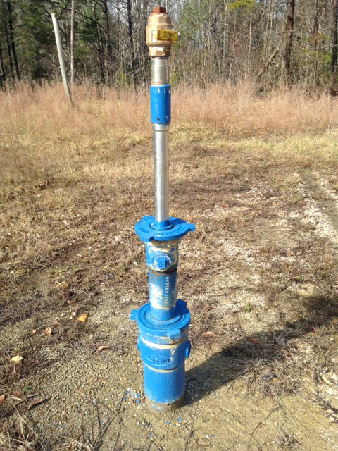
Bretagne
DOG 110685
KYS-1292163
KYI1053
Bretagne
DOG 110747
KYS-1292162
KYI1052

Slide 23
Division of Oil & Gas contact:
    Kim Collings
    (502) 782-6923
    Kim.collings@ky.gov
    Marvin Combs
    (502) 782-6925
    marvin.combs@ky.gov

